Slide 1
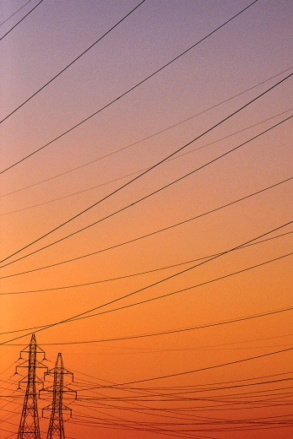

Australian Energy Regulator
Public Forum
Qld electricity distribution revenue proposals
2015-20
9 December 2014

Slide 2

Agenda
10.00 - 10.15 Registration
10.15 – 10.30 AER introduction – Paula Conboy, AER Chair
10.30 – 11.00 Energex
11.00 – 11.30 Ergon Energy
11.30 – 12.00 Consumer Challenge Panel (CCP) presentation
12.00 – 12.30 Q & A (please hold questions until Q&A)
12.30 Wrap-up – Paula Conboy, AER Chair

Slide 3
Purpose of the public forum
Begin the review process
Provide Energex and Ergon Energy with an opportunity to speak to their regulatory proposals
Hear perspectives from the AER’s Consumer Challenge Panel
Hear from consumers, consumer representatives and other interested parties
Outline the process going forward

Slide 4
Process to date
AEMC rule change determination on November 2012
Better Regulation guideline development process in 2013
Receipt of regulatory proposals 31 October 2014
Publication of proposals 19 November 2014
Publication of issues paper 5 December 2014

Slide 5
Energex’s proposed revenue
Energex – proposed total revenue ($million, 2014–15)

Slide 6
Ergon Energy’s proposed revenue
Ergon Energy – proposed total revenue ($million, 2014–15)

Slide 7
AER approach
Implement the ‘Better Regulation’ Guidelines:
  for capex and opex – our Expenditure Assessment Guideline
  compare the Qld businesses with the results from our first Annual Benchmarking Report
  cost of asset financing – our Rate of Return Guideline
We will examine carefully how Energex and Ergon Energy have engaged with consumers . We are interested in how relevant concerns raised by consumers have been addressed by each business in its regulatory proposal.

Slide 8
  Presentations from Energex, Ergon Energy and
  AER Consumer Challenge Panel

