Slide 1
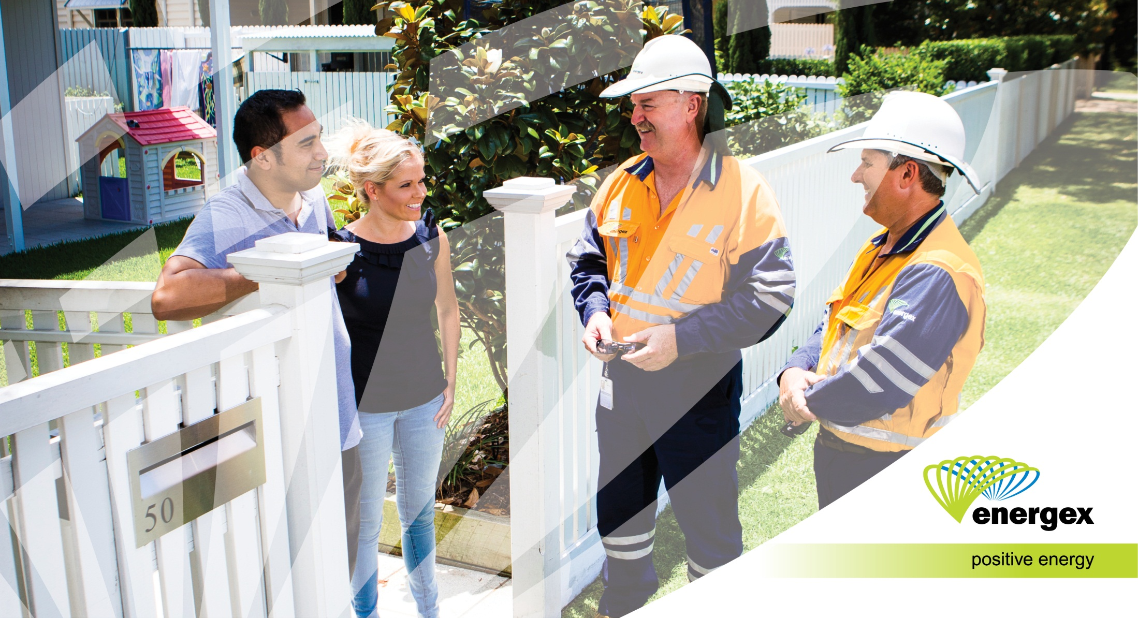
2015-20 Regulatory Proposal
December 2014

Slide 2
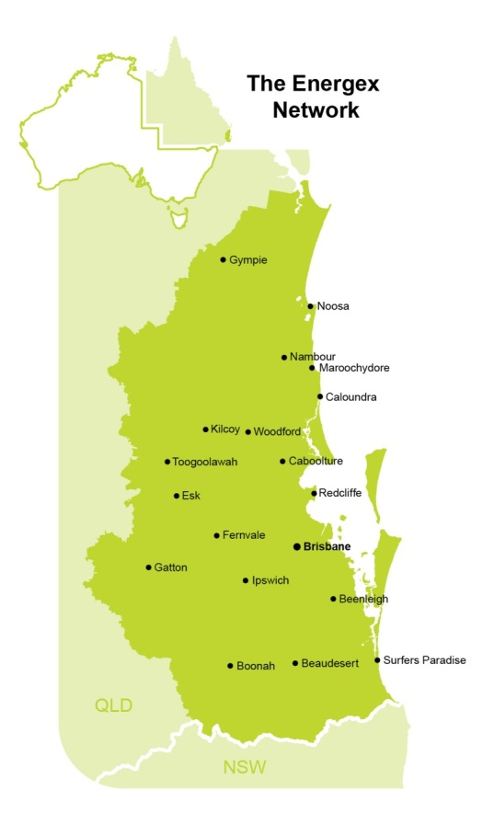
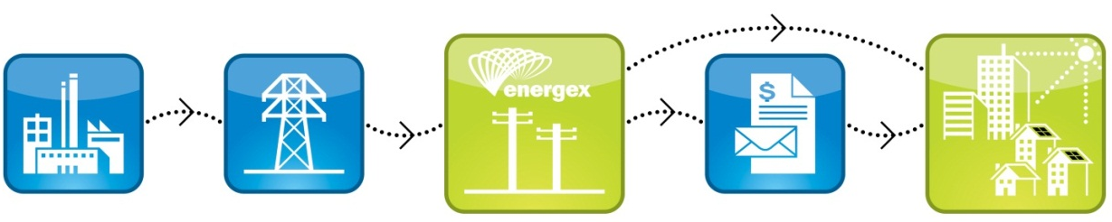
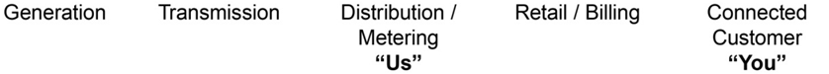
About us
We provide distribution services to 1.4 million residential and business customers
We deliver electricity to a population base of 3.2 million people in the region
Service an area of 25,000 km² from Gympie in the north to Withcott in the west, Stradbroke Island in the east and Coolangatta in the south
Own and operate almost $12 billion in high performing network equipment
We employ over 3,000 staff

Slide 3



Regulatory Proposal summary
Our proposal means that residential customers will experience real price reductions in the network component of their electricity retail bill to June 2020
Revenue $8.4 billion*
reduce upward price pressures
deliver long-term network price stability for our customers.
*Excluding approximately $1.4 billion in payments made under the Queensland Government Solar Bonus Scheme
We will deliver network price stability to reduce costs to customers and deliver a price decrease should the Queensland Government Solar Bonus Scheme be removed from our network prices.
Capital expenditure $3.2 billion
reduce capital expenditure
maintain the current high levels of reliability
improve reliability in network areas that are experiencing the most frequent power outages.
We will continue to deliver a safe and reliable electricity supply to homes and businesses and plan our network to meet future needs and technologies.
Operating expenditure $1.7 billion
maintain operating expenditure
enhance engagement with our customers.
We will continue to deliver services to our customers including demand management programs, easy to use communication channels, tree trimming, community safety as well as storm and emergency response. We commit to providing customers with a safe and reliable electricity supply as well as high standards of service.

Slide 4

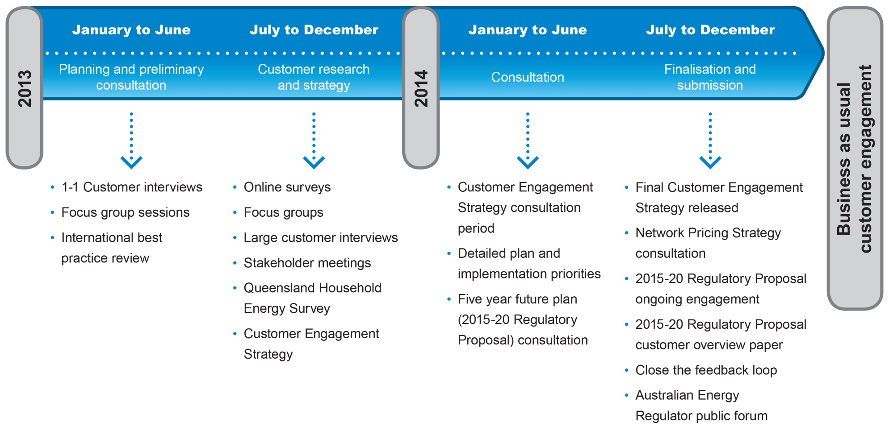
‘Connecting with you’ program
Our ‘Connecting with you’ program was
established in early 2013 to ensure customer views and expectations
are incorporated in key business decisions we are making.
Through our Customer Engagement Research Program and our five year future plan consultation, over 6,700 customers influenced key decisions for our submission.

Slide 5
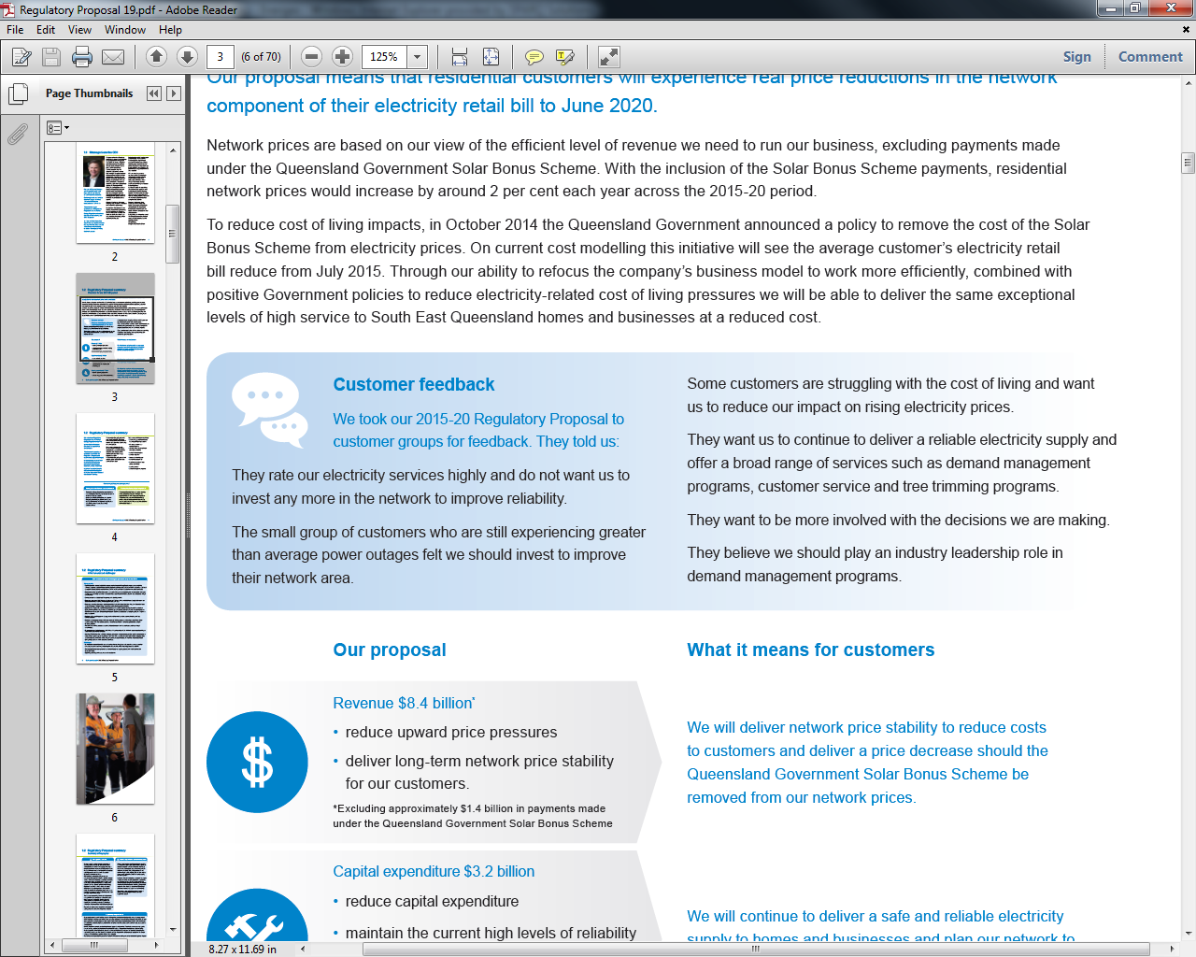
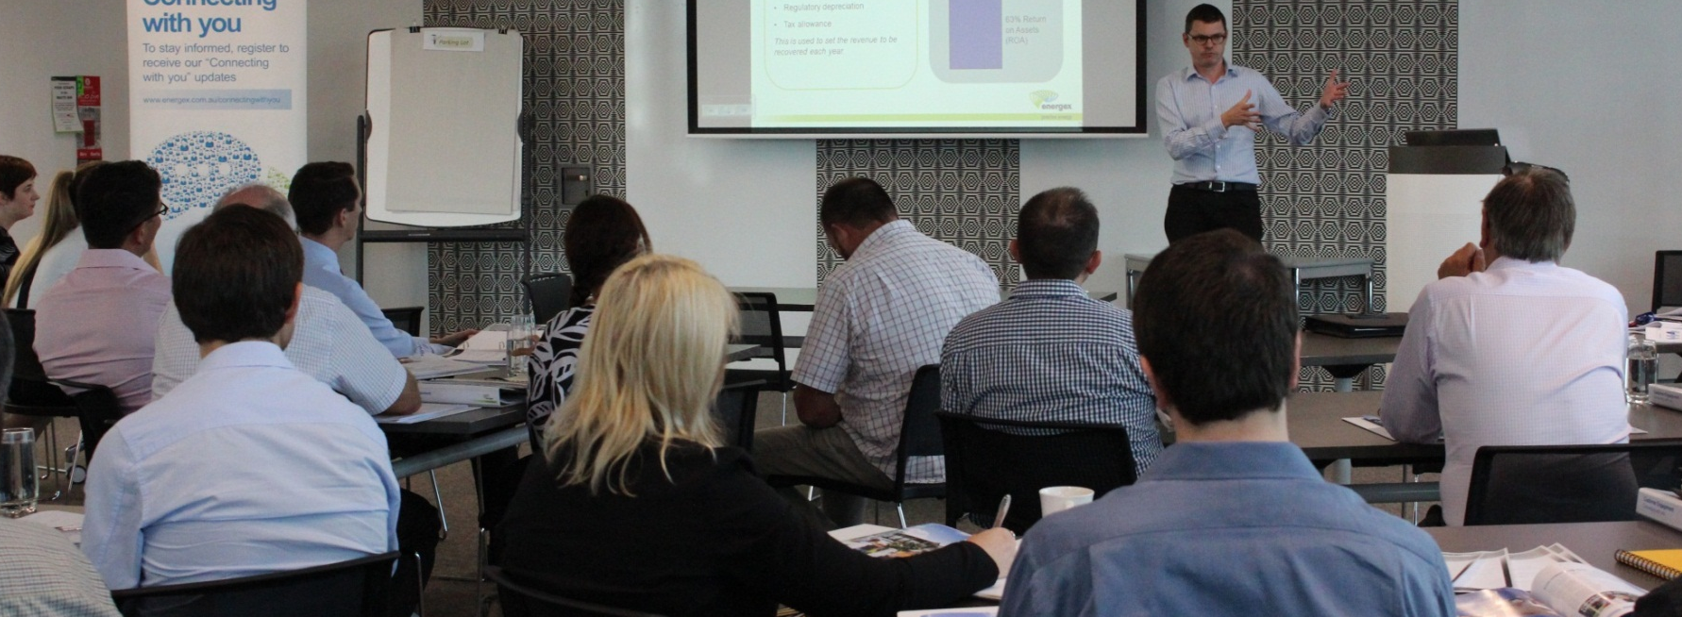
‘Connecting with you’ program
Notes:
.

Slide 6
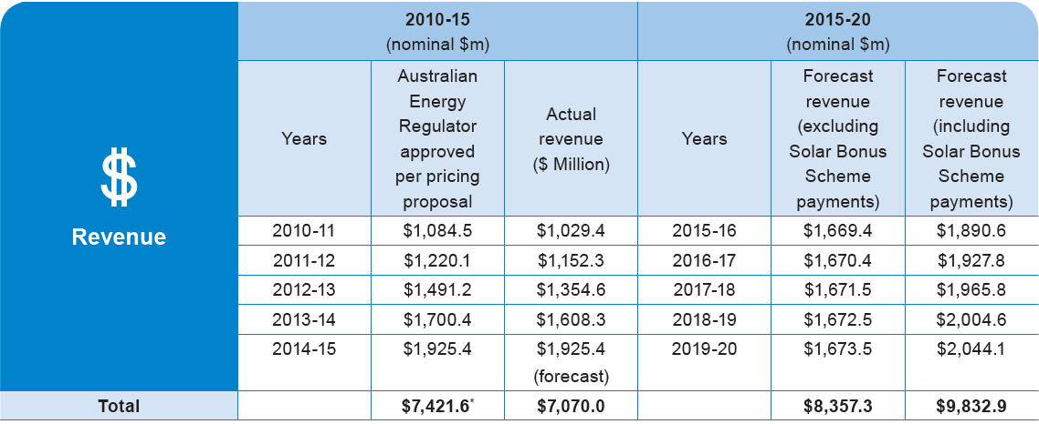
Revenue
For the 2015-20 period, we will be seeking approval for $8.4 billion of revenue (excluding payments made under the Solar Bonus Scheme payments).
The slight increase we are asking for during the 2015-20 period is due to growth in our asset base as we have invested in improvements to the electricity network during the 2010-15 period.
Energex proposed Weighted Average Cost of Capital | 7.75% | A return on debt of 5.91 per cent A return on equity of 10.5 per cent Gearing of 60 per cent
Gamma | 0.25

Slide 7
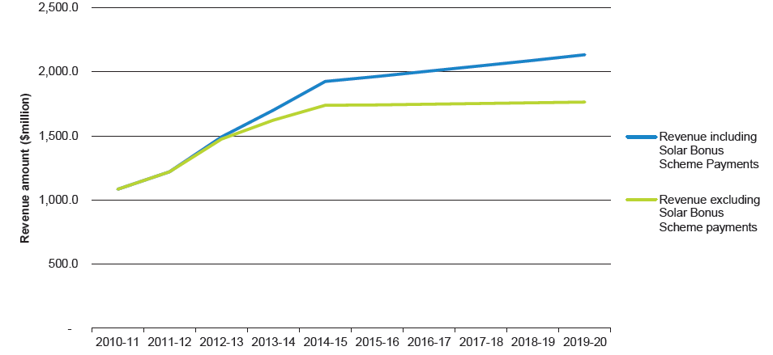
Revenue
2010-15 and 2015-20 yearly revenue
The green line represents the efficient revenue we need to run our business and the blue line represents the efficient revenue including the Queensland Government Solar Bonus Scheme.

Slide 8
Expected pricing outcomes
Our proposal means that residential customers will experience real price reductions
in the network component of
their electricity retail bill to
June 2020.
Our network prices are based on our view of the efficient level of revenue we need to run our business which excludes Queensland Government Solar Bonus Scheme payments.
If Solar Bonus Scheme payments were included, residential network prices would increase by around 2 per cent each year across the
2015-20 period.
Network Tariff Code / Name | Price unit | 2015-16 | 2016-17 | 2017-18 | 2018-19 | 2019-20
Expected network prices excluding Queensland Government Solar Bonus Scheme payments
8400 Residential Flat (default residential tariff) | c/kWh | 13.53 | 13.57 | 13.38 | 13.18 | 13.00
 | Change from prior year | -9.7% | 0.3% | -1.4% | -1.5% | -1.4%
 | $/customer | 588.73 | 577.99 | 562.23 | 549.62 | 539.02
Expected network prices including Queensland Government Solar Bonus Scheme payments
8400 Residential Flat (default residential tariff) | c/kWh | 15.32 | 15.66 | 15.74 | 15.80 | 15.88
 | Change from prior year | 2.2% | 2.3% | 0.5% | 0.4% | 0.5%
 | $/customer | 666.70 | 667.17 | 661.24 | 658.77 | 658.39
These prices exclude the cost of metering and GST

Slide 9
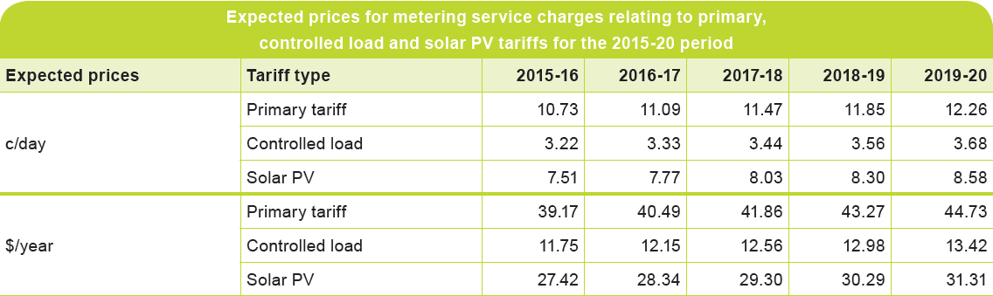
Expected pricing outcomes - metering
We intend to change the approach
to metering and apply specific
charges based on individual
customer circumstances. This
means the charges are being
un-bundled from the cost that
forms part of our overall revenue,
paid for by everyone.
Separating metering costs from other electricity charges allows customers to see what they are paying for. This also means there are opportunities for market competition in the future, meaning customers can choose a meter provider other than Energex to provide metering services.
We have decided to charge a daily fee on a per tariff basis as this generally aligns to each individual customer’s metering needs.

Slide 10
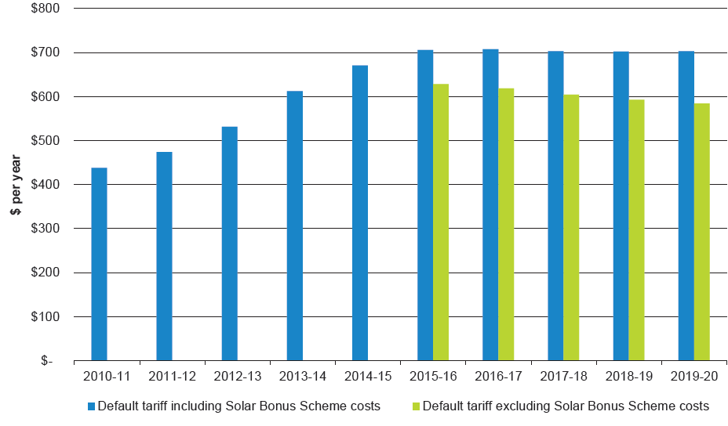
Expected pricing outcomes
Residential Customers
Average network charges – network tariff code 8400
For comparison purposes we have included the cost of metering in the above chart form 2015-16 onwards

Slide 11
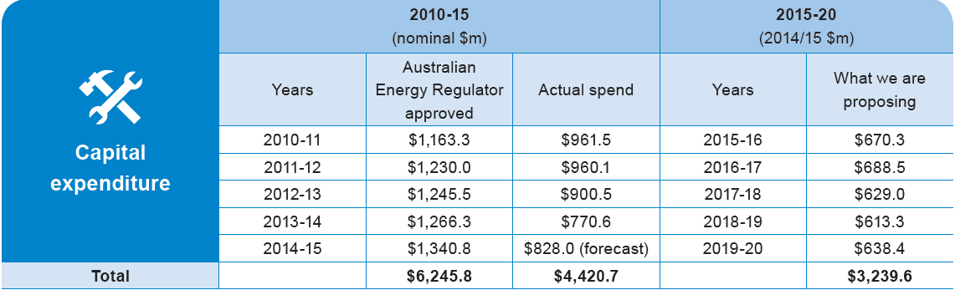
Capital expenditure – network investment
For the 2015-20 period we
will be seeking approval for
$3.2 billion in capital expenditure which is a significant reduction
of $1.2 billion compared to what we spent during the 2010-15 period.
During the 2015-20 period, the majority of our efforts will be to replace network equipment that is at the end of its useful life.
This will deliver ongoing community safety and high standards of network reliability.

Slide 12




Capital expenditure – network investment
Breakdown of capital expenditure proposed for the 2015-20 period
55% Replacing ageing plant & equipment
Replacing or repairing network equipment that is in poor condition or may be a safety risk / Replacing obsolete equipment such as the hardware and software used to operate and control the network
22% Building new network
New substations and circuits to supply growth areas / Flood defences at vulnerable substations / Improving reliability in worst performing supply areas / Resolving power quality issues caused by solar PV
15% Connecting new customers
New supplies to large new developments such as the Bus and Train Tunnel, Moreton Rail Extension and other community infrastructure
8% Buildings, IT, vehicles, tools & equipment
Desktop and laptop computers used by the business / Cars, trucks, tools and equipment used to work on the network

Slide 13
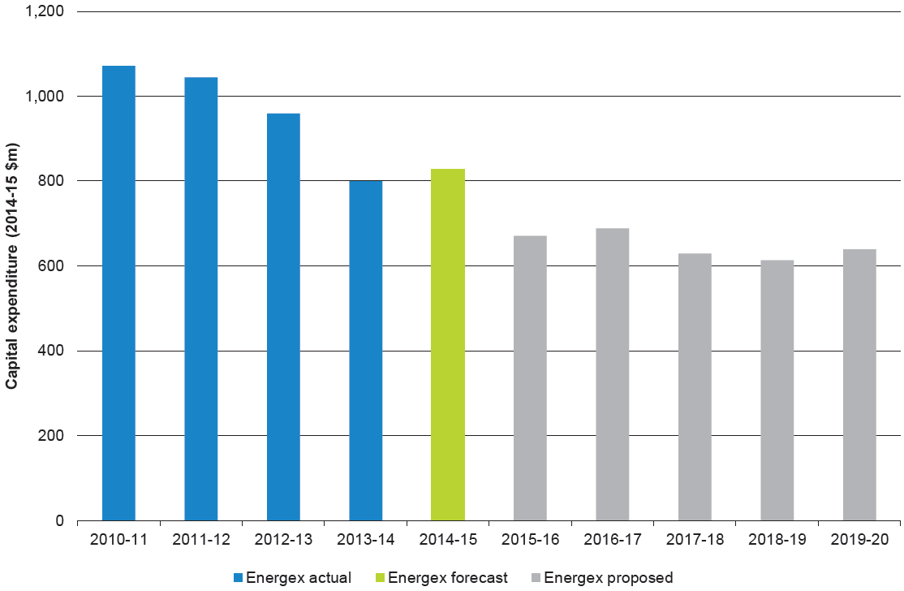
Capital expenditure – network investment
Comparing 2010-15 with 2015-20
We are expecting a continued decrease in our capital expenditure

Slide 14
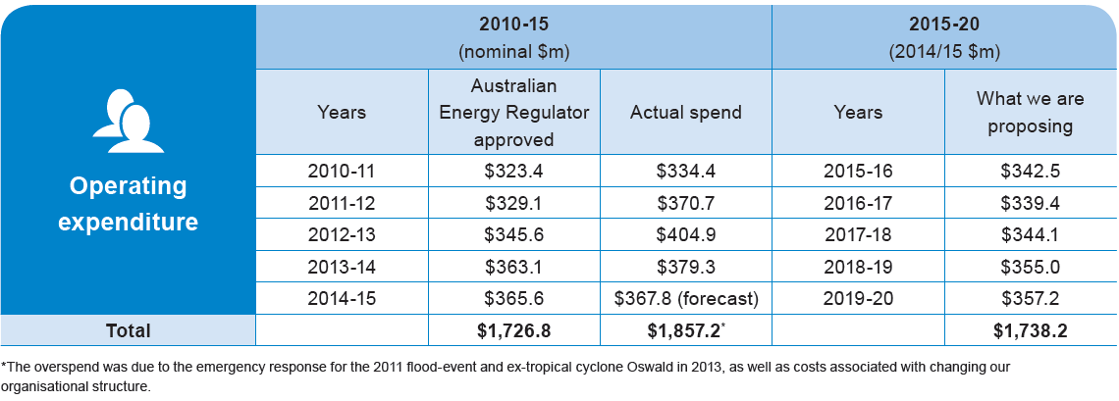
Operating expenditure – our day to day services
For the 2015-20 period we will be
seeking approval for $1.7 billion in
operating expenditure which is less
than what we spent for the
2010-15 period.
Operating expenditure will deliver the daily services our customers need and value. This includes the routine, ongoing activities of running an electricity network, emergency response, fixing faults, maintaining network
equipment and demand management initiatives.

Slide 15








Operating expenditure – our day to day services
Breakdown of operating expenditure proposed for the 2015-20 period
29% Maintenance
Inspections / Planned maintenance
8.5% Operating the network
Response to power outages / 24-hour control centre, including after hours emergency and loss of supply support
19% Tree trimming
Trimming trees near powerlines to maintain high levels of reliability and community safety
5.5% Demand management
Incentives to customers to reduce demand during peak times / Use of small generation as an alternative to building new network
16% Other operating costs
Levies / Debt raising costs / Self-insurance / Audit / Legal / Finance / Regulatory groups /
Safety Programs / Community support and safety communications
3.5% Storms
Emergency response and repairs to the network after a severe weather event
12% Corrective repair
Repairing or making safe equipment that fails in service
6.5% Customer services
Customer Contact Centre / Network billing to electricity retailers / Hot water complaints

Slide 16
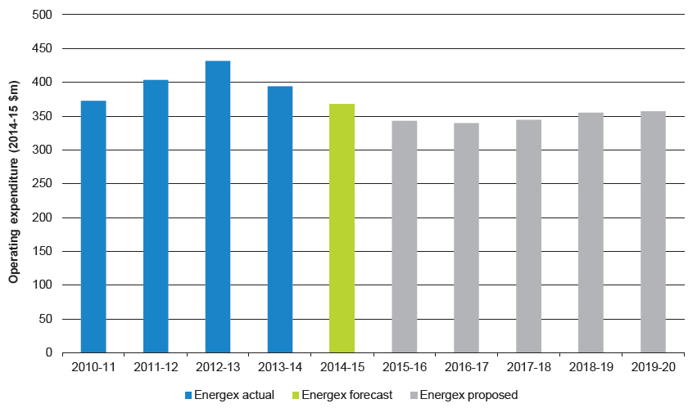
Operating expenditure – our day to day services
Comparing 2010-15 with 2015-20
We are expecting a continued decrease in our operating expenditure

Slide 17
Regulatory Proposal summary
Our proposal means that residential customers will experience real price reductions in the network component of their electricity retail bill to June 2020
Revenue $8.4 billion*
reduce upward price pressures
deliver long-term network price stability for our customers.
*Excluding approximately $1.4 billion in payments made under the Queensland Government Solar Bonus Scheme
We will deliver network price stability to reduce costs to customers and deliver a price decrease should the Queensland Government Solar Bonus Scheme be removed from our network prices.
Capital expenditure $3.2 billion
reduce capital expenditure
maintain the current high levels of reliability
improve reliability in network areas that are experiencing the most frequent power outages.
We will continue to deliver a safe and reliable electricity supply to homes and businesses and plan our network to meet future needs and technologies.
Operating expenditure $1.7 billion
maintain operating expenditure
enhance engagement with our customers.
We will continue to deliver services to our customers including demand management programs, easy to use communication channels, tree trimming, community safety as well as storm and emergency response. We commit to providing customers with a safe and reliable electricity supply as well as high standards of service.

Slide 18


