Slide 1
Customer engagement toolkit
Better practices for identifying and supporting consumers experiencing vulnerability

Slide 2
What is the Customer engagement toolkit?
The toolkit is Action 2 in the AER’s Towards energy equity – a strategy for an inclusive energy market.
Aim
The toolkit shares insights that consumer-facing energy businesses can adapt to their specific context. It is intended as a resource to help proactively identify vulnerability, including by supporting their customers to identify themselves by sharing their experiences of vulnerability.
Design
The AER sought to collaborate with consumer-facing energy businesses and consumer stakeholders to understand what is already working well and identify where there may be gaps in understanding or techniques in identifying vulnerability.
This toolkit has been informed by existing research and guidance, consumer journey mapping workshops with retailers and financial counsellors, conversations with select energy retailers and distributors, and workshops with consumer advocates and representatives.
Vision
Disclaimer: Energy service providers have legal obligations in relation to identifying and engaging with customers experiencing vulnerability, including customers affected by family violence and customers experiencing hardship or other payment difficulties. If there is any inconsistency between this toolkit and a statutory obligation (under the National Energy Retail Law, the National Energy Retail Rules, or otherwise), the statutory obligation remains unaffected and continues to apply.
Notes:
The purpose of the toolkit is covered on page 5 of the Customer engagement toolkit.

Slide 3
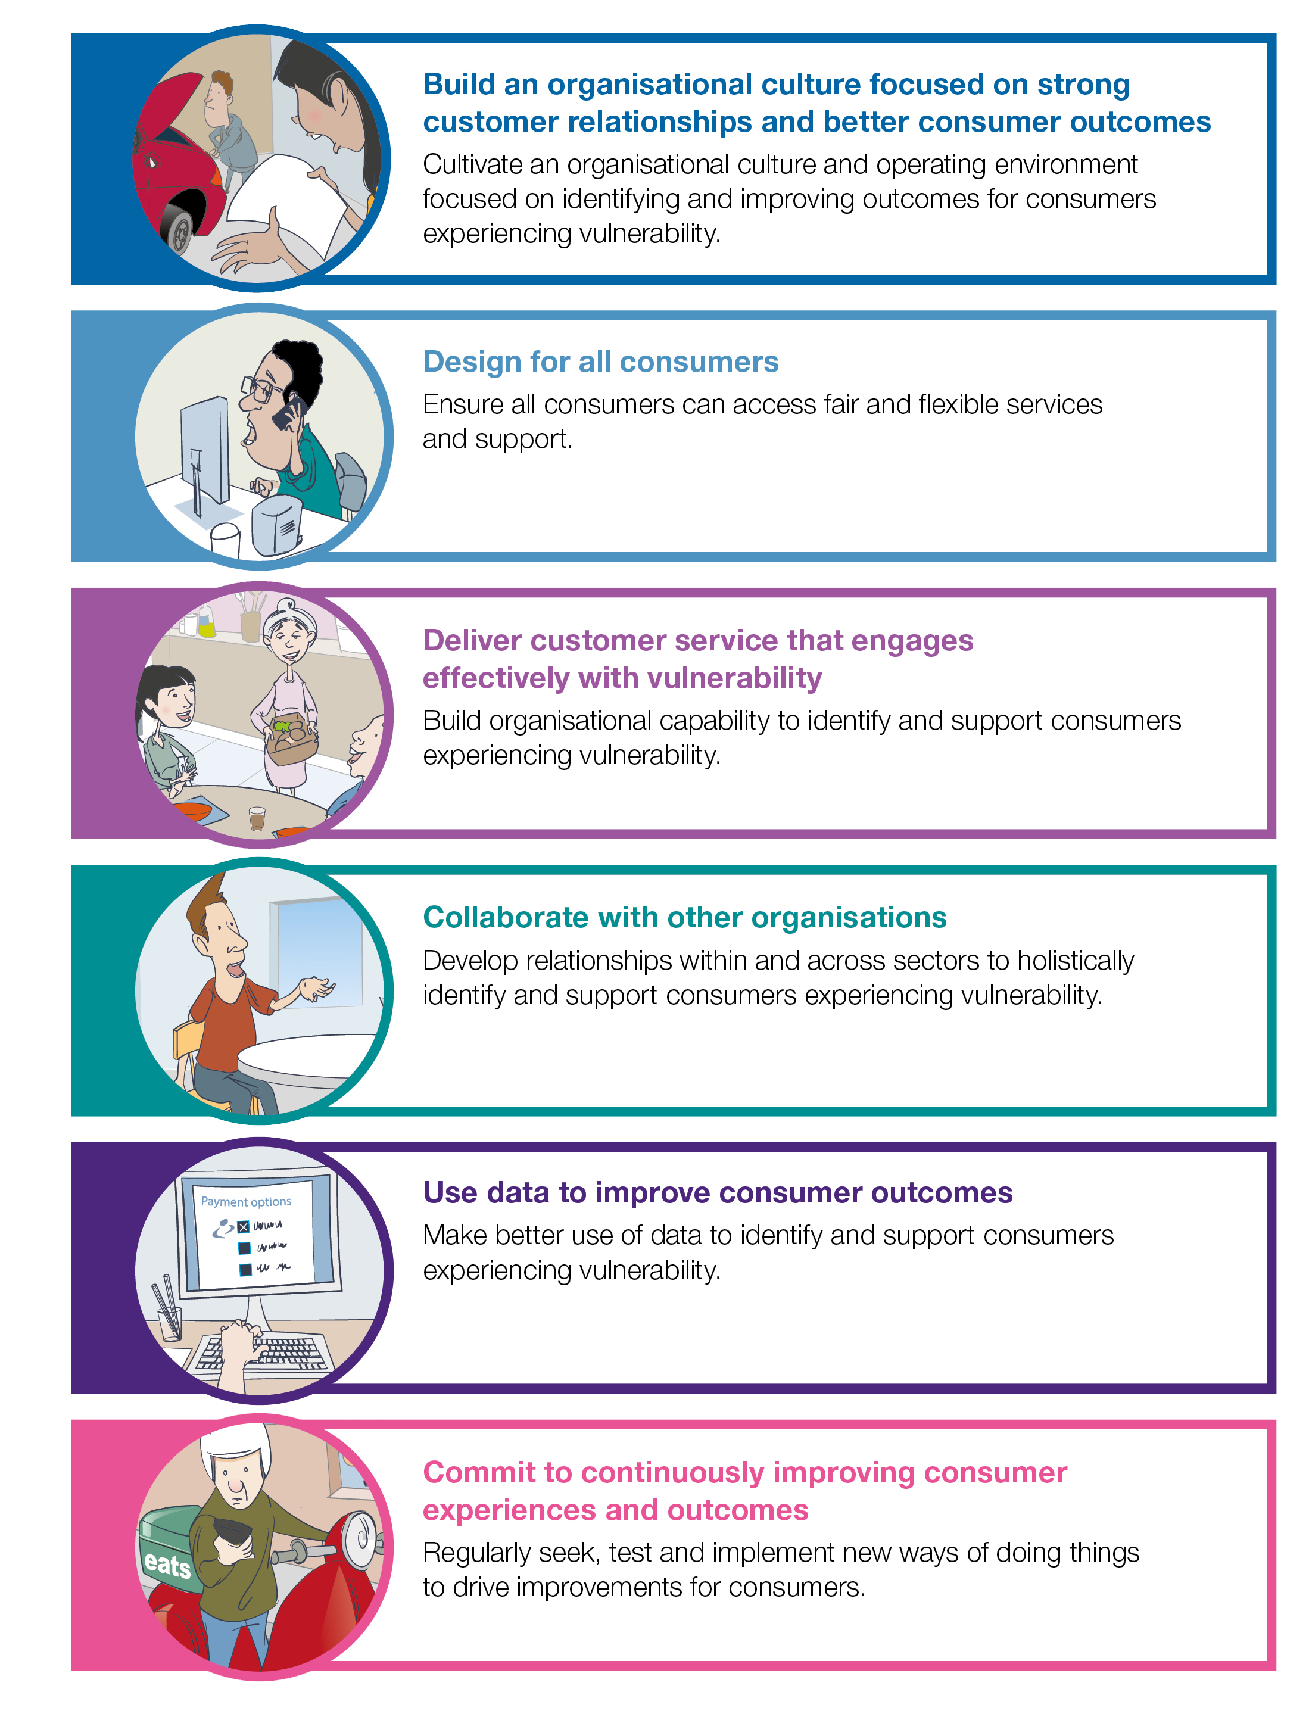
The better practice principles
The toolkit contains 6 better practice principles for identifying and supporting consumers experiencing vulnerability.
The principles are intended to work in unison.
In the toolkit each principle is explained through:
a consumer story that illustrates the potential impact on customer experiences and outcomes
better practice findings from research and consultation
industry case studies with practical examples of how the principle can be implemented
a summary of how you can put the principle into practice in your organisation.

Slide 4
Driving better practice at every level
None of us can solve consumer vulnerability, but we all have a role to play in reducing the risk of vulnerability and helping consumers who are experiencing vulnerability have better experiences in the energy market.

Slide 5
Consider how to use the toolkit in your work
Instead of prioritising one principle over another, consider setting goals and taking actions that address all the principles to make progress towards better practice.
The consumer stories are illustrative examples only and do not represent the full range of consumer experiences or potential actions. In implementing the principles, you should draw on the lived experiences of your own customers and your own organisational insights.
Identify goals and actions to improve how your organisation identifies, engages and supports consumers experiencing vulnerability. Aim for a mix of short, medium and long-term ideas.
Worksheet slides are included throughout this presentation to support consumer-facing energy businesses in implementing the practices outlined in the toolkit. Consider how these activities can be used and adapted to suit your organisation.
Commit to reviewing your progress implementing the better practice principles and revisiting your goals.

Slide 6
What is vulnerability?
Vulnerability can be defined as circumstances that mean a person may be less able to protect or represent their interests, engage effectively or are more likely to suffer detriment.
1. Vulnerability may stem from:
- Characteristics of the energy sector or products (such as complexity) - Individual circumstances, such as low income, lived experience of disability and/or mental ill health.
2. Anyone can experience vulnerability at any time.
The experience of vulnerability is complex and varied and impacts people in different ways for different periods of time.
4. Good business practice or service delivery can reduce harm to those at risk of experiencing vulnerability.
If assistance is provided early, consumers are less likely to accrue high levels of debt, be disconnected and experience harm – ultimately reducing the burden of bad debts on energy businesses.
3. Vulnerability can impact a person’s ability to comprehend, communicate and take action.
This can exclude people from markets, make it challenging to access services, reduce consumers’ ability to represent their interests, and cause or exacerbate mental ill health or financial detriment.
Notes:
‘Understanding vulnerability’ is covered on page 4 of the Customer engagement toolkit.

Slide 7
Vulnerability and better practice principles
The support provided to a consumer experiencing vulnerability can be a ‘moment of truth’ in their journey with a business.
A poor experience can be perceived as a service failure, potentially damaging the relationship with that customer for good.
Poor business practice or service delivery can increase harm to those at risk of or experiencing vulnerability.
A good experience can strengthen the relationship, reducing the risk of consumer harm in the long term.
Good practices can increase consumer trust in energy businesses, with benefits for customer loyalty, advocacy, retention and growth.

Slide 8
Using the toolkit and understanding your customers
WORKSHEET
Questions to consider:
What are the key messages and takeaways from the toolkit for you?
How do the consumer stories from the toolkit resonate with you? Do you think they are similar to the experiences of your organisation’s customers?
Are there any takeaways from the industry case studies that you could use, adopt or develop in your organisation?
Activity suggestion:
Use these questions to guide a discussion with your colleagues.

Slide 9
Build an organisational culture focused on strong customer relationships and better consumer outcomes
Better practice principles

Slide 10
Build an organisational culture focused on strong customer relationships and better consumer outcomes
This principle is about energy service providers cultivating an organisational culture and operating environment focused on identifying and improving outcomes for consumers experiencing vulnerability.
In developing the toolkit, we found that:
Relying on people to self-identify as vulnerable does not often work.
Energy service providers need to take a more proactive role in identifying vulnerability, and a consumer-centric organisational culture is crucial to achieve this.
Organisations that embed a consumer-centric culture built on genuine understanding, empathy and trust (both of and from their customers) will be better able to identify and respond to vulnerability.
Developing and embedding a shared understanding of vulnerability in an organisation will support everyone in the organisation to better recognise and identify vulnerability in customer data and interactions.
Notes:
This principle is on page 8 of the Customer engagement toolkit.

Slide 11
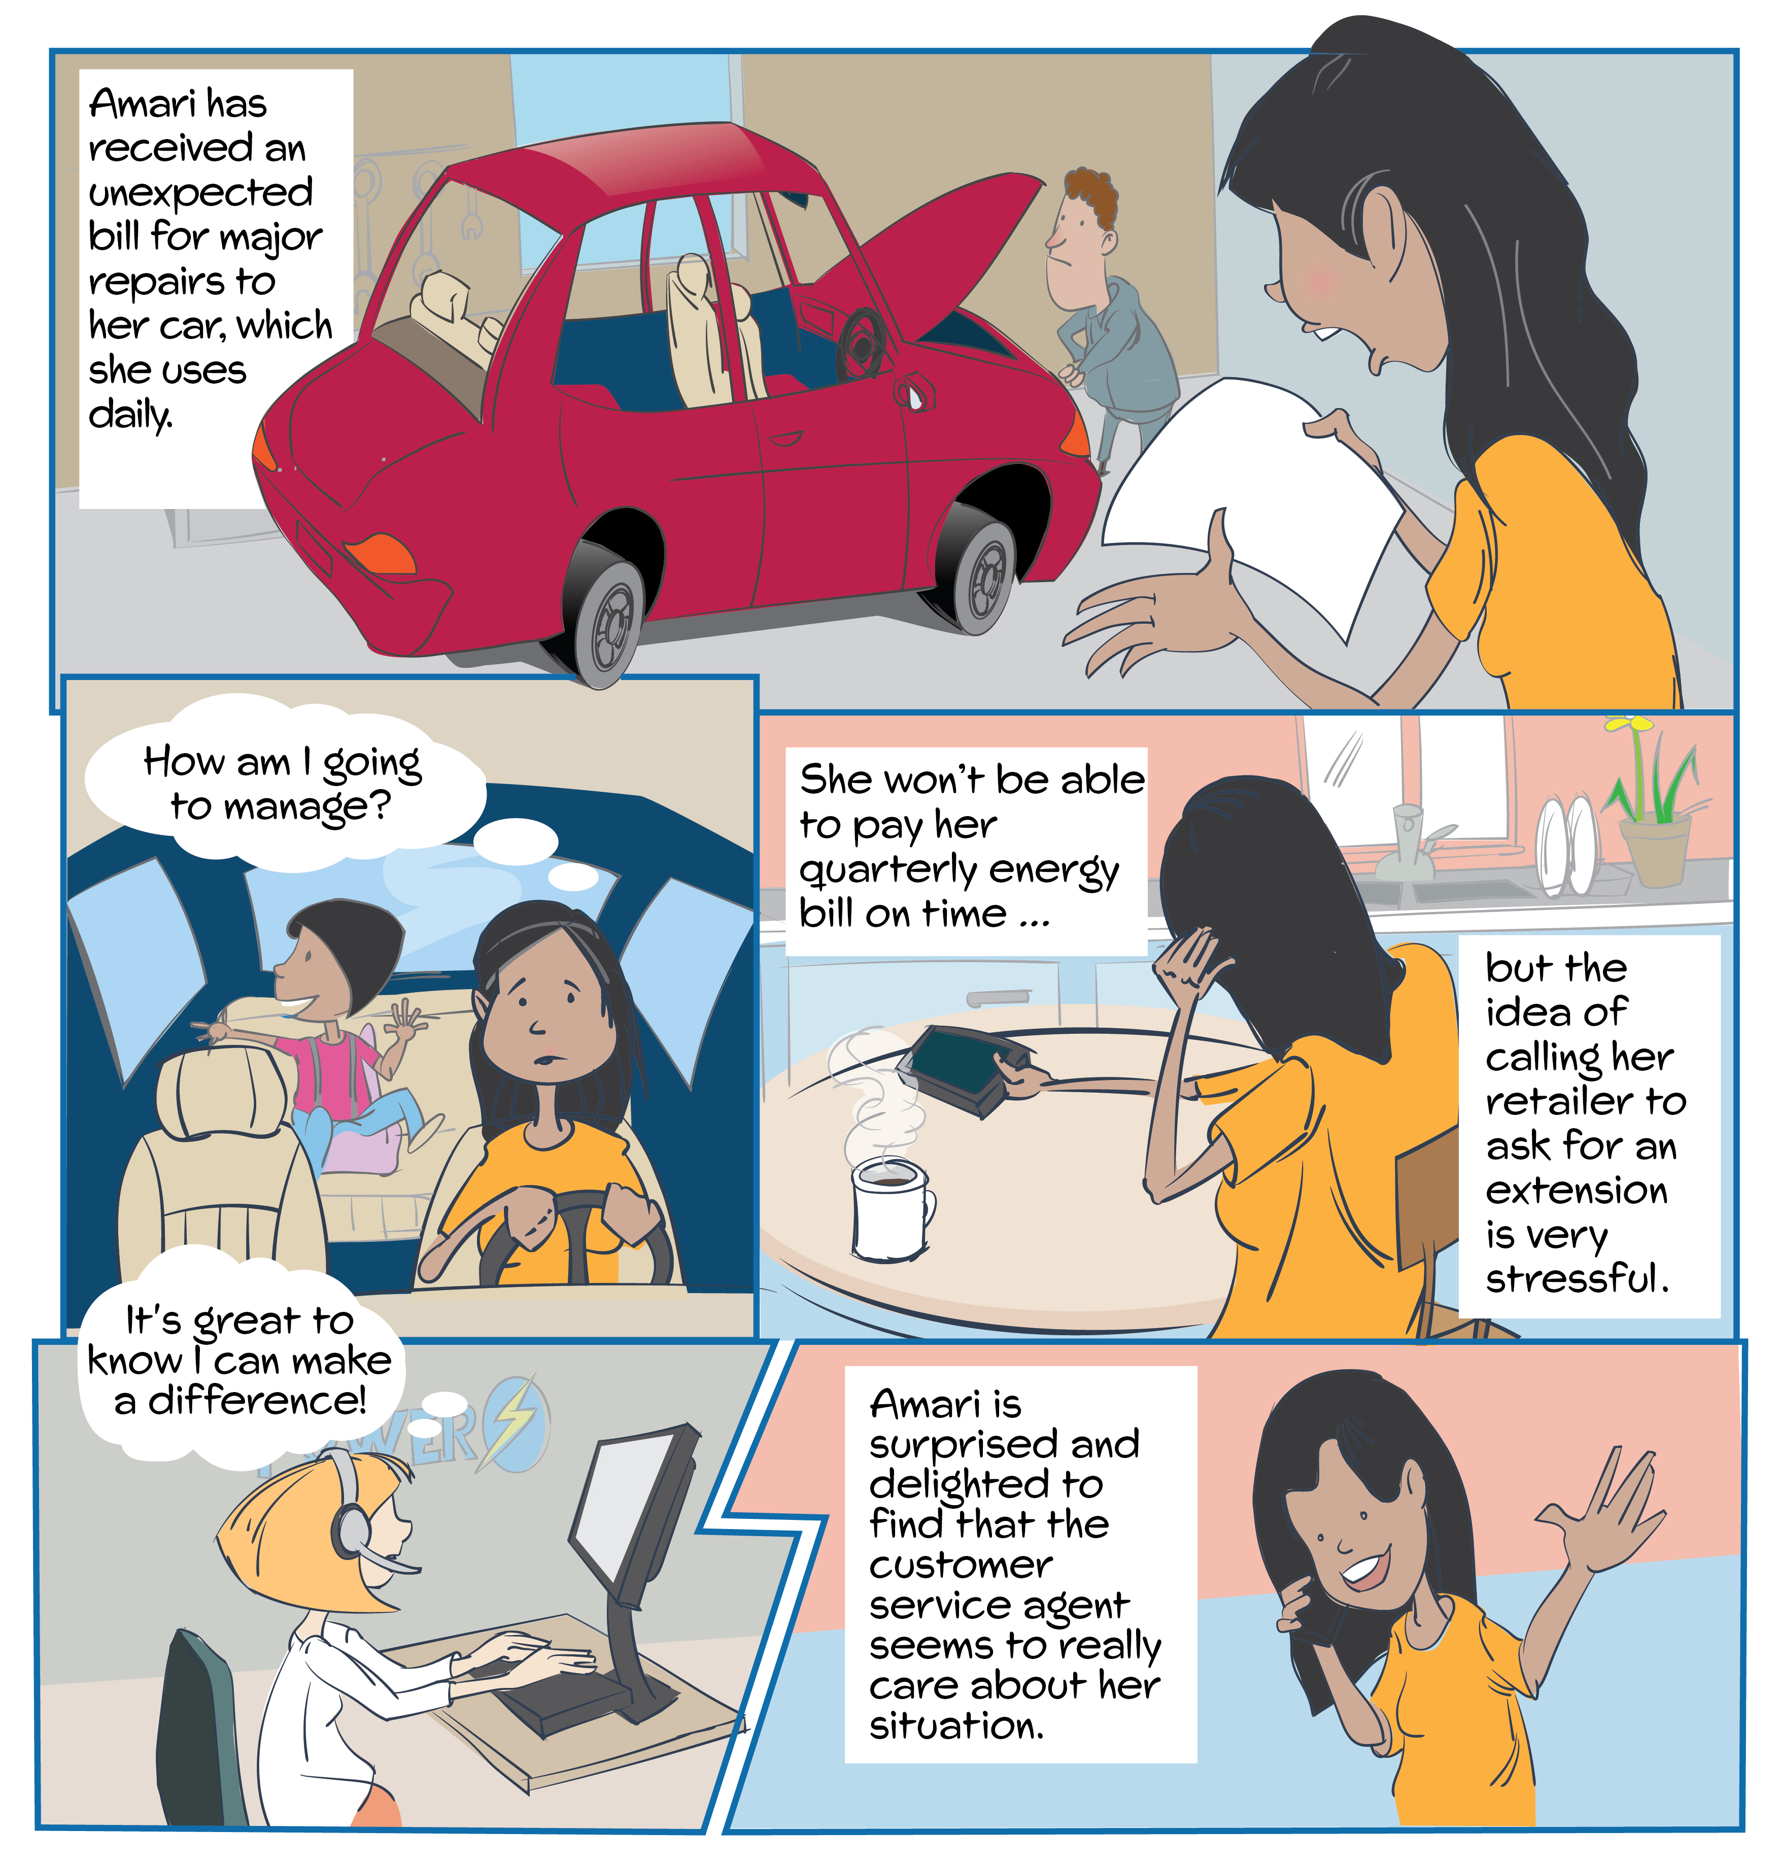
Better practice principle in action: Build an organisational culture focused on strong customer relationships and better consumer outcomes
Amari receives an unexpected car repair bill and cannot pay her quarterly energy bill on time.
She finds the idea of calling her energy retailer to ask for an extension very stressful and is ashamed about not being able to pay her bill on time.
When she decides to finally call her retailer, she is surprised to find that the customer service agent is empathetic, understanding, and offers tailored support.
The customer service agent feels positive because they feel they have genuinely helped Amari.
Importantly, the customer service agent knows their approach to Amari’s case aligns with organisational priorities, as it is frequently emphasised by leaders, explicitly outlined in policies and communications, and incorporated into performance reviews.

Slide 12
Better practice principle in action: Build an organisational culture focused on strong customer relationships and better consumer outcomes
In learning from Amari’s experience, what could be done?
Make sure the organisation’s culture, systems and processes embed fair, flexible and empathetic treatment of consumers.
Create a shared understanding of vulnerability within the organisation.
Develop strategies to identify vulnerability early, including where it may be difficult to detect.
Clearly outline expectations for all employees in identifying and addressing vulnerability.
Link the organisation’s objectives and actions in identifying and assisting vulnerable consumers, ensuring alignment from company strategic documents to operational policies and procedures.
Emphasise awareness of vulnerability throughout the business, encouraging leaders at all levels to actively promote and communicate the importance of identifying and supporting consumers experiencing vulnerability.
Ensure the organisation has the necessary skills and resources to fulfil its business objectives and activities related to identifying and supporting consumers experiencing vulnerability.
Case study:
National Australia Bank (NAB)
NAB’s Framework for customers experiencing vulnerability details specific initiatives to support customers across all business areas. Taking such action has fostered an organisational culture focused on strong relationships and better consumer outcomes.
This is because their framework has measurable performance indicators and timelines and allocates responsible senior executives to oversee progress towards specific goals.
The framework is communicated and understood throughout the whole organisation, with a focus on how cultivating shared value drives its business strategy.
NAB’s approach to customers experiencing vulnerability has helped over 100,000 Australians in financial distress get back to good credit standing and has also saved NAB more than $80 million in bad debt as a direct result of the program’s early contact with customers.

Slide 13
Build an organisational culture focused on strong customer relationships and better consumer outcomes
WORKSHEET
Questions to consider:
In your organisation:
Do the culture, systems and processes embed fair, flexible and empathetic treatment of consumers?
Do you have strategies to identify consumers experiencing vulnerability early, including where it may be difficult to detect?
Are expectations to identify and assist vulnerable consumers clear? Do these expectations align with your operational policies and procedures?
Do your team leaders, managers and senior leadership actively promote the importance of identifying and supporting consumers experiencing vulnerability?
Do staff have the necessary skills and resources to identify and support consumers experiencing vulnerability?

Slide 14
Build an organisational culture focused on strong customer relationships and better consumer outcomes
WORKSHEET
Activity suggestion:
Use the questions in a formal or informal staff survey.
Consider using a scale to gauge staff’s response to each question (e.g. ‘Yes, all the time’ through to ‘No, not at all’).
Identify areas where improvement in results is desirable.
Establish goals to improve how your organisation identifies and engages with consumers experiencing vulnerability.
Outline actions to help achieve improvement goals, considering short, medium and long-term actions.

Slide 15
Design for all consumers
Better practice principles

Slide 16
Design for all consumers
This principle is about energy service providers ensuring that all consumers can access fair and flexible services and support.
In developing the toolkit, the AER found that:
Inclusive service design is generally considered to be an effective way to improve outcomes for all consumers, leading to greater overall customer satisfaction and reduced harm.
When services are overly complex or not accessible, consumers with different backgrounds, experiences and needs may struggle to understand and access the service or support best suited to them.
When developing a new product or service, consider the needs of consumers experiencing vulnerability in every stage of the design process.
It is important and beneficial for both businesses and consumers that information is communicated in a way that is easily understood by as many people as possible.
Notes:
This principle is covered on page 12 of the Customer engagement toolkit.

Slide 17
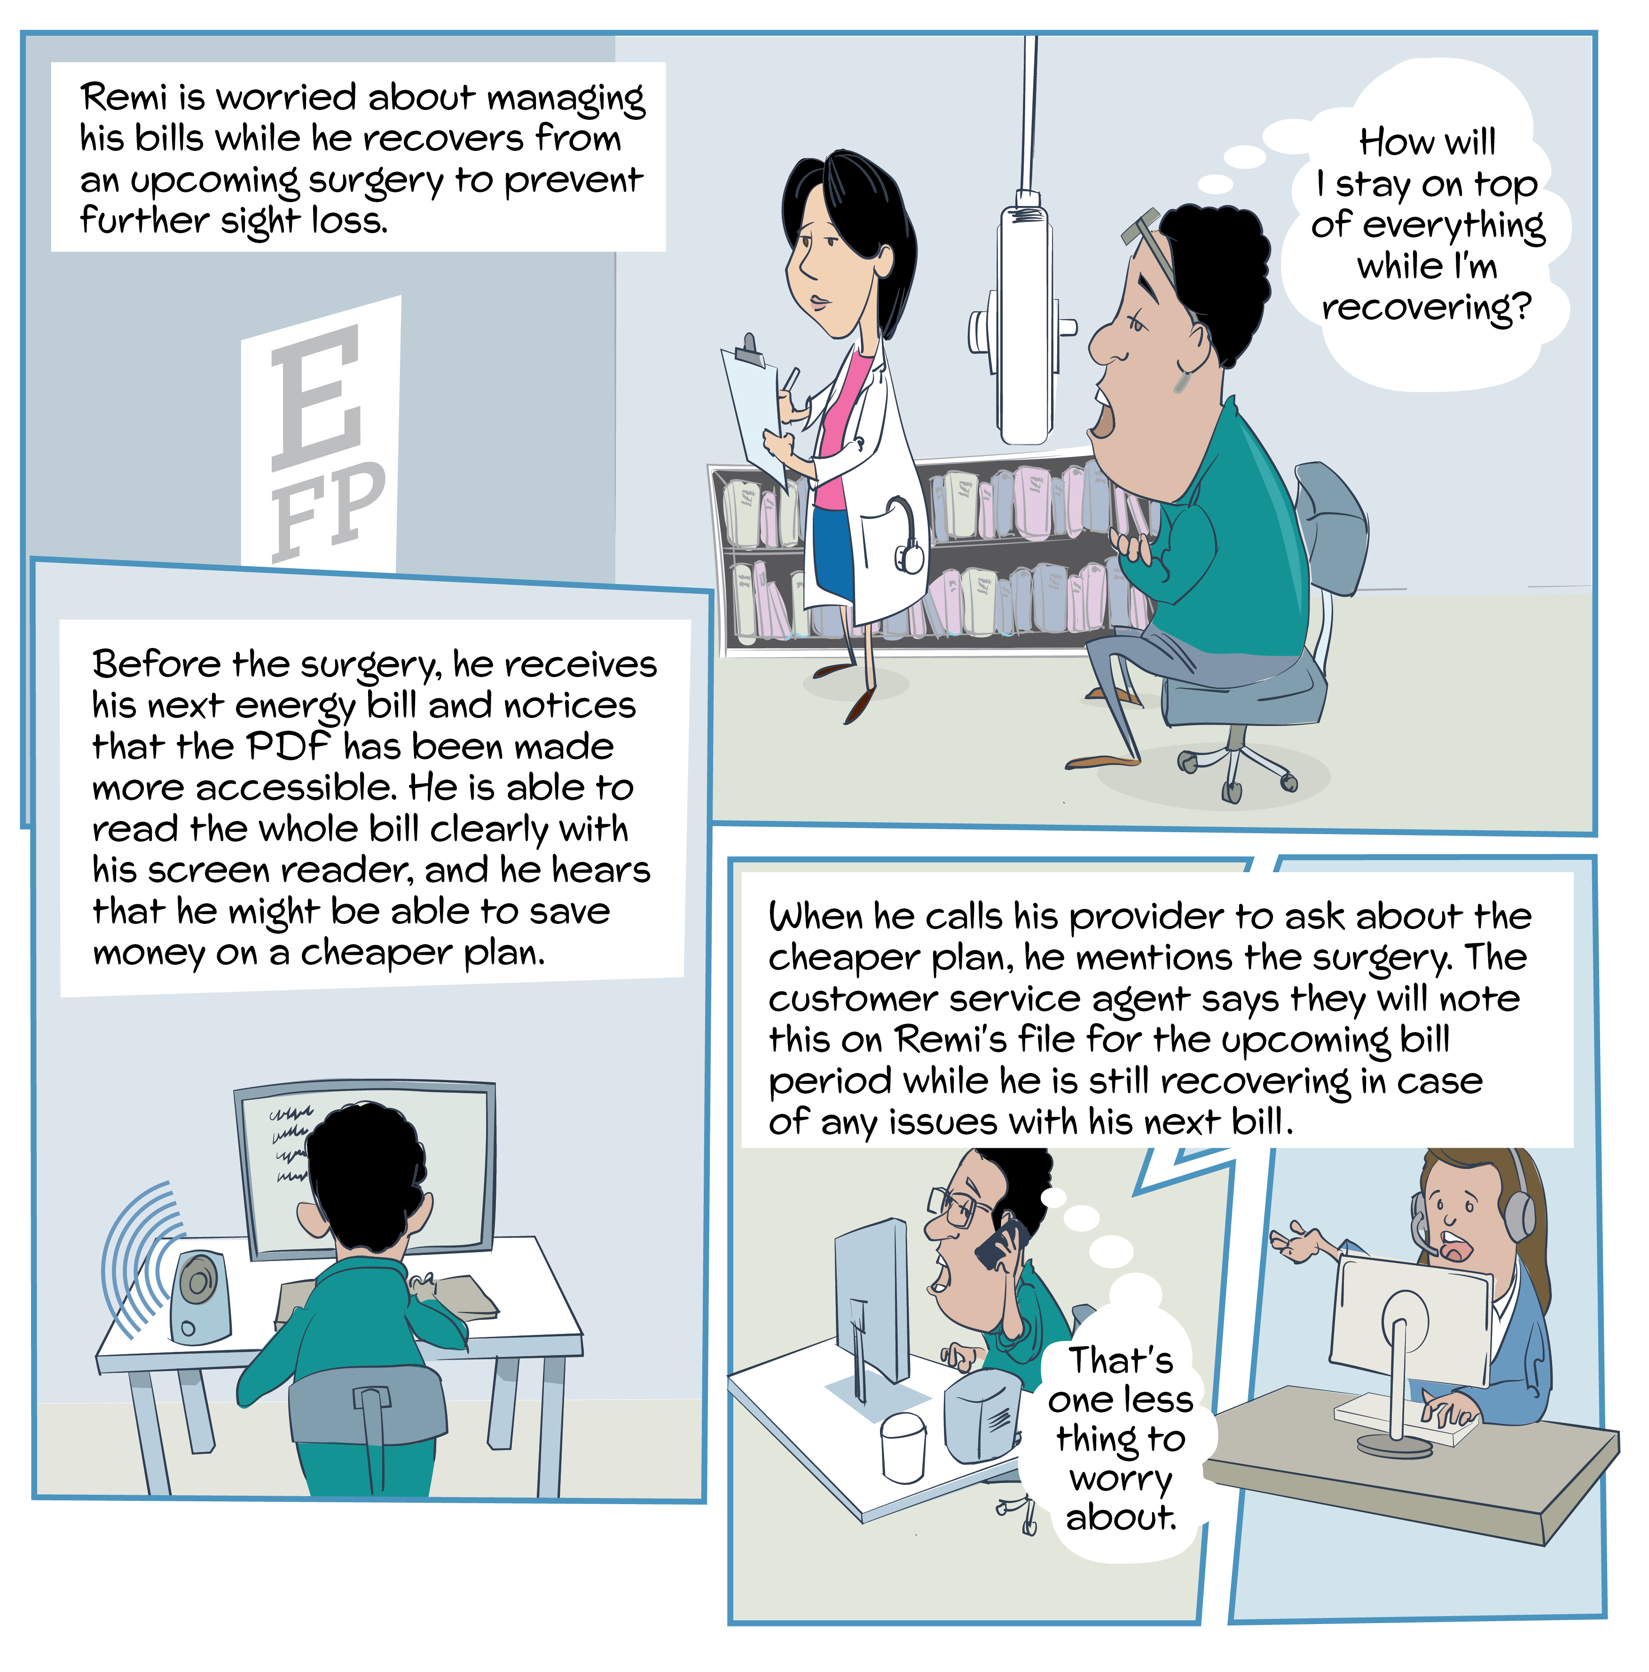
Better practice principle in action: Design for all consumers
Remi will be unable to work for several months due to surgery to prevent further sight loss.
He notices that his energy provider has made the PDF bill more accessible, allowing him to read it clearly with his screen reader.
He learns he might save money on a cheaper plan and contacts his provider, who switches him to the cheaper option.
During the call, he mentions his upcoming surgery, and the customer service agent assures a follow-up call after his next bill if needed.
He receives accessible documentation for his new plan, strengthening his trust in his provider.
Remi feels reassured that his provider is aware of his circumstances and will address any bill issues during his recovery.

Slide 18
Better practice principle in action: Design for all consumers
In learning from Remi’s experience, what could be done?
In the design and delivery of services, proactively understand, anticipate and address the needs of diverse consumers experiencing vulnerability.
Use insights from consumer feedback, research and lived experience to design more inclusive and consumer-centric services.
Ensure inclusive service design is considered for all stages of service delivery and across all consumer touchpoints.
Make it easy for all consumers to interact with you by providing various accessible engagement options tailored to their individual needs.
Understand the needs of consumers in vulnerable situations, their challenges, preferences and how they interact with the organisation’s products or services.
Ensure products and services are clear, comprehensible and accessible to consumers, especially those who may be vulnerable to harm.
Case study:
Aurora Energy
Aurora Energy incorporated the lived experiences of consumers into service design and delivery.
Aurora involved customers or 'lived experience partners' with diverse backgrounds in key business projects to gather feedback on business processes and policies.
Feedback from lived experiences allowed frontline operators to develop tailored training programs for frontline staff that allowed them to develop a better understanding of the types of customer experiences that could lead to bill payment difficulty and other challenges.

Slide 19
Design for all customers
WORKSHEET
Questions to consider:
How does your organisation:
Use insights from consumer feedback, research and lived experience to design more proactive, inclusive and consumer-centric services?
Ensure products and services are designed with the challenges, needs and preferences of consumers experiencing vulnerability in mind?
Make it easy for all consumers to interact with you by providing various accessible engagement options tailored to their individual needs?
Activity suggestion:
For each question, outline your organisation’s current design approach and then consider ‘how could we do this better?’ to define your ideal approach.

Slide 20
Deliver customer service that engages
effectively with vulnerability
Better practice principles

Slide 21
Deliver customer service that engages effectively with vulnerability
This principle is about energy service providers building organisational capability to identify and support consumers experiencing vulnerability.
In developing the toolkit, the AER found that:
Consumers experiencing vulnerability might refrain from engaging with their energy retailer for various reasons, such as fear of judgement or past negative experiences with ‘robotic’ or inflexible service interactions.
For energy service providers to make significant strides in identifying and enhancing outcomes for consumers experiencing vulnerability, they must consistently deliver customer service that is empathetic, patient, flexible and informed by a solid understanding of vulnerability and its indicators.
Providing information on support and assistance options early in the customer relationship can build trust and create opportunities for identifying vulnerability.
Notes:
This principle is covered on page 17 of the Customer engagement toolkit.

Slide 22
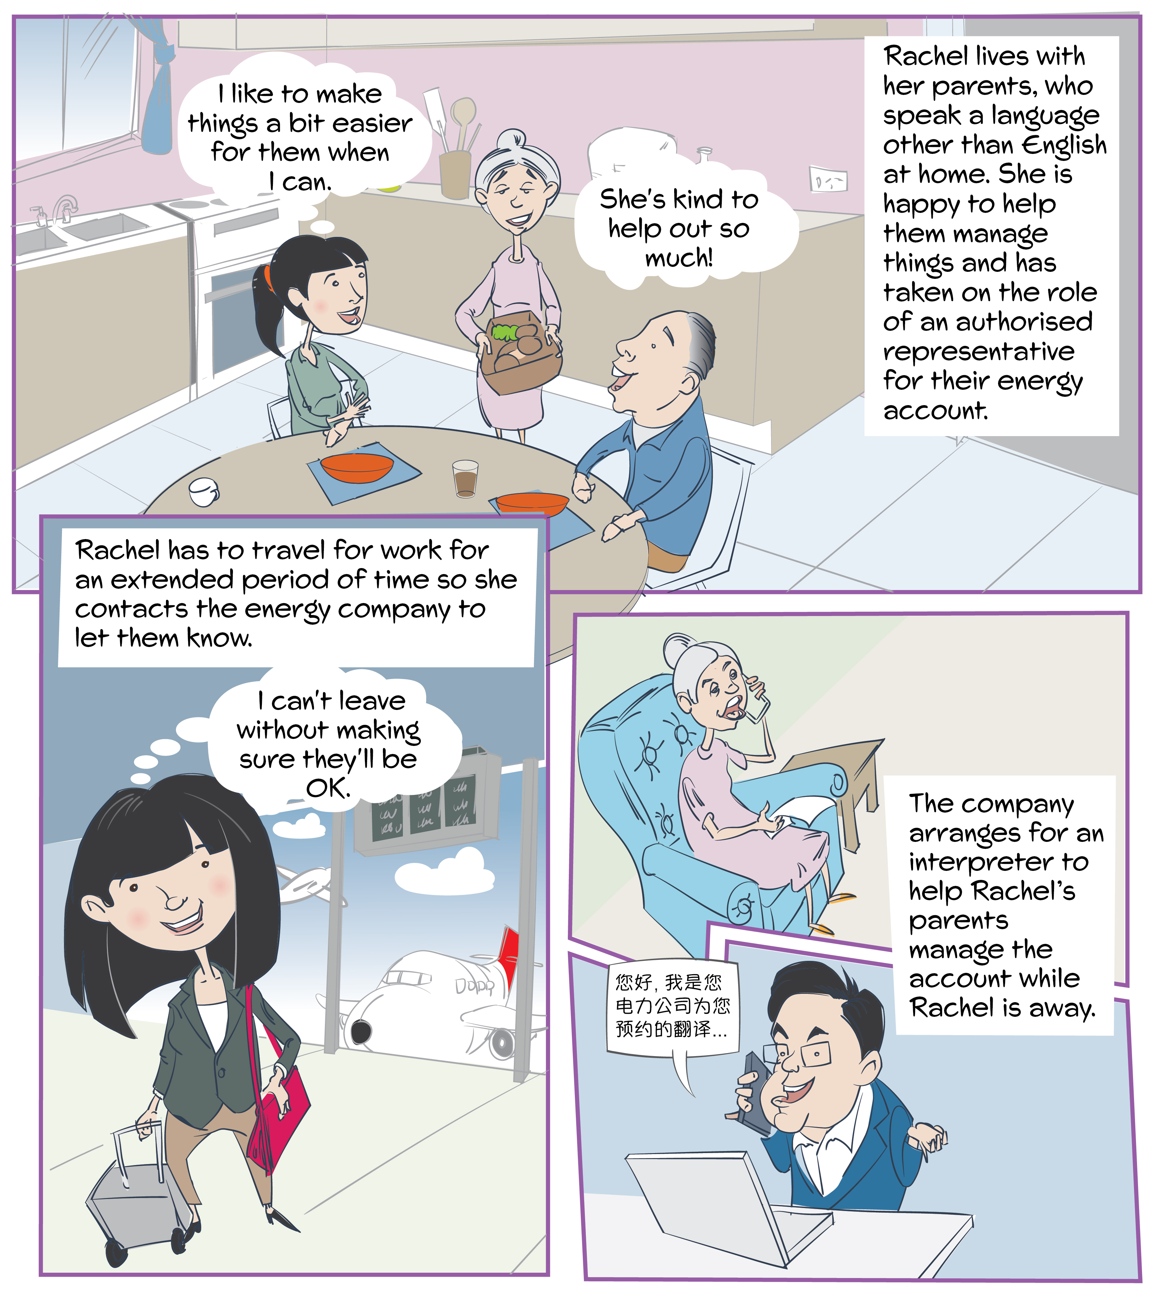
Better practice principle in action: Deliver customer service that engages effectively with vulnerability
Rachel is a young worker living with her elderly parents, who are from a non-English speaking background.
She is an authorised representative on the account to make it easier to engage with their energy provider.
Before going away for work, Rachel contacts her energy service provider to tell them about her family’s situation.
The service provider arranges for an interpreter to help follow up with Rachel’s parents so they can pay the bills while she is away.
Rachel feels better knowing that her parents will be able to manage their account in her absence, without worrying that they could get disconnected.

Slide 23
Better practice principle in action: Deliver customer service that engages effectively with vulnerability
In learning from Rachel’s experience, what could be done?
Inform customers of available support options and how to access them as early as possible.
Provide empathetic, patient and flexible customer service.
Consider where scripts could be replaced or supplemented by conversational guides and tools.
Take steps to create a disclosure environment that makes it easier for customers to share relevant information about vulnerable circumstances they may be experiencing.
Support and resource frontline staff to ensure they have the capabilities, capacity and incentive to identify and support consumers in vulnerable situations.
Ensure staff with specialist skills are available to support consumers who require more targeted assistance.
Facilitate disclosure and improve support for specific groups or cohorts of consumers, including considering options for dedicated specialist support, ensuring easy access to interpreter services and tailoring communication channels to consumers’ needs.
Case study:
Westpac
In 2019, Westpac established a First Nations specific call centre.
The call centre aimed to make banking more inclusive for First Nations customers through a tailored service experience. This includes the ability to speak to First Nations staff in 21 Aboriginal and Torres Strait Islander languages.
The call centre has served over 5,000 customers and its services now extend across all Westpac brands. The effectiveness of the service can be attributed to the Indigenous representation of call centre staff with at least 50% of the call centre team identifying as Aboriginal or Torres Strait Islander.
The establishment of the Westpac First Nations call centre is an example how organisations can deliver customer service that effectively engages with vulnerability.

Slide 24
Deliver customer service that engages effectively with vulnerability
WORKSHEET
Questions to consider:
How could your organisation inform customers about available support options and how to access them as early as possible?
Are there any existing scripts that could be replaced or supplemented by conversational guides and tools?
Do frontline staff have the empathy, capabilities, capacity and incentive to identify and support consumers in vulnerable situations? What additional support or resources could be provided?
Does the organisation create a disclosure environment that makes it easier for customers to share relevant information about vulnerable circumstances they may be experiencing? How could this be improved?
Activity suggestion:
Use these questions to guide a discussion with your colleagues.

Slide 25
Collaborate with other organisations
Better practice principles

Slide 26
Collaborate with other organisations
This principle is about developing relationships within and across sectors to holistically identify and support consumers experiencing vulnerability.
In developing the toolkit, the AER found that:
Silos within and between organisations and sectors can exacerbate customer vulnerability, limiting identification of vulnerability and preventing consumers from accessing necessary support.
The burden of having to engage with several organisations can lead to a severe emotional toll or a total lack of engagement.
Effective inward referral pathways can alert you to vulnerable circumstances that may otherwise remain hidden, while outward referral pathways can ensure your customers receive appropriate holistic support to improve their outcomes in the long term.
Establishing appropriate referral pathways, policies and procedures can amplify the impact of identification and improve outcomes for your customers.
Notes:
This principle is covered on page 26 of the Customer Engagement toolkit.

Slide 27
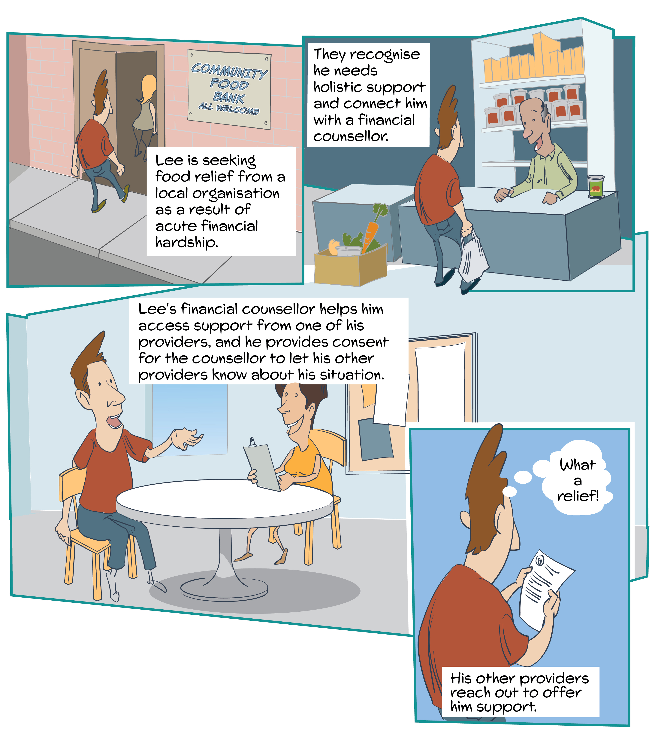
Better practice principle in action: Collaborate with other organisations
Lee is experiencing acute financial hardship and seeks food relief from a local community support organisation.
The organisation recognises he needs more holistic support and schedules an appointment with a financial counsellor. The financial counsellor helps Lee make a plan to address some of his current challenges, including debts with his energy and water providers.
Lee is relieved to only have to tell his story once and to receive proactive support from his other providers.
Rather than calling his individual service providers one at a time, he can focus on improving his situation more broadly. This helps Lee get back on track and start catching up on his bills again sooner.

Slide 28
Better practice principle in action: Collaborate with other organisations
In learning from Lee’s experience, what could be done?
Establish relationships with external organisations such as other retailers, networks and distributors, government agencies, non-profits and financial counsellors.
Maintain procedures for receiving third-party disclosures and develop links with local and national support services to ensure third parties are aware of channels to provide disclosures.
Develop and implement clear referral policies and procedures, including policies and procedures for obtaining and recording consumer consent in line with relevant privacy obligations.
Create efficient and secure channels for information sharing.
Appoint a dedicated staff member or team to manage relationships with third parties.
Implement a regular reporting process to assess outcomes and identify areas for improvement.
Case study:
Knock to Stay Connected Customer Code
The Knock to Stay Connected Customer Code is a customer-led approach to keeping customers connected to their energy.
Participating retailers and network providers collaborate to ensure customers at risk of disconnection receive a ‘knock on the door’. This lets customers know that assistance is available and encourages them to contact their energy retailer before they are disconnected.
National trials have demonstrated that up to 80% of disconnections can be avoided through this human-centred approach.
The Knock to Stay Connected program is an example of how collaboration with other organisations can effectively address consumer vulnerability.
Notes:
An additional case study, ‘Connecting consumers to support with the One Stop One Story Hub’ is provided on page 28 of the Customer engagement toolkit. This case study looks at how, in 2021, Thriving Communities Partnership launched the One Stop One Story Hub. This is a cross-sector digital platform enabling frontline workers to refer customers to a range of supports through a single, secure access point. The One Stop Story Hub makes it easier for consumers experiencing vulnerability to access the support they need without the emotional toll or re-traumatisation of sharing their story with multiple different service providers.

Slide 29
Collaborate with other organisations
WORKSHEET
Questions to consider:
In your organisation:
What referral pathways and partnerships are established to support consumers, particularly those experiencing vulnerability?
What collaborative relationships do you have with other organisations to improve practices and share knowledge regarding consumers experiencing vulnerability? This may include other retailers, networks and distributors, government agencies, non-profits and financial counsellors.
What referral policies and procedures do you have, including policies and procedures for obtaining and recording consumer consent?

Slide 30
Collaborate with other organisations
WORKSHEET
Activity suggestion:
Run an interactive session with staff to brainstorm responses to each of the questions.
Consider using sticky notes (digital or physical) or an online collaboration tool (e.g. Padlet) to collect staff’s responses. This provides a visual reference to aid discussion and for review post-brainstorming.

Slide 31
Use data to improve consumer outcomes
Better practice principles

Slide 32
Use data to improve consumer outcomes
This principle is about energy service providers making better use of data to identify and support consumers experiencing vulnerability.
In developing the toolkit, the AER found that:
Poor data management can hinder early identification of vulnerability and contribute to consumer harm.
Effective, ethical and secure data and customer management systems can aid in identifying and supporting consumers experiencing vulnerability.
Technologies and processes have significant potential to assist in the identification of vulnerability.
Using data to act on vulnerability indicators can improve relationships with customers, drive greater engagement and improve outcomes for both the service provider and the customer in the long run.
Notes:
This principle is covered on page 30 of the Customer engagement toolkit.

Slide 33
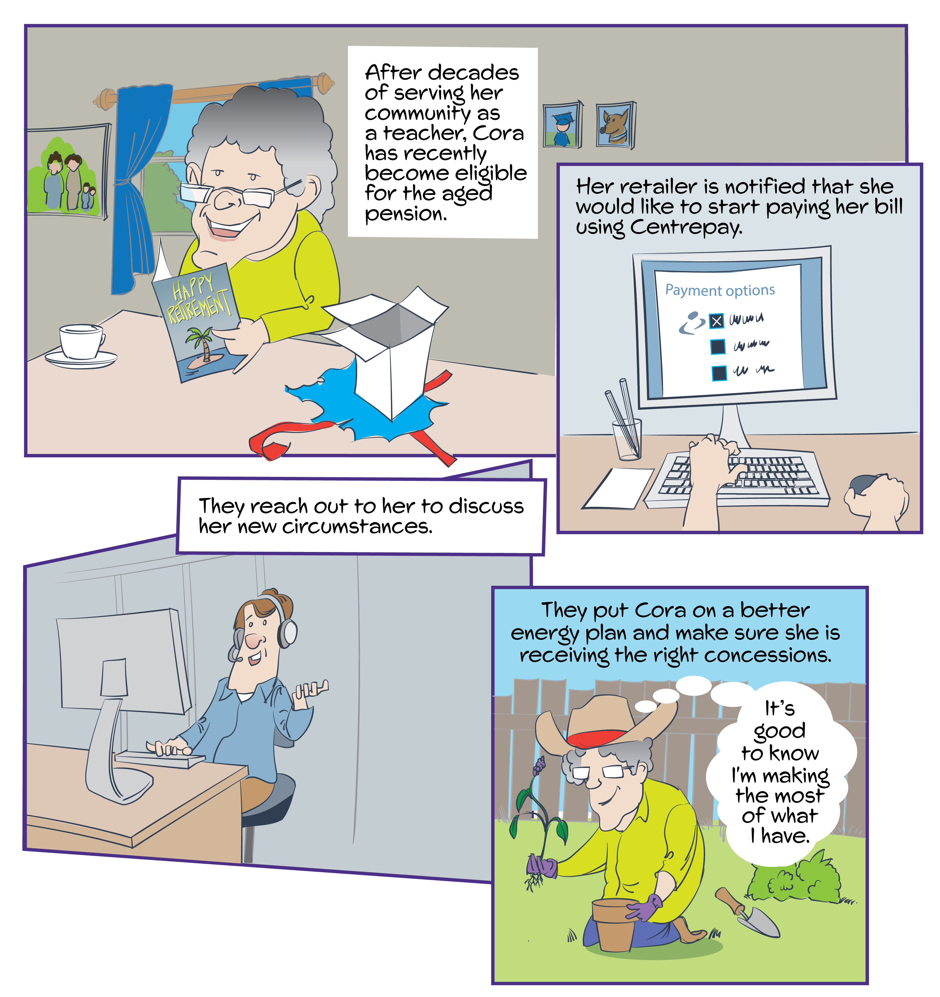
Better practice principle in action: Use data to improve consumer outcomes
Cora has recently retired and become eligible for the aged pension. The retailer is notified that she would like to start paying her bill using Centrepay.
The request immediately identifies Cora in the retailer’s system and their hardship team proactively reaches out to her to discuss her circumstances and needs.
The retailer puts Cora on the most appropriate energy plan for her circumstances and make sure she is receiving the right energy concessions, putting her on a path to avoid energy debt and setting them up for a good relationship into the future.

Slide 34
Better practice principle in action: Use data to improve consumer outcomes
In learning from Cora’s experience, what could be done?
Learn from your data and use it to identify when consumers might be experiencing vulnerability, so that you can provide proactive and empathetic support.
Proactively maintain and update data for consumers in vulnerable circumstances.
Ensure that frontline staff can not only recognise and record vulnerability, but also clearly explain what data is being recorded, why it is being recorded and how it will be used.
Work with other organisations to facilitate better use of data across sectors.
Case study:
Horizon Power
Horizon Power has developed a statistical model which uses customer data to proactively identify and assist customers who may be experiencing payment difficulty.
Using historical payment and billing information, the model predicts a customer’s risk of default to identify whether they might be experiencing payment difficulty and need further support.
Proactively reaching out to customers based on the insights from the model has provided an additional opportunity for Horizon Power to engage with customers and identify available support options as early as possible in the payment difficulty journey.

Slide 35
Use data to improve consumer outcomes
WORKSHEET
Questions to consider:
In your organisation:
Are you learning from your data and using it to proactively identify when consumers might be experiencing vulnerability and provide empathetic support?
Do you proactively maintain and update data for consumers who may be experiencing vulnerability?
Are you ensuring that frontline staff can not only recognise and record vulnerability, but also clearly explain what data is being recorded, why it is being recorded and how it will be used?
Activity suggestion:
Use these questions to guide a discussion with your colleagues.

Slide 36
Commit to continuously improving consumer experiences and outcomes
Better practice principles

Slide 37
Commit to continuously improving consumer experiences and outcomes
This principle is about energy service providers regularly seeking, testing and implementing new ways of doing things to drive improvements for consumers.
In developing the toolkit, the AER found that:
Without effective monitoring, reporting and change, energy service providers will miss opportunities to improve identification and support of consumers experiencing vulnerability.
Well-communicated expectations of staff and performance measurement ensure organisational goals are adequately passed on to the frontline.
Key performance indicators and other organisational metrics play a vital role in driving better practice and improving outcomes for consumers experiencing vulnerability.
By actively disclosing initiatives on addressing vulnerability to the public, consumer-facing energy businesses are better able to build and maintain trust with their customers.
Notes:
This principle is covered on page 34 of the Customer engagement toolkit.

Slide 38
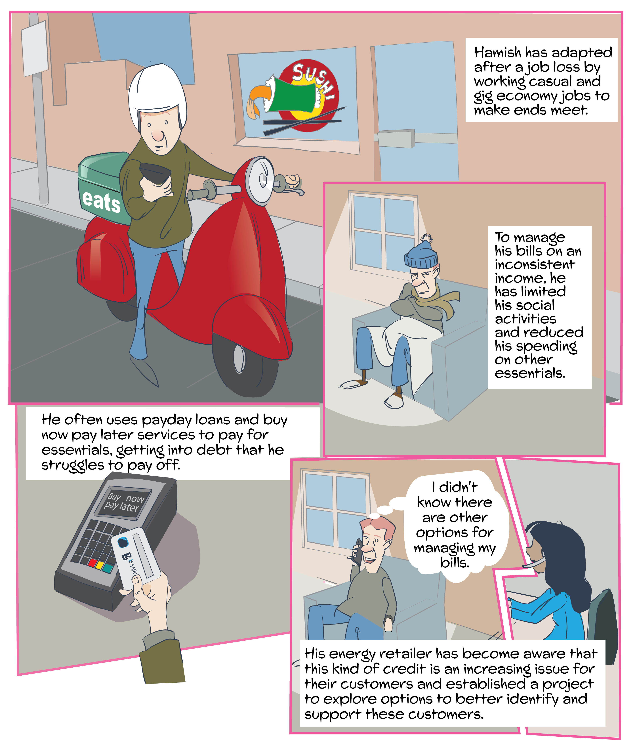
Better practice principle in action: Commit to continuously improving consumer experiences and outcomes
Hamish lost his job during the pandemic and has been working casual jobs in the gig economy to make ends meet.
Instead of seeking support from his retailer, he has been managing his energy bills by making sacrifices in other areas of his life – severely restricting his heating and cooling and reducing his spending on other essentials such as food.
He has used either payday loans or buy now pay later services to pay for his groceries and utilities.
Monitoring feedback and data from customers, frontline staff and external stakeholders, his retailer has become aware that this kind of credit is increasingly becoming an issue for their customers experiencing vulnerability.
In response, his retailer established a project to explore how they can better identify and support these customers, including options to update their billing systems or staff training so that use of buy now pay later services can be used as an indicator of potential vulnerability.

Slide 39
Better practice principle in action: Commit to continuously improving consumer experiences and outcomes
Learning from Hamish’s experience, what be done?
Establish relevant performance indicators and organisational metrics to monitor and report on.
Evaluate whether consumers’ needs are being met and improve processes where needed.
Regularly review policies, practices and complaints to identify barriers for consumers or opportunities for improvement.
Audit records for customers experiencing financial hardship to assess whether this may have been exacerbated by poor service experiences or improper practices.
Monitor and adapt new research and developments in identifying and addressing vulnerability.
Case study:
Ergon Energy
Ergon Energy Retail used research and data to improve the customer experience of its Interactive Voice Response system.
Calls were analysed to identify the top 3 drivers of customer contact, evaluate customer sentiment and understand consumer intention. Ergon Energy used these data insights to simplifying the menu structure, providing a call-back option and introducing tailored wait messages.
This reduced the cost to serve by enabling better resource allocation and led to increased customer satisfaction.
Ergon Energy has committed to continuously improving consumer experiences and outcomes by using research and data to better identify and engage with consumers.
Notes:
An additional case study, ‘Reporting on progress of customer and community outcomes through disclosures at the Energy Charter’ is provided on page 35 of the Customer Engagement toolkit. In this case, Energy Charter signatory CEOs agree to publicly disclose how they are delivering against the Energy Charter’s 5 principles through public disclosure.
These disclosures are part of the Energy Charter’s Accountability Process, which exists to add value to customers and energy businesses by identifying both positive outcomes and opportunities for improvement.

Slide 40
Commit to continuously improving consumer experiences and outcomes
WORKSHEET
Questions to consider:
What performance metrics relating to identifying and supporting customers experiencing vulnerability does your organisation monitor and report on?
How often does your organisation review policies, practices and complaints to identify barriers for consumers and opportunities for improvement?
Does the organisation audit records for customers experiencing financial hardship to assess whether this may have been exacerbated by poor service experiences or improper practices?
Activity suggestion:
For each question, consider your organisation’s current approach and then consider ‘how could we do this better?’ to define your ideal approach.

Slide 41
Special cohorts and addressing vulnerability
Some customer groups may particularly benefit from more specialised support. These include:
First Nations consumers
Culturally and linguistically diverse communities
Improve relationships with these customers by taking actionable steps to improve accessibility for services to those who may have limited or no English.
Consumers affected by family violence
In addition to existing obligations, it is critical that organisations establish clear capabilities, policies and processes to enable identification and protect consumer privacy and safety following identification.
Consumers affected by pandemics and natural disaster
Consumers affected by mental illness and suicide
Consider how customers may be impacted in these situations in both the short and long term, and what actions you can take to proactively identify and support them.
You can better support customers and staff by preparing for the possibility of suicide disclosures and ensuring that staff can easily access suicide policies and are trained to follow suicide processes.
Engage closely with First Nations consumer groups and communities to understand how organisational policies and service design and delivery can be improved for First Nations consumers.
Notes:
Special cohorts are covered on page 22 of the Customer Engagement toolkit.

Slide 42
Why identifying and supporting consumers experiencing vulnerability is important
Identifying and engaging with consumers experiencing vulnerability has benefits for both the consumers and energy service providers. Early identification and effective engagement can reduce an energy provider’s cost to serve and lead to greater customer satisfaction.
It is important for consumer-facing energy businesses to play a more proactive role in identifying vulnerability, including by supporting their customers to identify themselves by sharing their experiences of vulnerability.
Your interaction with the customer may be the ‘moment of truth’ for the customer. A good experience can strengthen the relationship, reducing the risk of consumer harm in the long term. A poor experience can be perceived as a service failure, potentially damaging the relationship with that customer for good.
There is evidence that this not only improves outcomes for consumers, but also benefits businesses. If assistance is provided early, consumers are less likely to accrue high levels of debt, be disconnected and experience harm – ultimately reducing the burden of bad debts on energy businesses.

Slide 43
Other resources
Other sectors and regions offer valuable learnings and insights that can be applied to drive better practice in the energy sector. We hope that these resources provide a useful starting point for more detailed consideration and implementation of the better practice principles.
Resource | Summary
Australian Communications and Media Authority Consumer vulnerability: expectations for the telecommunications industry | This document presents the telecommunications regulator’s expectations for the telecommunications industry to improve outcomes for consumers experiencing vulnerability. Both telecommunications and energy are essential services, and many of the recommendations are also applicable in an energy context.
Australian Financial Security Authority Vulnerability Framework 2022–25 | This resource sets out a three-year strategy for improving AFSA’s identification and support of vulnerable people. Its 6 focus areas can be applied to most sectors and may be a useful example for energy companies that are creating their own strategic vulnerability framework.
Office of Gas and Electricity Markets of the United Kingdom Good practice for supporting customers in payment difficulty | This resource shares examples of what the UK energy regulator considers to be good practice when supporting people who are struggling to pay their energy bills. It focuses on 4 main areas: debt prevention, debt communications, debt support and debt recovery.
Australian Energy Council Guidance for retailers seeking to implement best practice customer support | This resource offers practical guidance for energy retailers to apply best practice principles when aiding people in managing energy costs. It does this by presenting a scenario and an objective, and steps out how retailers may act in this situation to achieve best-practice assistance outcomes.
Queensland University of Technology Supporting CALD Australians to be empowered energy consumers | This resource provides 6 strategic recommendations to industry on how to better support energy consumers from culturally and linguistically diverse backgrounds. The recommendations are informed by comprehensive qualitative research into the lived experiences of culturally and linguistically diverse consumers, undertaken with funding from Energy Consumers Australia.
Notes:
Additional resources can be found in the Customer engagement toolkit. These include:
Financial Conduct Authority (UK) Guidance for firms on the fair treatment of vulnerable customers
International Organization for Standardization - International Standard 22458: Consumer Vulnerability: Requirements and guidelines for the design and delivery of inclusive service
Money Advice Trust and Money Liaison Group (UK) - Disclosure Environments: Encouraging consumers to disclose a mental health problem
Money Advice Trust and Money Liaison Group (UK) and Fair by Design - Inclusive design in essential services: A practical guide for firms and suppliers
Australian Energy Council Statement of objectives & principles: Best practice energy retail customer assistance – through COVID and beyond
Government Debt Management Function (UK) - Debt Management Vulnerability toolkit for frontline debt management staff

Slide 44
Questions?

