Slide 1
Powerlink 2027-32 Electricity Transmission Revenue Proposal
Public Forum
9 April 2026

Slide 2
Acknowledgement of Country
Lynne Gallagher
AER Board Member

Slide 3
AER welcome and introductions
Lynne Gallagher
AER Board Member

Slide 4
Agenda
Topic | Speaker | Duration
Welcome and Acknowledgment of country | Lynne Gallagher AER Board member | 10 min
Overview Our regulatory framework The transmission system in Queensland
Powerlink’s proposal and our preliminary issues | Gavin Fox GM, Network Regulation, AER | 10 min
Regulatory Proposal Reference Group (RPRG) insights | Nardia Yeates, Aurizon Revenue Proposal Reference Group | 10 min
CCP insights | Mike Swanston Consumer Challenge Panel 34 | 10 min
Powerlink’s next steps in consumer engagement | Darryl Rowell Interim Chief Executive Manager, Powerlink | 5 min
Facilitated discussion | Gavin Fox GM, Network Regulation, AER | 10 min
Closing remarks and next steps | Lynne Gallagher AER Board member | 5 min

Slide 5
Overview
Lynne Gallagher
AER Board Member

Slide 6



Our regulatory framework
Propose-respond
Framework & approach
Powerlink’s revenue proposal
Issues paper
Public forum
Draft decision
Public forum
Powerlink’s revised proposal
Final decision
April 2027
AER consultation and assessment
National energy objectives
Revenue & pricing principles
Efficient & prudent expenditure
Incentive mechanisms

Slide 7




The transmission system in Queensland
Queensland transmission network planning
Developments in Queensland
Changing demand and supply patterns
Queensland Energy Roadmap
Powerlink
Operates, maintains & develops the existing network
Energy Roadmap & ISP
Details future plans, developments & expansion to the network

Slide 8
Powerlink’s proposal and our preliminary issues
Gavin Fox
GM, Network Pricing, AER

Slide 9
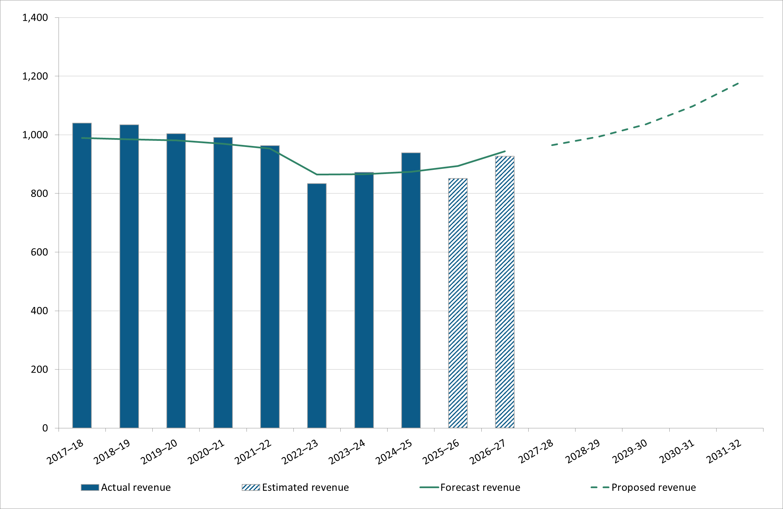
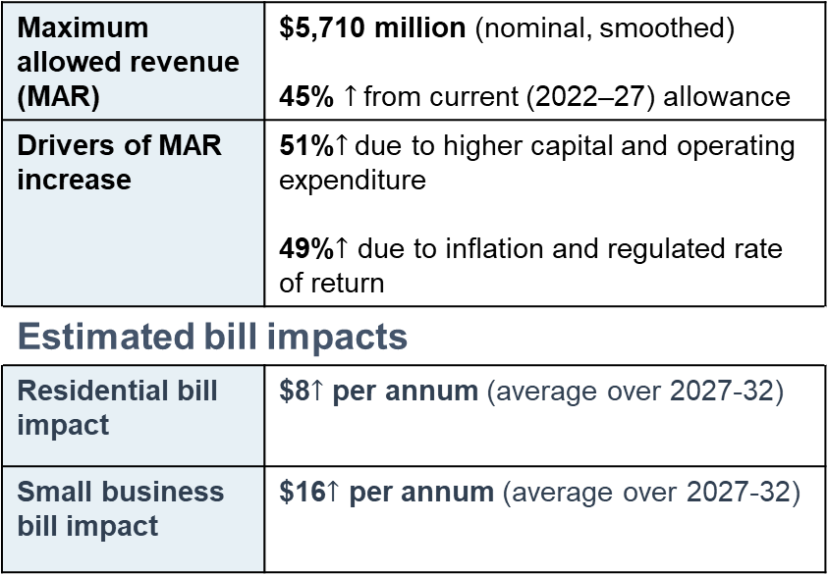
Powerlink’s revenue and bill impacts
Changes in regulated revenue over time ($ million, 2026–27)
Proposed revenue (nominal)
Maximum allowed revenue (MAR) | $5,710 million (nominal, smoothed) 45% $↑$from current (2022–27) allowance
Drivers of MAR increase | 51%$↑$due to higher capital and operating expenditure 49%$↑$ due to inflation and regulated rate of return
Estimated bill impacts
Residential bill impact | $8$↑$ per annum (average over 2027-32)
Small business bill impact | $16$↑$ per annum (average over 2027-32)

Slide 10
Powerlink’s forecast and actual capital expenditure over time
Trend in Powerlink’s forecast and actual capex over time
($ million, 2026–27)
Key capex figures ($2026–27)
Category | Forecast (2027-32) | Difference from 2022-27*
Total capex | $2,499.5 million | ↑ $995 million (66%)
Asset reinvestment (replacement) | $1,674.3 million | ↑ 53.8%
Easements | $295.1 million | ↑ 789.9%
Support the Business | $231.9 million | ↑ 178.1%
Security & compliance | $166.8 million | ↑ 198.4%
*actual/estimated expenditure)

Slide 11
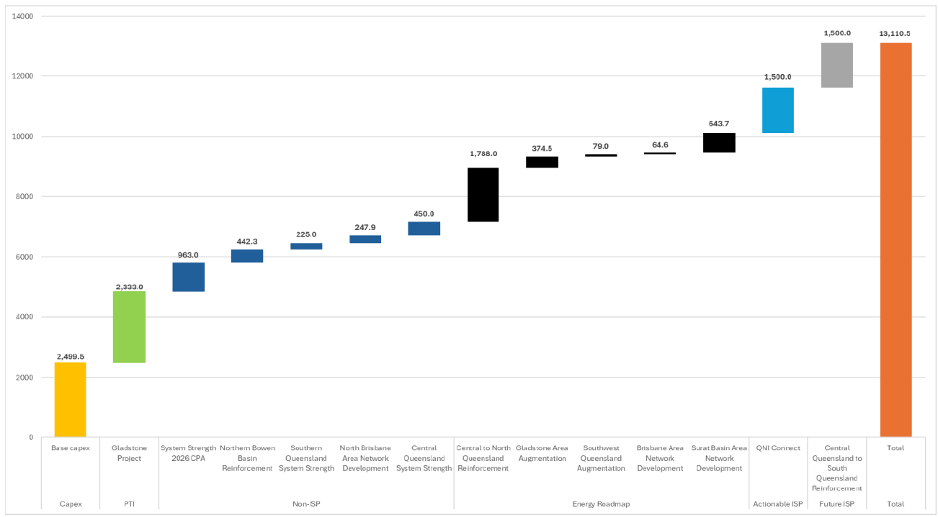
Powerlink’s probable capex over the next 10 years – includes ISP-related and Energy Roadmap capex

Slide 12
Powerlink’s operating expenditure
Comparison of Powerlink’s opex over time ($ million, 2026–27)
Key opex figures
Total opex forecast inc. debt raising costs | $1,832.2 million | $307.7 million (20.2%) ↑ than actual/est.
Drivers of forecast opex increase | Choice of base year (2025–26)
 | Step changes ($85.1 million) (4.6% of total opex) Transition to cloud-based solutions ($60.0 million) Physical security uplift ($16.4 million) Overnight network monitoring ($8.7 million)

Slide 13
Preliminary issues
Prudent and efficient replacement expenditure
Efficient operating expenditure
Current period capex and ex-post review
Contingent projects

Slide 14
RPRG insights
Nardia Yeates
Revenue Proposal Reference Group (RPRG)

Slide 15
Comments to AER Public Forum on Powerlink 2027-32 Revenue Proposal
9 April 2026
Powerlink Revenue Proposal Reference Group (RPRG)
Mark Grenning (Independent Chair)
Robyn Robinson, Council on the Ageing
Chris Hazzard, St Vincent De Paul
Katie Anne Mulder, Queensland Renewable Energy Council
Stephanie McKechnie, Queensland Farmers’ Federation
Nardia Yeates, Aurizon

Slide 16
Revenue Proposal Reference Group (RPRG)
Appointed from the Customer Panel members to provide ‘customer centric’ input to the 2027-32 revenue proposal, designed to…
“Deliver a Revenue Proposal that is capable of acceptance by our customers, the AER and Powerlink.”
Capable of Acceptance Criteria | Customer Panel | AER | Powerlink
Nature of engagement | Yes | Yes | Yes
Breadth and depth | Yes | Yes | Yes
Clearly evidenced impact | Yes | Yes | Yes
Proof point | Optional | Yes | Yes
The role of the RPRG is to…
Assess Powerlink’s proposal against the co-designed Capable of Acceptance criteria.
Prepare a submission on the draft Revenue Proposal.
Prepare a submission on the Revenue Proposal.
{
Better Resets Handbook
Build consumer understanding of expenditure forecast
{

Slide 17
Impact of Challenging Times
CHALLENGES…
RESULTED IN…
LED TO…
FORECAST REAL 2022-27 EXPENDITURE
Significantly above AER allowances.
Opex increase by 20%
Capex increase by 39%
Cost pressures on labour and materials
Increased system complexity with renewal integration
Balancing system reliability and increased renewables
Balancing resilience with significant weather events
Customer focus on affordability and social licensing.
FORECAST REAL 2027-32 EXPENDITURE
Strong RPRG focus on deliverability.
‘On time’/’on budget’ as key issue that the AER highlights.
Significantly above 2022-27 forecast.
Opex increase by 19%.
Capex increase by 66% and significant Regulatory Asset Base (RAB) increase.
Proposed revenue increase by 25% over 2022-27 approval – half due to increased capex/opex, half due to higher inflation/WACC.
Increase in price for residential and small businesses.

Slide 18
RPRG Recommendations and Conclusions
Theme | R-A-G | Notes
Business Environment |  | Informative and well considered analysis of the operating environment challenges. Recommend AER focus on productivity and labour cost pressures.
Customer Engagement |  | Collaborative and in some cases exceeds principles set out in the Better Resets Handbook. Recommend RPRG membership and the role of an independent chair in future revenue resets. Recommend transparency on reporting to Customer Panel.
Capex |  | Recommend review of capex forecasts and estimations. Recommend monitoring of projects outside ex-ante capex. Recommend ongoing monitoring of stranded asset risk.
Opex |  | Credible case for a review of the methodology for calculating output measures in the opex trend component. Recommend review of base year efficiency assessment. Recommend sector wide review on output measures. Recommend monitoring of labour cost assumptions. Recommend clarification of step change materiality thresholds.
Price Path |  | Commendable for transparent price path information. Recommend support for a stable and predictable price path. Recommend transparency for future price scenarios.
Deliverability |  | Powerlink provided extensive information to support their capability of delivering their capex plan. Recommend AER scrutiny of opex and capex programs.
Capable of Acceptance |  | Preliminary conclusion is ‘capable of acceptance’. Evaluation of the proposal continues until final submission.

Slide 19
CCP Insights
Mike Swanston
Consumer Challenge Panel 34 (CCP34)

Slide 20

Powerlink Qld revenue reset 2027-32
Consumer Engagement
Engagement is now occurring in a context of heightened uncertainty. Real cost pressures already being experienced.
Influential in parts:
Price path (smoothing, predictability), proposal transparency and structure and articulation of trade-offs and impacts
Balanced representation:
The RPRG tended to stakeholder representation, with some reg expert members
Genuine and substantive:
The engagement is mature, credible, structured, respectful and well-resourced.
There is limited evidence it has materially constrained costs for consumers
Consumer Challenge Panel 34
Notes:
Slide 1 — Consumer Engagement
Engagement for the 2027–32 reset remains mature, structured, and clearly aligned with the Better Resets framework. This is not a compliance exercise – it is substantive and ongoing.
Powerlink has maintained a strong RPRG process, with early involvement and iterative testing of key issues.
From a customer perspective, the messages are consistent. There is support for maintaining reliability and enabling the energy transition, but a strong constraint on affordability and price predictability.
What is different in this reset is the context. Engagement is now taking place in an environment of known cost escalation and increased uncertainty. This is no longer about optimising a stable cost base – it is about navigating trade-offs under uncertainty.
We see very similar patterns in AusNet’s engagement, which reinforces that this is a sector-wide shift rather than something unique to Powerlink.
Overall, engagement is strong and influential, but it is now being applied in a much more uncertain and cost-pressured environment.

Slide 21
Powerlink Qld revenue reset 2027-32
Areas of challenge
Review of output growth methodology (deferred)
Acknowledging productivity deterioration - improvements are uncertain
Alternative smoothing to reduce volatility, include all price impacts
The potential ultimate capex stack, including ISP and Energy Roadmap
Alternative CESS approach and ‘costs beyond our control’ (not pursued)
Consumer Challenge Panel 34
Notes:
The central issue for this reset is not engagement quality – it is the risks, credibility and efficiency of forecasts and deliverability in a changing environment.
Since the last reset, there have been material increases in labour costs, contractor availability constraints, and supply chain pressures. At the same time, system complexity has increased and delivery risk has become more pronounced.
In the current period, we are seeing opex above allowance in the later years, and benchmarking is suggesting some decline in relative performance. This raises legitimate questions around base year efficiency.
The AER is therefore focusing on a number of key areas: whether the base year is efficient, whether step changes are justified, whether output measures appropriately reflect system complexity, and whether observed productivity trends are real or a function of measurement.
The critical analytical tension is whether these cost increases reflect inefficiency, or whether they are driven by structural and external factors.
The AusNet issues paper highlights very similar themes – rising costs, base year scrutiny, and challenges around step changes. This indicates that the AER is confronting a broader sector-wide shift in cost conditions.

Slide 22
Powerlink Qld revenue reset 2027-32
A challenge for the AER
Powerlink deliberately created “constructive discomfort” in its previous proposal to drive cost discipline and deliver lower prices — a strategy welcomed by consumers but also exposed it to downside risk when conditions changed.
In the previous determination, Powerlink responded to strong engagement signals in the last reset and took genuine steps to constrain costs.
The AER explicitly endorsed the quality of Powerlink’s engagement and importantly, that it drove real outcomes.
Powerlink embraced that engagement- they didn’t just listen; they tightened forecasts and made difficult calls to keep prices down.
With hindsight, that position proved optimistic given cost escalation, and we now see overspend relative to allowance.
The risk now is regulatory - if the AER applies strict ex-post penalties (CESS / opex efficiency carryover) it effectively says, “you should have forecast higher costs.”
That creates a perverse incentive - next reset → businesses pad forecasts, and less ambition to find efficiencies, leading to a more combative regulatory environment and a weaker engagement outcome.
Consumer Challenge Panel 34
Notes:
In the previous determination, Powerlink responded strongly to engagement signals. It tightened its forecasts and deliberately created what it described as “constructive discomfort” to drive internal discipline and deliver lower prices for consumers.
With hindsight, the operating environment changed materially. Costs escalated, and delivery conditions became more difficult. As a result, we now see overspend relative to allowance.
The key question for this reset is how those outcomes are interpreted.
If the AER treats this primarily as inefficiency, that would lead to tighter allowances and potential penalties through mechanisms such as the CESS or base year adjustments.
However, if those outcomes are at least partly driven by exogenous or structural factors, there is a risk of misallocating risk within the framework.
The incentive implications are important. If businesses face downside exposure for factors beyond their control, the rational response will be to adopt more conservative forecasts in future resets, with less willingness to pursue efficiency stretch or respond ambitiously to engagement.
We see the same pattern emerging in AusNet, which reinforces that this is a NEM-wide issue.
If structural cost change is interpreted as inefficiency, the likely outcome is more conservative proposals and higher long-term costs for consumers.
So the task for the AER is to preserve strong efficiency incentives, while recognising the changing cost realities facing the sector.

Slide 23
Next steps in consumer engagement
Darryl Rowell
Interim Chief Executive, Powerlink

Slide 24
Revenue Proposal 2027-32
AER Public Forum
April 2026

Slide 26
Operating environment
Powerlink serves five million Queenslanders, for which the cost of electricity remains a key issue
Never been more important to get the balance right between appropriate investment and minimising price impacts to customers
Operating conditions have changed materially, complexity rising
Workforce and supply chains are under pressure
Expectations for reliability, resilience, security and social licence have increased
AER Public Forum – April 2026

Slide 27

Ongoing Engagement
Co-designed approach with clear engagement scope and evidence of influence on proposal
Prior to lodgement: 12 meetings with Revenue Proposal Reference Group (RPRG)
12 of 35 topics engaged at Involve or above on IAP2 public participation spectrum
Post lodgement:
FEB
MAR
MAY
RPRG meeting
Powerlink outlines Revenue Proposal positions
Customer Panel meeting
RPRG has indicated the proposal is capable of acceptance subject to wider Customer Panel input
RPRG meeting
Identify future engagement, e.g. deliverability, base year efficiency, priority transmission investments and system strength projects.
AER Public Forum – April 2026

Slide 28
Facilitated Discussion
Lynne Gallagher
AER Board Member

Slide 29
Next Steps
Milestone | Date
Regulatory proposal submitted to the AER | 30 January 2026
AER published an issues paper | 30 March 2026
AER holds a public forum | 9 April 2026
Submissions on regulatory proposals close | 13 May 2026
AER publishes draft determination decision | 30 September 2026*
AER holds a pre-determination conference | October 2026*
Revised regulatory proposal submitted to AER | 2 December 2026*
*Timings are indicative)

Slide 30

Submission details
We invite interested parties to make submissions on the Issues Paper by 5pm AEST, Wednesday, 13 May 2026.
Submissions should be emailed to
AERresets2027-32@aer.gov.au

