Slide 1
Rainfall overlay for 2025 North Coast Weather Event
OFFICIAL
OFFICIAL

Slide 3
North Coast Weather Events
Background
From March to May 2025, a sequence of weather events, including Cyclone Alfred and subsequent localised flooding across the Hunter and Mid-North Coast, impacted a significant portion of assets within Essential Energy’s distribution network.
Cyclone Alfred delivered substantial precipitation in early to mid-March. In the period that followed, east coast catchments recorded cumulative rainfall in the order of 300–400 mm over the subsequent two months. These sustained conditions coincided with elevated soil moisture levels across affected catchments.
In mid to late May, further low-pressure systems resulted in flooding across parts of the network, contributing to additional faults and restoration activities.

Slide 4
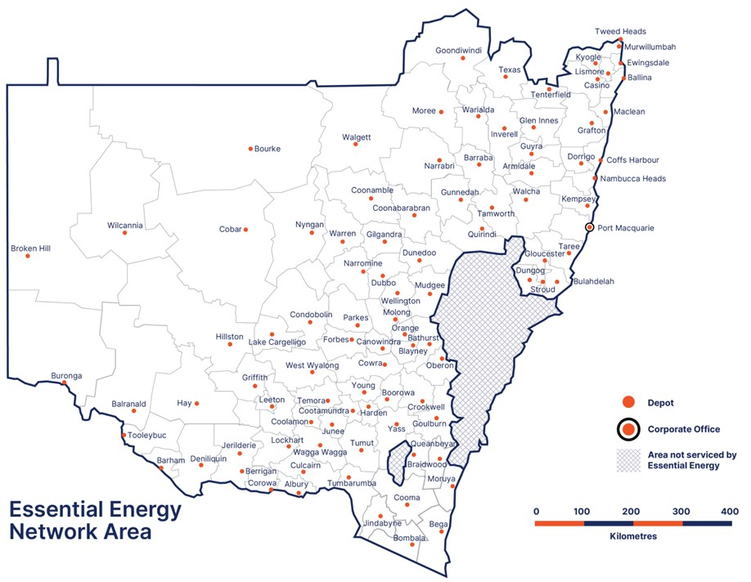
We call this the Venn diagram of the impact of the events from both a rainfall and soil moisture perspective
Area impacted by TC Alfred
Area impacted by flooding

Slide 5
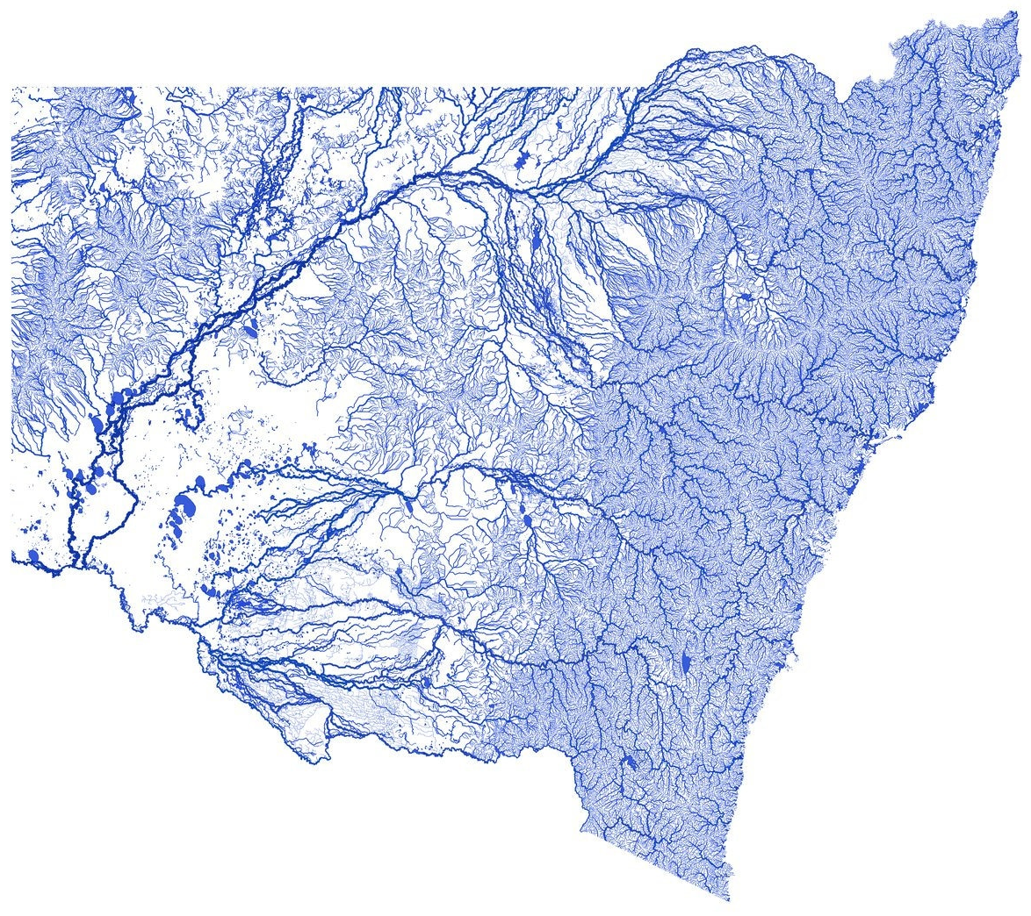
Weather events- combined, river catchment overlay

Slide 6
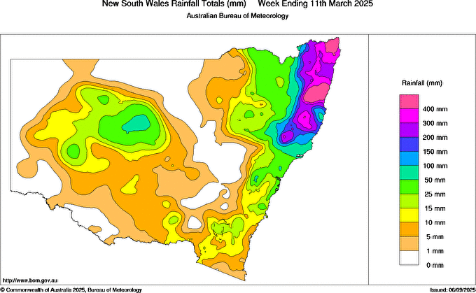

Slide 7
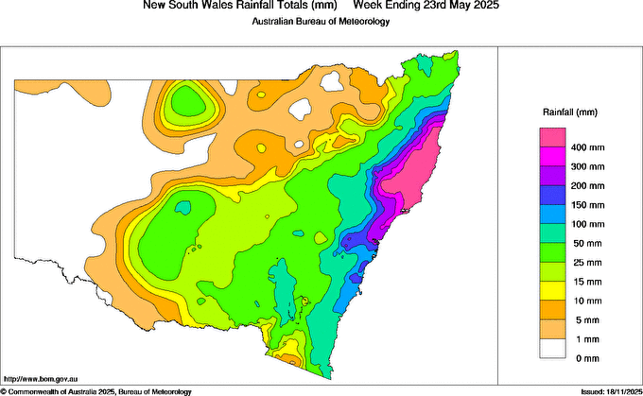

Slide 8
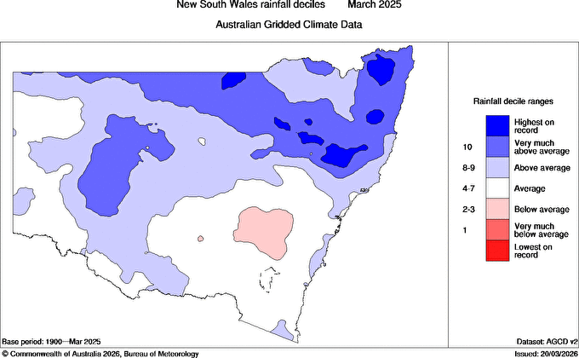
NSW Rainfall Decile Summary
Example of one set of metrics used internally, anomaly's, soil moisture & difference year on year were also mapped
Rainfall Decile description recorded by BOM for NSW. For the North Coast the Data shows:
March 2025 (BOM Data) –
highest on record & very much above average
April 2025 (BOM Data) –
very much above average & above average
May 2025 (BOM Data) –
highest on record & very much above average

Slide 9
NSW Rainfall Decile – March 2025 (BOM Data)

Slide 10
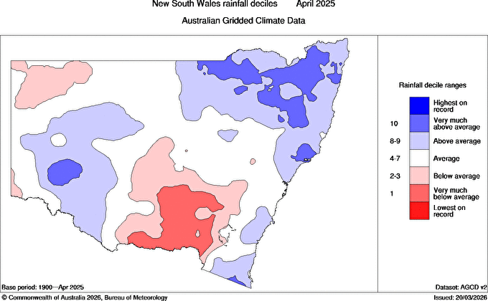
NSW Rainfall Decile – April 2025 (BOM Data)

Slide 11
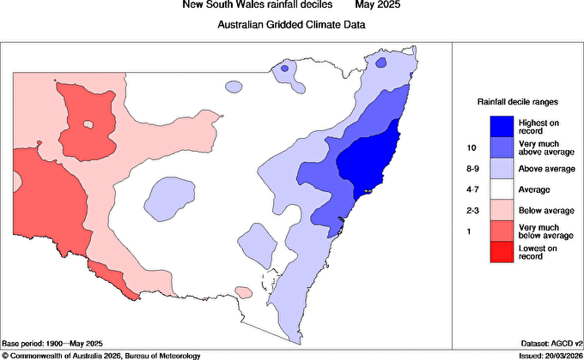
NSW Rainfall Decile – May 2025 (BOM Data)

Slide 12
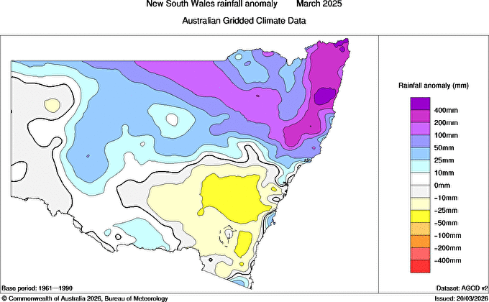
NSW Rainfall Anomaly Summary
Rainfall anomalies recorded by BOM for NSW. For the North Coast the Data shows:
March 2025 (BOM Data) –
Mainly 100mm-400mm rainfall
April 2025 (BOM Data) –
Mainly 50mm-100mm rainfall
May 2025 (BOM Data) –
Mainly 50mm-400mm rainfall

Slide 13
NSW Rainfall Anomaly – March 2025 (BOM Data)

Slide 14
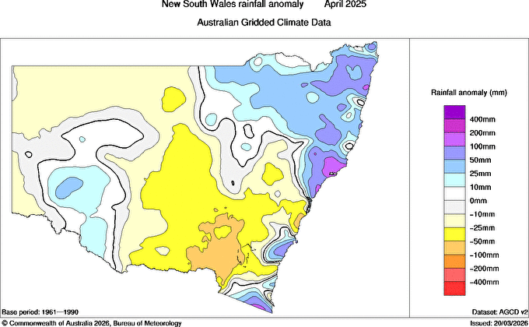
NSW Rainfall Anomaly – April 2025 (BOM Data)

Slide 15
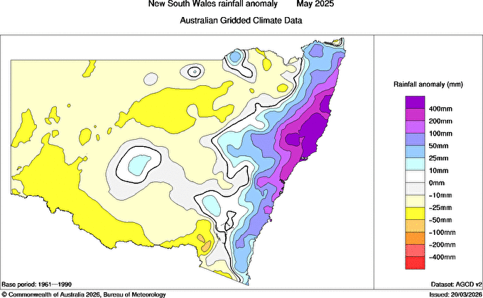
NSW Rainfall Anomaly – May 2025 (BOM Data)

Slide 16
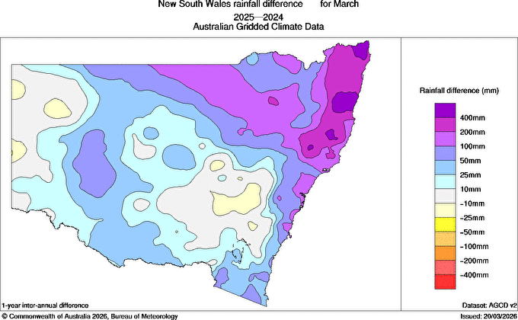
NSW Rainfall Difference 2024-2025 Summary
Rainfall difference for 12 months period prior recorded by BOM for NSW. For the North Coast the Data shows:
March 2025 (BOM Data) –
Mainly 100mm-400mm increase
April 2025 (BOM Data) –
Mainly 0mm-100mm increase
May 2025 (BOM Data) –
Mainly 50mm-400mm increase

Slide 17
NSW Rainfall Difference – March 2024-25 (BOM Data)

Slide 18
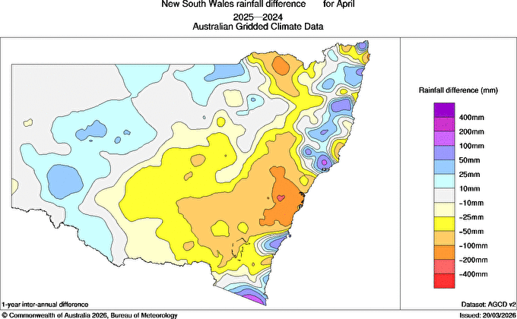
NSW Rainfall Difference – April 2024-25 (BOM Data)

Slide 19
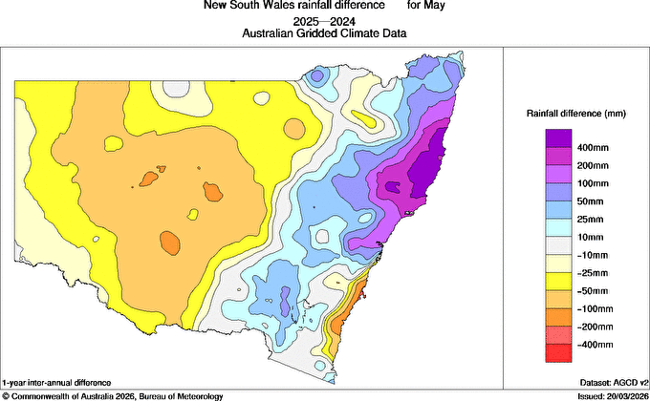
NSW Rainfall Difference – May 2024-25 (BOM Data)

Slide 20
NSW Root Zone Soil Moisture Summary
Root Zone Soil Moisture percentile rank recorded by BOM. For the North Coast the Data shows:
March 2025 (BOM Data) –
Very much above average & above average
April 2025 (BOM Data) –
Highest 1% & very much above average
May 2025 (BOM Data) –
Highest 1% & very much above average

Slide 21
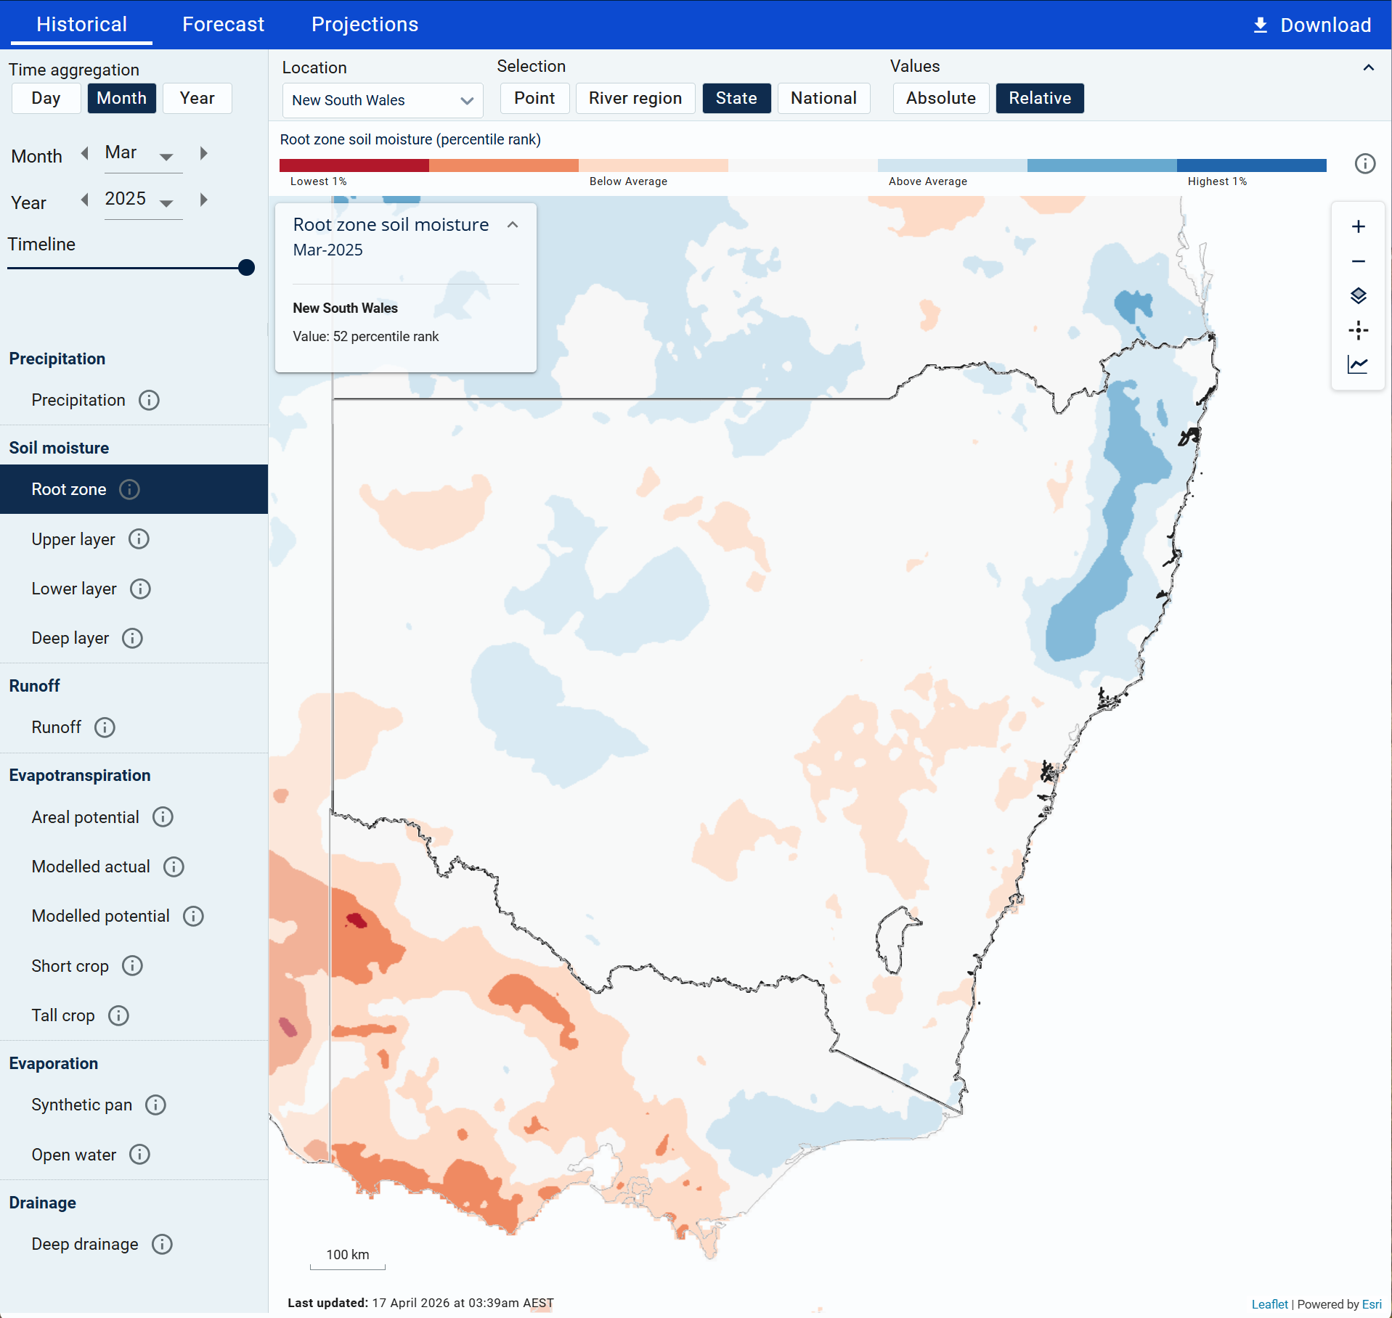
NSW Root Zone Soil Moisture – March 2025 (BOM Data)
https://awo.bom.gov.au/products/historical/soilMoisture-rootZone/6.5,-33.346,148.103/st,-32.247,147.426/r/m/2025-03

Slide 22
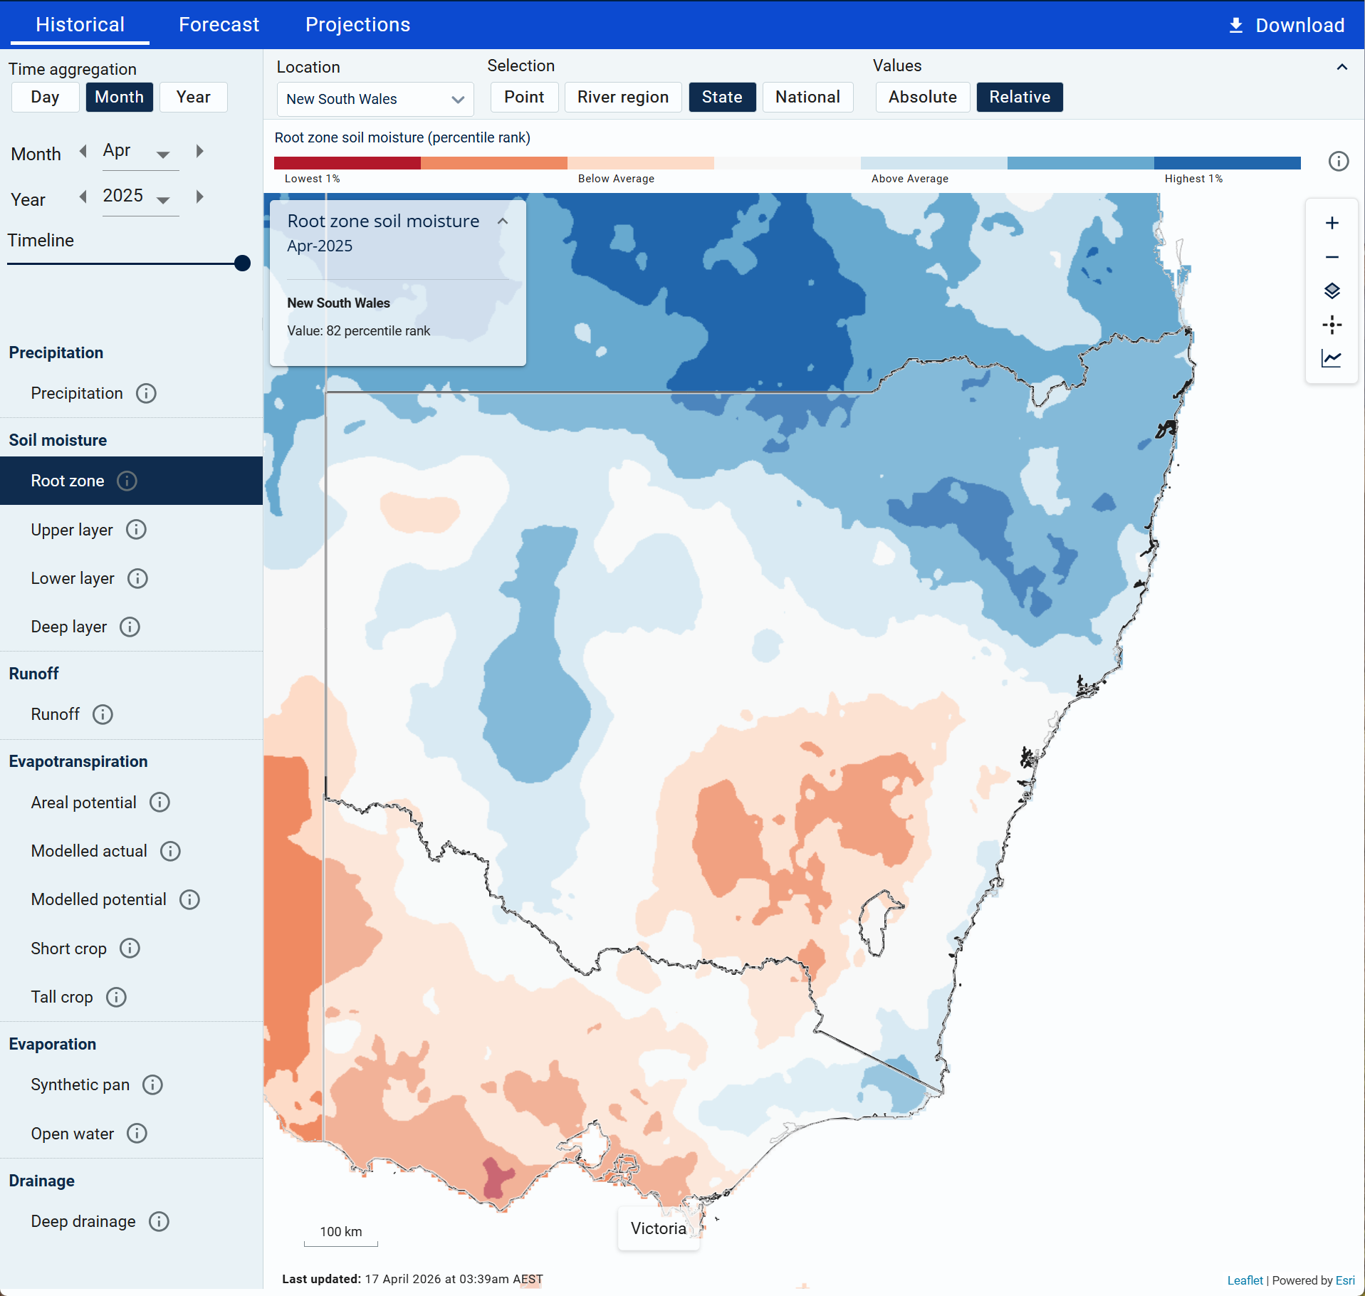
NSW Root Zone Soil Moisture – April 2025 (BOM Data)
https://awo.bom.gov.au/products/historical/soilMoisture-rootZone/6.5,-33.346,148.103/st,-32.247,147.426/r/m/2025-04

Slide 23
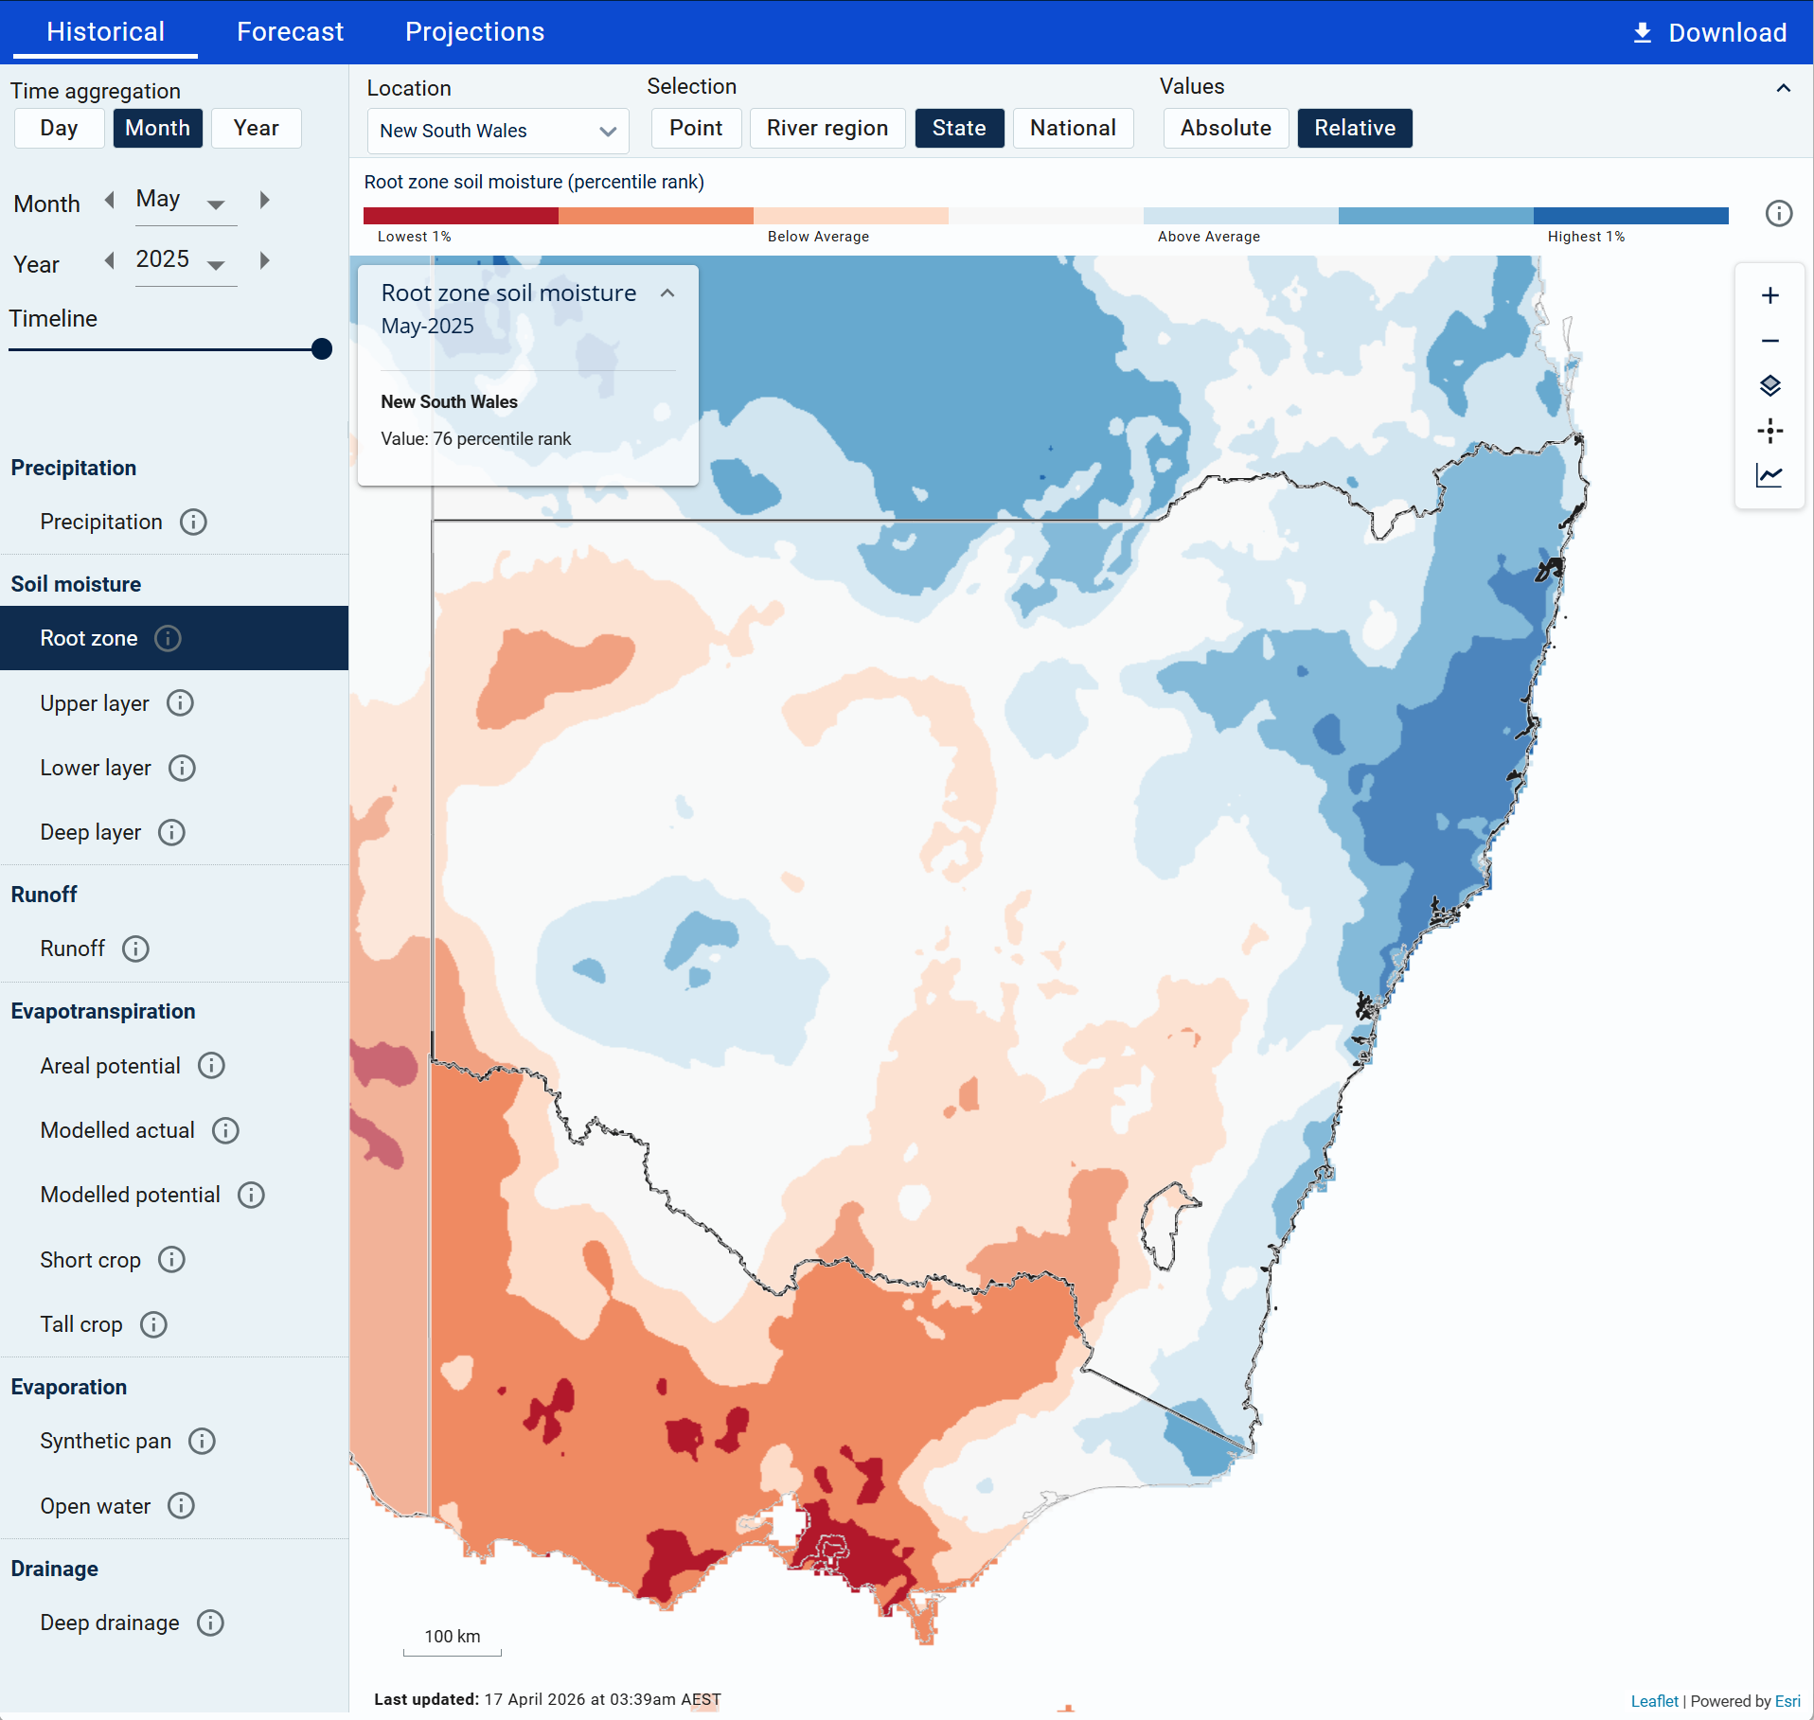
NSW Root Zone Soil Moisture – May 2025 (BOM Data)
https://awo.bom.gov.au/products/historical/soilMoisture-rootZone/6.5,-33.346,148.103/st,-32.247,147.426/r/m/2025-05

Slide 24
Firstname Lastname
Job title
name.lastname@essentialenergy.com.au

