Slide 1
An Overview of
Our Regulatory Proposal
2015-2020

Slide 2
Today’s topics
Ergon Energy
and our service commitments
Our progress, the challenge ahead and how we compare
The price
impact
Our
investment
plans
Questions

Slide 3
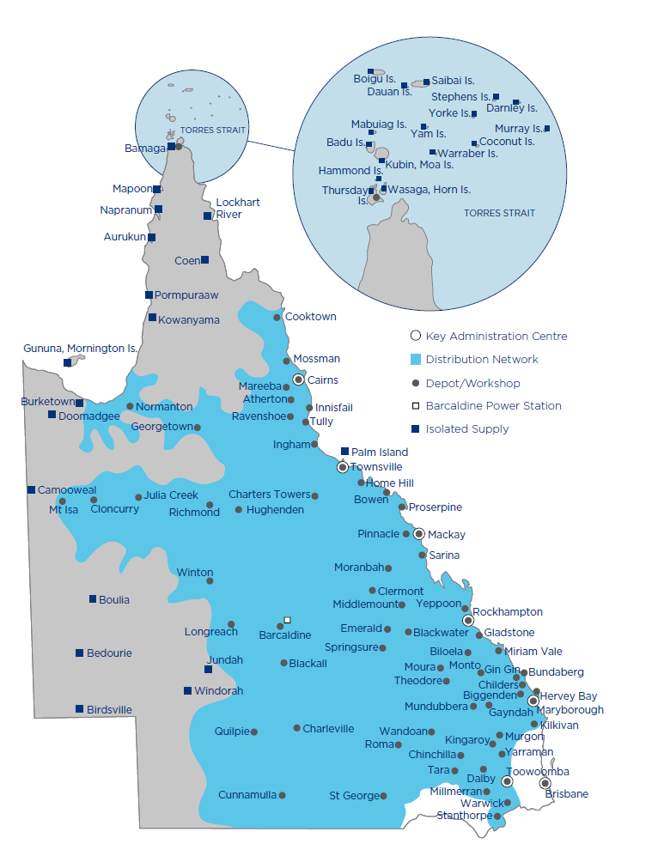
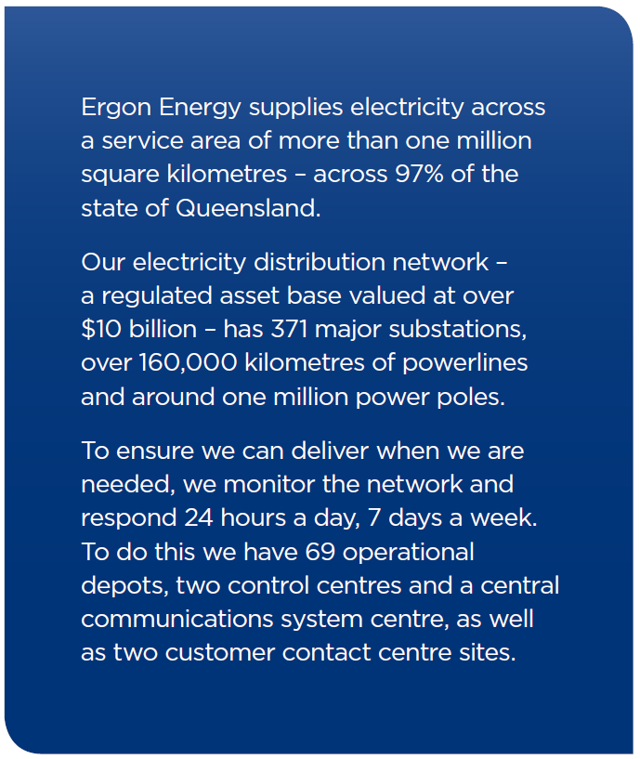
Ergon Energy’s network

Slide 4
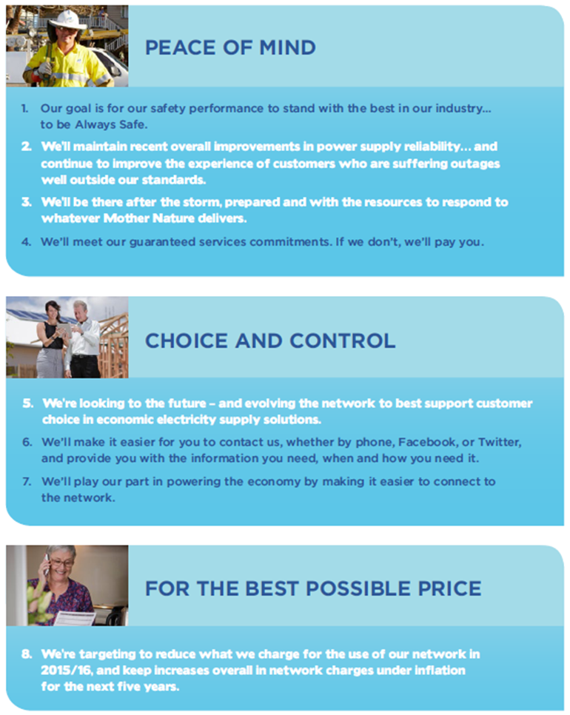
Ergon Energy’s Drivers…
Our Vision:
“To be a High Performance, Customer-Driven, Energy Business”
Our Purpose:
“To provide safe, reliable, efficient and sustainable energy solutions to support our customers and the Queensland economy”
Our Values:
“Success is built on our values of Safety, Professionalism, Integrity, Respect, Innovation and Teamwork – SPIRIT”
Our Customer Commitments:

Slide 5
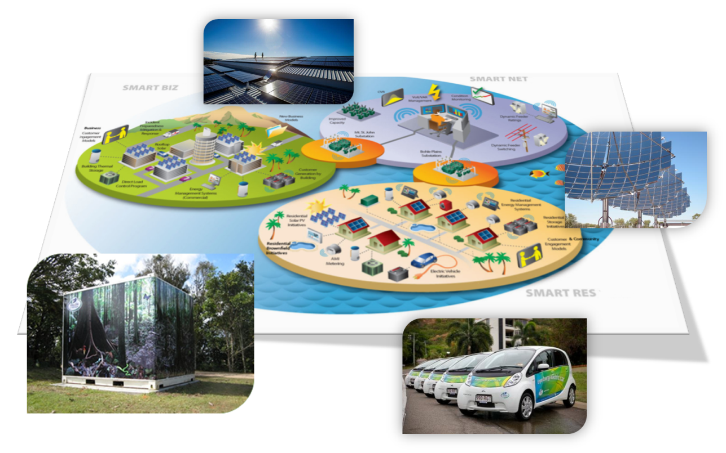
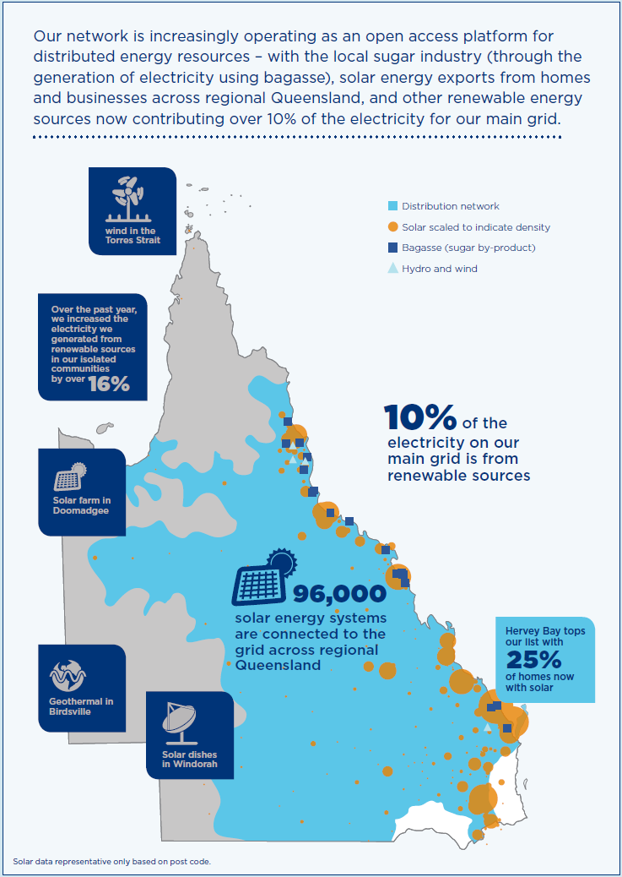
Ergon Energy’s Strategy…
To keep average Network Price Increases below Inflation
To improve network productivity through tariff reform.
To develop an Open Access Platform that enables an equitable and Effective Market for energy, demand, storage, information, control and services.
To deliver Efficient Services.

Slide 6
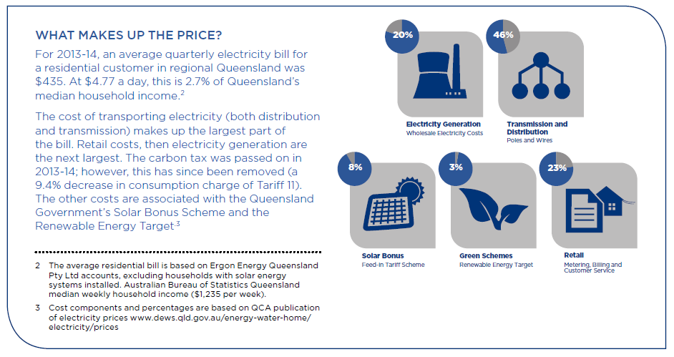
What makes up the price?

Slide 7
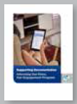
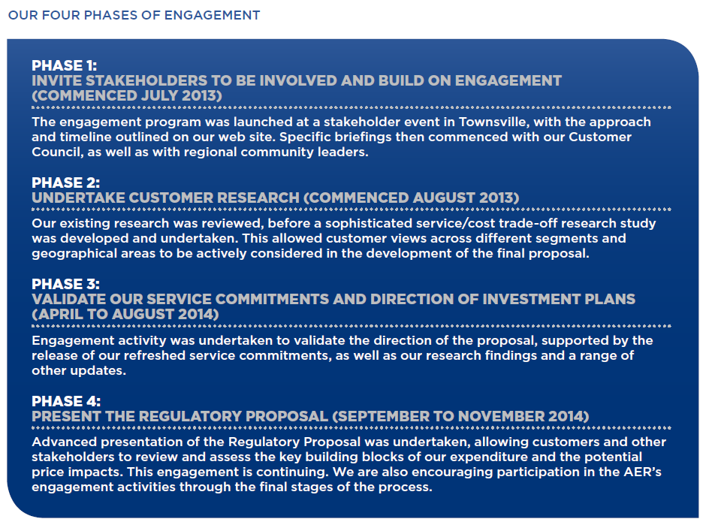
Listening to our customers

Slide 8
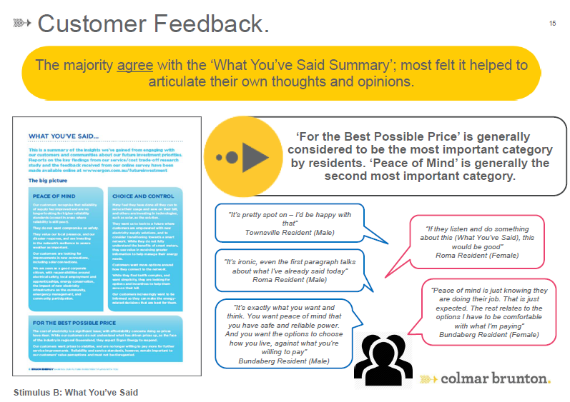
What our customers said about our Customer Commitments

Slide 9
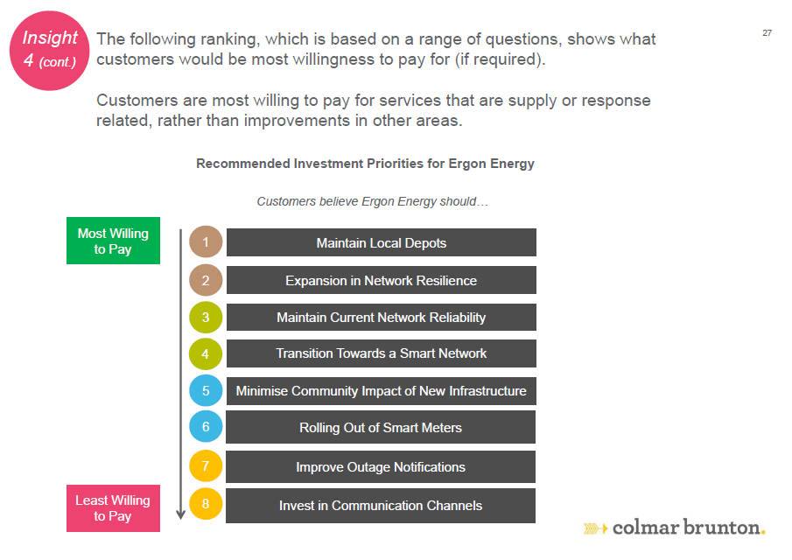
Customer Segments – Willingness to Pay
Residential/Business Cost Trade Off Research

Slide 10
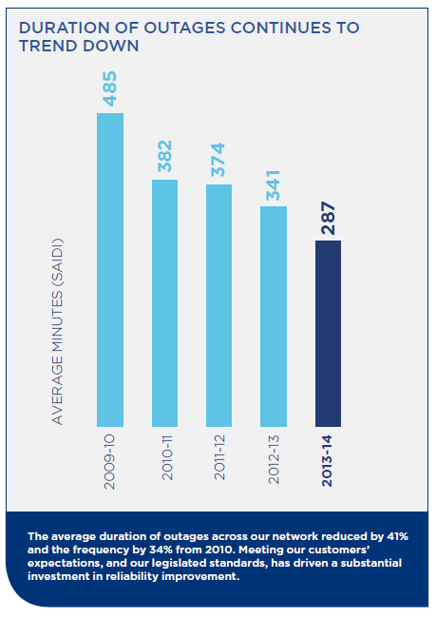
Our progress, the challenge ahead
In 2004 the EDSD Review led to
reliability standards that became
increasingly stringent & higher security standards, both of which drove investment up.
Over the last five years the performance of the network has significantly improved.
In 2014 – for the first time since 2008 – we achieved all six reliability performance targets within the Minimum Service Standards.

Slide 11

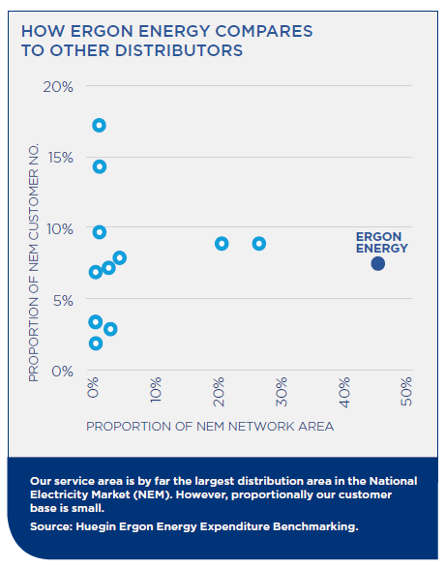
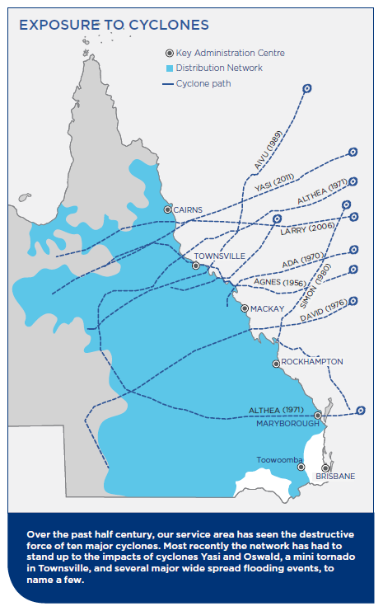
How Ergon Energy compares

Slide 12
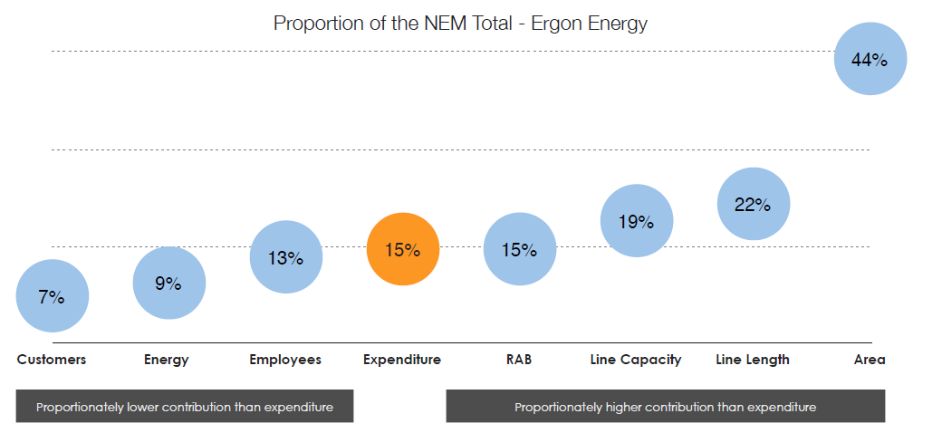
How Ergon Energy compares across the NEM

Slide 13
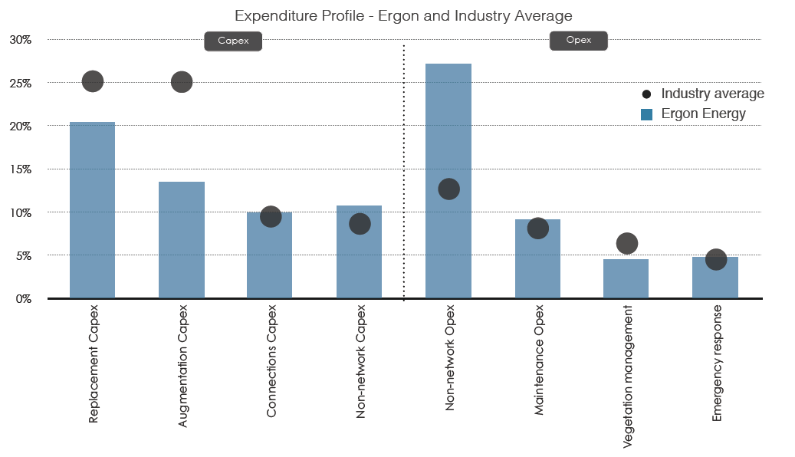
How our expenditure profile compares

Slide 14
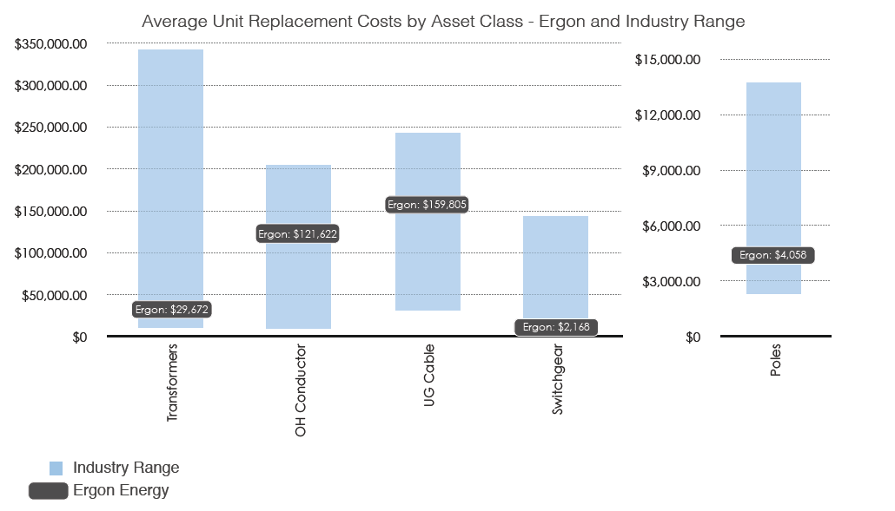
How our unit replacement costs compare

Slide 15
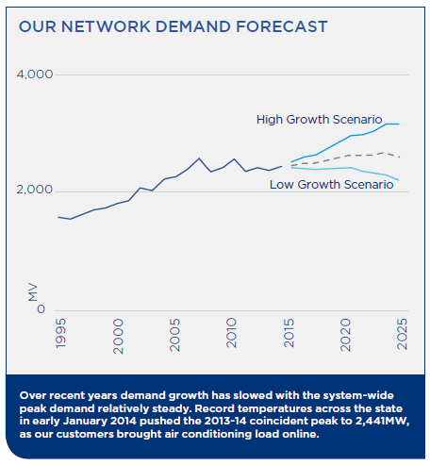
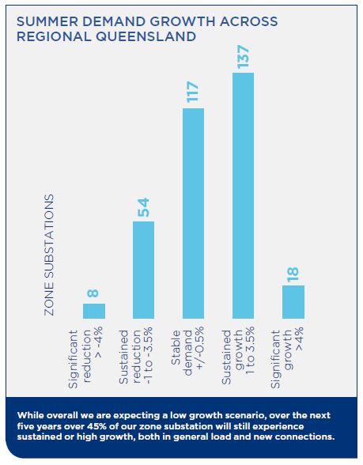
A changing growth scenario
Our submission is based on a low growth scenario, but there is political drive for change:
The Queensland Plan targets a doubling of regional Queensland’s population in 30 years.
Northern Australia White Paper in progress. Objectives:- Set out a clear, well-defined and timely policy platform for promoting the development of Northern Australia.

Slide 16
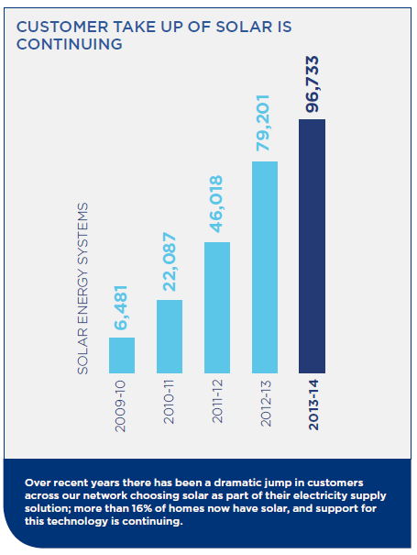
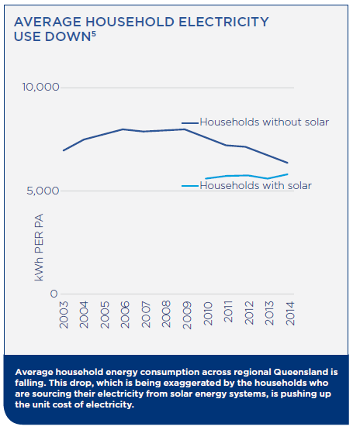
A changing industry and marketplace
Distributed Roof Top PV on over 21% of stand-alone houses
Estimated 2010-15 FIT & associated costs = $413m.
Estimated 2010-15 SRES costs = $280m

Slide 17
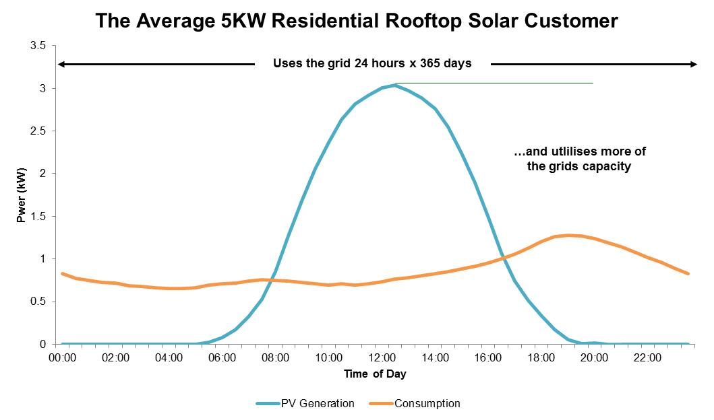
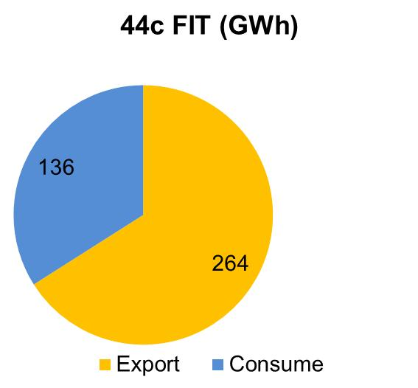
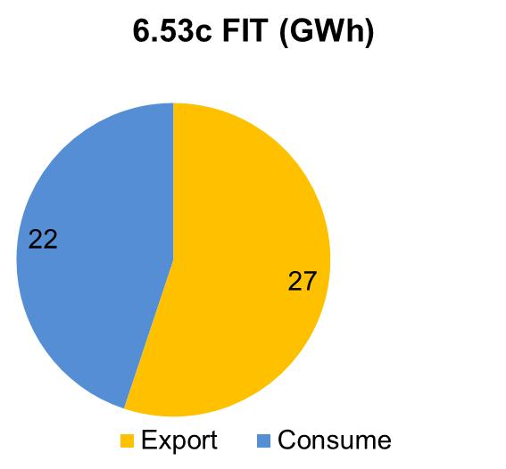
How Clean-Tech is integrated to benefit all is critical
Distributed roof top solar supplies 2.1% of the energy traded in the grid, plus owners self consume approximately 1.15% above total grid fed energy.
High residential Feed In Tariffs have increased grid costs as 44c customers change behaviour by moving more load into the evening, adding to the peak for predominantly evening peaking substations.
Residential Solar PV is now a key driver for sizing infrastructure in residential subdivisions

Slide 18

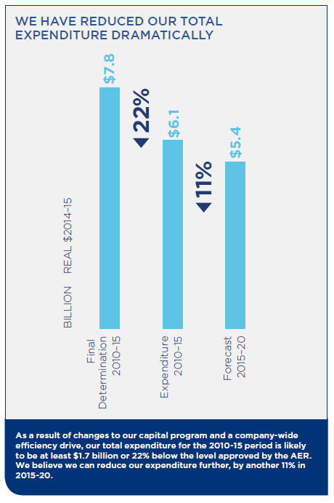
We have taken action to address affordability
In 2011, Ergon Energy adopted a strategic goal to limit increases to average network charges to less than the CPI over the medium to longer term.
Our focus has been on driving efficiencies and effectiveness, and ensuring prudent investment.
If we had not acted, and finance costs had not fallen, our customers would have been facing another substantial increase in network charges of over 12% in 2015-16.

Slide 19
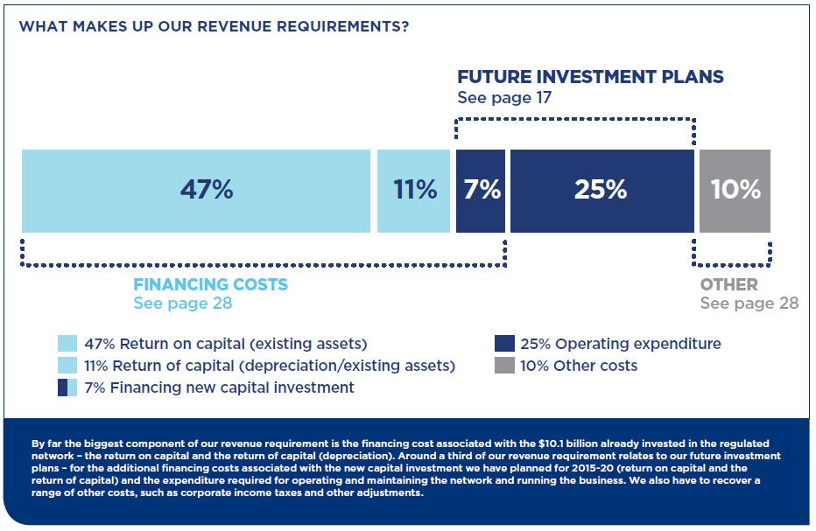
How our plans impact our revenue requirement

Slide 20
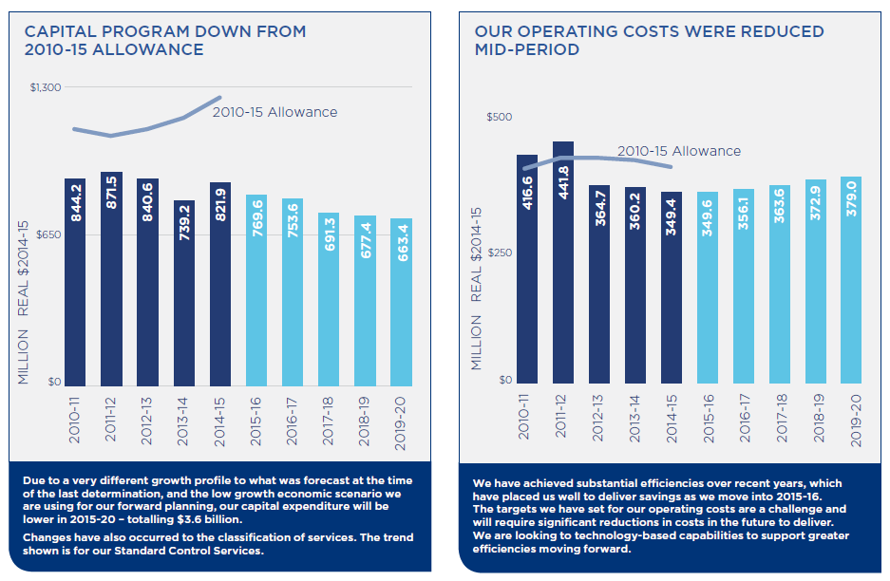
Our journey to the best possible price …
Capital reduced due to falling demand for energy & connections, demand management deferring/avoiding $664m and new security standards in 2012 & 2014. Cyclone Yasi costs not passed through.

Slide 21
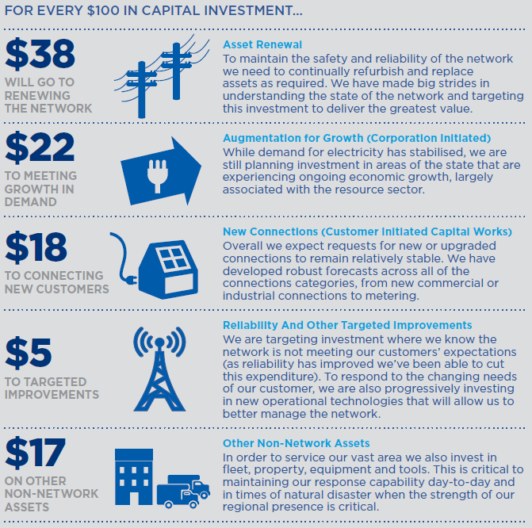
Where we plan to invest … Capex
In 2015-20 we are seeking a capital
investment allowance of $3.6 billion to build and renew the poles and wires, and other assets.

Slide 22
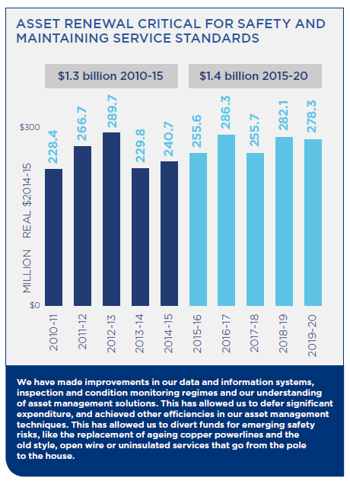

Maintaining reliability and safety performance…
With affordability such a significant issue, and given our improved performance, we have cut our reliability improvement investment.
Safety drivers account for 30% of our proposed asset renewal spend
Replacing assets nearing end of functional life accounts for 70% of our proposed asset renewal spend
We have allocated expenditure to address the performance of up to 45 feeder lines that are consistently underperforming.
We are targeting investment into operational technology and other
improvement initiatives
like protection devices
and network resilience
(spreaders).

Slide 23
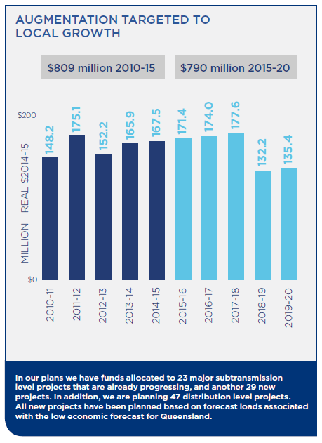
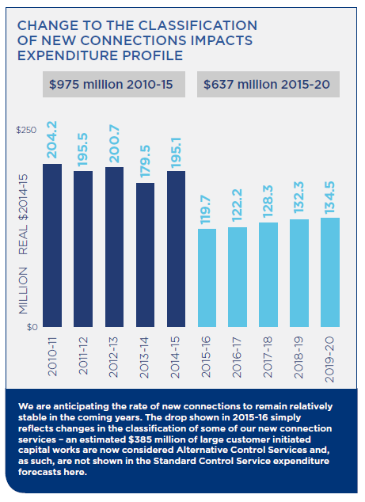
Meeting demand for Standard Control Services

Slide 24
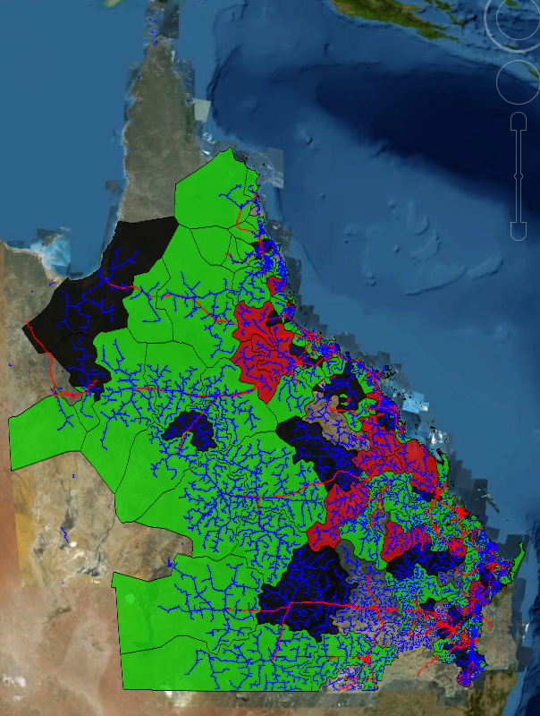
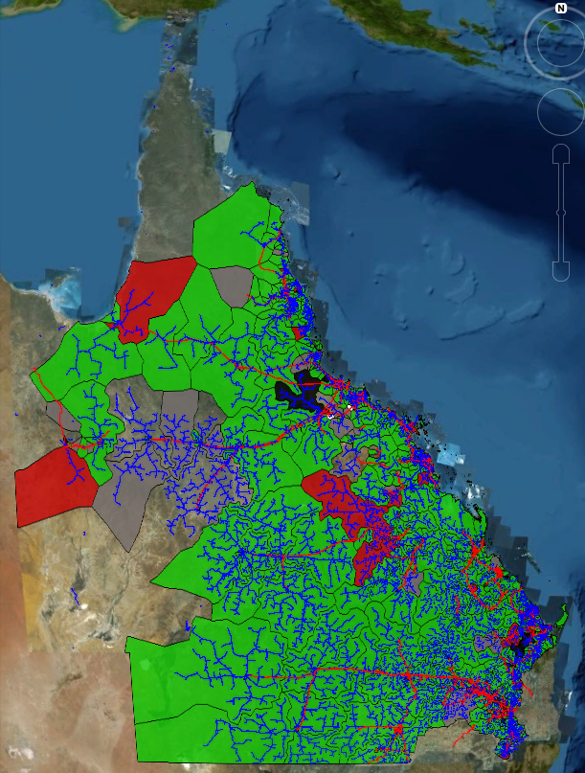
Managing Demand – Demand Response Incentives
Zone sub - capacity
and
Feeder - capacity
Note: data validation under way to ensure visualisation is accurate, i.e capacity constraints have not been verified

Slide 25
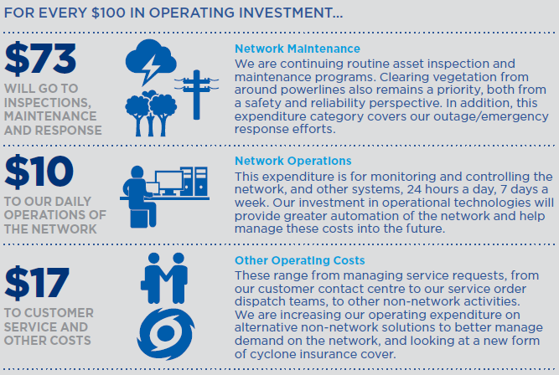
Where we plan to invest … Opex
In 2015-20, for our day-to-day operating
investment we are seeking $1.8 billion.

Slide 26
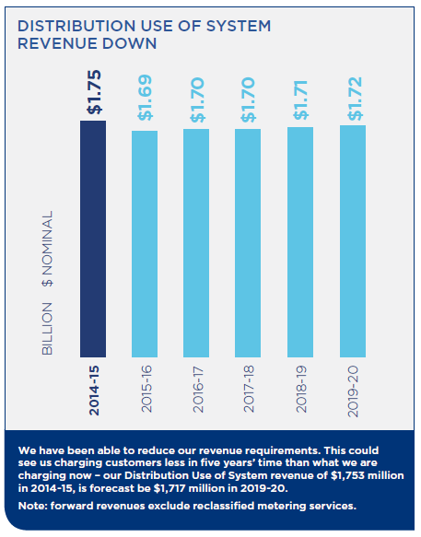
Distribution revenue is forecast to go down
We are forecasting our distribution revenue
to fall, with increases under inflation.
This could mean we are charging customers less in 2019-20 than today.
The $1,717 million forecast for 2019-20 is lower than our anticipated 2014-15 revenue of $1,753 million.

Slide 27
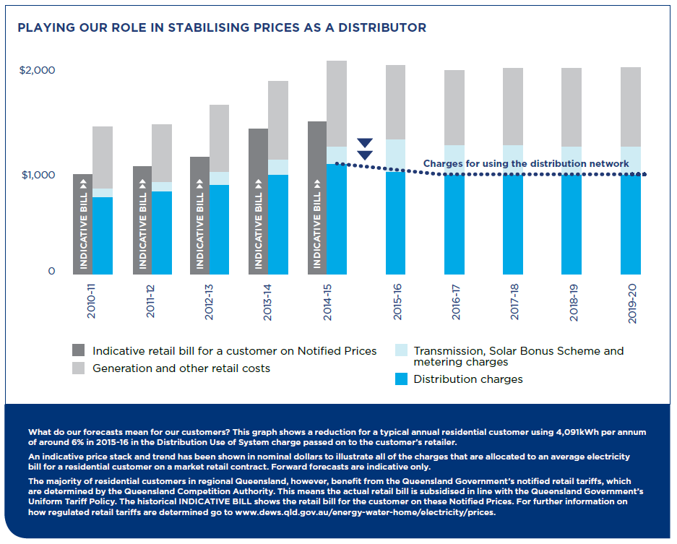
A typical residential customer

Slide 28
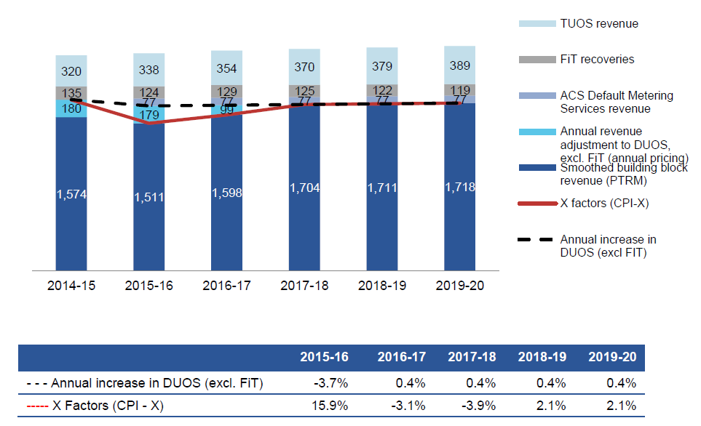
Aggregate expected network charges:
Placeholder WACC = 8.02%
MILLIONS NOMINAL $

Slide 29
The document library
A suite of documents are available for
you to access on our web site:
www.ergon.com.au/futureinvestment

Slide 30

Thank You
Our 2015-20 regulated revenue submission enables us to meet our Customer Commitments

