Slide 1
Public Forum
10 December 2014
SAPN Regulatory Proposal 2015-2020
Bev Hughson
Consumer Challenge Panel Member

Slide 2
Some key things to consider in SAPN’s Proposal
WACC: Is the WACC of justified given the risks of the network business?
Tax allowance & imputation credits?
Are the forecasts of energy and demand reasonable?
Is the capex proposal adequately justified?
  Efficient? Prudent?
Is the opex proposal adequately justified?
  Efficient? Prudent
Was the customer engagement effective?
Incentives
Tariff Strategy
Metering
Public Lighting

Slide 3
The past paradox! The future dilemma?
GWh
$M 2014-15
Volumes declined from 2009-10 to 2014-15 at a rate greater than forecast; a total reduction of 9%.
Revenue increased from 2009-10 to 2014-15, at at rate greater than forecast; a total of almost 50% in real $ terms.
 | 2014-15 | 2015-16 | 2016-17 | 2017-18 | 2018-19 | 2019-20
Volumes (% change) | 10,418 (GWh) | 0.9% | 0.2% | -0.6% | -0.2% | -0.2%
Revenue (% change) | 918.7 ($M real) | -4.3% | 0.0% | 0.0% | 0.0% | 0.0%
Source: AER SAPN Issues Paper (Fig 1 & 4). SAPN Proposal Tables 12.1 & 29.1 for 2014-15 estimates

Slide 4
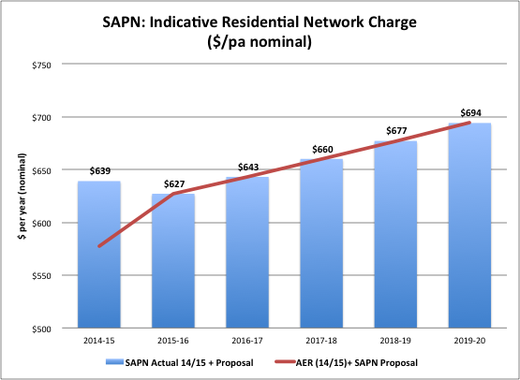
The starting point makes a difference!
-2%
+8%
Source: Forecast SAPN revenue from SAPN proposal, Table 29.4, p 354; the 2014-15 residential allowed revenue estimated from AER, Issues Paper, Figure 1, p 10 (ratio of allowed and actual total revenue).

Slide 5
Is this additional capex reasonable?
$M 2014-15
Total capex increase of 51.7% to $2.5B
Source: AER, SAPN Proposal, Issues Paper, Figure 2, p 12

Slide 6
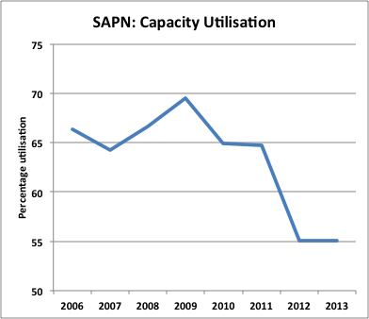
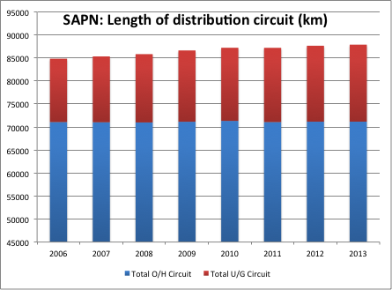
The past paradox: A network that’s not growing much and has declining utilisation
Source: SAPN Economic Benchmarking RIN (Public), June 2014

Slide 7
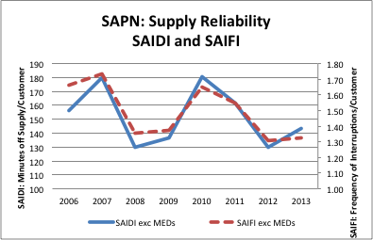
And network reliability is relatively sound
Source: SAPN Economic Benchmarking RIN, Public, June 2014

Slide 8
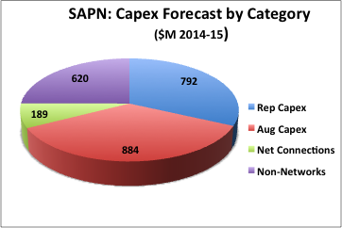
How does SAPN propose to spend $2.5 billion capex?
Source: SAPN Proposal Table 20.4

Slide 9
Overall trends in SAPN capital expenditure
$M 2014-15
Non-network capex is also doubling – with new IT systems main driver (total IT $354M)
NB: “Connections” includes customer contributions. Net connection expenditure is $189M over 5 years
Source: AER, SAPN Issues Paper, Figure 3, p 14. Net connections from SAPN Regulatory Proposal Table 20.40, p 230; IT expenditure from SAPN Regulatory Proposal, Table 20.42, p 235. All costs in $M 2014-15.

Slide 10
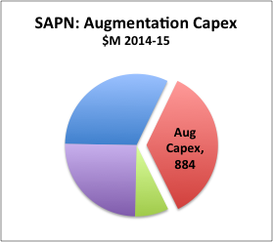
Augmentation Capex: Is this proposal justified?
Current RCP:
  $610M actual spend ($Nom)
  $841M AER allowed ($Nom)
Changes:
  Demand augex down by half
  Safety augex up (* 19)
Drivers: SAPN says:
  Peak demand growth flat
  Bushfire risk increasing
  Victorian bushfire royal commission
  Undergrounding assets
  Feedback from consumers
Source: SAPN Regulatory Proposal, Attachment 20.6

Slide 11
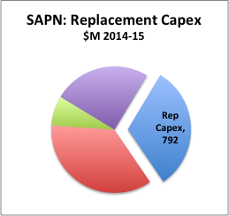
Replacement capex: Is it catch-up or gold plating?
Current RCP (2010-2015):
  $382M actual spend
  $239M AER allowed
SAPN states:
  Comply with external acts, regulations, codes & Guidelines
  Comply with SRMTMP (approved by OTR/ESCOSA)
  Increased inspection, increased # of defects identified
    In discussions with OTR re SRMTMP
  Replace before fail approach (risk based approach)
    Maintenance Risk Value (MRV): probability of failure & severity of defect
    High Corrosion & bushfire regions
    Return to “normal” risk levels
  Feedback from consumers

Slide 12
Building in a Structural Problem
$M Nom
Source: AER, SAPN Issues Paper, Figure 5, p 16.

Slide 13
SAPN’s Opex Increases: Are these justified?
$M 2014-15
Total opex = $1,554M
Total Opex = $1,100M
Source: AER, SAPN Issues Paper, Figure 6, p 18

Slide 14
Opex: the “base – step – trend” approach
Defining the base year: 2013-14
  Is this an efficient base year?
Adjusting the base
  Have special factors in 2013-14 been removed?
Taking the steps
  These are increases in 2015-16 above base year
  Are these reasonable?
  Are their savings as well as costs?
Identifying the trends
  Cost increases above/below CPI?
Adding other factors
  The catch all…

Slide 15
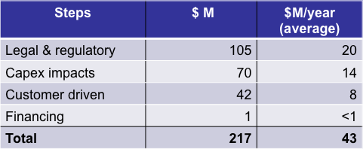
Base - Step - Trend
SAPN claims step increases of $217M ($2014-15) over the base year - i.e about $43M per year:
  Significant increases in regulatory compliance costs
  Greater opex arising from increased capex
  Customer expectations for vegetation management, services & safety (increased vegetation management $31.9M)
($2014-15)
Source: SAPN Proposal, Table 21.3, p 256.

Slide 16
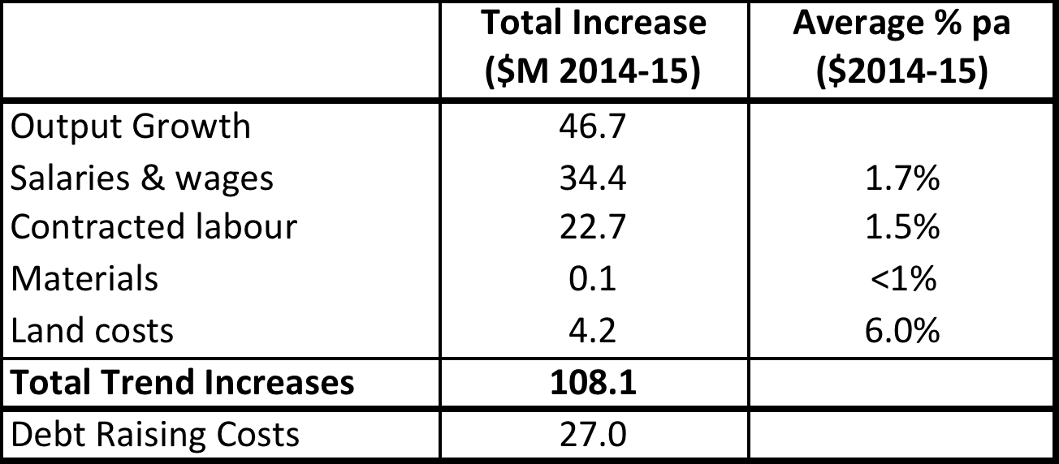
Base - Step - Trend
The opex trends across the forecast regulatory period:
Productivity adjustment:
  SAPN states this should not be applied
  i.e. efficiencies are already built into proposal
Source: SAPN Regulatory Proposal, Tables 21.9, 21.12, 21.13, 21.14, 21.15, 21.16.

Slide 17
Consumer Engagement (CE) –What role does it play?
Pros…
Cons…
Customer Consultative Council
Customer Satisfaction Measures
Customer Engagement Program (2012):
  Align with CE standards
  Covers all customer sectors
  Includes hardship customers
  Qualitative & quantitative
  Face 2 Face, Internet
  Independent consultants
  Willingness to Pay research
  Directions & Priorities
Feedback to CCP
  Cost/price implications not clear to participants
  Concern with cost of program itself
  Is sample indicative of population
  Option of price reductions not explored adequately, i.e.
  Ignores option of achieving same outcome with less input, ie:
    Pay more for more
    Same for same
    Less for less
Is CE sufficiently mature to justify increased expenditures?

Slide 18
QUESTIONS FOR CONSUMERS
Should SAPN have applied the AER’s Guidelines when proposing the WACC & the tax imputation credit adjustment?
Is SAPN’s overall revenue proposal reasonable, particularly given the big increases allowed in past 5 years, plus over-recovery
Is the demand forecast reasonable?
Is the capex proposal reasonable
  Do you accept SAPN’s arguments for higher augmentation, replacement, and non-network investment
Is the opex proposal reasonable?
  Do you accept SAPN’s arguments for higher real $ expenditures in vegetation management & regulatory compliance
  Do you accept real $ trend increases in labour/contractor costs
Does SAPN’s consumer research provide sufficient justification for additional expenditure on safety and vegetation management?

