Slide 1
Victorian transmission Connection point FORECASTs
15 July 2015
Louis Tirpcou, LINTON CORBET, Peter Young

Slide 2
Methodology
Historical trend of weather-corrected demand
Post-model adjustments made for EE and PV.
Reconciliation to 2015 NEFR.
  Methodology paper available on AEMO website
Prepare data
Weather-normalise
Time trend
Baseline forecast
Post model adjustments
Reconcile to system forecast
Notes:
Refer to PV-specific slides at end of presentation.

Slide 3
Methodology
New since VIC 2014:
Pooling data, increases consistency in weather-normalisation.
Improved PV generation estimates using a model built by University of Melbourne and AEMO, and method to incorporate time of day.
Non-linear historical trends accommodated.
Forecasting based on physical network configuration

Slide 4
Methodology
Related NEFR 2015 methodology updates
Separate uptake rates for commercial and residential solar PV
Sensitivity analysis for energy storage (not incorporated into main connection point forecast)

Slide 5
Methodology in detail
Non-linear time trends
Rooftop PV

Slide 6
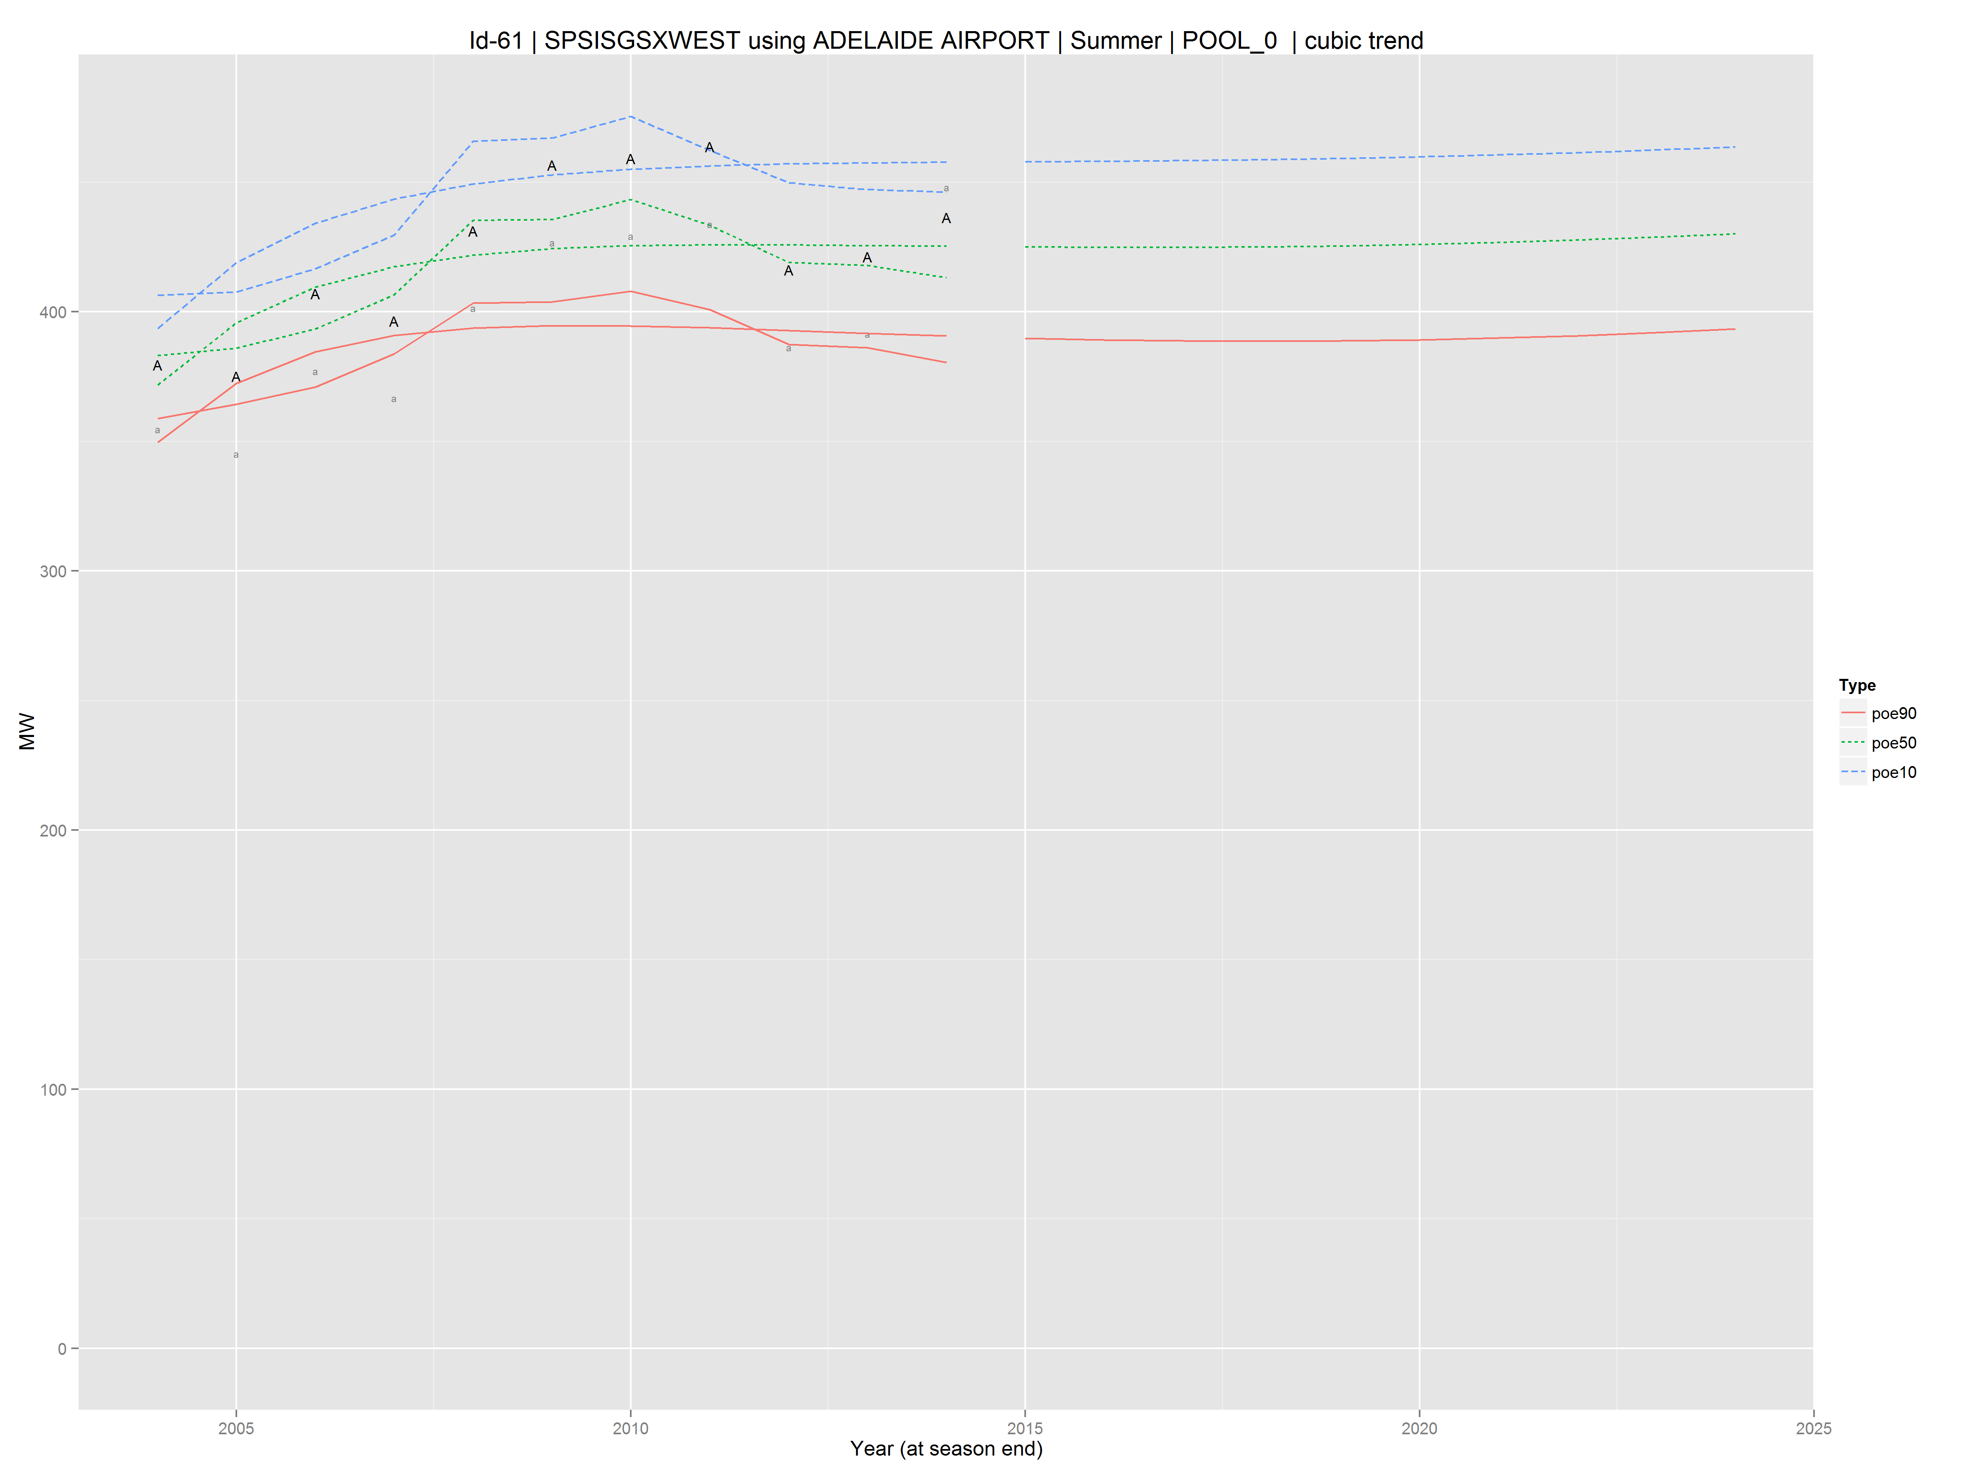
Non linear time trends
AEMO considers cubic trends for forecasts,
where statistical tests suggest the trend is non-linear.
Notes:
For connection points where demand it “tapering off”, AEMO will investigate whether a cubic trend may be appropriate

Slide 7
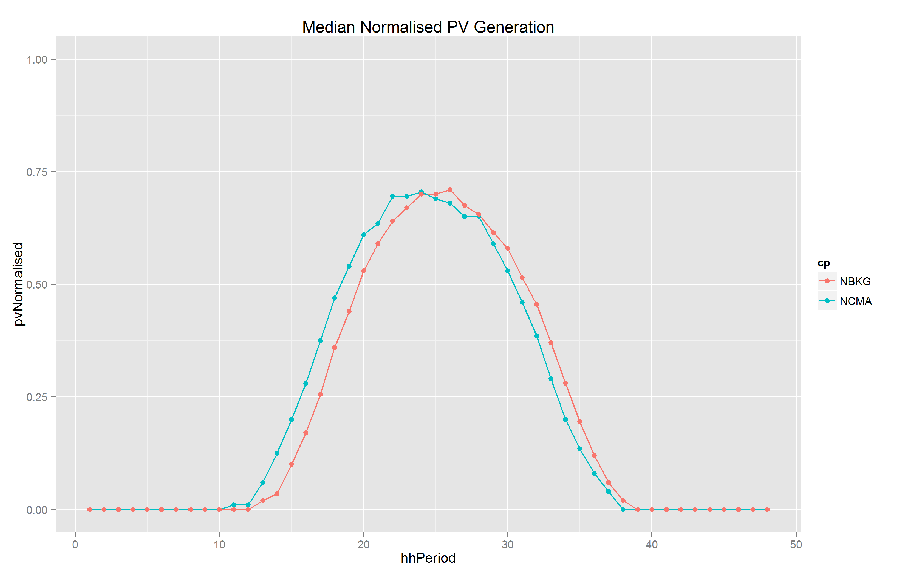
Overview of rooftop PV Model
Developed in conjunction with University of Melbourne
Better accounts for:
  Location differences between CPs
  (i.e. cloudiness, geographical position)
  Shading of panels
Cooma
Broken Hill

Slide 8
Next Steps
Upcoming publications
September 2015 - VIC.
October 2015 - SA.
Forecasting efforts
Improvements to streamline data and modelling steps.
Sensitivities to new technology (storage)
Separate uptake rates for commercial and residential solar PV

