Slide 1
Pricing Methodology
James Brown – Manager Financial Accounting
June 2021

Slide 2
AEMO TUOS Scope
AEMO’s Transmission Charges
Planning responsibilities are limited in Victoria to:
  Network Planning
  Investment Justification
  Connections
Focusing this discussion on the Prescribed Services
Negotiated Services
Prescribed Services
=
=
Direct cost recovery
Prescribed Regulated Services
+
Prescribed Non-Regulated Services
+
AEMO’s Planning & Procurement costs
+
/
-
Net Charges / Receipts from
Inter-Regional TUOS
+
Victoria’s allocation of AEMO’s National
Transmission Planner costs
-
Other Revenue AEMO receives in
providing prescribed transmission services
+
/
-
Under/Over Recovery from the previous
year(s)

Slide 3
AEMO Consultation Timeline
Issues Paper Published
Draft Consultation Paper
Final Paper Proposed
TUOS 22/23 Prices Published
22/23 Prices Apply
28 Jun 2021
16 Sep 2020
25 Nov 2020
30 Mar 2021
We are here
15 Mar 2022
1 Jul 2022
  Drivers for change:
  The growing occurrence of measured negative energy and demand from connected systems caused by increasing penetration of distributed generation (primarily rooftop solar).
  TUOS treatment of batteries and other energy storage devices that are becoming an increasingly important part of the overall electricity delivery chain.
  Consideration of alternative methodologies to determine the locational price component of TUOS in response to more mixed set of transmission investment drivers than has historically been the case.

Slide 4
Pricing Structure
The proposed pricing structure is in line with the AER
Guidelines is comprised of:
      1. Locational Prices – set using Cost Reflective Network
      Pricing (CRNP) based on network utilisation.
      2. Non-Locational Prices – postage stamp basis which
      applies a uniform price for all customers regardless of
      use.
      3. Common Service Price - postage stamp basis which
      applies a uniform price for all customers regardless of
      use.

Slide 5
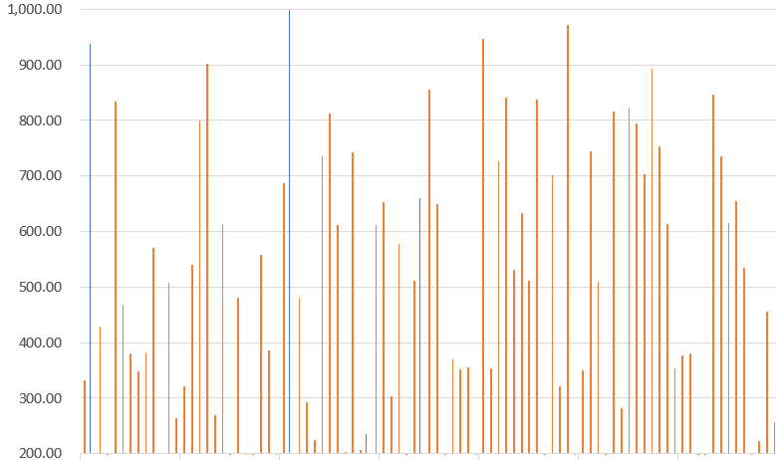
Current Pricing Methodology
Maximum Demand 10 (MD10)
Average half-hourly maximum demand (when system demand is highest)
Not between 11:00-19:00
Between 11:00-19:00
Transmission connection points with relatively higher maximum demands on the 10 days of system maximum demand would be allocated a relatively a higher lump sum dollar amount

Slide 6
Proposed Pricing Methodology
365 Day
365 method identifies peaks regardless of time of day or the time of system maximum demand.
Average half-hourly maximum demand
Transmission connection points with relatively higher monthly maximum demands would be allocated a relatively a higher lump sum dollar amount under the 365 day method.

Slide 7
Proposed Methodology
365 Day - Calculation
Locational prices ($/MW) at connection points are calculated using the average of the connection point half-hourly monthly maximum demand or contract agreed maximum demand (CAMD).
Customer charges ($) are calculated using the higher of the average of the transmission customer’s half-hourly monthly maximum demand at the time of connection point maximum demand or CAMD.

Slide 8
Methodology Change Exemptions
Directly connected energy storage systems will not be charged TUOS, with the following exemptions:
  The energy storage system is co-located with a customer’s load that is connected to the transmission system and is itself behind the meter.
  Pumped hydro storage systems that use electrically powered pumps to recharge, but also use those pumps for other purposes.
  Energy storage systems connected to the distribution network.
  AEMO retain the right to determine whether to charge an energy storage system at the time the facility applies to connect

Slide 9
Methodology Change Notes
All negative consumption and demand values will be zeroed out as this is less distortionary and more consistent with the guidelines than other options considered.
Effective date for calculation reflects last full year (prior to submission date).

Slide 10
Reasons for Change: Utilisation
Current (MD10) no longer reflects the period of greatest investment in the transmission network.
365 day period finds all the high utilisation periods and not just the ones that coincide with peak demand periods.
Provides clarification around negative usage measurements at distribution connection points and charging TUOS to energy storage devices (e.g. batteries)

