Slide 1

AusNet Services 2022-27 Electricity transmission
Revenue Proposal
Online Public forum
16 December 2020

Slide 2
Agenda
Time | Item
10:00 – 10:10 | AER: Welcome, introductions & housekeeping
10:10 – 10:30 | AER: Initial observations & how to get involved
10:30 – 10:50 | Consumer Challenge Panel: Initial observations
10:50 – 11:20 | AusNet Services: Thoughts in response
11:20 – 11:50 | Discussion/Q&A
11:50 – 12:00 | AER: Thank you & close

Slide 3
About this Process
The AER is responsible for the economic regulation of electricity transmission in all Australian jurisdictions except Western Australia
Regulated electricity network businesses must periodically apply to the AER to assess their revenue requirements (typically, every five years)
AusNet Services is one of seven electricity transmission businesses the AER regulates by determining revenues over a five year period

Slide 4
Our Determination for AusNet Services
Will set the revenue AusNet Services can recover from customers for the provision of electricity network services
Will approve a pricing methodology which prescribes how that revenue is recovered

Slide 5
Delivering improved outcomes for customers
Strong consumer engagement helps us test network service providers’ expenditure proposals
The framework for considering consumer engagement in our recent Victorian electricity draft decisions includes the following elements
      Nature of engagement
      Breadth and depth of engagement
      Clearly evidenced impact
      Assessment of outcomes

Slide 6
Nature of engagement
Transmission may seem ‘remote’ but all Victorians depend on AusNet Services to meet their energy needs
Transmission companies often engage with their ‘customers’ (generators, large users and distributors) and with community groups more generally
Questions
To what extent do you consider AusNet Services has engaged with (as opposed to simply seeking feedback from) consumers to inform the proposal?
To what extent have consumers been provided with impartial support to engage with energy sector issues?

Slide 7
Breadth and depth of engagement
Key themes from AusNet Services’ consumer engagement:
  Price and affordability
  Better relationship management
  Improved connections for new generators seeking to connect to the network
Questions
To what extent do you consider you were able to influence the topics engaged on by AusNet Services?
To what extent were you able to access and resource independent research and engagement?

Slide 8
Clearly evidenced impact
AusNet Services has proposed
to address affordability by absorbing several opex step changes and forecast productivity improvements
to invest more to improve the communication and management of planned and unplanned outages
to develop ways to improve customer experience and eliminate ‘pain points’ for new generators seeking to connect to the network
Question
To what extent do you consider AusNet Services’ proposal ties to your expressed views as a consumer?

Slide 9
Assessment of outcomes
The AER has prepared an Issues Paper to assist stakeholders in their consideration of AusNet Services' proposal
Our initial observations are presented on the following slides
Stakeholders can assist our process by providing their views on these observations
Stakeholders should feel free to comment on any aspect of the regulatory proposal

Slide 10
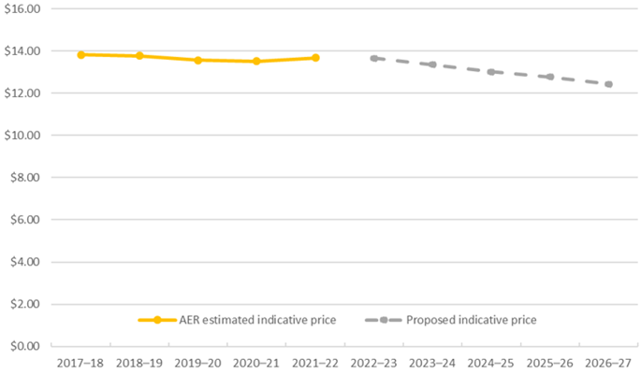
Bill Impacts
AusNet Services’ proposed revenue, if accepted, would translate to transmission price decreases for Victorian consumers of 1.8% per annum in real terms

Slide 11
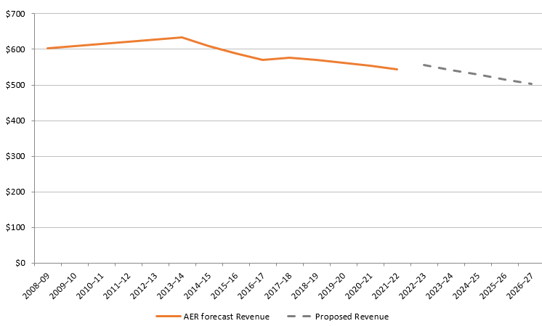
Total Revenue
Proposed 2022-27 total revenue of $2647.1 million ($real)
5.8% lower compared to the total revenue approved for the current 2017-22 regulatory control period

Slide 12
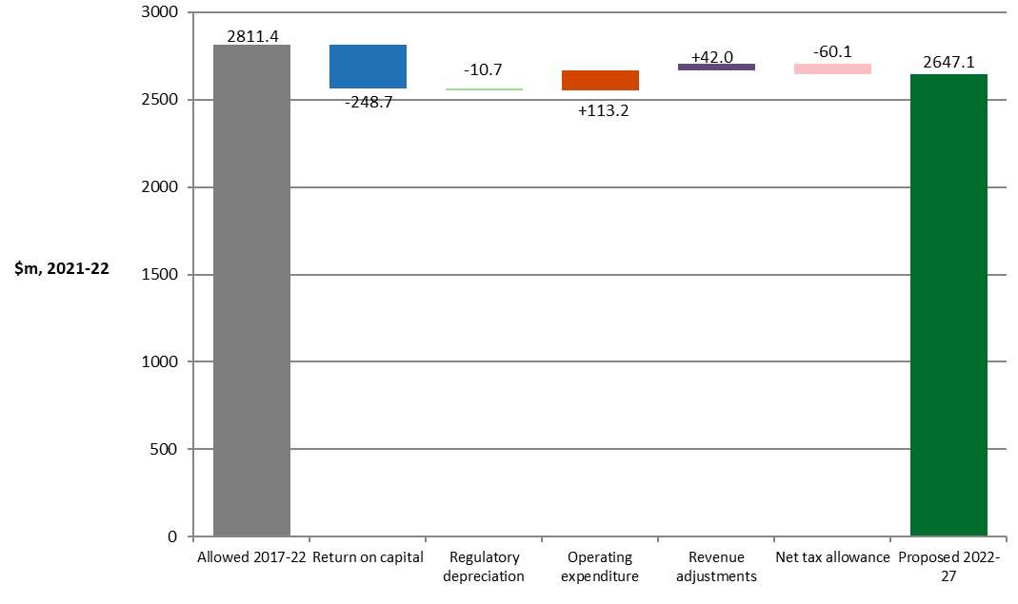
Building blocks
Proposed lower revenue at the building block level

Slide 13
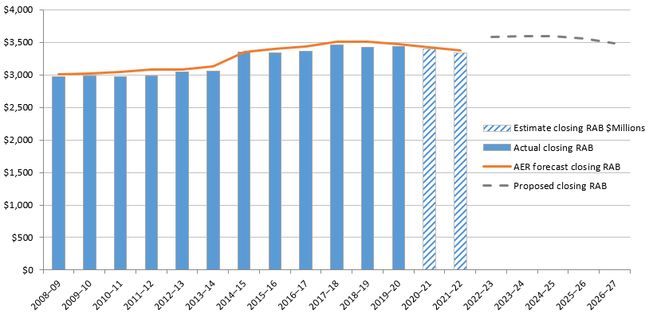
Regulatory Asset Base
Proposed to roll in $294 million of ‘growth assets’ into the RAB as at 1 April 2022
Growth assets have increased roughly threefold compared to that approved in the 2017–22 revenue determination

Slide 14
Depreciation
Proposed to decrease (in real terms)
Proposed (estimated) $442 million of insulators and instrument transformers to be depreciated over a shorter remaining asset life
If accepted, the revision to the remaining lives for these assets will add about $35.6 million ($real) to the depreciation amount in each of the next three regulatory control periods
Question
Do you agree with AusNet Services’ proposal to separate assets with shorter asset lives from broader asset classes?

Slide 15
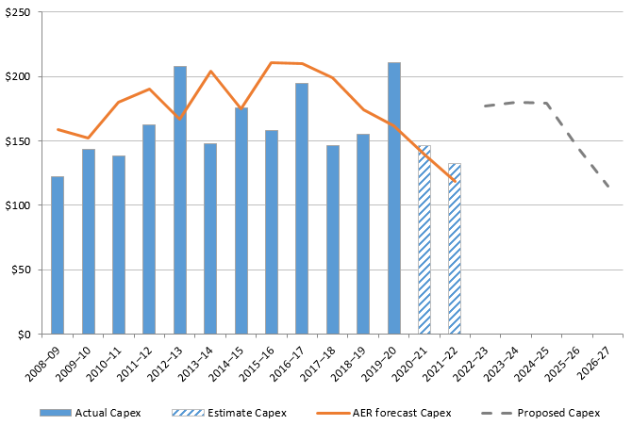
Capital Expenditure (capex)
Proposed capex is $796.2 million for the 2022–27 period. A 9% increase compared to actual expenditure over the 2017–22 period, due to:
higher expenditure to replace major station assets and ground-wire and insulator line assets, based on their condition
higher technology expenditure, including cyber security investment to comply with an anticipated change in regulatory obligations

Slide 16
Capital Expenditure (capex)
Breakdown of proposed capital expenditure by driver category

Slide 17
Capital Expenditure (capex)
Questions
Do you consider that AusNet Services’ smoothing of its capex profile appropriately addresses deliverability concerns and reflects the views of stakeholders?
Does AusNet Services’ economic assessment framework provide appropriate justification for its proposed capex projects and programs?
Do you consider that AusNet Services' forecast capex reasonably reflects the efficient costs of a prudent operator?

Slide 18
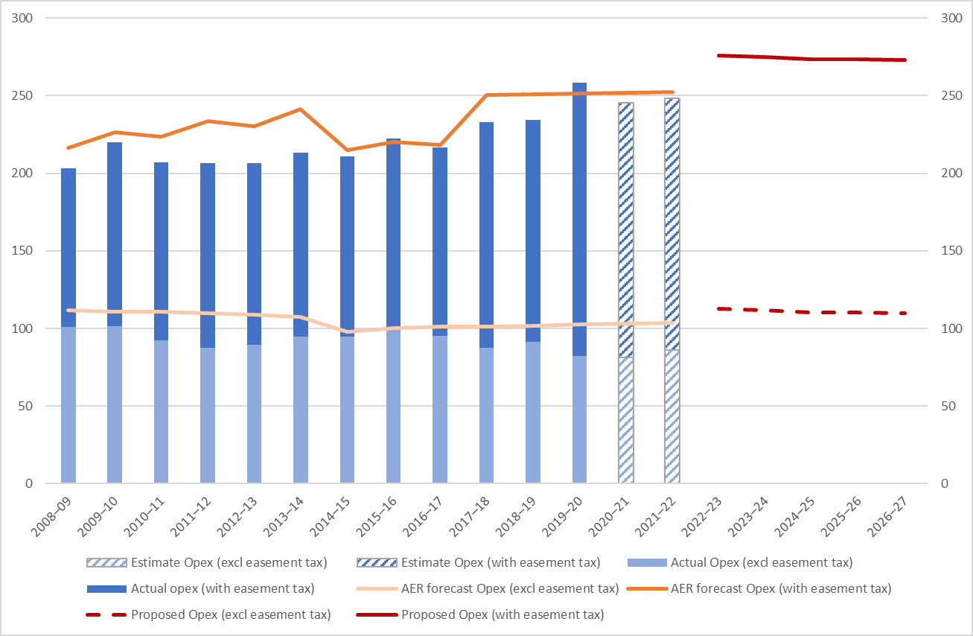

Operating Expenditure (opex)
Proposed opex is $1370.7 million ($real) for the 2022–27 regulatory control period
This is 12% higher than AusNet Services’ actual spend for the 2017–22 period
Easement land tax accounts for 60% of AusNet Services' proposed opex

Slide 19
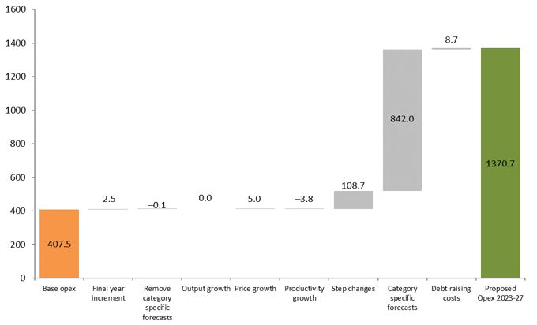
Operating Expenditure (opex) – Key Drivers
Proposed base opex is $407.5 million ($real) (excluding easement land tax)
AusNet Services proposes to apply
adjustments for trends to base year expenditure
5 step changes
3 category specific forecasts (primarily easement land tax)
debt raising costs
Proposed opex is $1370.7 million

Slide 20
Operating Expenditure (opex) – Key Drivers
5 step changes totalling $108.7 million ($real). Key step changes are:
  Council rates - $71.5 million
  Cyber security program - $27.9 million
3 category specific forecasts totalling $842.0 million ($real)
Key forecasts are:
  Easement land tax - $815.9 million
  Group 3 assets (or excluded prescribed assets) - $26.1 million
Debt raising costs - $8.7 million ($real)

Slide 21
Operating Expenditure
Question
Do you consider that AusNet Services' forecast opex reasonably reflects the efficient costs of a prudent operator?

Slide 22
Incentive Schemes
EBSS
Question
Do you consider that AusNet Services' forecast EBSS provides an incentive for distributors to pursue efficiency improvements in opex and to fairly share these between distributors and consumers?
CESS
Question
Do you consider that AusNet Services' forecast CESS incentivises AusNet Services to undertake efficient capex throughout the regulatory control period by rewarding efficiency gains and penalising efficiency losses?

Slide 23
Incentive Schemes
STPIS
Questions
What are your views on AusNet Services’ indication that it may depart from a STPIS target calculated as the 5-year average?
What are your views on AusNet Services’ proposed use of a network pass through to manage planned outages and the interaction with the STPIS?

Slide 24
Incentive Schemes
Demand management incentive mechanism
Questions
Do you consider the DMIAM should be applied to AusNet Services’ 2022–27 regulatory control period?

Slide 25
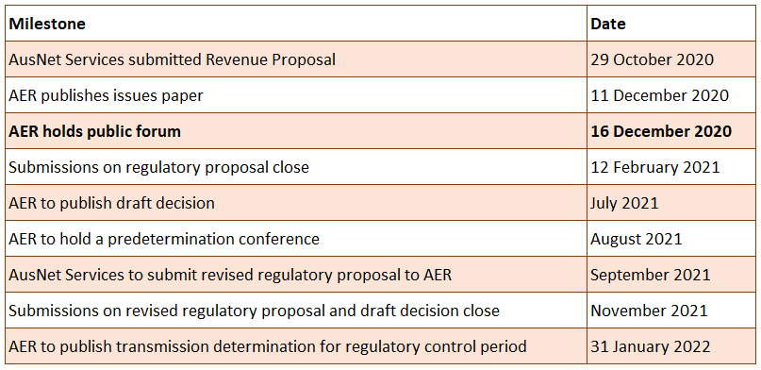
What Happens Next?

Slide 26

Questions?

Slide 27
How You Can Get Involved
1
Stakeholder submissions are due 12 February 2021
Write a submission to the AER
Subscribe to our website for updates
  Contact us
2
https://www.aer.gov.au/newsletter/subscribe
3
  AusNetServices2022@AER.gov.au

