Slide 1
Interim Contracts and Firmness Guideline
Retailer Reliability Obligation
Workshop - June 14th 2019

Slide 2
Agenda
Overview of the guideline
Firmness approach taken by the AER
Standard contracts
Non-standard contracts
Auditors Panel
NCP Report
Questions

Slide 3
Interim Contracts and Firmness Guideline
Published 31 August 2019
Final Contracts and Firmness Guideline
Published 31 December 2020
Applies for NCP Reports prepared before 31 December 2020.
Applies for contracts entered into after 31 December 2020
Applies to contracts entered into from 31 August 2019 to 31 December 2020

Slide 4
Interim Contracts and Firmness Guideline
The guideline sets out:
  The AER’s approach to firmness
  Default firmness methodologies for standard contracts
  Bespoke firmness methodology guidance for non-standard contracts
  Auditors Panel
  NCP Report

Slide 5
Contracts and Firmness Timeline
T-3
  T-3 Reliability Instrument is issued
  Liable entities enter into contracts to cover their forecast demand
T-1
  T-1 Reliability Instrument is issued.
  Liable entities submit their NCP Reports to the AER
  Liable entities may adjust their NCP between T-1 and T if they meet the requirements. They must submit an NCP adjustment to the AER.

Slide 6
Contracts and Firmness Timeline
T
  AEMO notifies the AER of all trading intervals during the gap period where demand exceeded the 1-in-2 year peak demand forecast.
T+40 weeks
  AEMO calculates a liable entity’s scaled actual demand.
  The AER assesses the liable entity’s scaled demand against its NCP.
  AER provides AEMO with compliance shortfall. AEMO undertake PoLR calculations.

Slide 7
Firmness Approach taken by the AER
Price Risk
Is the price per MWh known, and how much protection does it give from high spot prices?
Volume Risk
Is the number of MWs known, is it fixed or variable, how likely is it to be there during the gap?
Contract Limitation
Do any contract terms limit the protection of the contract (such as payout limits or weather triggers)?

Slide 8
Qualifying Contracts
Definition:
Section 14O(1) of the National Electricity Law defines a qualifying contract of a liable entity as a contract or other arrangement to which the liable entity is a party –
(a) that -
    (i) is directly related to the purchase or sale, or price for the purchase or sale, of electricity from the wholesale exchange during a stated period; and
    (ii) the liable entity entered into to manage its exposure in relation to the volatility of the spot price; or
(b) of another type prescribed by the Rules to be a qualifying contract.

Slide 9
Qualifying Contracts
Rules:
“The AER must have regard to the principle that the contract or other arrangement should support (directly or indirectly) investment in plant or other arrangements that:
(1) can supply energy that may be dispatched; or
(2) can reduce demand of energy that may be activated,
as required to meet energy requirements in the relevant region.”

Slide 10
Standard and Non-Standard Contracts
Standard Contracts
Contain simple and easily observable calculation of firmness factor
Do not require sign off by auditor
Non-Standard Contracts
Require more detailed calculation of firmness factor
Firmness methodology must be approved by an independent auditor before submission

Slide 11
Standard Contracts
Standard swaps
Standard caps
Standard options
Average rate options
Load following contracts
Grandfathered contracts
MLO products

Slide 12
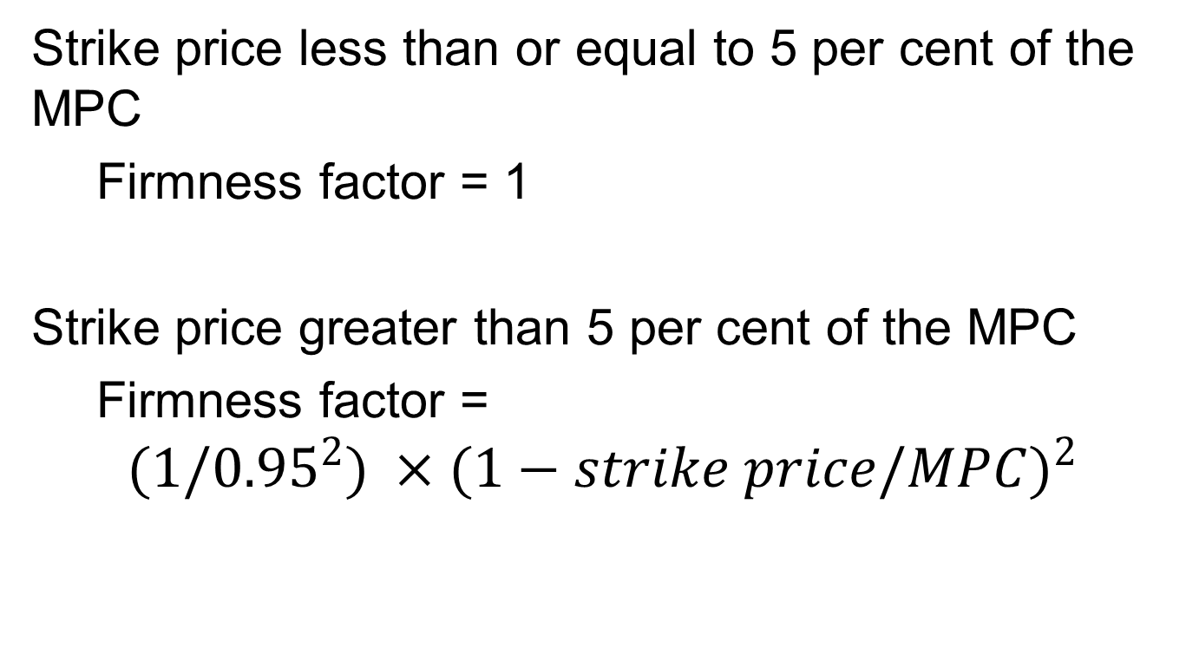
Standard Contracts - Caps
Strike price less than or equal to 5 per cent of the MPC
Firmness factor = 1
Strike price greater than 5 per cent of the MPC
Firmness factor =
$${(1/0.95}^{2}) ×(1−strike price/{MPC)}^{2}$$

Slide 13
Standard Contracts - Caps

Slide 14
Standard Contracts - Options
A standard formula for assessing the option delta will be used to calculate the firmness
Absolute value of a call or put delta to be used as the firmness factor
Applies to average rate, swaptions and captions

Slide 15
Standard Contracts – Load Following
Firmness factor of 1 for any volume covered by the buyer of the contract

Slide 16
Non-Standard Contracts
Liable entities must develop bespoke firmness methodologies to firmness adjust non-standard qualifying contracts.
Bespoke firmness methodologies must be developed in accordance with the firmness principles outlined in the guideline.
If a non-standard contract is included in the NCP, it must be accompanied by an Auditors Report

Slide 17
Non-Standard Contracts – Internal hedges
Recent historical performance of the generator
Any planned generator outages forecast for the gap period
Planned upgrades to the generators
Any fuel considerations

Slide 18
Non-Standard Contracts - PPAs
Recent historical performance of the generator
Does the generation behind the PPA include storage? What extent does this provide additional firmness?
Any planned outages forecast for the gap period
Planned upgrades to the generating assets
For new plant, similar data used for site development and performance of existing plant in similar location

Slide 19
Non-Standard Contracts – Interregional
Contract Risk:
What is the firmness factor applied to the underlying contract?
Volume Risk:
What proportion of the IRSR does the liable entity own?
What is the likely interconnector limit during periods of price separation?
Recent historical performance of the interconnector.
Planned outages on the interconnector
Planned upgrades to the interconnector

Slide 20
Non-Standard Contracts – Demand response
How much control does the liable entity have when curtailing the load?
Is there a maximum duration the load can be curtailed for an event or total duration load can be curtailed over the contract period?
How long does the load take to respond to a curtailment notice?
Number of times a load can be curtailed over the contract period?

Slide 21
Auditors Panel
The AER must establish and maintain an Auditors Panel. In establishing and maintaining the Auditors Panel, we must have regard to:
the need for a person to have sufficient experience and expertise in energy derivatives and energy contracts to carry out the functions of the Independent Auditor
whether the person is an independent person
The AER will conduct an expression of interest process.

Slide 22
NCP Report
NCP for each trading interval
Expected maximum demand for each trading interval (liable entity’s share of the system 1-in-2 year peak demand)
List of all qualifying contracts. Including the volume and firmness factor.
List of NMI’s for each demand response contract
Adjustments for non-qualifying contracts
Independent Auditors Report/s
Written report signed by the CEO or Company Director

Slide 23
Questions?
Stakeholders are invited to make written submissions in response to any matter covered in the guideline, by the close of business Wednesday 19th June 2019.

