Slide 1
Customer Service Satisfaction Incentive Scheme
Workshops
Sydney – 6 November 2019
Melbourne – 13 November 2019

Slide 2
Purpose
A further opportunity to discuss the objectives and potential design of a small scale incentive scheme
AER staff will take notes and prepare an overall summary of discussion
  We will circulate for comment

Slide 3
Background
Our issues paper received 20 detailed and considered responses from a variety of stakeholders
These include consumer representative groups, electricity and gas networks and industry representatives
These responses generally supported re-considering our approach to customer service
Stakeholders want us to focus on listening to customers and targeting what they value

Slide 4
Background (2)
This proposal originated from the AusNet New Reg trial
Issues paper feedback suggested the telephone answering parameter in STPIS is a narrow measure
Other economic regulators incentivise improvement in broader measures
AEMC – SSIS designed to facilitate trialling of schemes

Slide 5
Agenda
Item | Time
Introduction | 15 mins
Session 1 performance parameters | 30 mins
Session 2 performance measurement | 30 mins
Break | 20 mins
Session 3 assessing performance | 30 mins
Session 4 financial rewards/penalties | 30 mins
Open discussion | 20 mins
Closing comments | 5 mins

Slide 6
Why a principles based scheme?
Customers across the country may be more or less concerned about customer service
Different customers may be more or less concerned about different aspects of customer service
Not all distribution networks may be well placed to implement one scheme
The small scale incentive scheme is about trialling incentive schemes
  Flexibility in design and trials may lead to better information about a NEM wide scheme

Slide 7
Steps in the application of a principles-based scheme
Distributor
consultation
identify customer priorities and preferences
Distributor proposal
distributor develops incentive for customers
AER assessment
public review against principles
Application
public reporting
ex-post review

Slide 8
Summary of potential principles
Performance Parameters
Genuine engagement and support
Measurement
Reliable
Assessment
Baseline or neutral performance level
Financial
Independent
Objective
Repeatable
Verifiable
Measure the correct aspect
Not already be covered by another incentive
Can estimate willingness to pay
Within control of NSP
Create a simple relationship between outperformance and receiving the reward
Establishes single value
Increase relative to the degree of performance
Not exceed customers’ willingness to pay
Utilise a proxy for willingness to pay that is reasonable
Service customers value
incentivise genuine improvement

Slide 9
Performance parameters
What to incentivise?
Issues
Align distributor’s interests with their customers
Customer interests demonstrated through customer support
Multiple approaches to engaging with customers
Primary responsibility placed on distributors

Slide 10
Potential performance parameter principles
Service customers value
Genuine engagement and support
Not already be covered by another incentive
Can provide a proxy for customer willingness to pay
Within control of the distributor

Slide 11
Performance - questions
What might constitute “customer support” and is this an appropriate pre-condition for the trial of incentives?
Should distributors have primary responsibility for developing the proposed parameters?
Have we identified the relevant principles?

Slide 12
Measurement
How to measure performance?
Issues:
Incentive schemes require robust data
Measurement influences the incentive
Assurance provides stakeholders with confidence but is not without cost

Slide 13
Potential measurement principles
be reliable, independent, objective and repeatable
be verifiable
measure the correct aspect of customer service to reflect customer value

Slide 14
Measurement - questions
What principles should be applied to manage the subjective nature of surveys?
What assurance requirements are appropriate for a trial incentive?
Have we identified the relevant principles?

Slide 15
Assessment
How to set targets and rate performance?
Issues:
Provide an incentive to improve
Options include targets based on previous performance or benchmarks

Slide 16
Potential assessment principles
Set baseline or neutral performance level
Incentivise genuine improvement
create a simple relationship between out-performance of the neutral or baseline level and the financial reward or penalty
Establish a single value (where multiple performance parameters are applied)

Slide 17
Assessment - questions
In what circumstances should historical performance be used to set performance targets?
In what circumstances should industry benchmarks be used to set performance targets?
Have we identified the relevant principles?

Slide 18
Financial
How to calculate reward or penalty?
Issues:
Rewards commensurate with customer benefit
Don’t want to ‘gold plate’ customer service but want to provide sufficient incentive to improve
Penalties/rewards through revenue adjustments

Slide 19
Potential financial principles
Reward increases with improvement
Not exceed the customers’ willingness-to-pay
Utilise a proxy for willingness to pay that is reasonable

Slide 20
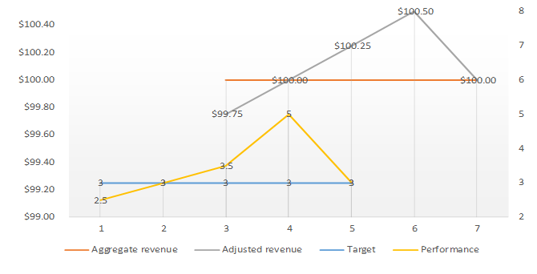
Financial – adjusting revenue using STPIS approach

Slide 21
Financial – questions
How do you gather customer perspectives on whether the identified proxy for willingness to pay is reasonable?
Are the STPIS revenue adjustment formulas appropriate for the CSIS?
Have we identified the relevant principles?

Slide 22
Next steps
Next workshop – Melbourne, 13 November
Note of discussion – to be circulated after meeting for comment
AER staff to draw on submissions and today’s discussion to develop draft scheme and explanatory statement

