Slide 1
Directlink 2020-25: our draft decision
Pre-determination conference
Wednesday, 23 October 2019
2:00pm – 3:00pm
Sydney

Slide 2
Agenda
Welcome and introductions
The AER’s draft decision
Next steps for Directlink
Thank you and close

Slide 3
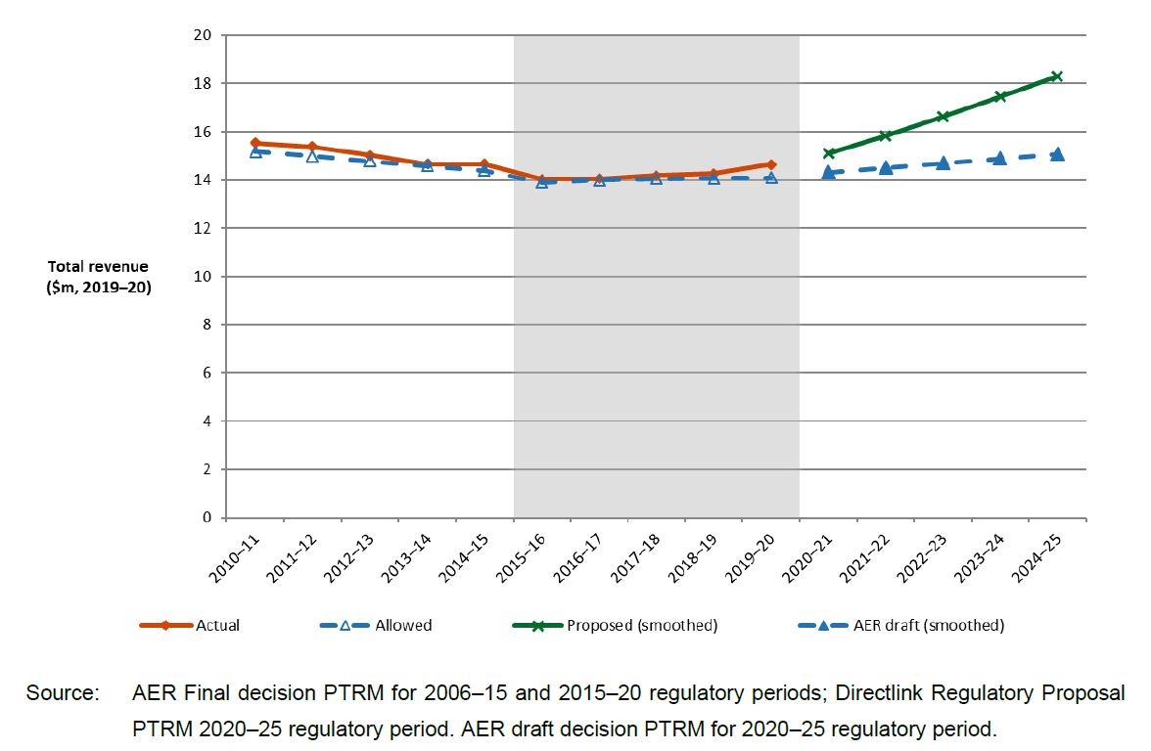
What is our draft decision?
Revenue over time ($million, 2019-20)

Slide 4
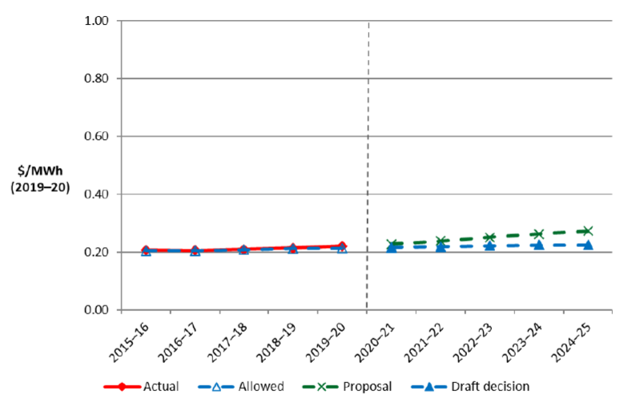
How would our draft decision affect transmission network tariffs?
Indicative price path for Directlink ($/MWh, $2019-20)

Slide 5
What would this mean for customers?
Indicative price impact for customers in NSW:
($nominal, from the 2019-20 total bill level)
$0.50 increase per residential electricity bill by 2024-25
$2.00 increase per small business electricity bill by 2024-25

Slide 6
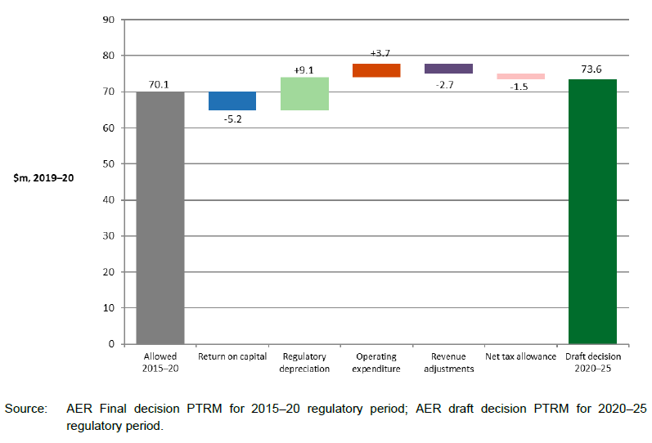
Key drivers Change in total revenue from 2015-20 to 2020-25
Approved allowance compared to AER draft decision ($million, 2019-20)

Slide 7
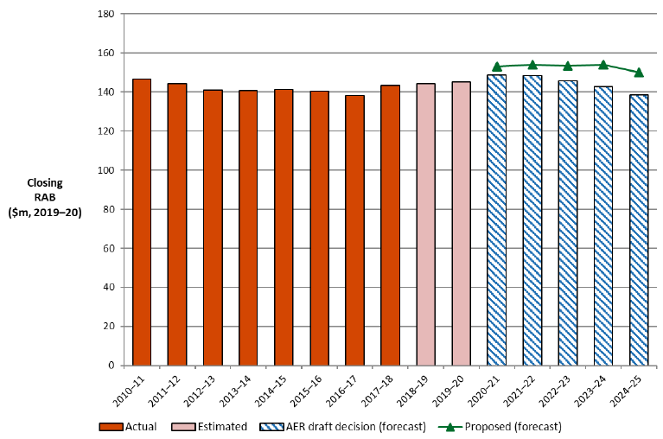
Key drivers Regulatory Asset Base
Projected RAB Growth ($million, 2019-20)

Slide 8
How do we differ from Directlink?
2018 Rate of Return Instrument
Forecast expenditure capex
Depreciation
Corporate income tax

Slide 9
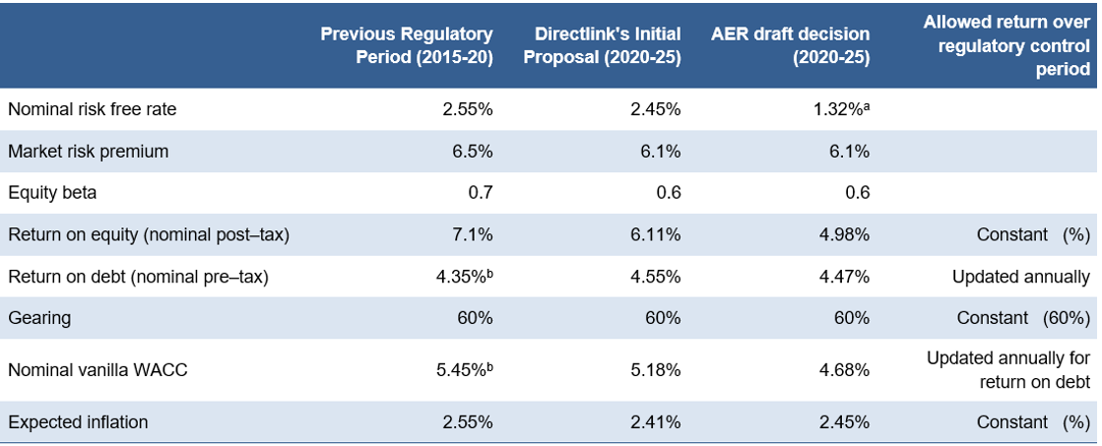
Rate of return

Slide 10
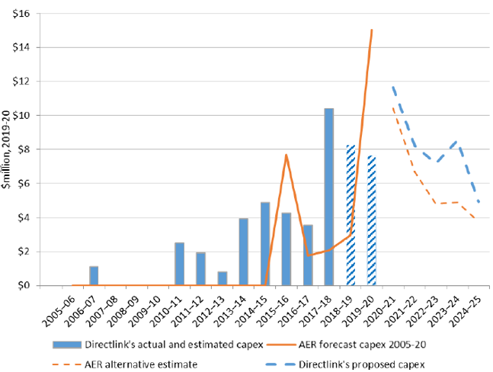
Our draft capex forecast
Capex over time ($million, 2019-20)

Slide 11
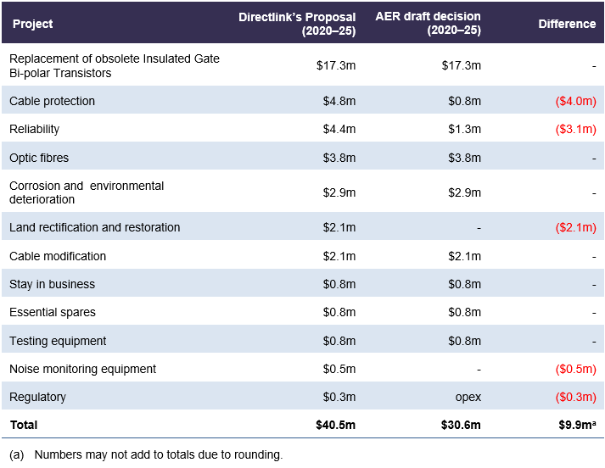
Our draft capex forecast
Directlink proposed total forecast capex of $40.5m for the 2020-25 regulatory control period
Our substitute estimate of total capex is $30.6m
This is a difference of 24.4%

Slide 12
Our draft opex forecast
Our draft decision is to include total forecast opex of $23.5 million ($2019–20)
This amount is based on an updated opex forecast submitted by Directlink on 21 August 2019
We have not accepted Directlink's original opex forecast of $24.7 million
We used our standard 'base-step-trend' approach to develop our alternative estimate which was $0.3 million lower than Directlink's updated opex forecast
As this difference is immaterial, we are satisfied Directlink's updated opex forecast of $23.5 million reasonably reflects the opex criteria.

Slide 13
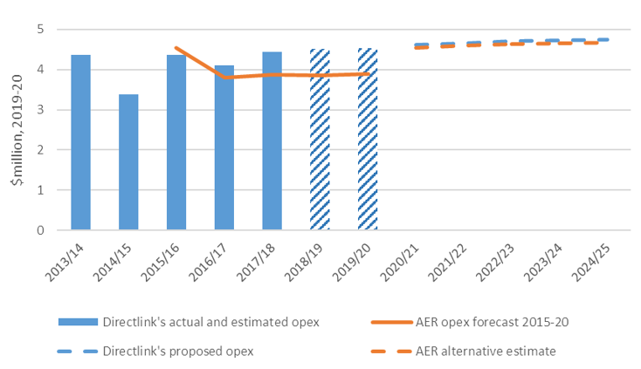
Our draft opex forecast
Opex over time ($million, 2019-20)

Slide 14
Incentive schemes
Our draft decision is to apply:
opex efficiency benefit sharing scheme (EBSS)
capital expenditure sharing scheme (CESS)
service target performance incentive scheme (STPIS)

Slide 15
Next steps
Milestone | Date
Directlink submitted regulatory proposal to AER | 31 January 2019
AER published issues paper | 28 March 2019
AER held public forum | 9 April 2019
Submissions on regulatory proposal closed | 16 May 2019
AER published draft transmission determination | 8 October 2019
→ Public forum on draft decision | 23 October 2019
Directlink to submit revised regulatory proposal to AER | 10 December 2019
Submissions on revised regulatory proposals and draft decision close | 15 January 2020
AER to publish transmission determination for regulatory control period | 30 April 2020

Slide 16
How you can get involved
Written submission on draft decision and revised proposal by 15 January 2020
Subscribe to our website for details
https://www.aer.gov.au/newsletter/subscribe
Contact us: Directlink2020@aer.gov.au

