Slide 1
AER: Pathway to 2022 – Energy Network Debt Data
Stakeholder forum
29 July 2020
Warwick Anderson, General Manager, Networks Finance & Reporting
Eric Groom PSM, AER Board member

Slide 2
Welcome
Agenda item | Presenter | Time allotted
Participant connection |  | 14.00 – 14.05
Welcome/Introduction | Warwick Anderson | 14.05 – 14.15
AER presentation | Eric Groom PSM | 14.15 – 14.35
ENA presentation | Charlotte Eddy and Tom Hird | 14.35 – 14.55
APGA presentation | Nick Wills-Johnson | 14.55 – 15.15
CRG presentation | Kieran Donoghue | 15.15 – 15-35
Closing | Warwick Anderson | 15.35 – 15.45
Email all questions to RateofReturn@aer.gov.au

Slide 3
Working Papers and Pathway to 2022
This debt paper is the first in a series of at least four which will advance work ahead of the active phase
Each paper will have its own stakeholder forum as well as a full submission round
Papers will develop AER position ahead of active phase, focusing discussion and submissions
CRG, IRG and RRG have now had initial meetings to begin setup

Slide 4
Use of Data in 2018
In 2018 the Energy Infrastructure Credit Spread Index (EICSI) and the dataset were useful in our consideration of:
Debt Term (“at least 7.4 years”)
Implementation of credit rating (evaluating impact of 1/3 A and 2/3 BBB weights)
It was not directly employed for estimating the final cost of debt
Given that this data was new work at the time, we wanted to do more work on it moving forwards

Slide 5
Work done since 2018 on EICSI/WATMI
Chairmont produced a report in 2019 extending work on the weighted average term to maturity at issuance (WATMI) in addition to the simple average term.
A new round of debt data gathering completed, improving the data available to inform the EICSI calculation

Slide 6
Motivation for more reliance on the EICSI
Industry specific data could more accurately reflect the efficient financing costs for regulated networks
Still a benchmark approach, compatible with incentive framework
Networks can outperform benchmark
But observed outperformance should lead to change in the benchmark, in long term interests of consumers
Grounded in reality, using industry data as per other building blocks and rate of return parameters

Slide 7
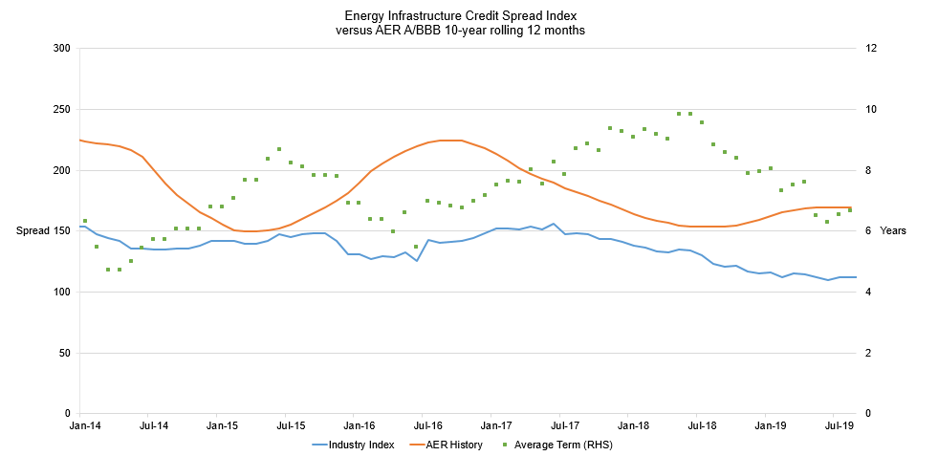
EICSI outcomes
AER RoRI Return on Debt
Average term (EICSI dataset)
EICSI
(Cost of debt)
New data

Slide 8
EICSI outcomes
Key Points
Return on debt under the 2018 Instrument has always been above EICSI, though gap varies over time
Term (simple average) appears to vary inversely to AER estimation of debt cost.
Shorter term debt issued when AER estimate of debt costs increases.
EICSI was at lowest point observed in July 2019

Slide 9
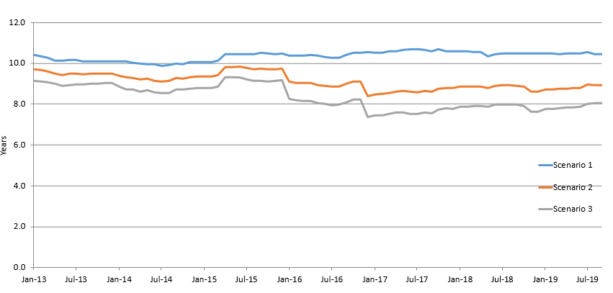
WATMI results
0% drawdown
50% drawdown
100% drawdown

Slide 10
Results WATMI
Key Points
Estimate of WATMI can vary by over 2 years depending on drawdown assumption
Assuming drawdown isn’t at 0%, WATMI has been below AER benchmark term estimate for most of the series
0% drawdown scenario is largely stable, other scenarios have seen step changes

Slide 11
Use of the EICSI and WATMI moving forward
Extended data series increases confidence in results
Can be used to give a marker of benchmark industry performance
EICSI shows departure from estimated cost of debt, we are keen to ensure this is not ignored – it should be explained or reconciled
Results are not surprising, they may reflect:
Debt optimisation strategies
Perceptions of debt providers

Slide 12
Use of the EICSI and WATMI moving forward
Multiple options for possible future use
WATMI can be used as a significant piece of information in determining term, not just floor
Dataset can be given increased role when determining the credit rating used for AER estimate
EICSI could be used as direct return on debt input, alongside other data (e.g. TR, RBA and Bloomberg)
EICSI could be used as primary return on debt input
Several sub-options around averaging periods or estimation frequency

Slide 13
Use of the EICSI and WATMI moving forward - Strengths
Index is based on direct industry data, not an economy wide judgement
Directly observing return on debt helps reduce impact of issues around benchmark characteristics
Credit rating data can be imprecise – it is not specific to utilities and so may not capture relevant risk profile observed by lenders
Varying term recorded in network debt data – our current measure may not incorporate potential variance

Slide 14
Use of the EICSI and WATMI moving forward - Concerns
Care taken over possible use and increased significance
Data has not been audited, and debt allocation requires judgement for many businesses
Need to be conscious of potential impacts on incentives
There is a range of data available to the AER, so using the correct balance is key
Consistency across RoR estimation important

Slide 15
Ongoing and Upcoming work – Debt Data
Aiming to collect debt data on a regular basis
Propose two more rounds of collection and EICSI extension before 2022 Instrument is published
Looking now at debt approach, not outcomes, as 2022 RoRI needs to be informed by latest data
Stakeholder submission period ends August 14 2020
Final paper on network debt data will be published Q4 2020

Slide 16
Ongoing and Upcoming work - RoR
Two working papers published (aiming late August):
Return on equity models
International regulatory approaches to the rate of return
Public forum will be held for those papers in Sept

Slide 17
Thank you
Please email all questions to:
RateofReturn@aer.gov.au

Slide 18
Agenda
Agenda item | Presenter | Time allotted
Participant connection |  | 14.00 – 14.05
Welcome/Introduction | Warwick Anderson | 14.05 – 14.15
AER presentation | Eric Groom PSM | 14.15 – 14.35
ENA presentation | Charlotte Eddy and Tom Hird | 14.35 – 14.55
APGA presentation | Nick Wills-Johnson | 14.55 – 15.15
CRG presentation | Kieran Donoghue | 15.15 – 15-35
Closing | Warwick Anderson | 15.35 – 15.45
Email all questions to RateofReturn@aer.gov.au

