Slide 1
Australian Energy Regulator
AER Preliminary decision for SA Power Networks 2015−20
Conference
13 May 2015

Slide 2
Today’s agenda
Welcome – Paula Conboy, AER Chair
Presentations from:
Sebastian Roberts, General Manager, AER
Bev Hughson and Bruce Mountain, AER Consumer Challenge Panel
Time for questions after presentations

Slide 3
Our preliminary decisions
Our preliminary decision reflects changes to the National Electricity Rules in 2012
There are 24 constituent decisions covering revenue, operating and capital allowances, amongst other things
We set the revenue a business may recover from customers, not its costs
Preliminary decision – used to set prices for 2015−16

Slide 4
AER process
Some highlights of the AER’s process:
This decision implements the AER’s better regulation program
Extensive consultation with stakeholders
Input from Consumer Challenge Panel Consideration of 31 submissions on SA Power Networks’ proposal
Engineering input from AER’s Technical Advisory Group
Consultancy input on willingness to pay survey

Slide 5
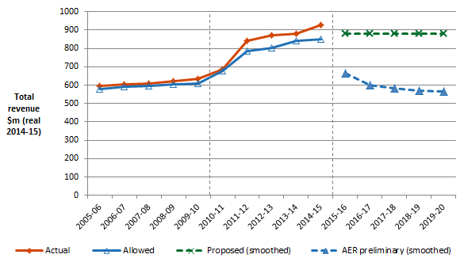
SA Power Networks – total revenue
SA Power Networks’ past total revenue, proposed total revenue and AER preliminary decision revenue allowance ($ million, 2014−15)

Slide 6
Indicative bill impact
Network business | Business proposal | AER preliminary decision | Percentage difference | Expected bill reduction for average household by end of 2015–20
SA Power Networks | $4745 million | $3211 million | -32 per cent | $197

Slide 7
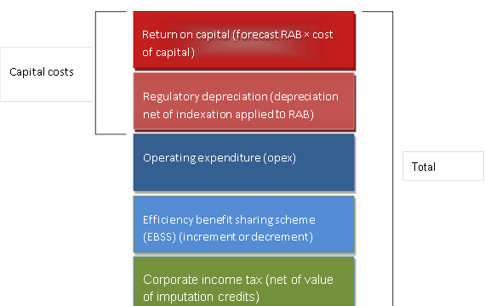
AER approach – building blocks

Slide 8
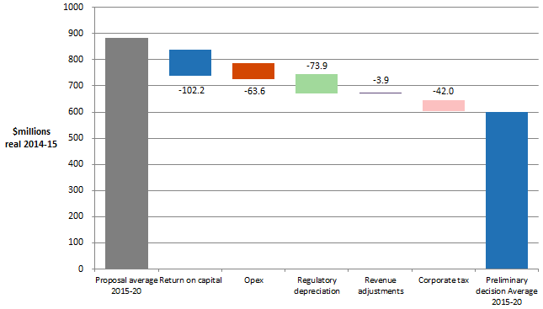
SA Power Networks – building blocks
AER's preliminary decision and SA Power Networks’ proposed annual building block costs ($ million 2014−15)

Slide 9
Rate of return
 | AER decision 2010–15 | SAPN's proposal 2015–16 | AER preliminary decision 2015–20
Nominal risk free rate (return on equity) | 5.89% | 3.43% | 2.55%
Nominal post–tax return on equity | 11.09% | 10.45% | 7.1%
Nominal pre–tax return on debt | 8.87% | 5.74% | 4.35%
Nominal vanilla WACC | 9.76% | 7.62% | 5.45%

Slide 10
Rate of return parameters
 | AER decision 2010–15 | SAPN's proposal 2015–20 | AER preliminary decision 2015–16 | AER preliminary decision 2016–20
Nominal risk free rate (return on equity) (a) | 5.89% | 3.43% | 2.55% | 2.55%
Equity risk premium (b) = (c*d) | 5.20% | 7.02% | 4.55% | 4.55%
MRP (c) | 6.50% | 7.72% | 6.50% | 6.50%
Beta (d) | 0.8 | 0.91 | 0.7 | 0.7
Nominal post–tax return on equity (e) = (a) + (b) | 11.09% | 10.45% | 7.1% | 7.1%
Nominal pre–tax return on debt (f) | 8.87% | 5.74% | 4.35% | Updated annually
Gearing | 60% | 60% | 60% | 60%
Nominal vanilla WACC = 0.4*(e) + 0.6*(f) | 9.76% | 7.62% | 5.45% | Updated annually
Forecast Inflation | 2.52% | 2.55% | 2.55% | 2.55%

Slide 11
Cost of debt - trailing average
Our starting point for existing debt is continuation of on-the-day approach
Then new debt is incorporated as it is progressively refinanced each year
10 year trailing average
10% of debt notionally re-financed each year
The benefit? Less price volatility for consumers

Slide 12
Depreciation – return of capital
SA Power Networks proposed a depreciation allowance of $936 million ($nominal)
Preliminary decision is 43% less at $533.7 million ($nominal)
SA Power Networks will recover its capital investment but over a longer period of time

Slide 13
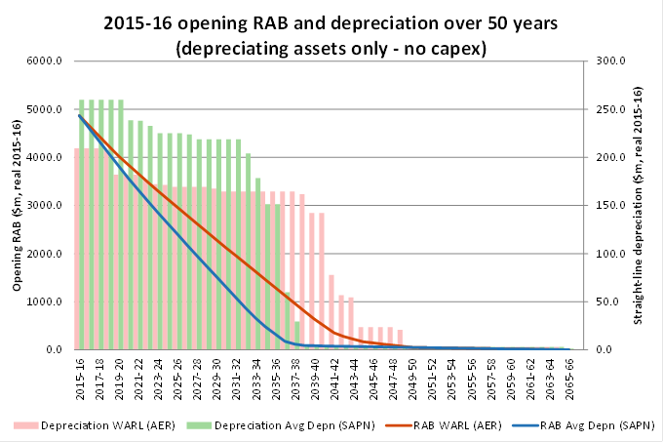
Depreciation

Slide 14
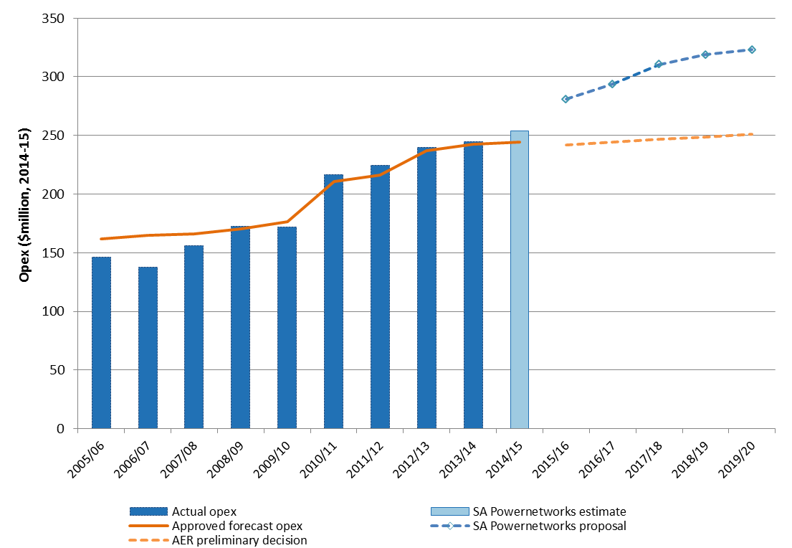
SA Power Networks - opex
SA Power Networks’ proposal compared to AER alternative forecast and past opex ($ million, 2014-15)

Slide 15
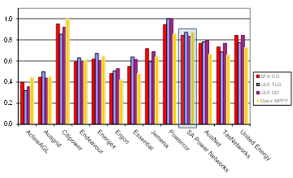
Benchmarking performance
Opex efficiency scores

Slide 16
Opex step changes
 | Proposal | AER preliminary decision
IT initiatives | $44m | $0
Vegetation management | $32m | $0
Asset inspections | $42m | $0
Demand side participation | $34m | $0
Other | $65m | $9m
Total | $217m | $9m

Slide 17
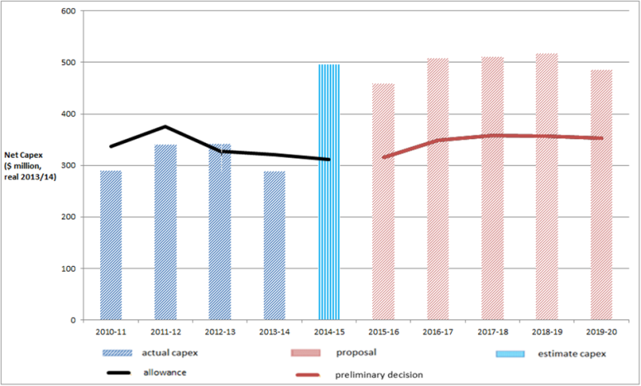
SA Power Networks - capex
AER preliminary decision compared to SA Power Networks’ past and proposed capex ($million, 2014-15)

Slide 18
Safety proposals
Safety Program | Proposal | AER decision
Bushfire mitigation | $228 | $0
Road safety | $78 | $0
Other | $13.5 | $13.5
Total | $319.5 | $13.5

Slide 19
Bushfire program
Legislative test for the AER
Is additional capex needed for improved safety and reliability of the network?
Is the additional capex a prudent and efficient investment?
SA Power Networks did not provide evidence to reasonably satisfy these tests.
For instance, for the undergrounding of powerlines (~$128 mill), SA Power Networks submitted a willingness to pay survey
Using this survey as the only supporting evidence is problematic – How does it satisfy the legislative tests?
Some problems with the survey
Around half the proposal is for undergrounding
But $40 million over the regulatory period is already available through the SA government’s PLEC program

Slide 20
Metering services in SA
Our preliminary decision approves two types of metering service charges:
Upfront capital charge (for all new and upgraded meters installed from 1 July 2015)
Annual charge comprising of two components:
capital—metering asset base (MAB) recovery
non-capital—operating expenditure and tax.
No upfront charge for replacement meters

Slide 21
CCP presentations

Slide 22
Next steps in SA reset
All queries, forum registrations etc. to SAelectricity2015@aer.gov.au
Date | Step
27 May 2015 | AER jurisdictional consumer forum
3 July 2015 | Submissions on AER preliminary decision close
3 July 2015 | SA Power Networks’ revised proposal due
24 July 2015 | Submissions on SA Power Networks’ revised proposal close
31 October 2015 | AER releases final decision for SA Power Networks

