Slide 1

AER INFLATION REVIEW
Technical Workshop
9 August 2017

Slide 2
Inflation review – Technical workshop
Key issues from submissions
Ben Stonehouse, AER

Slide 3
Inflation review – Technical workshop
Question 1:
Which is the more important issue?
Issue 1
What is the best method for estimating inflation?
Issue 2
What happens in the models when we update for actual inflation?

Slide 4
Inflation review – Technical workshop
Question 2:
What type of return should we target?
Target real
WACC
Target nominal
WACC

Slide 5
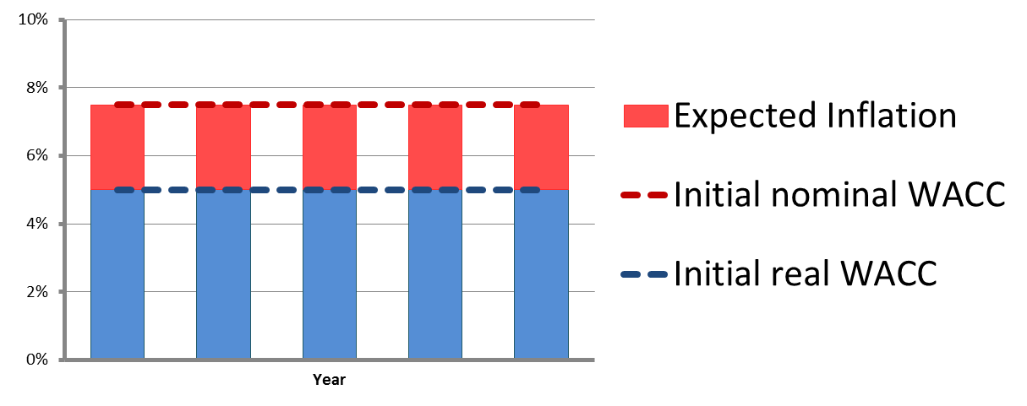
Inflation review – Technical workshop
Simple example with:
  Initial nominal WACC of 7.6%
  Expected inflation 2.5%
  Initial real WACC of 5.0%

Slide 6
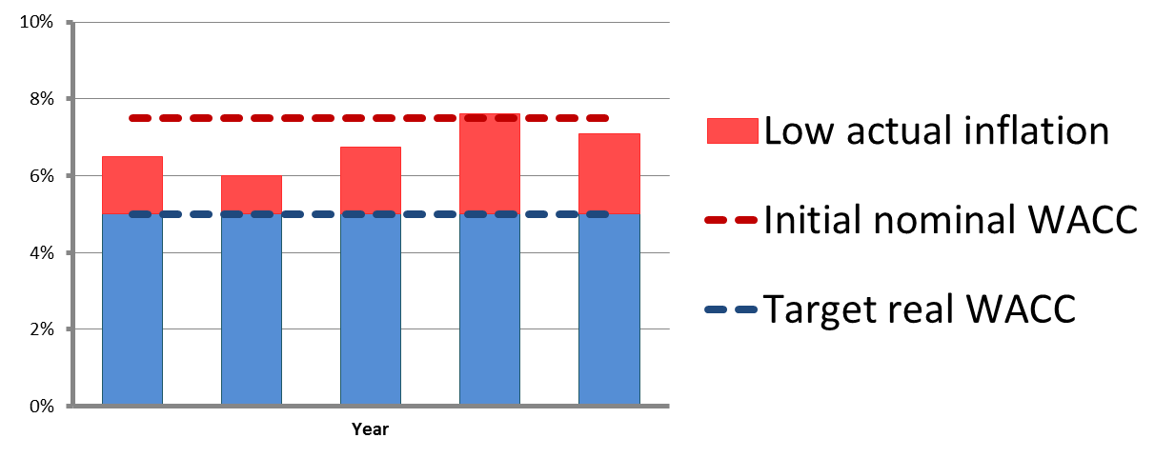
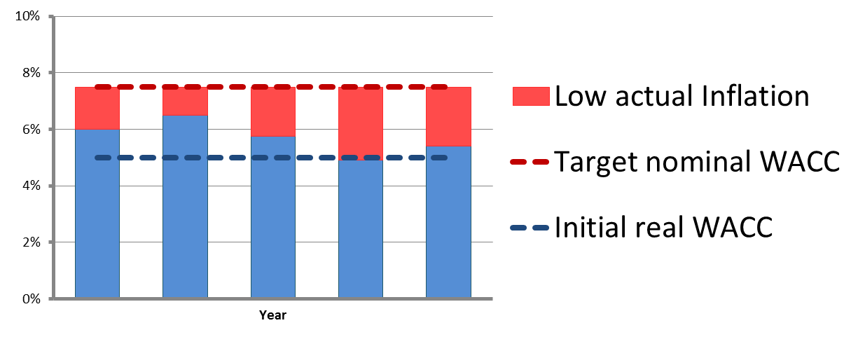
Inflation review – Technical workshop
Low actual inflation - if we target real WACC:
Low actual inflation - if we target nominal WACC:

Slide 7
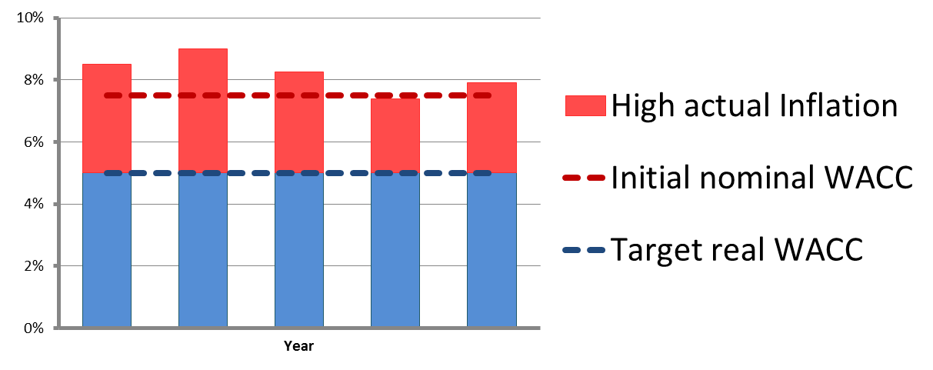
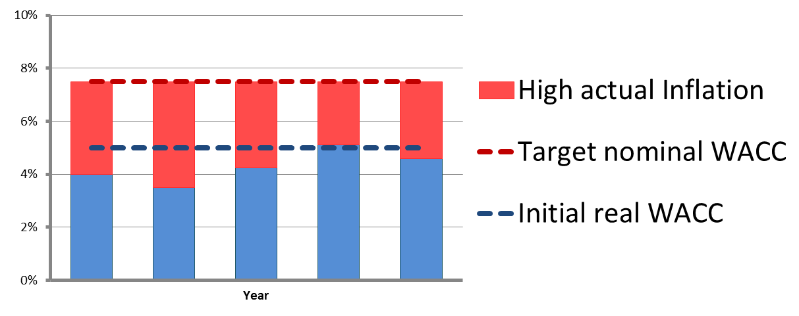
Inflation review – Technical workshop
High actual inflation - if we target real WACC:
High actual inflation - if we target nominal WACC:

Slide 8
Inflation review – Technical workshop
Question 3:
What level of return should we target?
Target real
WACC
Target nominal
WACC
Target real
return on equity
Target nominal
return on equity

Slide 9
Inflation review – Technical workshop
Question 4:
How long is the relevant time frame?
  Single regulatory control period or many regulatory control periods?

Slide 10
Inflation review – Technical workshop
Common framework proposed by the AER:
  Address RFM/PTRM/Pricing processes across multiple five year regulatory control periods
  Include return on capital / return of capital (but not opex/tax/revenue adjustments)
  Set WACC (not separate debt/equity), and calculate NPV in real terms
  Capex $1000 in year 0, $100 in years 1-10, all with 30 year life, real straight line depreciation

Slide 11
Inflation review – Technical workshop
Core scenarios proposed by the AER:
  Nominal WACC of 7.62%
  Expected inflation is 2.50%
  Implied real WACC is therefore 5.00%
Scenario 1: Actual inflation is 2.50%
Scenario 2: Actual inflation is 1.50%
Scenario 3: Actual inflation is 3.50%

Slide 12
Inflation review – Technical workshop
Final questions:
What happens to revenue when actual inflation differs from expected inflation?
Do the models (PTRM/Pricing/RFM) achieve the intended inflation outcomes?

Slide 13
Inflation review – Technical workshop

