Slide 1
AEMO transmission determination 2022-27:
Victorian transmission pricing
Public forum
29 June 2021

Slide 2
Acknowledgement of country

Slide 3
Agenda
Introduction – AER process (AER) – 10 minutes
Proposed pricing methodology (AEMO) – 20 minutes
Discussion, Q&A – 25 minutes

Slide 4
Public forum
Objective
AEMO to present its regulatory proposal
Stakeholders can ask questions regarding the regulatory proposal
Stakeholder engagement
Proposed pricing methodology (published 5 May)
AER issues paper (published 15 June)
Submissions close: 27 July 2021

Slide 5
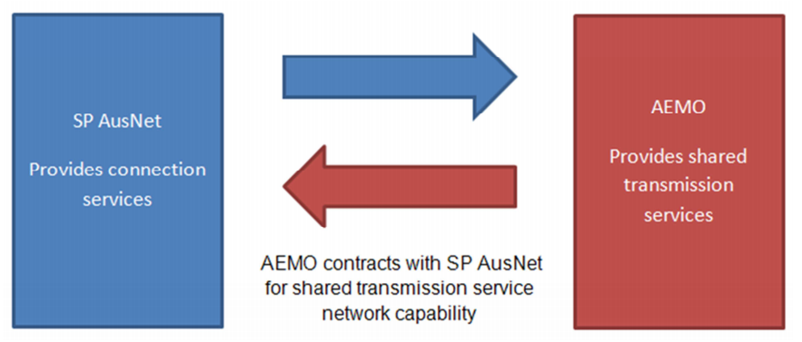
Unique Victorian transmission arrangement
We are assessing AusNet Services’ pricing methodology for the period 1 April 2022 to 31 March 2027

Slide 6
AEMO transmission determination 2022-27
Pricing methodology
Answers the question “who should pay how much” for transmission network services
The AER is assessing the proposed pricing methodology against:
the NER
our pricing methodology guidelines
Draft decision: September 2021

Slide 7
Need for a transmission determination
AEMO is a TNSP for the purposes of NER chapter 6A
The previous transmission determination for AEMO expired 30 June 2019.
Pricing methodology applies up to 30 June 2022 via enforceable undertaking

Slide 8
Issues paper
We requested feedback on the derivation of locational prices (from MD10 method to 365 day method)
MD10: uses the average of a customer’s half-hourly maximum demand on the 10 weekdays, between 11:00 and 19:00, when system demand was highest in the last 12 months
365 day method: uses the average of a customer’s half-hourly monthly maximum demand over a period of 365 days

Slide 9
Issues paper (continued)
We also requested feedback on:
Prescribed TUOS prices: Treatment of negative demand and values as zero
Energy storage systems: exempt from transmission charges
AEMO’s stakeholder engagement
Of course, stakeholders can make submissions on other aspects of the proposed pricing methodology

Slide 10
Key dates
Submissions close: 27 July 2021
Draft decision: September 2021
Predetermination conference: October 2021
Final decision: 29 April 2022

Slide 11
Expedited process
AEMO asked whether an expedited process is possible (e.g. final decision in December 2021).
MLEC publication: 15 February
Transmission prices: 15 March
Depends on extent of stakeholder concerns, and outcome of AER assessment.
We reserve the right to utilise the timeframe allowed in the NER if required.
Are stakeholders open to an expedited process?

