Slide 1
Victorian electricity distribution pricing review, 2016–20
Overview of revised proposals
January 2016

Slide 2
Total revenue (SCS, unsmoothed) – 2016–20, $m nominal
 | Initial proposal | AER preliminary decision | Revised proposal | Change from preliminary to revised | Change from initial to revised
AusNet Services | 3567 | 2887 | 3812 | 32% | 7%
CitiPower | 1718 | 1418 | 1838 | 30% | 7%
Jemena | 1412 | 1167 | 1527 | 31% | 8%
Powercor | 3662 | 3098 | 3808 | 23% | 4%
United Energy | 2317 | 1841 | 2517 | 37% | 9%

Slide 3
Residential bill impact of AER preliminary decisions – incl. SCS and AMI ($ nominal)
 | Indicative annual bill in 2015 | Indicative annual bill in 2020 | Change ($) | Change (%)
AusNet Services | $1939 | $1777 | –$162 | –8.3%
CitiPower | $1524 | $1452 | –$72 | –4.7%
Jemena | $1771 | $1590 | –$181 | –10.2%
Powercor | $1816 | $1737 | –$79 | –4.4%
United Energy | $1676 | $1558 | –$118 | –7.1%

Slide 4
Residential bill impact of revised proposals – incl. SCS and AMI ($ nominal)
 | Indicative annual bill in 2015 | Indicative annual bill in 2020 | Change ($) | Change (%)
AusNet Services | $1939 | $2040 | +$101 | +5.2%
CitiPower | $1524 | $1562 | +$38 | +2.5%
Jemena | $1771 | $1810 | +$39 | +2.2%
Powercor | $1816 | $1868 | +$52 | +2.8%
United Energy | $1676 | $1787 | +$111 | +6.6%

Slide 5
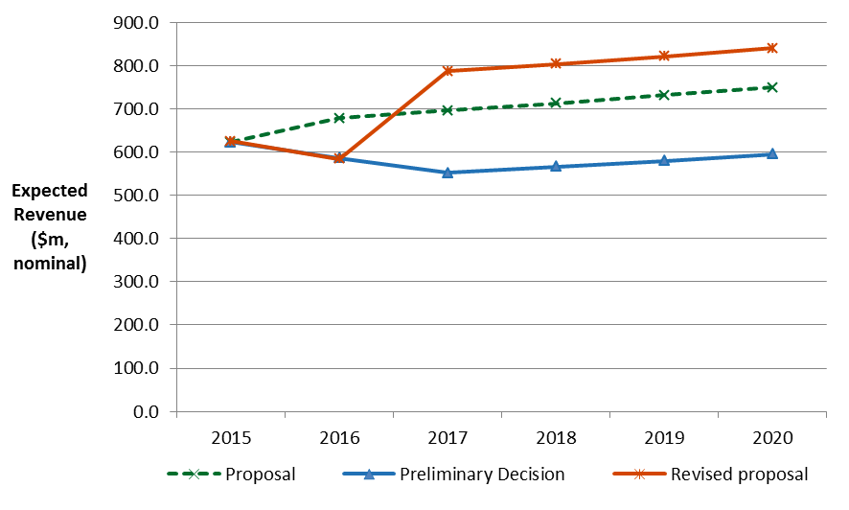
AusNet Services – Expected revenue

Slide 6
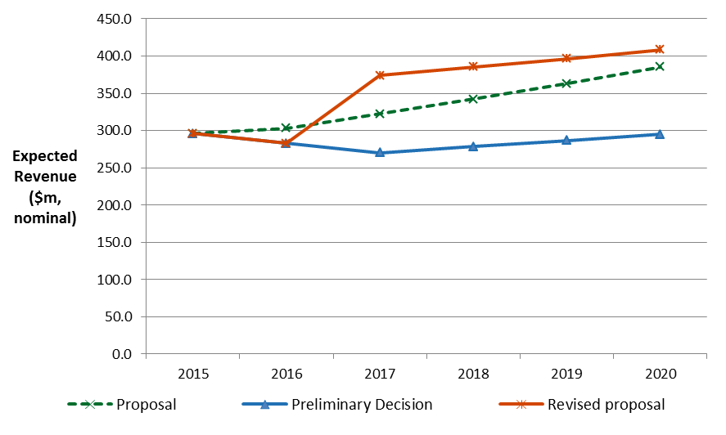
CitiPower – Expected revenue

Slide 7
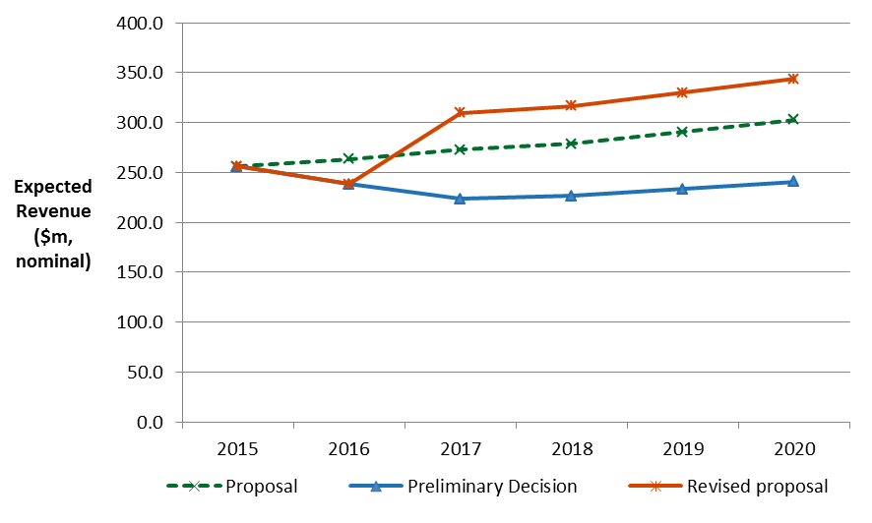
Jemena – Expected revenue

Slide 8
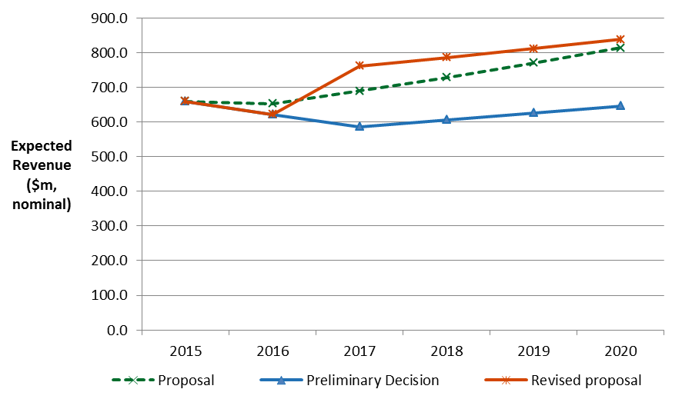
Powercor – Expected revenue

Slide 9
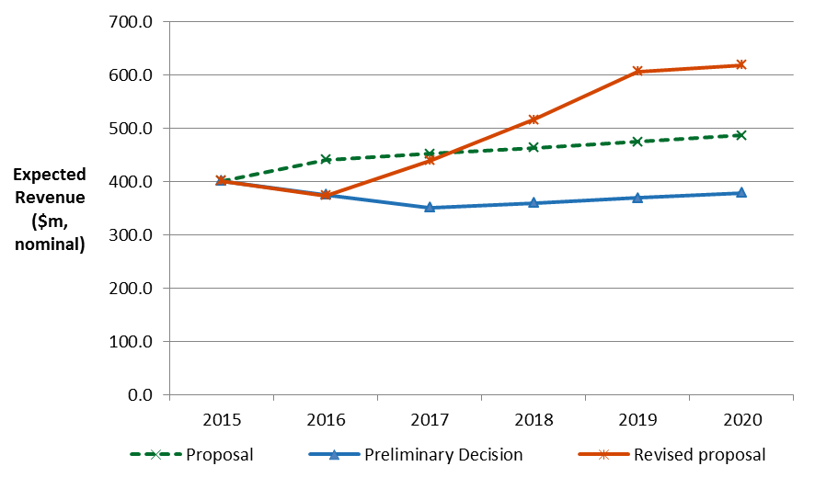
United Energy – Expected revenue

Slide 10
AusNet Services revised proposal – key elements
Element | Initial proposal | AER preliminary decision | Revised proposal | Change from preliminary to revised
Opening RAB ($m, nominal) | 3547.2 | 3423.3 | 3444.6 | 0.62%
Rate of return (%) | 7.19% | 6.10% | 8.66% | 2.56 points
Capex ($m, $2015) | 1695.9 | 1473.1 | 1749.1 | 19%
Opex ($m, $2015) | 1256.4 | 1104.3 | 1269.6 | 15%
Depreciation ($m, nominal) | 478.3 | 368.7 | 519.2 | 41%
Income tax ($m, nominal) | 262.0 | 138.7 | 254.7 | 84%

Slide 11
CitiPower revised proposal – key elements
Element | Initial proposal | AER preliminary decision | Revised proposal | Change from preliminary to revised
Opening RAB ($m, nominal) | 1804.7 | 1795.1 | 1802.6 | 0.42%
Rate of return (%) | 7.20% | 6.02% | 8.61% | 2.59 points
Capex ($m, $2015) | 850.4 | 659.7 | 822.9 | 25%
Opex ($m, $2015) | 502.0 | 413.3 | 467.4 | 13%
Depreciation ($m, nominal) | 297.3 | 304.6 | 318.9 | 5%
Income tax ($m, nominal) | 130.6 | 72.8 | 160.4 | 120%

Slide 12
Jemena revised proposal – key elements
Element | Initial proposal | AER preliminary decision | Revised proposal | Change from preliminary to revised
Opening RAB ($m, nominal) | 1190.8 | 1187.0 | 1198.5 | 0.97%
Rate of return (%) | 7.18% | 6.02% | 8.62% | 2.60 points
Capex ($m, $2015) | 710.8 | 670.7 | 709.0 | 6%
Opex ($m, $2015) | 499.0 | 390.1 | 470.9 | 21%
Depreciation ($m, nominal) | 243.2 | 237.7 | 282.5 | 19%
Income tax ($m, nominal) | 97.2 | 62.9 | 128.8 | 105%

Slide 13
Powercor revised proposal – key elements
Element | Initial proposal | AER preliminary decision | Revised proposal | Change from preliminary to revised
Opening RAB ($m, nominal) | 3362.9 | 3344.4 | 3357.6 | 0.39%
Rate of return (%) | 7.20% | 6.02% | 8.61% | 2.59 points
Capex ($m, $2015) | 2015.4 | 1610.4 | 1769.9 | 10%
Opex ($m, $2015) | 1333.7 | 1164.2 | 1252.4 | 8%
Depreciation ($m, nominal) | 503.5 | 503.2 | 526.9 | 5%
Income tax ($m, nominal) | 244.8 | 167.0 | 287.7 | 72%

Slide 14
United Energy revised proposal – key elements
Element | Initial proposal | AER preliminary decision | Revised proposal | Change from preliminary to revised
Opening RAB ($m, nominal) | 2069.3 | 2051.9 | 2063.7 | 0.58%
Rate of return (%) | 7.38% | 6.12% | 8.70% | 2.58 points
Capex ($m, $2015) | 1107.4 | 817.4 | 1055.5 | 29%
Opex ($m, $2015) | 800.4 | 659.5 | 781.4 | 18%
Depreciation ($m, nominal) | 388.2 | 315.4 | 463.3 | 47%
Income tax ($m, nominal) | 149.1 | 84.6 | 184.4 | 118%

Slide 15
AusNet Services revised proposal – WACC
 | Current period | Initial proposal | AER preliminary decision | Revised proposal
Return on equity (nominal post–tax) | 10.34 | 9.9 | 7.3 | 9.8
Return on debt (nominal pre–tax) | 9.36 | 5.39 | 5.30 | 7.83
Gearing | 60 | 60 | 60 | 60
Nominal vanilla WACC | 9.75 | 7.19 | 6.1 | 8.66
Forecast inflation | 2.57 | 2.52 | 2.50 | 2.19

Slide 16
CitiPower/Powercor revised proposals – WACC
 | Current period | Initial proposal | AER preliminary decision | Revised proposal
Return on equity (nominal post–tax) | 10.28 | 9.9 | 7.3 | 9.89
Return on debt (nominal pre–tax) | 8.97 | 5.39 | 5.16 | 7.76
Gearing | 60 | 60 | 60 | 60
Nominal vanilla WACC | 9.49 | 7.20 | 6.02 | 8.61
Forecast inflation | 2.57 | 2.60 | 2.50 | 2.50

Slide 17
Jemena revised proposal – WACC
 | Current period | Initial proposal | AER preliminary decision | Revised proposal
Return on equity (nominal post–tax) | 10.85 | 9.87 | 7.3 | 9.89
Return on debt (nominal pre–tax) | 9.99 | 5.39 | 5.16 | 7.77
Gearing | 60 | 60 | 60 | 60
Nominal vanilla WACC | 10.33 | 7.18 | 6.02 | 8.62
Forecast inflation | 2.57 | 2.52 | 2.50 | 2.19

Slide 18
United Energy revised proposal – WACC
 | Current period | Initial proposal | AER preliminary decision | Revised proposal
Return on equity (nominal post–tax) | 10.28 | 9.95 | 7.3 | 10.05
Return on debt (nominal pre–tax) | 8.97 | 5.67 | 5.33 | 7.80
Gearing | 60 | 60 | 60 | 60
Nominal vanilla WACC | 9.49 | 7.38 | 6.12 | 8.70
Forecast inflation | 2.57 | 2.50 | 2.50 | 2.01

