Slide 1
Victoria Distribution reset 2021-25
Stakeholder meeting: AER preliminary framework and approach
25 October 2018

Slide 2
What is the Framework and approach?
Provides guidance and direction to distributors in preparing their regulatory proposals for 2021-2025
F&A determines:
  Service classification
  Forms of control and control mechanisms
  Likely application of guidelines and incentive schemes
  Any other relevant issues relevant to the reset process and the next regulatory control period

Slide 3
Victoria determination process (indicative)
Step | Date
AER publishes preliminary F&A for Vic distributors | 14 September 2018
Stakeholder forum | 25 October 2018
Submissions on the preliminary F&A for Vic distributors close | 9 November 2018
AER to publish final F&A for Vic distributors | 31 January 2019
Vic distributors submit regulatory proposals to AER | 31 July 2019
AER publishes issues paper and holds public forum | October 2019*
Submissions on regulatory proposal close | November 2019
AER to publish draft decision | March 2020
AER to hold a predetermination conference | April 2020
Vic distributors to submit revised regulatory proposal to AER | June 2020
Submissions on revised regulatory proposal and draft decision close | July 2020*
AER to publish distribution determination for regulatory control period | 31 October 2020
*The date provided is based on the AER receiving compliant proposals. The date may be altered if we receive non-compliant proposals.

Slide 4
Major drivers of change for the 2021-25 regulatory period
AEMC contestability rule change
Ring-fencing Guideline
New incentive scheme – DMIS
Distribution Service Classification Guideline
Increasing focus on consumer engagement
Implementation of chapter 5A for connections and charges

Slide 5
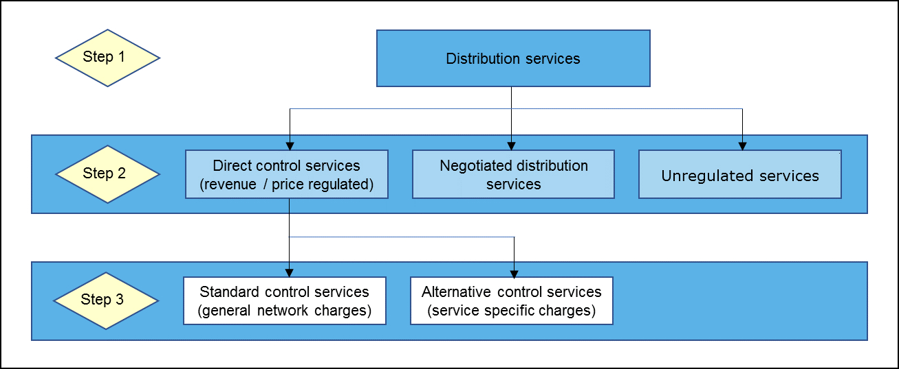
Classification affects service delivery

Slide 6
Changes to Service Classification
Very few changes to existing classification of most services – no major changes intended
Alignment with new Service Classification Guideline
    New names and service structure. Easier to follow and improves alignment with other jurisdictions
    Better alignment with chapter 5A terminology, connections policies (basic, standard and negotiated). Umbrella terms for “connection application and management services” and “enhanced connection services”.
    Unintended effects? These should be highlighted in submissions (with possible solutions)
Maintains DNSP support for third-party initiated network asset relocations/re-arrangements under ESCV Guideline 14
Enables one DNSP to support another during an emergency event (SCS – recoverable works)

Slide 7
Classification issues
Standalone power systems
  important issue that is under review by AEMC: is this a distribution service?
Charging for “wasted truck visit”
  could risk discouraging people from reporting a network outage
Community network upgrades
  under an open access regime, this approach to addressing congestion has problems
Transmission support services
  don’t want to discourage, but regulatory treatment needs to be considered carefully

Slide 8
AER proposed classification of Vic distributors' distribution services
Vic distributors' distribution services
Direct control (revenue/price regulated)
Standard control
(bundled network charges)
Alternative control
(user charges)
Negotiated
Unregulated
Type 1-4 metering services
Unregulated distribution services
Common distribution services (bundled services under DUoS)
Bulk supply point metering
Standard and negotiated extensions and augmentations connection
services
Network ancillary services
Public lighting services
Type 5 & 6 metering provision (including smart meters)
Type 7 metering services
Basic Connection services

Slide 9
New incentive schemes
Demand management incentive scheme (DMIS)
  incentivises efficient expenditure on non-network options for demand management
  scheme provides generous allowance (+50% opex)
  improved DMIA provides for R&D
Possible Small Scale Incentive Scheme (SSIS) for AusNet Services
  Consumer service linked scheme still being considered by AusNet, possible revenue reward/at risk
Notes:
DMIS:
Incentive equaling up to 50 per cent of a distributor's expected efficient demand management expenditure, with a cap of the total financial incentive a distributor can receive in any regulatory year to 1.0 per cent of its annual smoothed revenue requirement for that regulatory year.
Distributors will identify eligible projects via RIT-D requirements or cost-benefit analysis for smaller projects – and report on project to us.
DMIA:
The Mechanism consists of three elements: The allowance itself, Project eligibility requirements: and Compliance reporting requirements.
Allowance includes a fixed amount, common amongst all distributors, with an additional percentage of the distributor's annual revenue requirement (ARR). It is calculated annually as $200,000 + 0.075% of the relevant distributor's ARR, as defined in the Mechanism and glossary. Distributors will recover this amount from customers throughout the regulatory control period.

Slide 10
Increased focus on consumer engagement
Vic distributors are engaging with customers:
  The future role of the network
  Pricing and affordability
  Tariff reforms
  Reliability
We expect these processes will help refine the regulatory proposals to be submitted July 2019. We will be looking for evidence of this.
CCP will be making a submission to the F&A setting out their views on DNSP consumer engagement so far.

Slide 11



How can stakeholders get involved?
Make a submission on our preliminary F&A by 9 November 2018.
See also Vic distributors’ websites:
https://talkingelectricity.com.au/
https://yourgrid.jemena.com.au/haveyoursay
https://www.ausnetservices.com.au

