Slide 1
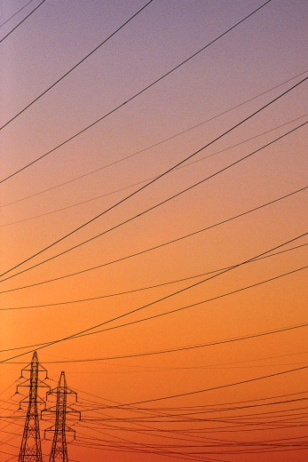

Australian Energy Regulator
Public Forum
NSW electricity distribution revenue proposals 2014-19
10 July 2014

Slide 2

Agenda
9.30 – 9.45 AER introduction – Andrew Reeves, Chairman AER
9.45 – 10.15 Networks NSW – Vince Graham, CEO Networks NSW
10.15 –11.00 Presentations from NSW distributors
11.00 –11.20 Consumer Challenge Panel (CCP) presentation
11.20 –12.15 Q & A
12.15 –12.30 Wrap-up – Jim Cox, Board Member, AER

Slide 3
Purpose of the public forum
NSW businesses to present their proposals
Consumer Challenge Panel to present some initial views on the proposals
Consumers and their representatives to ask questions of the businesses about their proposals
Outline the determination process from here

Slide 4
Process to date
AEMC rule change determination on November 2012
Deferral of full regulatory determination process for the NSW distributors’ next regulatory control period (2014–19)
Better Regulation guideline development process in 2013
Placeholder revenue allowance for a transitional regulatory control period (1 July 14 to 30 June 15) in April 2014
Receipt of regulatory proposals 31 May 2014
Publication of proposals 20 June 2014
Publication of issues paper 8 July 2014

Slide 5
How proposals affect consumers
The NSW distributors’ proposed price paths ($nominal)

Slide 6
AER approach
Our analysis of the revenue proposals will consider each of the revenue components and any inter-relationships between these components
We must decide the businesses revenues as a whole.
We will have regard to our ‘Better Regulation’ Guidelines, including:
  Expenditure Assessment Guideline – and the results from our first benchmarking report
  Rate of Return Guideline
We will be interested in hearing consumer views on the NSW distributors’ consumer engagement initiatives (including engagement on its proposed changes to the pricing methodology)

Slide 7
  Presentations from Networks NSW, NSW distributors and Consumer Challenge Panel

