Slide 1
Feedback forum
Demand Management (DM)
Incentive Scheme
&
Innovation Allowance Mechanism
8 November 2017

Slide 2
Purpose of this feedback forum
Understand how we have incorporated your views
An opportunity to seek clarification or raise concerns before we publish the final Scheme and Mechanism

Slide 3
The Scheme

Slide 4
Key stakeholder input
Issues Day
Keep things simple and act quickly
Options day + submissions
More support for a cost-uplift
General support for the Scheme & don’t let the perfect be the enemy of the good
Pre-draft directions forum
Broadly define DM to not restrict the Scheme to peak demand issues
Include worked examples
Consultation Paper + submissions
Project efficiency (not ownership or targets) should drive eligibility
Amend market testing requirements to better fit distributors’ business practices
Be careful not to undermine competition
Little support for STPIS exclusions
Consider the economic benefits
Strong support for encouraging competition
Support for connecting project evaluation to market testing

Slide 5
Draft/final Scheme summary*
Eligibility
Distributor identifies need on its network
Distributor identifies project with highest net benefit via a RIT-D or a market testing process (if the RIT-D need not apply)
Incentive can apply if the highest net benefit option has a non-network DM component
Calculating the incentive
Distributor commits eligible DM project by signing contract or equivalent document
Distributor accrues the project’s incentive of up to 50% of the project’s expected DM costs, subject to constraints
Constraint 1: the project’s incentive cannot exceed its expected net benefit across the relevant market
Compliance Reporting
Distributer reports information to AER so it can evaluate the incentive available, given constraints
Constraint 2: the total incentive accrued to a distributor any year cannot exceed 1.0% of its annual allowed revenue that year
Distributor receives incentive payment with a lag via its control mechanism
* Changes between the draft and final are sufficiently non-substantial to not be reflected in this summary

Slide 6
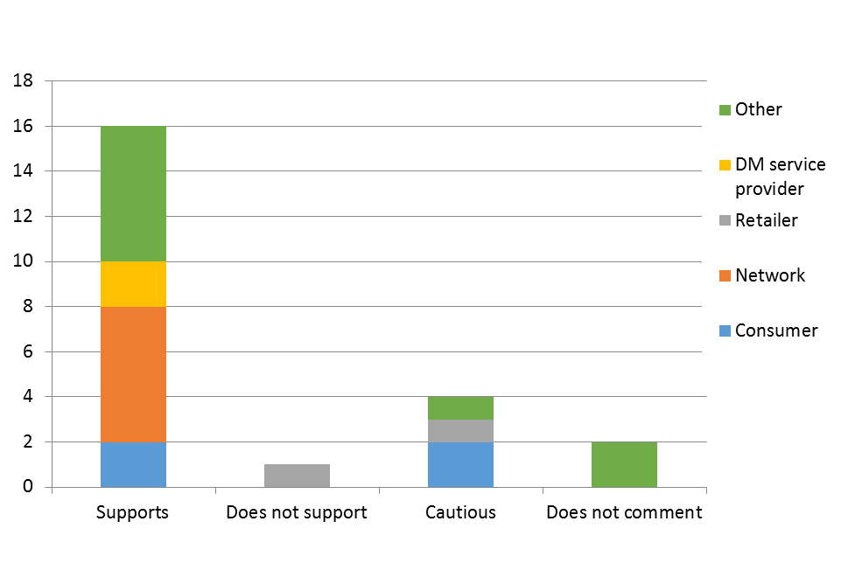
Feedback on the draft Scheme

Slide 7
Our proposal to incorporate feedback
Proposed changes to the draft Scheme are minor improvements:
Reflective of stakeholder’s broad support of the draft Scheme.
Revisions or additions to increase clarity or flexibility, where warranted.
Correcting some minor typos.
…and, this is the same for the Mechanism

Slide 8
Submissions | Possible change | Our proposal
ISF & SAPN questioned whether a distributor must identify an initial preferred option before it tests the market. | Change so distributors provide information to market on the initial preferred option only if it has already been identified. | Adopt change. Clause in draft only included to assist the market in developing DM proposals. If DM is the obvious choice, the requirement is redundant and could stall market testing.
ISF concerned we implied that the initial preferred option must be a network option. | Do not state distributors must compare DM to a ‘preferred network option’. | Adopt change. The initial preferred option need not be a network option. Network options are the default.

Slide 9
Submissions | Possible change | Our proposal
CEC & EQ question requirement to meet ‘identified need’, which connects DM to an alternative network option. EEC concerned with need to assess non-network options against competing network options. | Allow DM solutions tied to network risk rather than immediate investment Promote distributors considering DM before network options. | Maintain reference to identified need. The Scheme Objective entails incentivising 'non-network options', tied to addressing identified needs. Remove unnecessary restrictions. Changes in previous slide fix some concerns. Provide additional guidance in the explanatory statement on how net benefit tests might be run.

Slide 10
Submissions | Possible change | Our proposal
EEC, ISF & EQ concerned with connecting the cost-benefit analysis to the RIT-D, as this is too onerous for small projects. | Provide guideline on the cost-benefit analysis needed for small projects (ISF). Have a ‘more streamlined approach’ for small projects (EEC). | No longer liken the cost-benefit analysis under the Scheme to the RIT-D. Maintain draft requirement to estimate PV of the net economic benefit, including costs & benefits (with option value) accrued to consumers via the distributor network & other parts of the market. In explanatory statement, add guidance on a simple net benefit test for small projects.

Slide 11
Submissions | Our proposal
EEC & MEU raised concerns with the cost-uplift approach. They suggested tying incentive to outputs, rather than costs. | Maintain cost uplift approach. Relative to basing incentives on benefits or outputs, this: Received more stakeholder support. Would impose a smaller administrative & compliance burden. Would be less sensitive to assumptions & inputs made when performing the calculation. Thus, it provides more certainty that we will provide a reasonable financial incentive, particularly for the first iteration of the Scheme. While a cost-uplift approach has shortfalls, the Scheme mitigates some of these by: Only incentivising efficient projects. Applying a net benefit constraint to ensure consumers receive positive economic benefits.

Slide 12
Submissions | Possible change | Our proposal
ISF suggested ‘streamlining’ the cost-benefit analysis to maximise net benefits to consumers. MEU suggested we assess each DM option in terms of total costs to consumers. | Treat the project incentive as a cost rather than a wealth transfer in the net benefit analysis. | Maintain test to maximise net benefits to those who produce, transport & consume electricity. Add that distributors need not calculate cost/benefit transfers between parties. Maintain net-benefit constraint, that goes some way to address MEU’s concern.

Slide 13
Submissions | Possible change | Our proposal
ISF suggested we set a maximum lead time between committing projects and incurring expenditure. | Include clause specifying that accrued incentives can’t be paid out until the DM project is already incurring expenditure. | Accept change. Include ‘lead time’ clause.
MEU & ISF advised the draft Scheme was unclear on whether distributors would return the incentive if they terminate the project early. | Include explicit claw-back clause. | The ‘lead time clause’ should prevent this concern. Do you agree, or do we also need a clause that allows for claw-back of the incentive?

Slide 14
Submission/s | Possible change | Our proposal
ISF & EEC felt there would be situations where the 50% uplift would be too conservative. MEU, Red & Lumo felt there would be situations where the 50% uplift would be too generous. | Unclear, but could imply a project-by-project assessment of incentive magnitude. AER could introduce guideline to assist with this & general Scheme compliance (ISF). Uplift, if required, should be 10% (Red & Lumo). | Maintain draft. There is capacity to alter the cost uplift over time depending on distributor engagement with the Scheme.

Slide 15
Specify that the project incentive is net of any subsidies provided towards the demand management component of that project.

Slide 16
Submission/s | Possible change | Our proposal
Ausgrid, ENA, EQ & SAPN asked for cap carryover mechanism, given it is on an annual basis. Citipower, Powercor, United Energy, EEC & ISF asked for a higher (or no) cap. | In effect, set the cap to a regulatory period rather than on a regulatory year basis. Remove the cap. Increase the cap to above 1.0% of annual revenue requirement. | Maintain the draft position as: The annual cap encourages the Scheme to take effect quickly, to not be too excessive in any year. We consider the size is reasonable (see next slide).

Slide 17
1% AAR annual incentive caps
Distributor | Expected cap for reg year ended-2019 (nom, $ mil)
ActewAGL Distribution | 1.50
Ausgrid | 16.33
AusNet | 6.55
CitiPower | 3.07
Endeavour Energy | 7.87
Energex | 14.23
Ergon Energy | 13.41
Essential Energy | 10.00
Jemena Electricity | 2.69
Powercor Australia | 6.54
SA Power Networks | 8.02
TasNetworks | 2.42
United Energy | 4.47
Total | 97.10

Slide 18
Submissions | Possible change | Our proposal
AGL, EEC, Red & Lumo concerned with how effective market testing requirements will be. This includes that the Scheme would not be neutral towards in-house suppliers. | Make all contracts with related parties public (Red & Lumo). Include requirements to prevent preferential treatment to in-house providers (EEC). | Concerns relate to ring-fencing. The Scheme promotes competition via market testing. Ring-fencing disallows preferential treatment to affiliate entities. Ring-fencing compliance detects/deters cross-subsidies as distributors must report on the purpose of their transactions with affiliate entities. Reporting on the application of cost allocation methods detects cross subsidies.

Slide 19
Submissions | Possible change | Our proposal
AusNet, SAPN & EQ concerned the burden or value of some reporting requirements. | Remove annual reporting of benefits. Reporting should be in modified RIN form. Do not require reporting of potentially eligible DM projects(e.g. projects 3rd parties have proposed). | Maintain draft. Report is useful for quantitative & qualitative data. This data allow us to assess the Scheme’s impact & assess compliance.
EEC & ISF concerned compliance & reporting requirements were too weak. | Introduce minimum DM targets, or at least more performance reporting (EEC). Provide reporting metrics & templates (ISF). | Maintain draft, which already has many of the suggested reporting metrics. Targets add little to performance reporting in penalty- free Scheme

Slide 20
What are your views on our proposed changes between the draft and final Schemes?
Given…the objective of the Scheme is to provide distributors with an incentive to undertake efficient expenditure on relevant non-network options relating to DM

Slide 21
The Mechanism

Slide 22
Key stakeholder input
Issues Day
Keep things simple & act quickly
Options day + submissions
General support to increase funds above the current DMIA
Pre-draft directions forum
Some concerns on only having minor increases to the previous DMIA
Consultation Paper + submissions
Large variation in stakeholder views
Support to encourage knowledge sharing & avoid project duplication
Support indicative approval given risk with stronger ‘project alibility criteria’
Consider the economic benefits
Be careful not to undermine competition
General support for increasing funds above the current DMIA
Generally seen as secondary to the Scheme
Value in low administrative burden & effective reporting requirements

Slide 23
Draft/final Mechanism summary
Setting the Allowance
Setting the allowance
AER provides allowance ex-ante in determinations as $200,000 + 0.075% of annual revenue requirement per year
Project eligibility
Distributor identifies the projects that meet the ‘eligibility criteria’, based on the NER 6.6.3A(c)(2) (e.g. must be innovative DM with potential to reduce long-term network costs)
Distributor may seek indicative approval from AER
Compliance Reporting
Distributor reports project data/results and socialises knowledge
AER approves expenditure and determines adjustment if distributor underspends its allowance

Slide 24
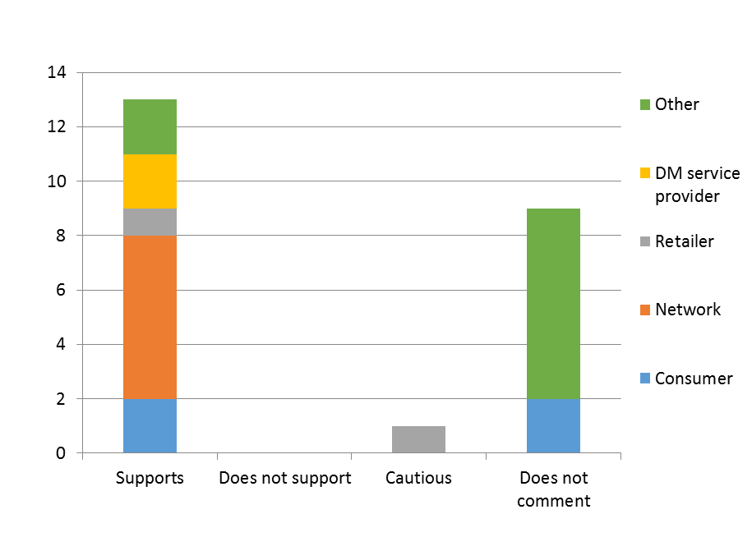
Feedback on the draft Mechanism

Slide 25
Submission/s | Possible change | Our proposal
Ausgrid suggested changing the allowance formula of $200k/year + 0.075% MAR, as MAR is a transmission concept. | Set allowance per year as $200k+ 0.075% of the annual revenue requirement | Adopt suggested change. Essentially a typo.
SAPN & Ausnet suggest increasing the allowance. | Change to $600k/year + 0.075% (SAPN) Increase unspecified (Ausnet) | Maintain draft formula, which provides a reasonable allowance (see next slide).

Slide 26
Allowance under the Mechanism ($’000)
Distributor | Allowance for 2019 (nom) | Previous annual DMIA | Change (%)
ActewAGL Distribution | 321.5 | 100 | 221
Ausgrid | 1,433.6 | 1,000 | 43
AusNet | 700.0 | 600 | 17
CitiPower | 439.1 | 200 | 120
Endeavour Energy | 799.7 | 600 | 33
Energex | 1,276.5 | 1,000 | 28
Ergon Energy | 1,215.1 | 1,000 | 22
Essential Energy | 959.4 | 600 | 60
Jemena Electricity | 411.0 | 200 | 105
Powercor Australia | 699.4 | 600 | 17
SA Power Networks | 810.7 | 600 | 35
TasNetworks* | 390.3 | 400 | -2
United Energy | 544.3 | 400 | 36
Total | 10,001 | 7,300 | 37
* Given reductions in its allowed revenues, TasNetworks’ allowance is expected to be lower than under the DMIA

Slide 27
Submission | Possible change | Our proposal
ENA suggests the Mechanism does not constrain the AER from determining a higher allowance as part of its distribution determination, if the AER is satisfied that this serves long term customer interests. | The allowance amount could be set flexibly during the reset process rather than through the Mechanism formula. | Maintain draft, explicitly opening the allowance available under the Mechanism to individual resets would invite repetitive debate, creating unnecessary regulatory costs.

Slide 28
Submission | Possible change | Our proposal
ENA felt the Mechanism should have flexibility to allow funding to go toward initiatives promoting collaboration, including transparent reporting mechanisms. | Encourage distributors to pool funding for collaboration & knowledge sharing. Include clauses to enable cross-collaboration. | Add clauses for avoidance of doubt, the AER will: permit distributors to collaborate in reporting. consider a distributor’s eligible project need not be geographically restricted to its distribution network. …provided that doing so is consistent with the Mechanism & any relevant laws.

Slide 29
Submissions | Possible change | Our proposal
ISF felt our eligibility requirements would prevent jointly-funded projects, which are valuable for spreading risks/costs & encouraging collaboration. Many other submissions strongly supported collaboration. | A clause in the draft Mechanism on project eligibility should be extended to allow the recovery of the costs of eligible projects that have been funded through cross-collaboration. | Adopt suggested revision. We intended the requirement ISF identified to avoid double-dipping funds, but the draft Mechanism went too far by excluding projects from funding if any part of its costs were recoverable from other government schemes.

Slide 30
Submissions | Possible change | Our proposal
SAPN suggests changing the requirement for a director to sign off on the annual compliance reports. | SAPN suggests either a CEO or suitably qualified officer should be able to sign off instead of exclusively a director. | Accept recommendation to reflect RIN wording.
GreenSync & MEU recommended we provide a system for the pre-approval of DMIA projects. | Design a framework to prequalify types of DMIA projects (Greensync). AER should pre-approve projects (MEU). | Maintain draft that allows for up-front indicative approval. This is a letter of comfort, providing assurance that AER staff will recommend the AER Board approve the project ex-post.

Slide 31
What are your views on our proposed changes between the draft and final Mechanisms?
Given…the objective of the Mechanism is to provide distributors with funding for research and development in DM projects that have the potential to reduce long term network costs.

Slide 32
Early application rule change
Along with the draft Scheme and Mechanism, we published a Consultation Paper to gauge support for a rule change to let us apply the Scheme to distributors mid-regulatory period
We consider an early application rule change would:
prevent long delays for some jurisdictions
provide distributors with investment certainty
allow consumers to capture the benefits sooner
We plan to submit the rule change proposal to the AEMC in early December, when we finalise the Scheme and Mechanism.

Slide 33
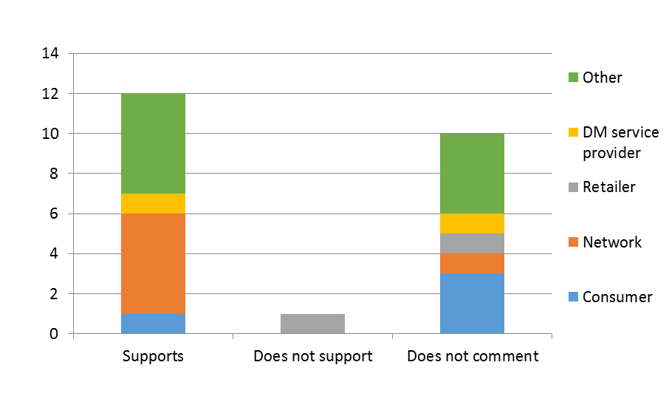
Early application rule change support
Fast-track rule change ≈ 12 - 17 weeks (should not delay Scheme application). Preferred.
Option to seek expedited rule change ≈ 6 weeks (must be non-controversial, and we have received an objection)

