Slide 1
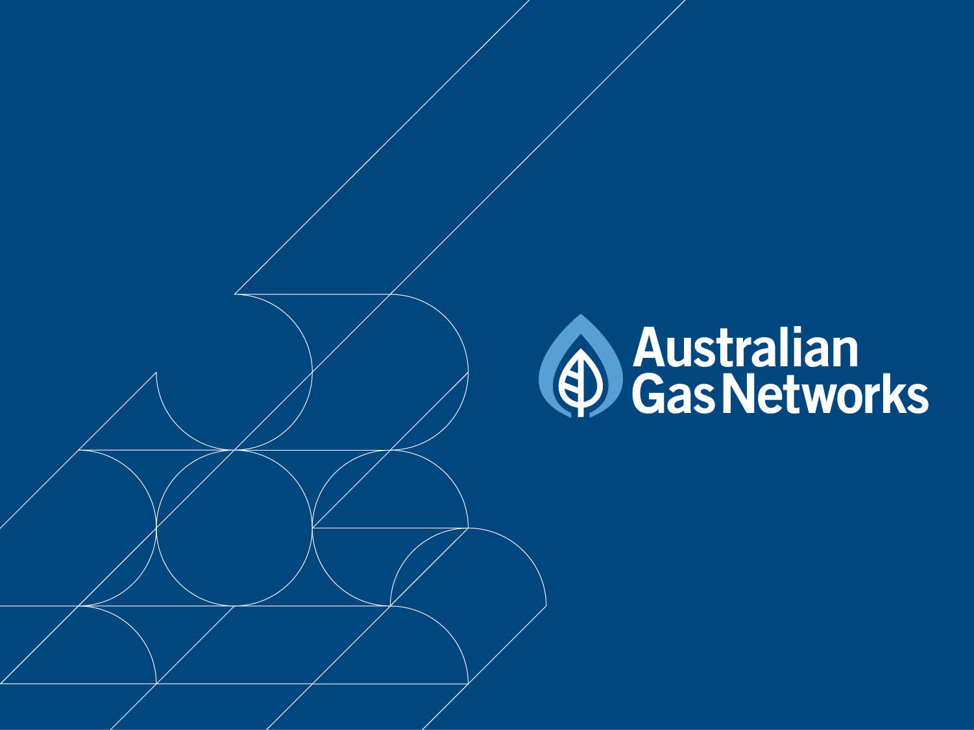
Proposed Consolidation of Albury and Victorian Access Arrangements
10 November 2015

Slide 2

Outline
Overview
Victoria and Albury networks
Customers by zone
Reference Services
National Gas Rules
Impact
Benefits
Approach

Slide 3
Overview
      AGN proposes to consolidate two of its Access Arrangements into one – the Victorian and Albury Access Arrangement
      Consolidation is allowed under NGR 53(2)
      Consolidating these Access Arrangements is a logical step because:
        both networks are managed and operated in the same way
        they operate under the same Victorian market rules
        Albury is directly connected to AGN’s Victorian network
        they provide the same reference services
        the AA reviews are due at the same time (1 January 2017)
        the AER reviewed them together last time (2012), as did the ESCV five years earlier
      AGN expects that this will have no operational impacts on customers
        No change to the operation of the network
        No change to our regulatory obligations
        No change to the structure of tariffs
        No change to the ability for stakeholders to influence the regulatory review process
      Will lead to lower regulatory costs, and hence prices to consumers
        AGN wants to understand stakeholders’ views prior to making a formal submission to the AER
3

Slide 4
Area covered by AGN’s networks
NSW
VIC
Albury
Melbourne
Transmission pipelines
AGN distribution networks

Slide 5
VIC network is split into 4 zones
NSW
VIC
Albury
Murray Valley
Northern
Melbourne
Central
Bairnsdale
VIC network zones

Slide 6
Albury is effectively a fifth zone
NSW
VIC
Albury
Murray Valley
Northern
Central
Bairnsdale
Covered under
Victorian Access Arrangement
Covered under
Albury Access Arrangement

Slide 7
Consolidate access arrangements
NSW
VIC
Albury
Murray Valley
Northern
Central
Bairnsdale
All zones covered under
Victorian and Albury Access Arrangement

Slide 8
Customers by zone
      Albury would be a larger zone than Murray Valley and Bairnsdale in the consolidated network
(21,000)
(521,000)
(73,000)
(10,000)
8

Slide 9
Reference services
      The same suite of reference services are provided in Albury as in the other zones under the same terms and conditions
Reference service | Victoria zones | Albury zone
Haulage services
Tariff D Haulage Reference Service | a | a
Tariff V Haulage Reference Service | a | a
Ancillary services
Meter and Gas Installation Test | a | a
Disconnection | a | a
Reconnection | a | a
Meter Removal | a | a
Meter Reinstallation | a | a
Special Meter Read | a | a
9

Slide 10
National Gas Rules
        AGN is proposing to consolidate under National Gas Rule 53
        Under NGR 53, the AER may direct the service provider to submit a consolidated access arrangement proposal which can be initiated by either the service provider or the AER
          The AER must consider the nature of the pipeline and pipeline services as well as any other matter
          The AER must consult on the proposed terms of the direction with the service provider and any other persons it considers appropriate and may require certain conditions to be met
        National gas objective:
        To promote efficient investment in, and efficient operation and use of, natural gas services for the long term interests of consumers of natural gas with respect to price, quality, safety, reliability and security of supply of natural gas.
        We want to understand and consider any issues or concerns of stakeholders
10

Slide 11
What is the impact of consolidation?
        Albury operates under the same market rules as Victoria and as such retail market dynamics are dictated by Victorian market characteristics; and
        The Albury network is managed and operated by the Victorian business
          Therefore no change in the operation or services of the network
        The AER reviewed the Access Arrangements together in its 2012 review (as did the ESCV five years earlier)
          Therefore no change in stakeholders’ ability to influence the review of the Access Arrangement
        Tariffs in Albury will be subject to the same review process as before
          Therefore no change in the tariff setting process
        Are there any other issues that might exist that would require Albury to retain a separate AA?
11

Slide 12
Why consolidate?
      The benefits of consolidating the Albury AA into the Victorian AA are:
        Reduced administrative burden and cost:
          Avoid the costs associated with preparing and complying with two Access Arrangements
          Cost savings are maximised if Albury can be treated the same as other zones in the Victorian Access Arrangement rather than requiring continued formal separate reporting through a Regulatory Information Notice (RIN)
        Improved certainty to support efficient investment:
          Both networks will be reviewed under one arrangement, assessed at the same time and operated under the same terms and conditions. This formalises the current approach but removes any doubt that the networks could be treated differently by the regulator. Greater certainty allows more efficient investment
12

Slide 13
If the AAs are consolidated:
      AGN will submit one consolidated Access Arrangement Proposal on 1 January 2017
      AGN will combine the Albury regulatory asset base (RAB) with the Victoria RAB
      Tariffs in Albury will be subject to the same regulatory review process but will be considered and calculated in the same way as the reference tariffs for other zones of the Victorian Access Arrangement
      Movements in tariffs for all zones will be considered together and costs will be allocated in line with the approved allocation method
      Information for Albury will continue to be captured separately. However, only one regulatory information notice (RIN) will be prepared
13

Slide 14
Stakeholder Engagement
      AGN has to date met with:
      NSW Energy Department;
      IPART; and
      AGN’s Retailer Reference Group for the Victorian and Albury AA reviews.
      AGN intends to also meet with:
      Victorian Energy Department;
      ESCV; and
      PIAC
    Feedback from stakeholders has been supportive, expressing understanding of AGN’s reasons for pursing consolidation
14

Slide 15
Next steps
      AGN’s next steps are to:
      Conclude stakeholder engagement;
      Reflect feedback from engagement into application to the AER; and
      Finalise and submit consolidation application to the AER – aiming for this to be provided prior to 20 November 2015.
15

Slide 16
Feedback
        Your Comments?
16

Slide 17
Supporting slides
17

Slide 18
Comparison of zones
18

Slide 19
Comparison of zones
<10TJ Customers | Revenue ($) | Volumes (GJ) | Customers
Albury | 5,808,901 | 1,103,957 | 21,115
Central | 167,534,005 | 29,289,705 | 520,799
Northern | 20,143,340 | 3,847,198 | 73,381
Murray Valley Vic | 1,860,109 | 1,004,318 | 10,289
Bairnsdale | 1,446,829 | 167,527 | 3,423
19

Slide 20
Key metrics – Albury
      The Albury network delivers gas to nearly 22,000 customers and accounts for around 1% (or $6 million) of AGN’s total revenue. AGN estimates a penetration rate of approximately 88%.
      Residential
      Connections have grown steadily by 1.8% on average over the past five years.
      Average (non-weather adjusted) consumption has declined by around 2.5% per annum on average over the past five years.
      Commercial
      Connections have grown steadily by 1.0% on average over the past five years.
      Average (non-weather adjusted) consumption has been relatively flat, increasing by 0.7% per annum on average over the past five years.
20

Slide 21
Key metrics – Northern Victorian Zone
      There are 74,000 customers in AGN’s Northern Victorian zone accounting for around 3% (or $20 million) of AGN’s total revenue
      Residential
      Connections have grown steadily by 2.3% on average over the past four years.
      Average (non-weather adjusted) consumption has declined by around 2.7% per annum on average over the past four years.
      Commercial
      Connections have grown steadily by 0.3% on average over the past four years.
      Average (non-weather adjusted) consumption has declined by 1.9% per annum on average over the past four years.
21

Slide 22
Key metrics – Victoria
      The Victoria network delivers gas to over 600,000 customers and accounts for around 35% (or $185 million) of AGN’s total revenue.
      Residential
      Average consumption per residential customer in Victoria is around 46 GJ per annum
      Connections have grown steadily by 2.5% on average over the past five years.
      Average (non-weather adjusted) consumption has declined by around 4.0% per annum on average over the past five years.
      Commercial
      Average consumption per commercial customer in Victoria is 300GJ per annum
      Connections have grown steadily by 0.4% on average over the past five years.
      Average (non-weather adjusted) consumption has declined by around 0.2% per annum on average over the past five years.
22

