Slide 1
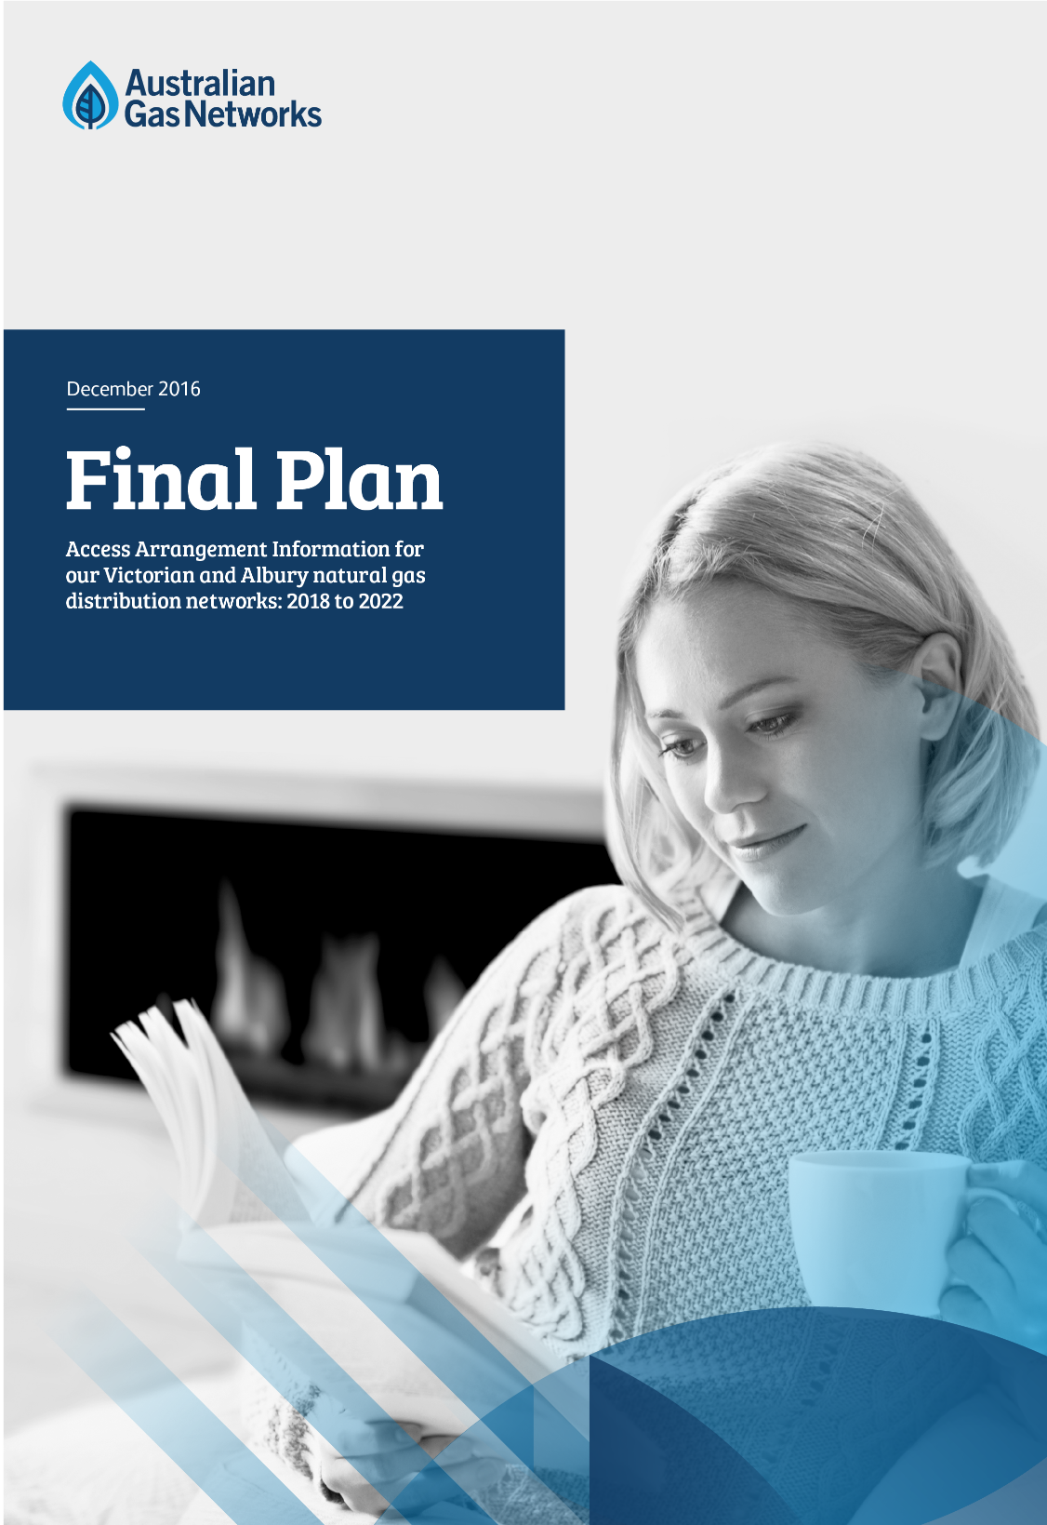
Our Final Plan
AER Public Forum
1 February 2017

Slide 2
Agenda
  Our Vision and Objectives
  Our Plans:
    Delivering for Customers
    Underpinned by Effective Stakeholder Engagement
    Capable of Being Accepted
  The Way Forward

Slide 3
Our Vision and Objectives

Slide 4
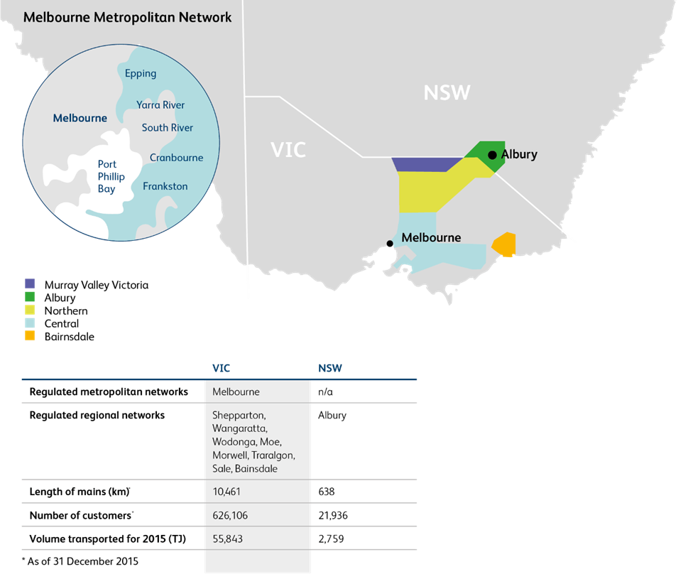
About AGN | Our Regulated Victoria and Albury Operations
We are one of the leading natural gas distribution businesses in Australia, serving 1.25 million domestic, small business and large industrial customers

Slide 5
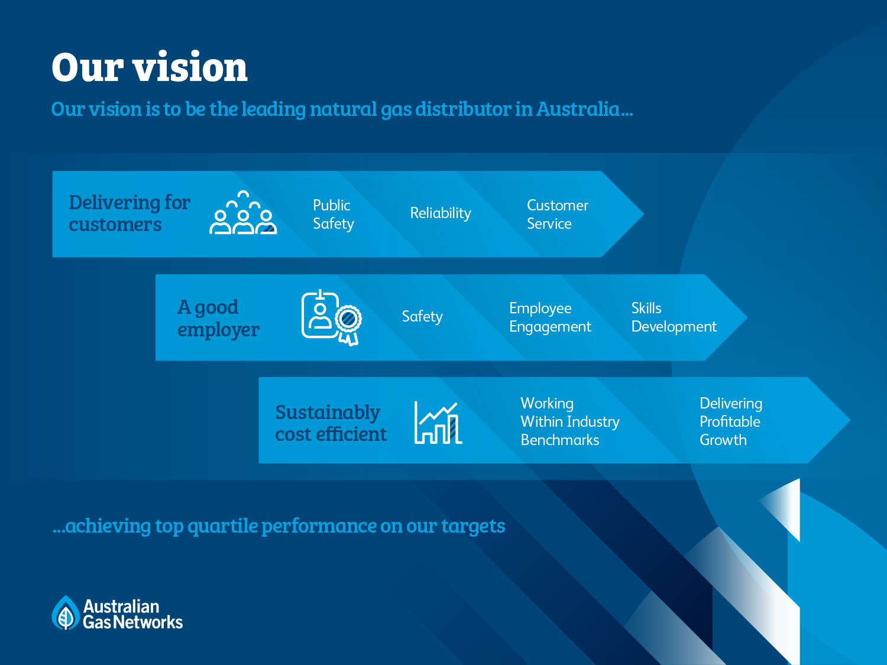

Slide 6
Keeping Customers on Gas
What? |  | Activities in 2016
Positive public perceptions of gas |  | 14 positive news stories SA price cuts campaign (TV, radio, press) New advertising creative
High quality customer service |  | Monthly customer survey, KPI for 2017 New Website – self-serve ready
Economic prices |  | Gas is cheaper than electricity in SA and VIC
Customer growth |  | Marketing
Long-term vision for gas networks |  | ENA ‘Gas Vision 2050’ work underway

Slide 7
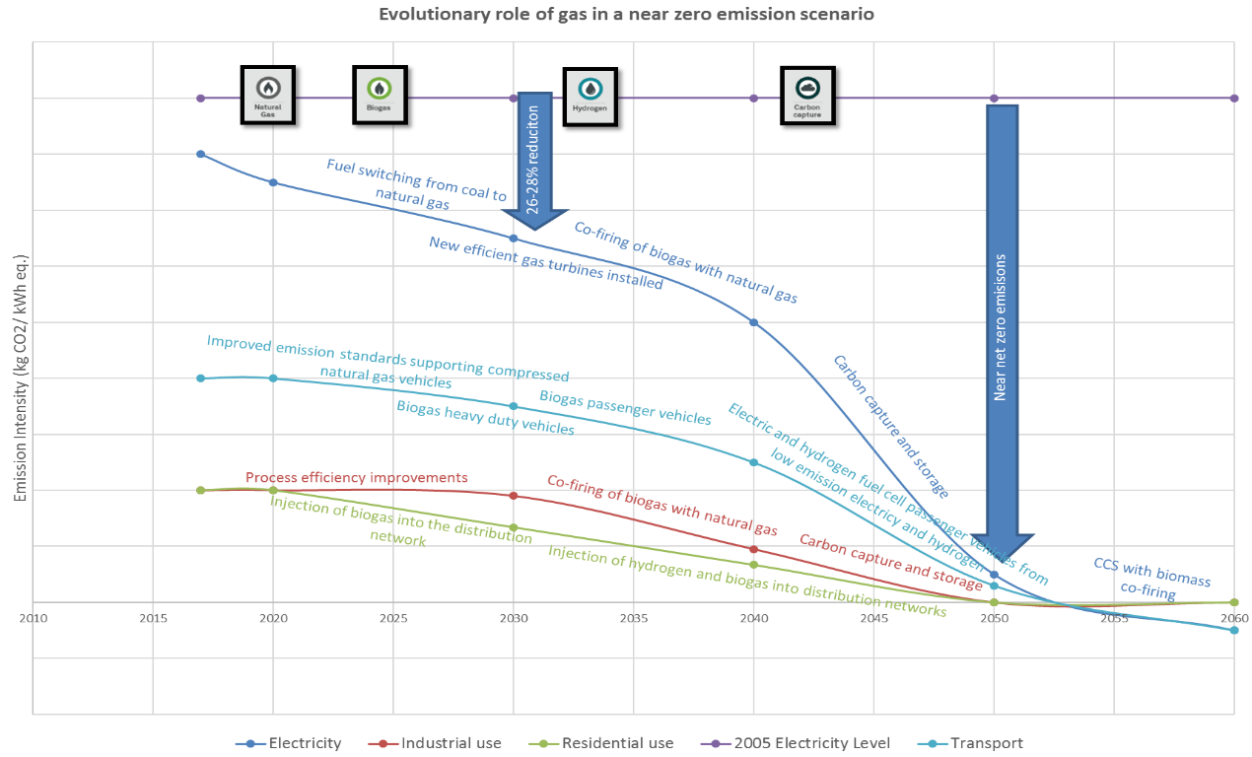
Gas’ Decarbonisation Journey
  The natural gas networks can decarbonise via biogas and hydrogen with carbon capture and storage
  Can pure hydrogen
  networks deliver zero
  carbon by mid-century,
  at a cost comparable
  to mains replacement?
    The modelling for
    conversion of the
    Leeds UK natural
    gas distribution
    network to
    hydrogen indicates
    this is the case

Slide 8
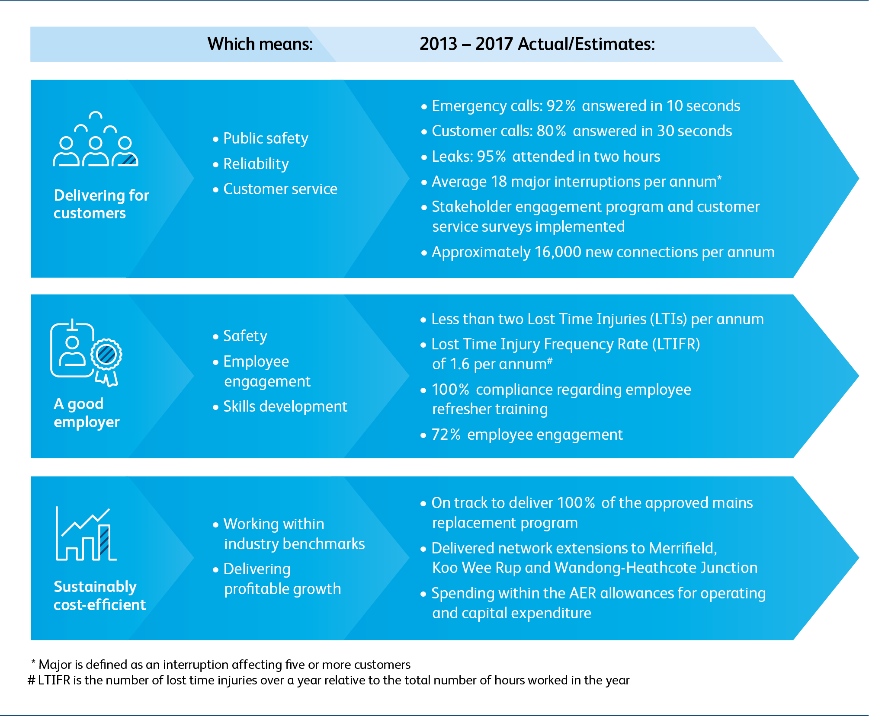
Our Vision | Delivering Against our Vision (Victoria and Albury)

Slide 9
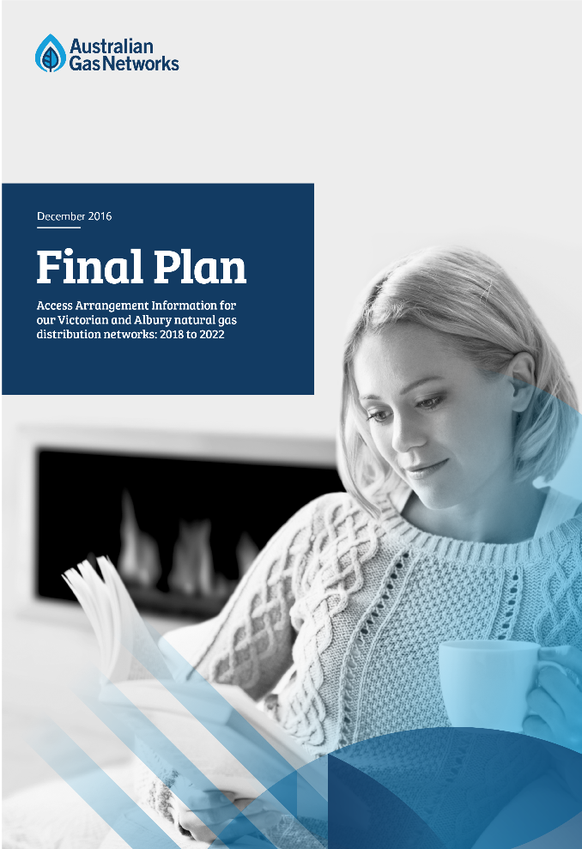
Our Overarching Objective
  Our overarching objective is to submit a plan that:
    Delivers for our customers
    Is underpinned by effective stakeholder
    engagement
    Is capable of being accepted by the
    Australian Energy Regulator (AER)
  This objective was set at the start of our process and
  has driven:
    The engagement process we have followed
    The approaches we have taken
    The decisions we have made
  We have provided clear and consistent information to
  stakeholders throughout engagement process

Slide 10
Our Plans…
Delivering for our Customers

Slide 11




Delivering for Customers | Plans for Victoria and Albury
11
^{Lower}
^{Prices}
%
Improved Service
Lower Costs
New Customers
>90_
$23_
%
m
+80,000
Of emergency calls answered within 10 seconds.
Cut in expenditure compared to actual expenditure incurred in the current period
New customers connecting to our networks over 2018 to 2022
Cut in prices on
1 January 2018*
100_
5.4
%
%
t CO₂
>2.00_
Mains replacement completed.
Finance cost down from 7.39% to <6%.
Tonnes of CO₂ saved per new customer per annum.
Continuous improvement in safety, reliability and customer service.
Ensuring we are sustainably cost-efficient.
Better access to gas, contributing to lower carbon emissions.
Lower prices, lower costs, continuous service improvements
* Before inflation

Slide 12
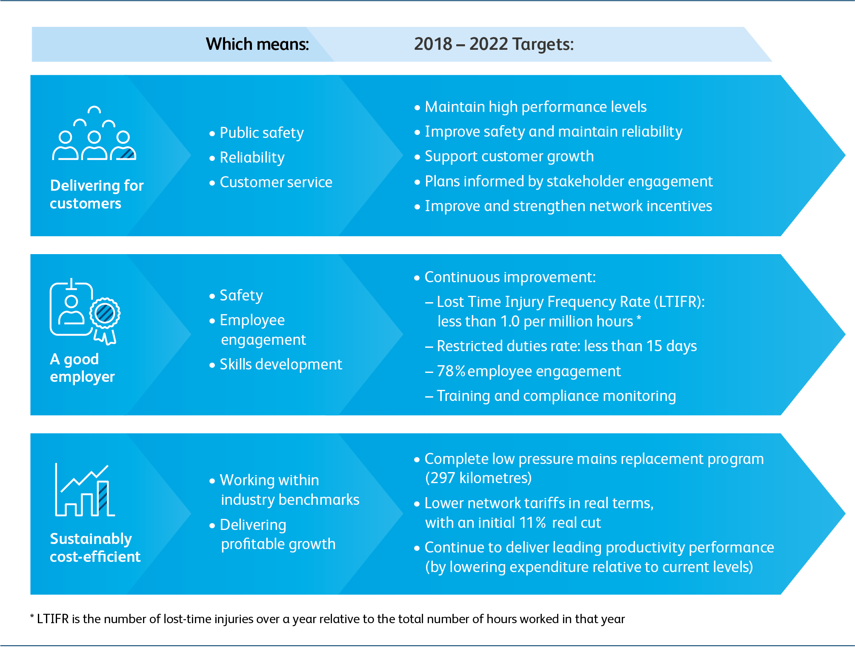
Delivering for Customers | What we will Deliver
297

Slide 13
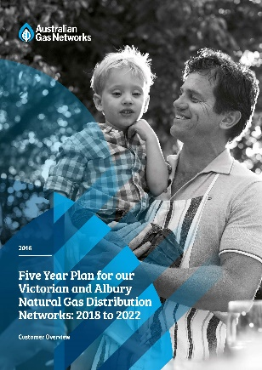
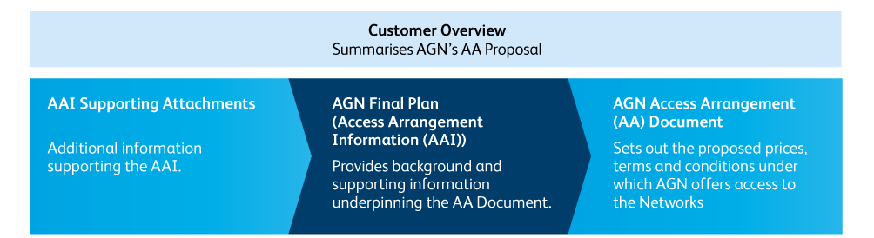
Delivering for Customers | Our Final Plan
  Our Proposal consists of three key documents:
    Customer Overview (20 pages)
    Access Arrangement document
    Final Plan (otherwise known as Access Arrangement Information document)
  Also submitted a range of Attachments and Supporting Information to our Final Plan
  Our Final Plan is written with customers and stakeholders in mind and clearly shows how stakeholder feedback has been considered
Customer Overview available today which provides a summary of the key components of our Final Plan

Slide 14
Our Plans…
Underpinned by Effective Stakeholder Engagement

Slide 15
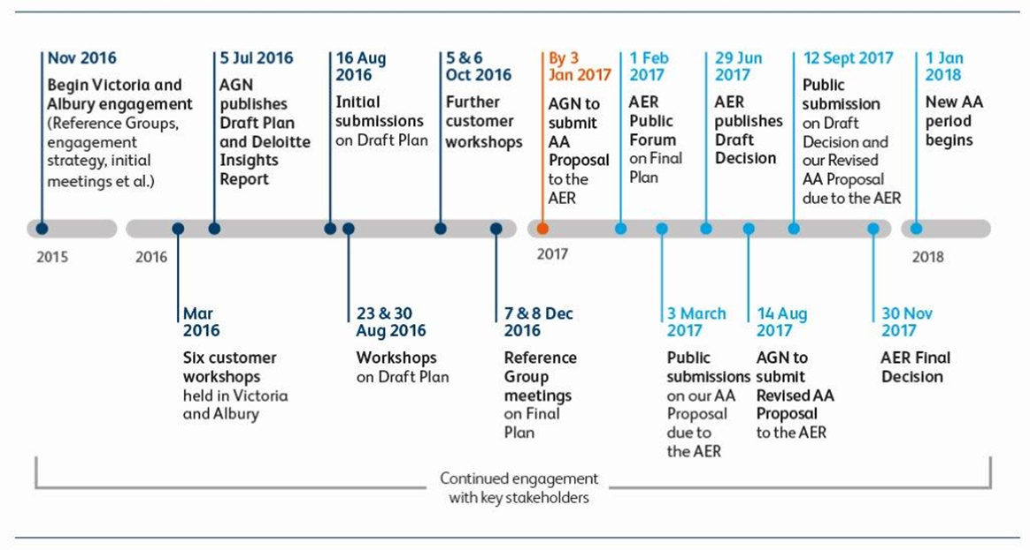
Stakeholder Engagement | Overarching Objectives
  We are committed to providing a plan that delivers for our customers and is capable of being accepted by the AER
  A robust stakeholder engagement program is key to achieving this objective

Slide 16
Stakeholder Engagement | Our Approach…Building on South Australia
Ongoing Engagement with Stakeholders
Strategy | Research | Implementation | Ongoing Engagement
Defines: Who we will engage with. How we will engage. The key issues that will be subject to engagement. How we will track the success of our program. This includes: Workshops with relevant stakeholders. Workshops with our Reference Groups. | Implementation of the engagement strategy. This includes: Designing engagement activities. Preparing clear information to assist stakeholders. Conducting research. Conducting dedicated engagement activities. Capturing and reporting on customer insights. | Insights from the Research Phase considered in the Draft and Final Plans. This includes: Internal workshops to understand insights. Incorporation into Plans. Reporting in a clear and transparent manner how insights are incorporated. Further stakeholder and customer engagement. | This includes: Reporting on the effectiveness of previous engagement. Incorporating lessons learnt into future programs. Ongoing engagement with stakeholders.
Key deliverables: Victoria and Albury Engagement Strategy | Key deliverables: Deloitte Customer Insights Report Findings Report on Incentive Mechanisms | Key deliverables: Victoria and Albury Draft Plan Deloitte Stakeholder and Customer Feedback Report Victoria and Albury Final Plan | Key deliverables: Ongoing Stakeholder Engagement Strategy

Slide 17
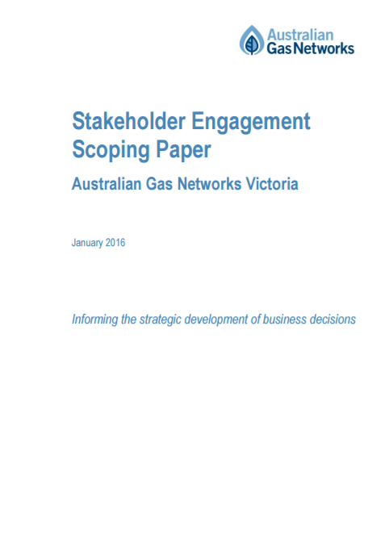
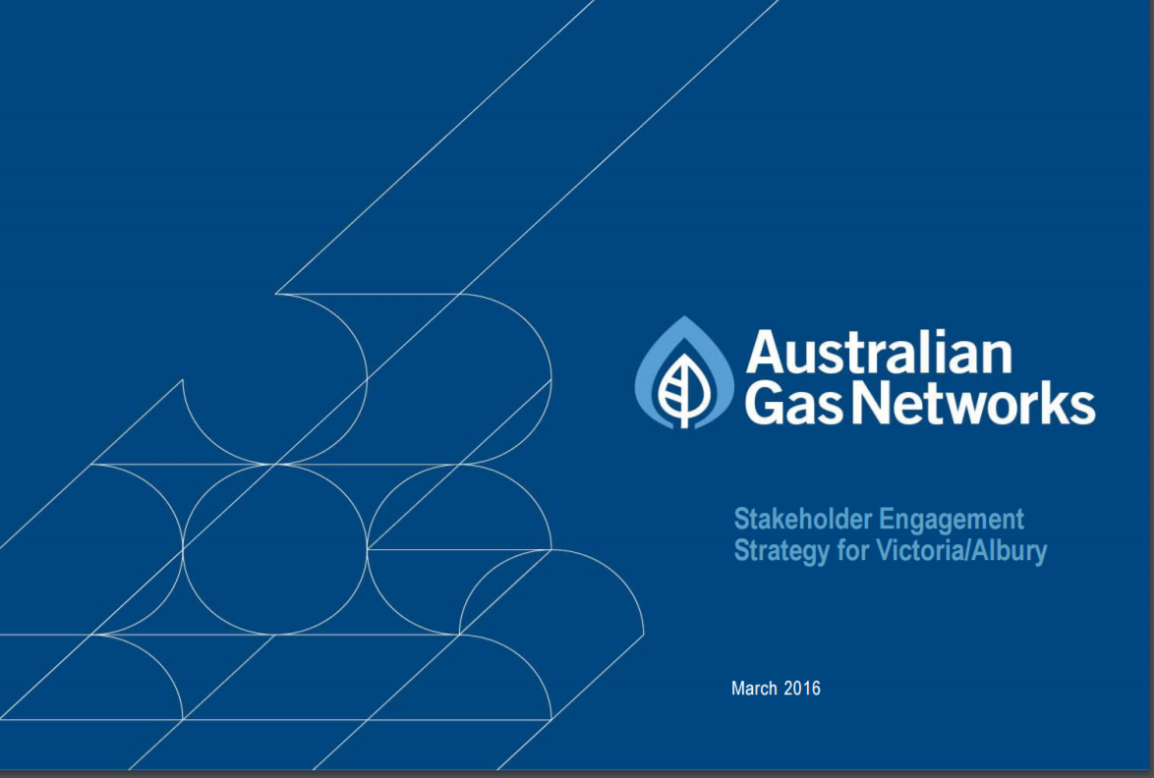
Stakeholder Engagement | Phase 1: Strategy
  Objective: to develop an effective approach to stakeholder engagement for Victoria and Albury
Establish Reference Groups
Develop Scoping Paper
Setting out learnings from previous engagement, who
our stakeholders are, what we should engage on and
our approach to engagement
November 2015
Begin Stakeholder
Engagement Process
Victoria and Albury Reference Group
Retailer
Reference Group
- St Vincent de Paul
CUAC
Ai Group
NORTH Link
Master Plumbers Association
COTA
ECA
AGL Energy
Origin Energy
Simply Energy
Lumo Energy
Alinta Energy
EnergyAustralia
AGN’s Stakeholder Engagement Strategy
Finalise Scoping Paper
Incorporate feedback into final version of Scoping Paper
Meet with Stakeholders
Meet with key internal and external stakeholders and re-iterate Scoping Paper based on feedback

Slide 18
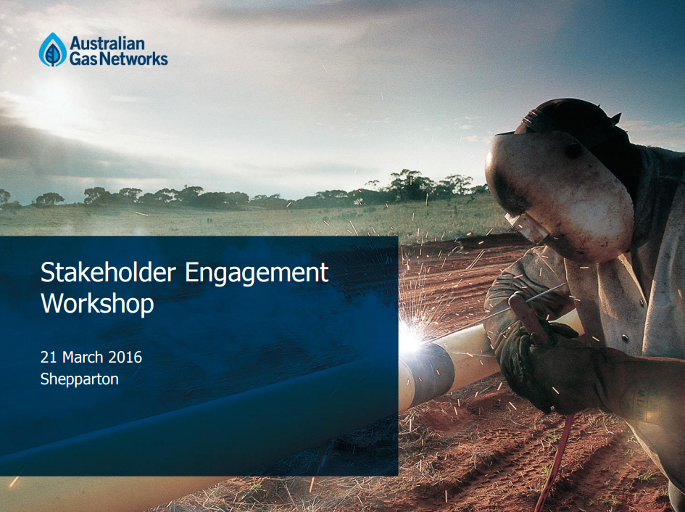
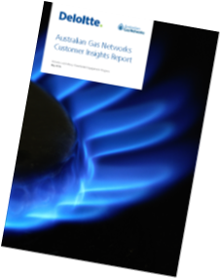
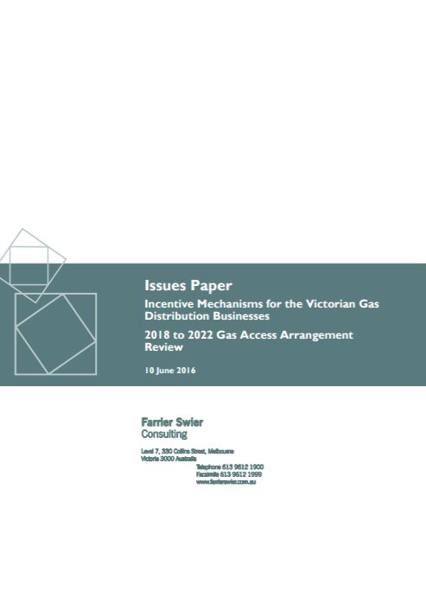
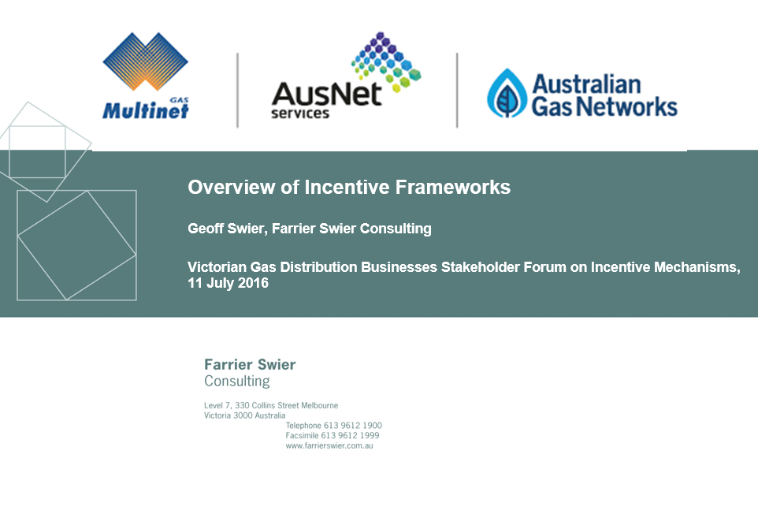
Stakeholder Engagement | Phase 2: Research
  Objective: to develop a better understanding of stakeholder values
March 2016
Six customer workshops | 78 participants | various demographics
July 2016
Deloitte Customer Insights Report
Research
Findings
Customer insights
Preparedness-to-pay in relation to six initiatives
Ranking of six initiatives
Feedback on proposed incentive mechanisms
Forecast demand for large users
Feedback on service from large users
Feedback on our Terms and Conditions
June 2016
Release Incentives Issues Paper
July 2016
Incentives Forum |
12 organisations
Online Survey
June 2016
Contact top 30 large users and issue survey
April 2016
Circulate Terms and Conditions with Retailer Reference Group (RRG)
Terms and Conditions
August and December 2016
Iterative versions of the Terms and Conditions, and a summary of feedback and changes, circulated with the RRG

Slide 19

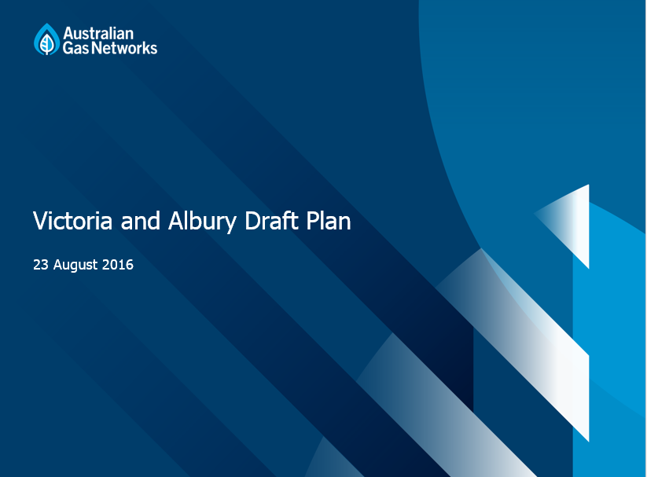
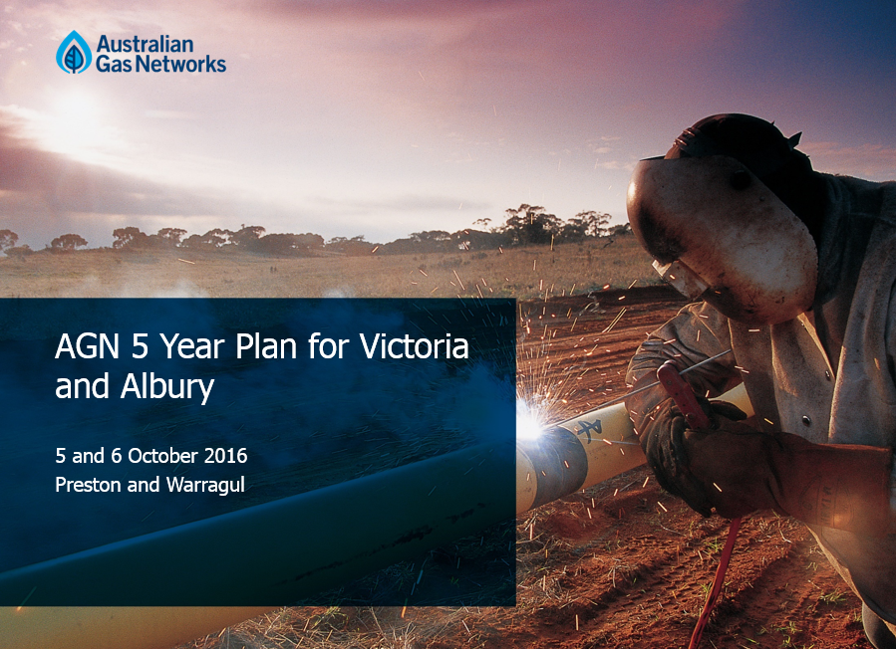
Stakeholder Engagement | Phase 3: Implementation
  Objective: to embed the findings from the Research phase into our Plans
April 2016
Develop Operational Themes to assist integration of Customer Insights into our Plans
April 2016
Internal workshops to discuss and implement Insights and Themes
July 2016
Publish AGN Draft Plan and Deloitte Insights Report – circulate to key stakeholders
By 3 January 2017
Submitted to the AER
October 2016
Capturing final feedback
Continued Refinement of our Plans
Reflective of stakeholder feedback and changes in
market
conditions
August 2016
Consultation on our Draft Plan including through stakeholder workshops and stakeholder submissions
Deloitte Stakeholder and Customer Feedback Report
Findings Report Victorian Gas Distribution Businesses’ consultation on Incentive Mechanisms
Two workshops (Preston and Warragul), 33 participants
Two workshops (12 and 10 organisations respectively), 23 participants

Slide 20
Stakeholder Engagement | Phase 4: Ongoing Engagement
  Objective: to review learnings from our previous programs and continually engage with stakeholders
  Key tools: customer satisfaction survey, stakeholder feedback forms
  Key outputs: feedback on our engagement approach
  Key deliverable: continued refinement and improvement, for example:
    Refined incentives package (asymmetric CESS – reliability protection)
    Energy Safe Victoria support for mains replacement
    No tariff alignment – all zones receive the same price cut

Slide 21
Stakeholder Engagement | Highlights – Broad Range of Stakeholders
 | VARG | RRG | Workshop 1 | Incentive Workshop | Draft Plan Workshop 1 | Draft Plan Workshop 2 | Demand & Service Survey | Workshop 2 | Draft Plan Submission | Other
AEMC |  |  |  |  |  |  |  |  |  | 
AEMO |  |  |  |  |  |  |  |  |  | 
AER |  |  |  |  |  |  |  |  |  | 
AGL Energy |  |  |  |  |  | 
Ai Group |  |  |  |  |  | 
Alinta Energy |  | 
ATA |  |  |  | 
CCP |  |  |  |  |  |  |  |  |  | 
COSBOA |  |  |  |  |  | 
COTA | 
CUAC |  |  |  |  |  | 
Customers: Industry |  |  |  |  |  |  | 
Customers: R & C |  |  |  |  |  |  |  | 
Dairy Industry |  |  |  |  |  |  |  |  |  | 
ECA |  |  |  |  | 
ENA |  |  |  |  |  |  |  |  | 
EnergyAustralia |  |  |  |  |  | 
ESV |  |  |  |  |  |  |  |  |  | 
EUAA |  |  |  |  |  |  |  |  |  | 
EWOV |  |  |  |  | 
Jemena |  |  |  |  |  |  |  |  | 
Lumo Energy |  |  |  |  |  | 
Master Plumbers | 
North Link |  |  |  |  | 
Origin Energy |  |  |  |  |  |  |  |  | 
PIAC |  |  |  |  |  | 
Seed Advisory |  |  |  | 
Simply Energy |  | 
St Vincent de Paul |  |  |  |  | 
Victorian Government |  |  |  |  |  |  |  |  |  | 

Slide 22
Stakeholder Engagement | Feedback
“It is a well considered and robust plan.”
(Stakeholders, Draft Plan workshop)
“…feels like I am being listened to.”
(Customer, secondary workshop)
“Stakeholders were supportive of AGN’s collaborative approach to stakeholder engagement and noted that the release of the Draft Plan facilitated improved engagement. Stakeholders noted that they have been provided adequate opportunity to input into our plans before they are provided to the AER.”
(Stakeholders, Draft Plan workshop)
“Origin values the co-operative approach adopted by AGN, most notably through the establishment of its retailer reference group.”
(Origin Energy, submission on AGN Draft Plan)
“Stakeholders agreed with the AGN approach of applying in Victoria and Albury the most recent AER positions taken in the SA review process”
(Stakeholders, Draft Plan workshop)
“Great to hear/see that our (stakeholder) opinions/values are considered and implemented to form the Plan.”
(Customer, secondary workshop)
Stakeholders have had an opportunity to participate in and influence our Plans

Slide 23
Stakeholder Engagement | Highlights – Draft Plan
  In July 2016, as part of our Implementation Phase, we released the
  Draft Plan for our Victorian and Albury natural gas distribution networks
  The Draft Plan set out our plans for the networks for the next AA
  period including expenditure, demand, rate of return, incentives and
  pricing
  This was the first time such a comprehensive Plan has been released by a natural gas distributor in Australia for engagement well before formal AA submission is due
  Significant step forward in our approach to engagement, including by improving the nature of engagement with our stakeholders
  Draft Plan allowed stakeholders to understand how we had incorporated feedback into our plans and facilitated further engagement on all or part of our plans in the context of our overall proposal
    Key document for a series of further stakeholder and customer workshops
  The Draft Plan, and subsequent engagement, has informed our Final Plan

Slide 24
Our Plans…
Capable of Being Accepted

Slide 25
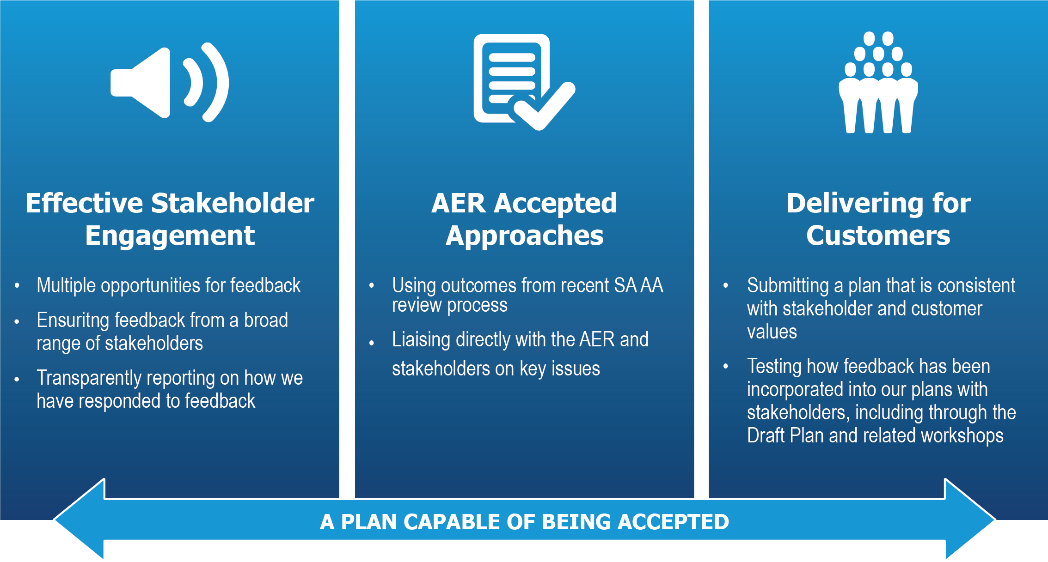
Our Plans | Elements of an Acceptable Plan

Slide 26
Our Plans | Effective Engagement: Opportunities and Incorporation
  Stakeholders (including customers) were provided many opportunities to give feedback including, but not limited to, through
    Numerous customer and stakeholder workshops and surveys
    Incentive issues paper and forum
    Publishing of, and consultation on, the Draft Plan and Deloitte Insights Report
    Dedicated engagement with key stakeholders
  We have ensured that we have understood stakeholder feedback by:
    Key personnel being present at customer and stakeholder workshops (CEO, GM Regulation and GM Victorian Networks)
    Dedicated internal workshops to discuss engagement activities and outcomes
  Final Plan includes a ‘traffic light’ table at the start of each chapter highlighting feedback received on our Draft Plan and how this feedback has been considered in our Final Plan
  Understanding of customer insights was tested through secondary customer workshops

Slide 27
Our Plans | Using Approved Approaches: A Base for Victoria and Albury
  In July 2016 our new Access Arrangement (AA) came into effect in South Australia
  Did not appeal due to preference to:
    Resolve issues with AER and stakeholders rather than through appeal
    Consider overall impact of decision rather than particular issues on their own
  Continued with this strategy in Victoria:
    Adopting AER positions taken in South Australia for Victoria and Albury, rather than re-agitating issues that have already (and recently) been resolved
    Adopting AER positions up until this is no longer appropriate, including as a result of the outcomes of current legal review processes
  For example, our plan:
    Relies upon the AER Guideline to calculate the rate of return, pending any further clarity from the legal review processes
    Outlines a strengthened incentive framework which has been informed by dedicated stakeholder engagement, as directed by the AER and CCP during our South Australian process

Slide 28
Our Plans | Delivering for Customers: Operating Expenditure
Stakeholder Feedback:
Support for our forecasting approach
Support for calculating output growth using customer numbers only
Support for new marketing initiative if we demonstrate that customer benefits outweigh costs
Operating Expenditure per Customer
4% increase in opex
10% increase in customers
81%
  We have applied the AER’s preferred forecasting approach wherever possible

Slide 29
Our Plans | Delivering for Customers: Operating Expenditure
We have used 2016 as our Base Year
Base
AER typically uses the second to last year of the current AA period, as it will be the most recent data available to the AER at the time it makes its Final Decision.
Step
The AER accepts that in some instances, a service provider may face changes to opex not accounted for in base year opex or the ‘trend’.
We have only incorporated one step change, relating to marketing
Trend
Input Cost Escalation
Output Growth
Productivity Growth
We have applied the AER’s preferred approach by averaging forecasts and using AER preferred weights
We have applied output growth based on customer number growth only, consistent with stakeholder feedback
We have applied zero productivity growth, consistent with AER’s decision in our SA review
  We have applied the AER’s preferred forecasting approach wherever possible

Slide 30


Our Plans | Delivering for Customers: Marketing
  Only non-base year cost included in our plan is a $1 million per annum joint marketing program with the other two Victorian gas distributors
  Proposing to expand current program to incorporate metropolitan Melbourne, as a joint project with the other gas distributors, to ensure costs are allocated appropriately
  The marketing program will increase the usage of our network, spreading fixed costs across more customers delivering lower unit costs
  In response to stakeholder feedback, have provided additional analysis to demonstrate benefits of marketing program outweigh costs
Discussion Point:
Conditional stakeholder support
Demonstrated that benefits>costs for all customers in the medium term

Slide 31
Our Plans | Delivering for Customers: Capital Expenditure
Stakeholder Feedback:
Support for our forecasting approach
Support for a range of initiatives (preparedness-to-pay and ranking)
Request for additional information on the impact of marketing on growth capex and IT expenditure allocation – in response we have provided this additional information
Support for engagement with Energy Safe Victoria (ESV) as opposed to stakeholders on mains replacement
Support from the ESV for our proposed mains replacement program
6% decrease in capex
10% increase in customers
Capital Expenditure per Customer
  Lower capex, but improved safety and ongoing reliability for customers

Slide 32
Our Plans | Delivering for Customers: Capital Expenditure
Composition of Capital Expenditure
  Key components of capex proposal (accounting for around 75% of proposed capex) are:
    Growth Assets – driven by demand forecasts and in line with current period spend (not discussed further)
    Mains Replacement – proposed kilometres of mains replacement endorsed by Energy Safe Victoria (ESV)
    Information Technology – consistent with national program of work approved by the AER in our SA AA review

Slide 33
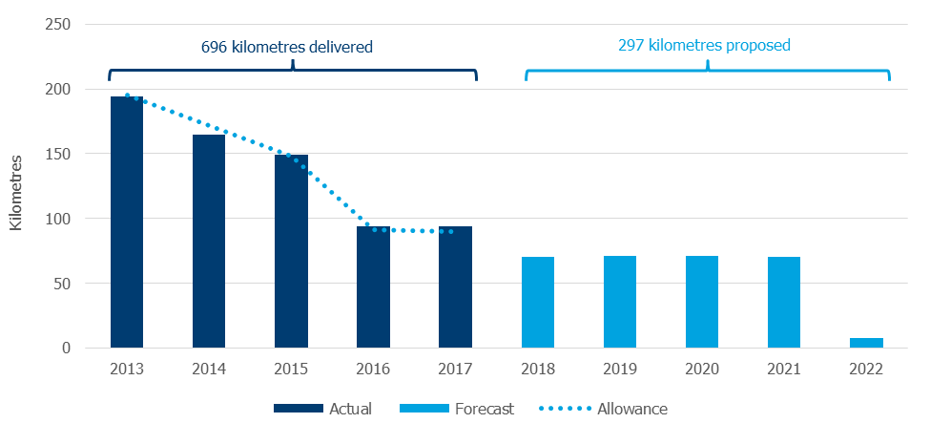
Our Plans | Delivering for Customers: Mains Replacement
  Current performance:
    On track to deliver
    benchmark volume of low
    pressure mains
    replacement program
  Next period proposal:
    Complete low pressure
    replacement program
    Moving into Melbourne CBD
  Decrease of approximately $90m over the next period, compared to costs incurred in current period
  Energy Safe Victoria (ESV) has endorsed our proposed mains replacement program:
        “…ESV supports the proposed mains and services replacement program outlined in AGN’s DMSIP [Distribution Mains & Services Integrity Plan]…”
Safety considerations are driving our mains replacement program
Discussion Point:
Continuation of current program, which we will deliver in full this period
Driven by safety considerations, supported by the ESV, consistent with stakeholder feedback

Slide 34
Our Plans | Delivering for Customers: Information Technology
  All proposed projects have been accepted in our South Australian AA, this consistency is driven by managing the roll-out of national IT systems across our networks
  Like South Australia, following a long period of no/low investment in IT capabilities
  IT projects fall under three key categories:
    Nationalisation – state based systems no longer supported (10+ years old)
    Stay-in-business – maintain the integrity, security and operability of IT investment
    Improvement of service – better utilisation of existing assets
Discussion Point:
Extension of national program recently approved in South Australia
Brings our capabilities in line with industry standard, consistent with stakeholder feedback on preferred communication
Expenditure remains at or below industry mean

Slide 35
Our Plans | Delivering for Customers: Financing Costs
Stakeholder Feedback:
Support for our approach of adopting the AER’s guideline
  We have applied the AER’s guideline approach to establishing the cost of debt, cost of equity and gamma
    This is consistent with our SA decision and was supported by our stakeholders
  We consider rate of return to be an industry issue, the same methodology therefore should be applied to each business when determining the respective rates of return
  We will continue to apply the AER guideline approach to the determination of these parameters up until there is information suggesting this is no longer appropriate
  Weighted Average Cost of Capital of 5.28% based on AER cost of equity (6.58%) and cost of debt (4.42%)
We have applied the AER’s guideline approach, subject to any third party applied outcomes
Discussion Point:
This is an industry issue and will be resolved through the legal review process. We will adopt the outcome of this process.

Slide 36
Our Plans | Delivering for Customers: Inflation
Stakeholder Feedback:
Discussion over the best approach to determine inflation, merit with our preferred market-based approach and the AER preferred use of RBA target – in response we have applied the AER preferred approach to estimating inflation
  Inflation remains a key outstanding issue coming out of the South Australian review
  We support a different methodology to the AER (market based breakeven approach)
    Relies on market information, consistent with that used to derive the nominal rate of return, this consistency is key to the effective operation of the PTRM and RFM
  AER raised concerns with the breakeven approach and we have responded to these in our Final Plan, and still maintain the breakeven approach gives the best estimate of inflation
  Our Final Plan relies on the AER preferred approach:
    2.39% – 10-year average of the RBA short-term forecast and long term target
    Compares to 1.5% current, and circa 2% short-term forecast
The AER recently announced a review into how inflation is estimated, we will participate in that review
Discussion Point:
We are looking forward to further collaborative engagement with the AER and other stakeholders on this issue and will adopt the outcome of this process.

Slide 37
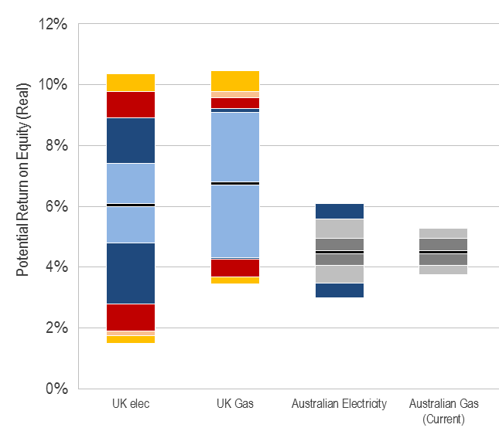
Our Plans | Delivering for Customers: Importance of Incentives
Stakeholder Feedback:
Support for the need for an incentive framework
Support for current opex incentive scheme (EBSS)
Support for introduction of capex incentive scheme (CESS), but with an ex-post reliability/service assessment
Support for network innovation incentive, some stakeholders considered this could be funded through existing opex and capex incentives
  Under a strong incentives framework, cost control and operational performance drive financial performance
  As a result companies focus on the customer and not on the Regulator
We are strong supporters of effective, outcome-based incentive arrangements

Slide 38
Our Plans | Delivering for Customers: Incentive Mechanisms
  Our Final Plan proposal was heavily guided by stakeholder engagement
  Along with other two Victorian distributors, we implemented a robust engagement program in relation to incentives
    Issues Paper circulated 17 June, workshop held 11 July, Findings Paper released October 2016
  Continue with current opex incentive scheme
  We are proposing to introduce a capex incentive scheme, of similar design with that applied in electricity
    Any payments are however contingent on maintaining current levels of network indicator performance across three measures: unplanned SAIDI, water in mains and leaks
      Consistent with stakeholder feedback no reward for increased performance (stakeholders already satisfied) but we are penalised for poor performance
  We are proposing a network innovation scheme to support our effort to de-carbonise the distribution network
Discussion Point:
We are looking forward to further collaborative engagement with the AER and other stakeholders on this issue and will adopt the outcome of this process.

Slide 39
Our Plans | Delivering for Customers: Tariff Structure and Prices
Stakeholder Feedback:
Support for price path, but questioned the alignment of tariffs across zones as this would lead to all customers not receiving a price reduction – we have decided not to align the tariff zones
  Our Plans provide for lower distribution charges over the next five years compared to the current AA period
    While delivering continuous improvement in safety
    and customer service and maintaining the reliability
    of the network
  Our prices reflect stakeholder feedback that:
    Customers are concerned with recent price increases
    Customers prefer having tariffs more heavily
    weighted to variable (usage) charges
    All tariff zones should receive the same price decrease
      Tariffs not aligned across zones
In 2018, the average customer will save:
$40
Residential
$185
Commercial
$3,698
Industrial
Initial price cut of 11.5% from 1 January 2018 followed by 2.5% real increases thereafter

Slide 40
The Way Forward

Slide 41
The Way Forward | Key Next Steps
  Public submissions to the AER close on Friday 3 March
  Look forward to ongoing collaboration with stakeholders and to feedback we receive in public submissions

Slide 42
Our Plans | Delivering for Customers
11
^{Lower}
^{Prices}
%
Improved Service
Lower Costs
New Customers
>90_
$23_
%
m
+80,000
Of emergency calls answered within 10 seconds.
Cut in expenditure compared to actual expenditure incurred in the current period
New customers connecting to our networks over 2018 to 2022
Cut in prices on
1 January 2018*
100_
5.4
%
%
t CO₂
>2.00_
Mains replacement completed.
Finance cost down from 7.39% to <6%.
Tonnes of CO₂ saved per new customer per annum.
Continuous improvement in safety, reliability and customer service.
Ensuring we are sustainably cost-efficient.
Better access to gas, contributing to lower carbon emissions.
Lower prices, lower costs, continuous service improvements
* Before inflation
Thank You

Slide 43
Supporting Information

Slide 44
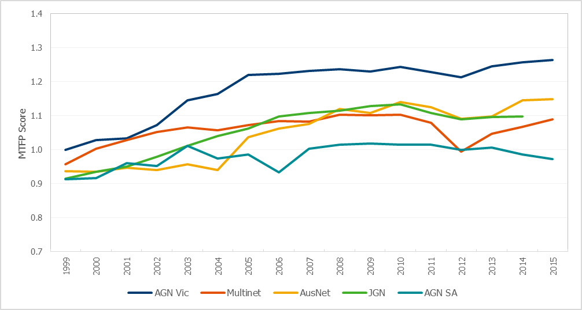
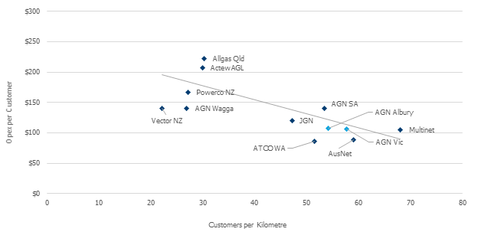
Our Vision | Leading Productivity Performance
  Multilateral Total Factor Productivity (MTFP)
  Opex per Customer versus Customer Density
MTFP = Outputs (throughput, customer numbers, system capacity) / Inputs (opex, network length, meters, other assets)
19%
Our productivity levels (MTFP) are around 10% higher than the next most efficient distributor
81%
Source: Economic Insights, May 2016

Slide 45
Stakeholder Engagement | Implementation of Customer Feedback
Insight | AGN Plan
Customers are not aware of AGN | We will introduce/continue several projects over the next five years, with a view to increasing visibility and understanding. These programs include: stakeholder engagement, marketing and digital capabilities.
Customers do not understand the structure of the gas industry
Customers would like AGN to be more visible, believing it would improve their experience as customers
Customers would like to access more information from AGN and favour digital channels
Customers traditionally considered gas a cost-effective alternative to electricity but are concerned with recent price increases | Distribution prices will be lower over the next five years, compared to the current period.
Customers view gas as a reliable source of energy and value the current standard of reliability | Our expenditure is focussed on safety and reliability. Funds will be used to maintain (not improve) network reliability and improve network safety.
Customers are supportive of initiatives that maintain the reliability and improve the safety of the network
Customers value the control gained by having their gas bill dependent on usage levels | AGN has retained current tariff structures which are weighted towards the variable charge
Customers would like AGN to play a leadership role in minimising environmental impact | AGN has commenced work relating to minimising and reporting on our environmental impact

Slide 46
Stakeholder Engagement | Implementation of Customer Feedback
Initiative | Estimated Cost | Support | AGN Plan | Proposed Cost
Do you support paying more on your gas bill to increase public awareness of AGN’s assets to improve safety? | $0.10 to $3.00 | 97% | AGN will be increasing awareness through other initiatives (digital capabilities, marketing). | -
Do you support paying more on your gas bill for AGN to gain access to inaccessible gas meters? | $0.50 | 60% | We will work with customers to access and relocate meters at the end of their useful life. | -
Do you support paying more on your gas bill to complete ~300kms of the mains replacement program? | $6.00 | 95% | We have determined that 297 kms of mains require replacement over the next five years. | $4.20
Do you support paying more on your gas bill to improve fire preparedness by installing safety devices? | $0.50 to $3.60 | 94% | We will install thermal safety devices on all new and replacement meters in bushfire zones. | $0.50
Do you support paying more on your gas bill to duplicate the Dandenong transmission pipeline? | $1.00 | 85% | We will duplicate the Dandenong transmission pipeline. | $0.50
Do you support paying more on your gas bill to conduct a series of smaller projects to support reliability? | $3.00 | 86% | We will undertake a series of smaller projects to maintain reliability. | $0.50
 | $11.10 to $17.10 |  |  | $5.70
Expanded marketing program to increase customers and network utilisation. | $3.00 (tested in second workshops) | 94% | In conjunction with the other Victorian gas distribution businesses we will expand our marketing program to lower costs to all customers in the medium term. | $1.50

Slide 47
Stakeholder Engagement | Key Feedback Consideration in Final Plan
Chapter | Stakeholder Feedback
Opex | Support for our forecasting approach Support for calculating output growth using customer numbers Support for new marketing initiative if we demonstrate that customer benefits outweigh costs
Capex | Support for our forecasting approach Feedback (preparedness to pay and ranking) for a range of initiatives Request for additional information on the impact of marketing on growth capex, new connection expenditure and IT expenditure allocation [we have provided additional information where available] Support for engagement with the ESV as opposed to customers on mains replacement
Financing Costs | Support for our approach of adopting the AER’s Guideline
Incentives | Support the need for an incentive framework Support for current EBSS Support for CESS, but with contemporaneous reliability/service scheme Support for network innovation incentive, some stakeholders considered this could be funded through opex and capex incentives
Chapter | Stakeholder Feedback
Network Revenue | Support for price path, but questioned if there was an alternate approach that provides stable credit metrics [in response we adjusted our price path] Support for financeability adjustment if required to provide stable credit metrics
Demand | Support for approach to demand forecasting Support for transparent forecasting assumptions
Network Pricing | Questioned whether it was appropriate to provide price decreases to all customers aside from those in the northern region [in response we adjusted our price structure so all customers receive a price decrease in 2018] Stakeholders questioned whether, despite the preferences stated of our customers, a greater proportion of cost recovery should come from fixed charges [we have maintained our current pricing structure, which is weighted towards variable costs]
Network Access | The RRG has provided several iterations of feedback on our Terms and Conditions

Slide 48
Our Plans | Delivering for Customers: Demand
Stakeholder Feedback – Demand:
Support for our approach taken to demand forecasting, noting that it was consistent with the approach recently approved by the AER for our South Australian network
Questioned if prior demand was an indicator of future demand – in response we explained the forecasting approach has the flexibility to capture change in policy or customer behaviour
Requested that all assumptions be made transparent in our Final Plan – we confirm that assumptions used to forecast demand will be transparent and identifiable in our Plan
  Summary of our demand forecasts is provided below:
Average Annual Growth Rates | Residential |  | Commercial |  | Driver
 | History | Forecast | History | Forecast
Demand per Connection | -1.5% | -2.2% | 0.2% | -0.5% | Forecast increase in wholesale price of gas, improved energy efficiency of appliances and new homes
Number of Connections | 2.4% | 2.0% | 0.6% | 0.7% | HIA forecasts of new dwelling construction activity and outcomes of marketing proposal
Total Demand | 0.8% | -0.2% | 0.8% | 0.2% | Results from the demand per connection and number of connection forecasts

