Slide 1
AER’s Murraylink public forum
Public
Public Forum

Slide 2
Contents
Topics to be covered
Direct current transmission
Operating expenditure
Capital expenditure
Consumer engagement
Contingent project

Slide 3
Direct current transmission
The Murraylink transmission line is not like other TNSPs
There are only two transmission lines in the world with Murraylink’s converter configuration
Murraylink
    Cross Sound Cable link (Connecticut to Long Island)
ABB is the manufacturer for both of these transmission lines
The configuration choices set at the construction set the nature of the asset for its entire life.
The nature of the transmission line goes to the heart of what is and isn’t efficient expenditure.

Slide 4
Direct Current Transmission
Murraylink/APA are trying to efficiently manage supplier relationships within the economic constraints – service level agreement.
Murraylink was built by ABB using a series of ABB and other proprietary technologies. These include:
Control System
IGBTs
Capacitors
Reactors
Circuit breakers and other switchgear
And other HVDC or HVAC operating equipment
This equipment was designed to smoothly interact with each other.
Replacement equipment needs cost effectively continue that interaction.

Slide 5
Direct Current Transmission
The Murraylink control system must be compatible with a range of equipment.
Control system is active part of the DC transmission line
The control system operates the
  Protection systems (HVAC and HVDC)
  Conversion system
  Dynamic voltage control
These systems do not function without the active participation of the control system.
Control system is highly integrated with other equipment.
The control system has to interact with all elements of the transmission asset flawlessly.
  In particular there is no scope for error in how it interacts with the IGBTs
A key challenge for replacement of the control system is software changes

Slide 6
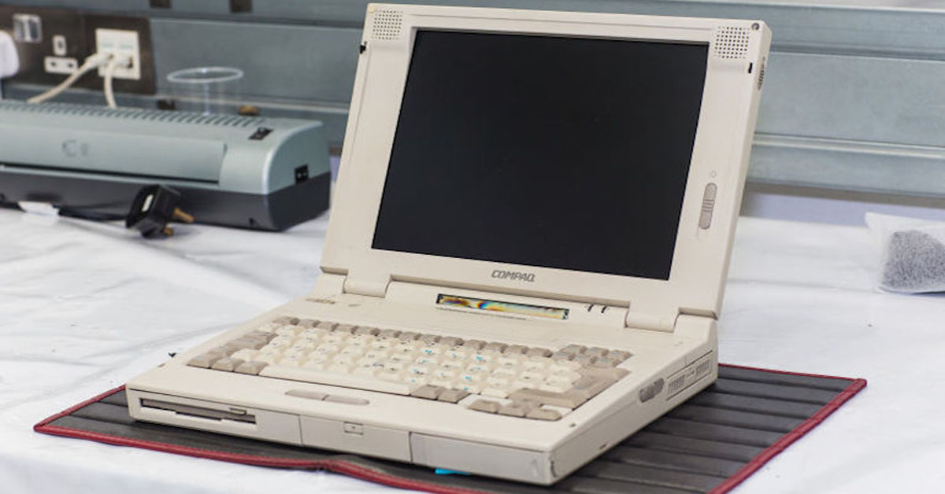

Capital expenditure
Why Murraylink can’t, and doesn’t need to, delay the replacement of the control system
82% of forecast capex
All TNSPs replace control and protection systems
  Murraylink only has one control and protection system
  HVAC’s have more than one ie a control and protection system for SVCs at substations - ElectraNet Para
To maintain ongoing delivery of service replacement is not optional or subject to flexibility.
  Can’t delay beyond 2021 as significant risk of total failure
  Supplier won’t replace failed parts as of 2021.
An upgrade of capacity on Murraylink would only require minor modifications to the control system.
Control system uses “cutting edge” technology from 1990s. To understand reflect on technology changes in that time in other computers.
late 1990s laptop
2017 laptop

Slide 7
Operating expenditure
Inclusion of a service level agreement is consistent with maintaining the quality, reliability and security of supply
Step change – ABB service level contract
Would form part of base opex in future years
Would be subject to the EBSS
Need to be careful to not “artificially constrain” AER’s consideration of forecast operating expenditure.
Can’t reprioritize expenditure to adjust for an ongoing annual payment. Reprioritization implies at certain point can do catchup.
Murraylink is too small to have the AER think in terms of “exceptional events”. Many “one offs” due to fewer assets than other networks.
In this respect Murraylink is not similar to AusNet/ Powerlink/ ElectraNet/ Transgrid.
Test is whether forecast operating expenditure is consistent with the rules (6A.6.6(c) and 6A.6.6(a)(3)(iii))

Slide 8
Consumer Engagement
Murraylink’s customer engagement is fit for purpose
Murraylink has frequent engagement with the users of our service
APA staff connected with Murraylink are frequently meeting:
  AEMO
  ElectraNet
  AusNet Services
  Transgrid
These parties either direct the operation of Murraylink (AEMO/ElectraNet) or are critical to the ongoing operation of the Murraylink (AusNet Services/Transgrid).
Murraylink charges AEMO and ElectraNet on a monthly basis

Slide 9
Contingent Project
SA power market is forecast to have major changes
Since lodgment of our revenue submission the following has occurred:
SA Government energy plan
  Renewable technology fund
  100MW grid connected battery storage
  250 MW gas fired generator
  Energy Security Target (requiring retailers to acquire SA sourced power)
Feasibility study on Snowy Hydro hydro storage scheme
  2 GW of hydro storage
  Exact location unknown – dependent on outcomes of feasibility study.
Federal Government announcement on gas security
  Consideration of the contingent project needs to be updated to reflect these changes.
  Murraylink will provide the AER additional information as it becomes available.

Slide 10
Contact details
For further information contact:
Mark Allen
Regulatory Manager
(02) 9275 0010
mark.allen@apa.com.au
Or visit the APA website at:
www.apa.com.au

Slide 11
Murraylink
Direct current interconnector between SA and Victoria (Monash to Buronga)
220 MW capacity – bi-directional
Runs underground through sensitive natural environment
Owned ultimately by Energy Infrastructure Investments

