Slide 1
victorian transmission system access arrangement revision proposal
Public forum
1 February 2017
Alex Curran
Regulatory Manager

Slide 2
overview
revision proposal key themes
components of revenue building blocks
demand, cost allocation and pricing
bill impacts
consumer engagement

Slide 3
revision proposal key themes

Slide 4
revision proposal key themes
Responsiveness to customer demand
Significant new gas flows north to NSW and Queensland
Investments for the future
Future growth through Western Outer Ring Main easement purchase
Safety and integrity spending
Possible changes to the policy environment
New market structures under policy consideration
Consistency with current arrangements
Consistency in tariff structure and how costs are allocated to tariffs

Slide 5
components of revenue building blocks

Slide 6
capital base and capital expenditure
VTS regulatory capital base at 1 January 2018 is $1,005 billion
Expenditure in current period higher than forecast
Driven by expansion to accommodate increased demand for capacity for gas flows north to NSW and Queensland (VNIE project)
Increase from incremental 30TJ/day demand for firm capacity at Culcairn to 149TJ/day
Total VNIE project expenditure $299 million (approved was $46.4 million)
Total forecast capital expenditure $168.4 million
Inline inspection (pigging) - $28.5m
Safety management – high consequence areas - $27.3m
WORM easement acquisition - $26.7m
Anglesea pipeline - $17.4m
Brooklyn Compressor Station upgrade - $9.6m

Slide 7
forecast capital expenditure -projects
Top 5 projects (out of 50) = 65% of forecast capital expenditure

Slide 8
operating expenditure
Significant operating expenditure efficiencies in earlier period driven by
APA restructure towards national operations (away from state-by-state) – implemented in 2012/13
Significant declines in insurance costs (renegotiation and positive claims history)
Reduction in corporate overhead

Slide 9
rate of return and value of imputation credits
Rate of return – 7.88%
Generally applied rate of return guideline
Updated for current values in respect of beta, RFR and MRP
Return on debt determined as a simple historical trailing average
Adopted gamma of 0.25
APA VTS expects outcome will ultimately reflect outworking of current legal/appeals processes

Slide 10
revenue
Increased revenue in the forecast period driven by increase in capital base from the VNI
Those shippers benefiting from that expansion are paying for it – increase in revenue from larger capital base not allocated to Victorian-based Tariff-V or Tariff-D customers
Tariff-D & Tariff-V total revenue increase is marginally more than inflation, driven by small increase in proposed cost of capital
2016 = $67.1m
2018 = $70.7m
Culcairn revenue increasing by more due to expansion
2016 – 16% of total revenue
2018 – 25% of (higher) total revenue
$m nominal | 2018 | 2019 | 2020 | 2021 | 2022
Smoothed revenue requirement | 121.9 | 131.8 | 142.5 | 154.0 | 166.5
X factors tariff revenue (%) |  | -6.0 | -6.0 | -6.0 | -6.0

Slide 11
demand, cost allocation and pricing

Slide 12
historic and forecast demand trends

Slide 13
cost allocation and pricing
APA VTS has retained tariff and cost allocation structure from current period
Transmission tariffs apply to injections and withdrawals separately
In VTS gas ownership can change within the system through the operation of the wholesale gas market
Shippers do not contract for point to point transportation
Injection tariffs recover the cost of transportation of gas from injection points to a nominal “hub”
Hub considered as the Melbourne metro area
Withdrawal tariffs recover the cost of transportation of gas from the “hub” to its withdrawal location
Includes transportation within or across the Melbourne metro area
Each delivery (withdrawal) point is allocated to a withdrawal zone
Demand is split between Tariff D (large industrial) and Tariff V (residential and small business) within each zone

Slide 14
VTS tariff structure
Total transmission charges
Injection charge
Withdrawal charge
Other withdrawal
Refill
Cross system

Slide 15
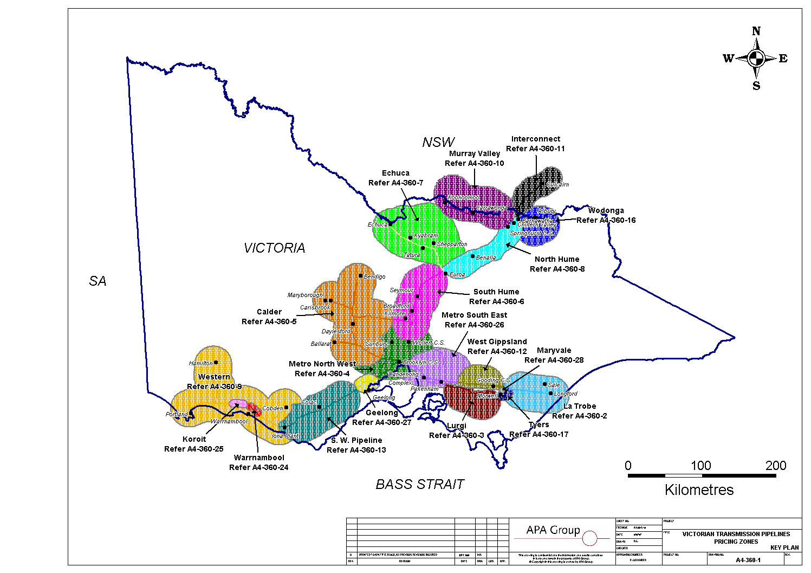
VTS tariff zones

Slide 16
VNI expansion cost allocation
VNI expansion
Capacity related system capital costs
Locational
Allocated to asset zone
Allocated to Culcairn withdrawal tariff
All within Tariff-D class (no small customer capex allocation)
Increased VNIE expenditure and volumes takes additional proportional share of non locational costs (eg. non-system capital, corporate, etc)
Victorian domestic customers do not bear the costs of VNI expansion and receive benefit from reduced allocation of common costs
Culcairn allocated $5m of indirect costs that would otherwise be shared throughout the system

Slide 17
tariff/bill impacts

Slide 18
tariff/bill impacts
Residential customer (60GJ/annum)
Transmission tariff average contribution to customer bill is about 2 per cent
Revision proposal equates to an increase in annual customer bill in 2018 of about $3.00 (0.3 per cent)
Small business customer (500GJ/annum)
Transmission tariff average contribution to customer bill is about 2.5 per cent
Revision proposal equates to an increase in annual customer bill in 2018 of about $27.00 (0.3 per cent)
Culcairn tariff
Movement in Culcairn tariff reflecting significant investment (and increase in volumes)
2017 tariff = $0.80/GJ
2018 tariff = $1.06/GJ

Slide 19
consumer engagement

Slide 20
transmission customers & relationships
Transmission businesses have direct and ongoing relationships with users of the system
Direct transmission customers are retailers (small and large), producers, large industrial customers, gas-powered generators
Areas of ongoing engagement
Direct account management – relationship management and understanding
Capacity development through open seasons
New capacity requirements are discussed in detail and (for contract-carriage pipelines) secured by contract
Day-to-day operation of the system through nominations, scheduling, planned maintenance, operational requirements
Information sharing and engagement
Development of new services
Small end users
Scope for development through education and information sharing
Other stakeholders – landholders

Slide 21
For further information contact:
Alex Curran
Regulatory Manager
02 9275 0020
alexandra.curran@apa.com.au
Or visit the APA website at:
www.apa.com.au

