Slide 1
AER Energy Network Debt Data Public Forum APGA Presentation 29 July 2020
Notes:
Thank you for coming.
First time we have done something like this.
I’d like to start a little bit off the topic of pipeline prices, and talk briefly about pipelines in Australia.

Slide 2
Overview
Concern 1: AER argument that all debt costs should be below average
Concern 2: AER may be overestimating its incentive power in respect of debt

Slide 3
APGA & ENA views on Concern 1
Agree – shift from status quo to EICSI represents a move from independent action to a strategic game
Now – Ausgrid’s choice of debt tenor (hence cost) barely effects that of AGIG, but under EICSI, it does
Disagreement – nature of the strategic games which may eventuate
ENA = Elinor Ostrom; APGA = Gregor Hardin
Neither case is in the long-run interests of consumers
Key problem is the creation of the strategic game, which is unnecessary & counter-productive
If you think economics theory of perfect competition is hard, try game theory

Slide 4
EICSI and below average debt costs
AER proposes it may use EICSI as the cost of debt allowance
Solely, or in combination with others – consider solely case for illustrative purposes as delivers most extreme result
RBA, TR, Bloomberg and EICSI are all averages (of sorts)
RBA, TR and Bloomberg contain many bonds, only some of which are from firms regulated by the AER
AER actions will have only a limited effect on these
EICSI has debt issuances only from firms regulated by the AER
AER actions will have a big effect on the EICSI
Mathematical truth about averages – someone has to be above average

Slide 5
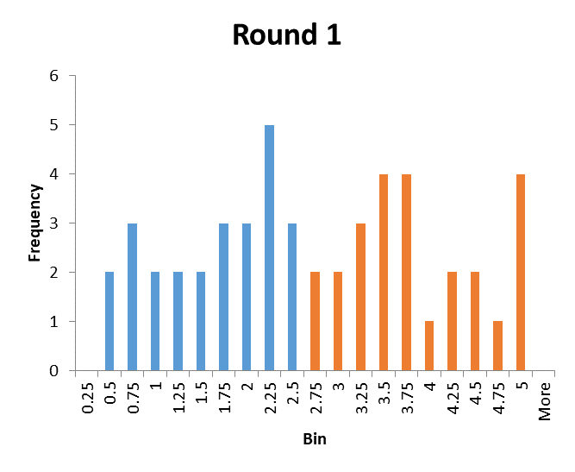
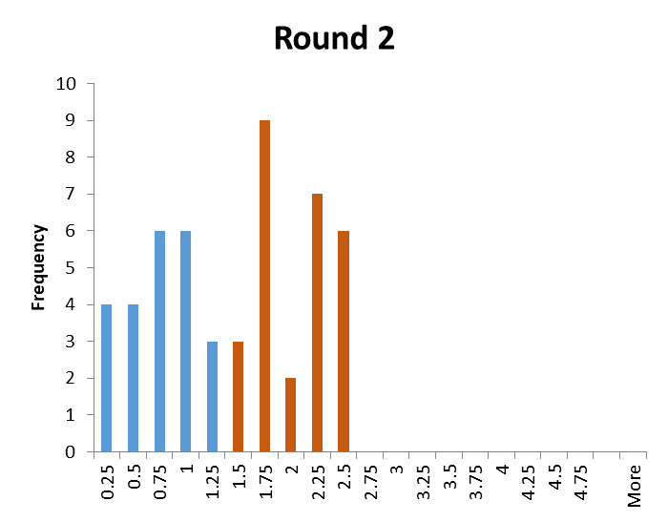
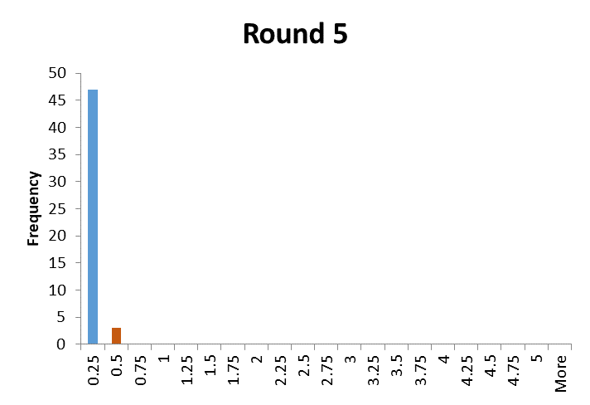
EICSI through time – creating a prisoners dilemma
Simple model:
Random debt costs between 0 & 5%
EICSI sets debt at average of whole set
If firm has debt cost above average, it refinances to avoid losing money.
AER has introduced a high cost for being the “second mover”
Conclusion – very quickly, the average falls & it becomes impossible to reduce debt costs further
How creditworthy will the firms in Round 5 be and what will this do to long-term viability of the industry?
No point creating game you think will force costs down if the costs come straight back up again because you’ve created a mechanism to incentivise instability

Slide 6
EICSI problem is mathematical
An average, however contrived, is not a measure of efficiency, it is just an average
If the EICSI is the cost of debt allowance, some firms must lose money every period, whether they are efficient or not
Regulation should not impose benchmarks that are physically impossible for networks to achieve regardless of their efficiency
Against the NGO/NEO
Strategically questionable – firms seeking to avoid being 2nd movers undercuts financial sustainability of whole system
Note:
Issue exists in more modified form if EICSI is used in combination, or if the WATMI index is used to set an average tenor
WATMI index raises other problems in respect of changing tenor when you have a 10-year trailing average – see submission

Slide 7
Strategic game conclusions
Don’t create a game where the outcome is unclear or you will lose control of costs in the industry
Our ability to game in a sellers market is limited, so this will just create unsustainable debt allowances because someone must be above average

Slide 8
Debt and the principal-agent problem
AER motivates EICSI partly to improve incentives for efficient debt
AER has limited regulatory resources
Impact of AER above & beyond existing incentives in respect of debt may be small
Simple principal-agent problem which recognises heterogeneity in the asymmetry of information
Does not invalidate collecting data and forming index; just modesty in what the AER can achieve

Slide 9
Principal – agent problem in economics
Firm’s owners = principal
Workers and providers of other inputs = agents
Incentive of principal is to maximise output from agents at minimal cost
Incentive of agent is to minimise output at max reward (cost for agent)
Principal would like to enforce their desire but faces asymmetry of information – cannot observe the “effort” of the agent

Slide 10
Principal-agent with heterogeneous asymmetries of information
Consider firm (Gasco); owned by large multinational
Consider two staff; engineer doing a “hot tap” and CFO
Hot tap – hard to observe efficient cost and disastrous consequences for owner if they force costs down too far.
CFO raising debt – easy to observe process of sourcing debt and multinational staff probably know debt market better than CFO
Information asymmetry for engineer > CFO
Implication – multinational has no interest in above average debt costs (lower profits for it) and a high ability to enforce efficient debt.
What does the AER add in this situation?

