Slide 1
Demand Forecasting workshop
Highlights from AusNet Services’ EDPR proposal

Slide 2
High level process
Extract historical customers by feeder
Forecast customer growth
Calibrate growth forecasts with Victorian Government projections
Extract historical demand data
Correlate demand and temperature
Generate spatial demand forecasts
Undertake validation process
Finalise forecasts

Slide 3
Customer forecasts

Slide 4
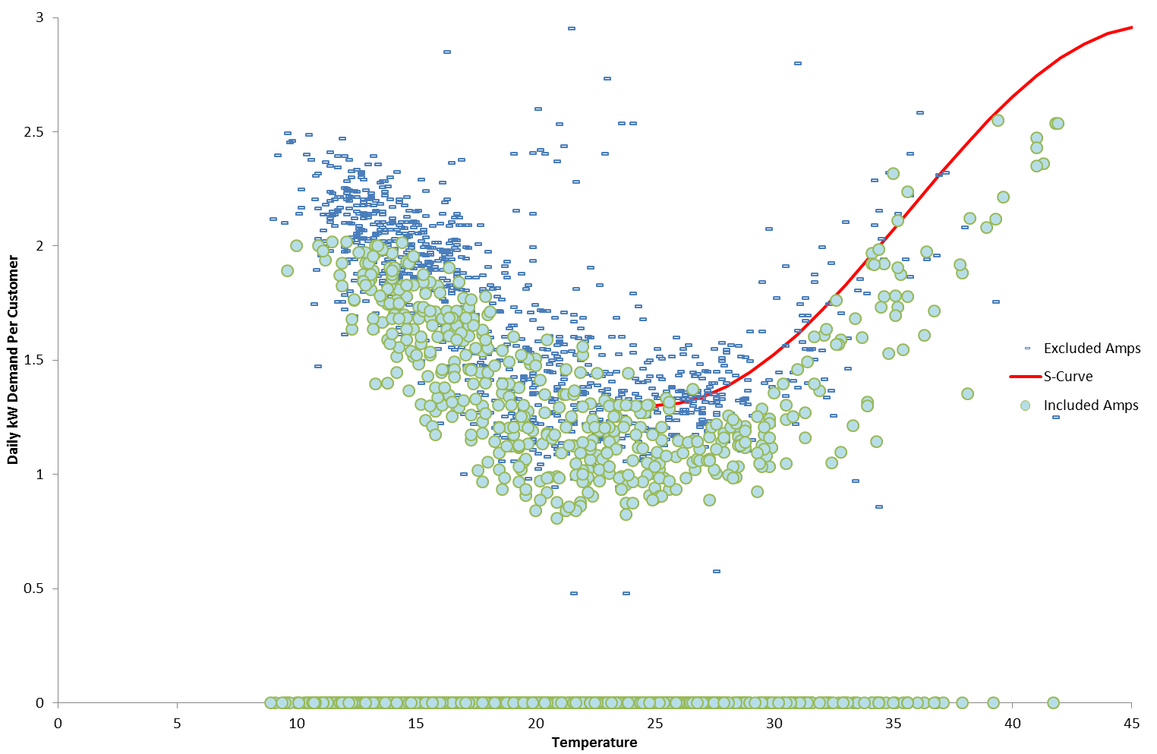
Temperature-demand correlations

Slide 5
Energy efficiency

Slide 6
Spatial analysis

Slide 7
Differences with AEMO
Contribution of solar
  Time of maximum demand
  Solar uptake assumptions
Energy v. demand efficiency
  Demand efficiency (i.e. contribution of energy efficient appliances at time of maximum demand) is less than energy efficiency
Growth areas
  AEMO forecasts in growth areas much lower than VDP forecast household growth

