Slide 1



AER Public Forum
Gas Access Arrangement
Review PROPOSAL
Our plans for 2018-22
Alistair Parker
Executive General Manager
Regulated Energy Services
1 February 2017

Slide 2


Overview
About AusNet Services
Surveys
&
Interviews
Surveys
&
Interviews
Listening to our customers and Our Vision
Forums
&
Workshops
About our proposal
Forums
Delivering on our aims
Focus groups
Focus groups
Workshops
Focus groups

Slide 3
Key dates
Jun 2016
Customer Engagement Insights Report published
Sep 2016
Further stakeholder discussions
16 Dec 2016
AusNet to submit AA proposal
3 Mar 2017
Public submissions on AA proposal close
14 Aug 2017
AusNet to submit Revised Proposal
30 Nov 2017
AER Final Decision expected
1 Jan 2018
New AA period begins
12 Sep 2017
Public submissions on Draft Decision and Revised AA Proposal due
1 Feb 2017
Public forum
29 Jun 2017
AER Draft Decision

Slide 4
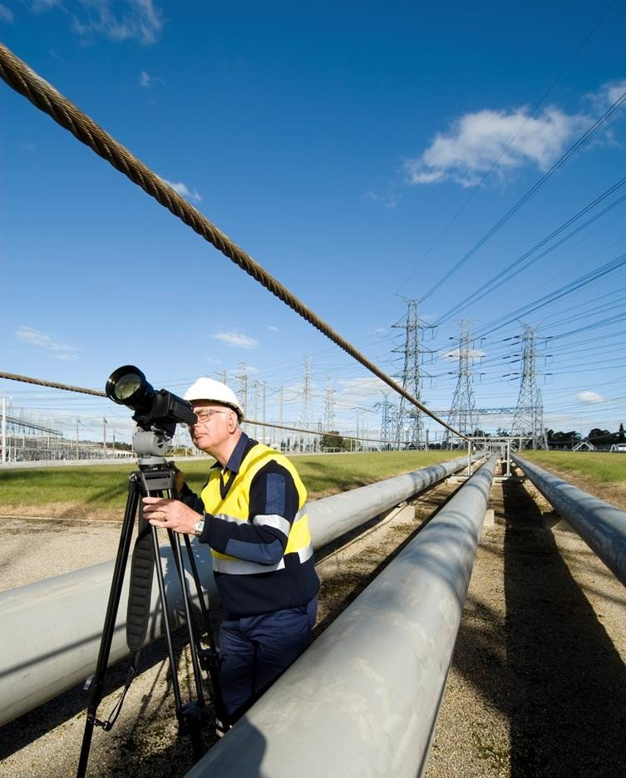
About AusNet Services

Slide 5
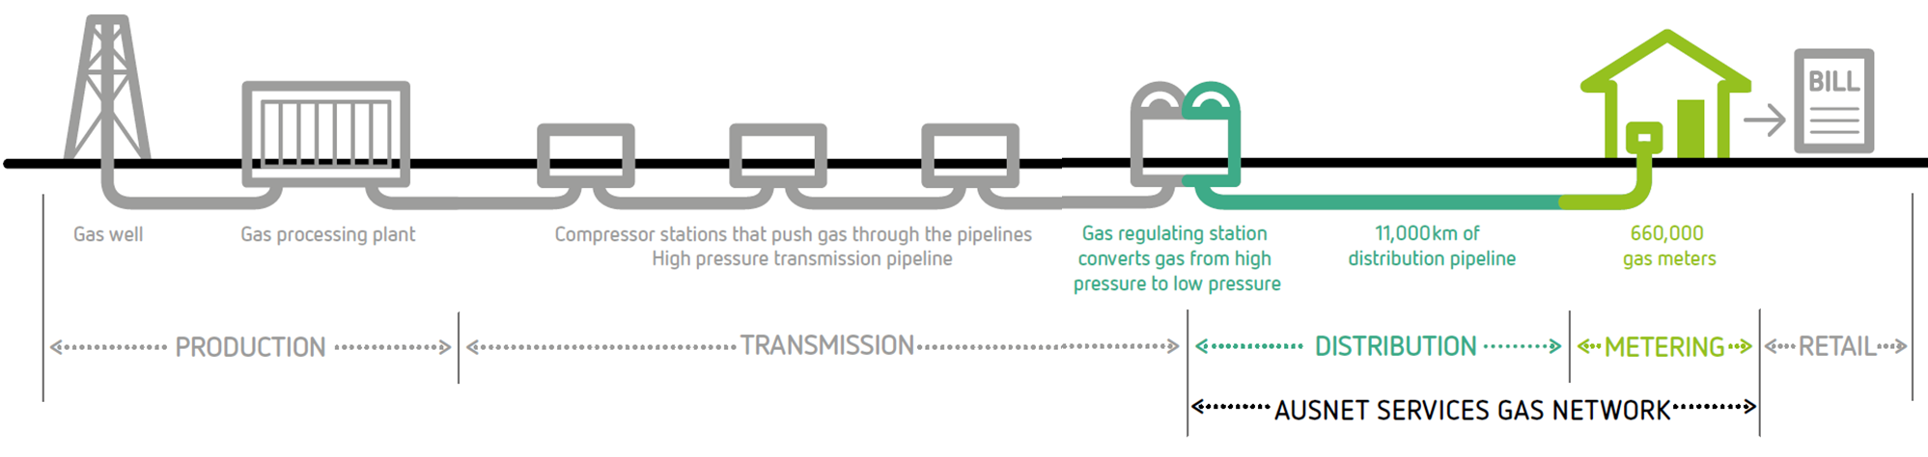
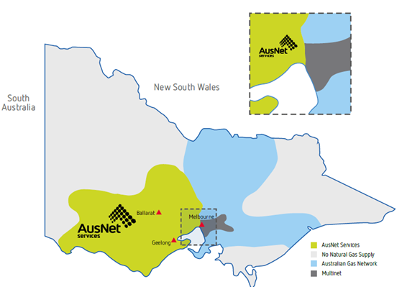
What we do
AusNet Services’ gas network extends from the Hume Highway towards the South Australian border, and north of Bendigo and Horsham.

Slide 6

Listening to our customers and Our Vision

Slide 7
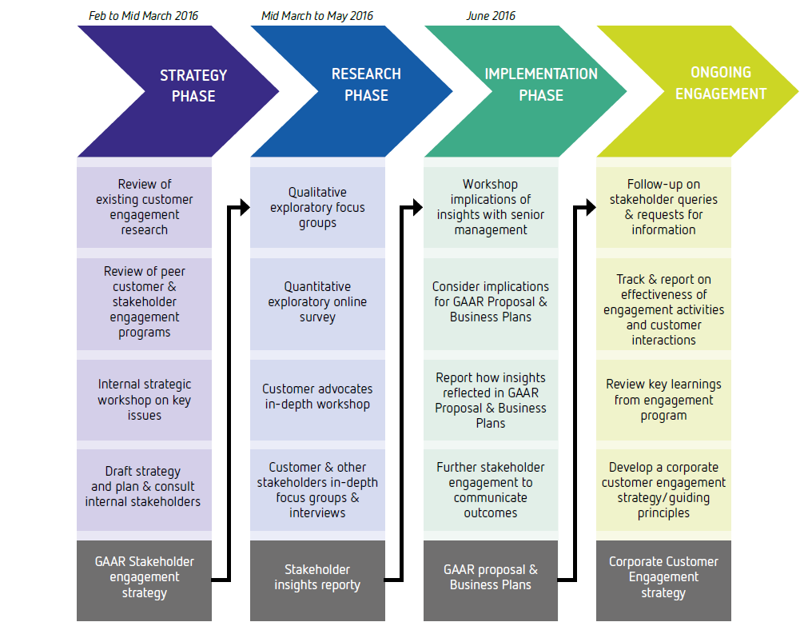
Customer and Stakeholder Engagement program

Slide 8
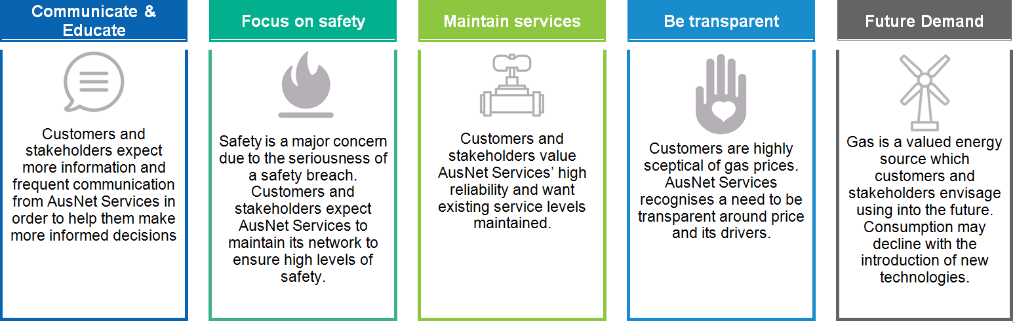
Key research findings

Slide 9
How we are incorporating customer feedback
Dial before you dig service and a free asset location service which seeks to prevent accidental third party damage of gas assets
Frequent 1-on-1 meetings with large stakeholders to discuss issues of concern
Tariff education through customer-friendly publications available online
Introduction of the network innovation scheme to ensure that the future energy needs of customers are met
New website that will be more customer friendly and informative
SMS outage notification to alert gas customers about any works that may affect them
Main replacement program to proactively remove deteriorated mains and pipelines
Meter replacement program to replace end of life metering assets at customer premises
Winter testing program designed to monitor pipeline pressure and identify areas that need augmentation
9

Slide 10

About our proposal

Slide 11
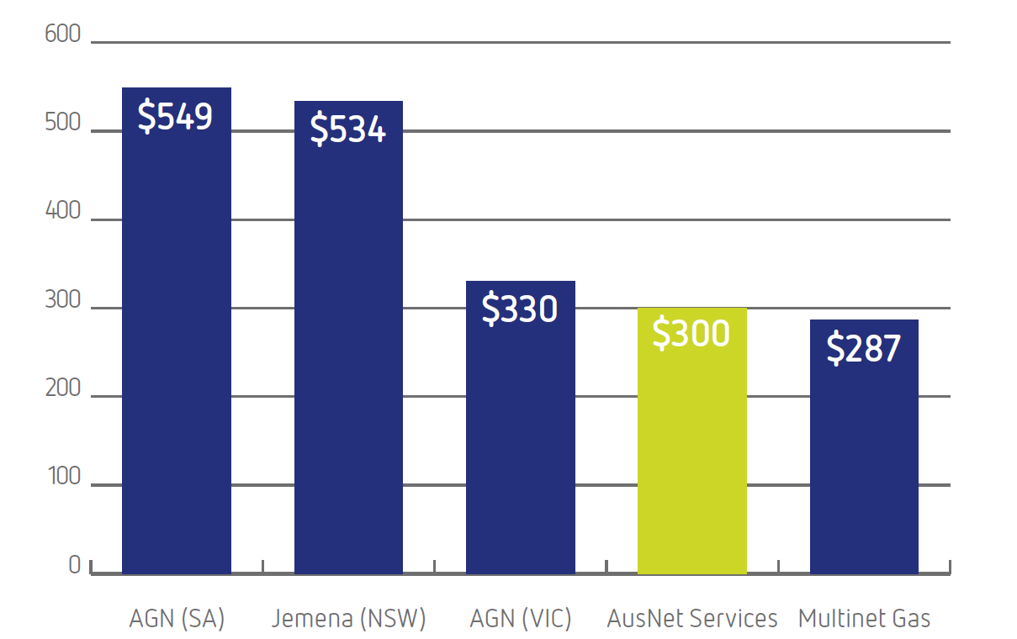
Delivering efficient services and lower prices
Estimated gas network charges in 2018
Distribution charges, 30%
11

Slide 12
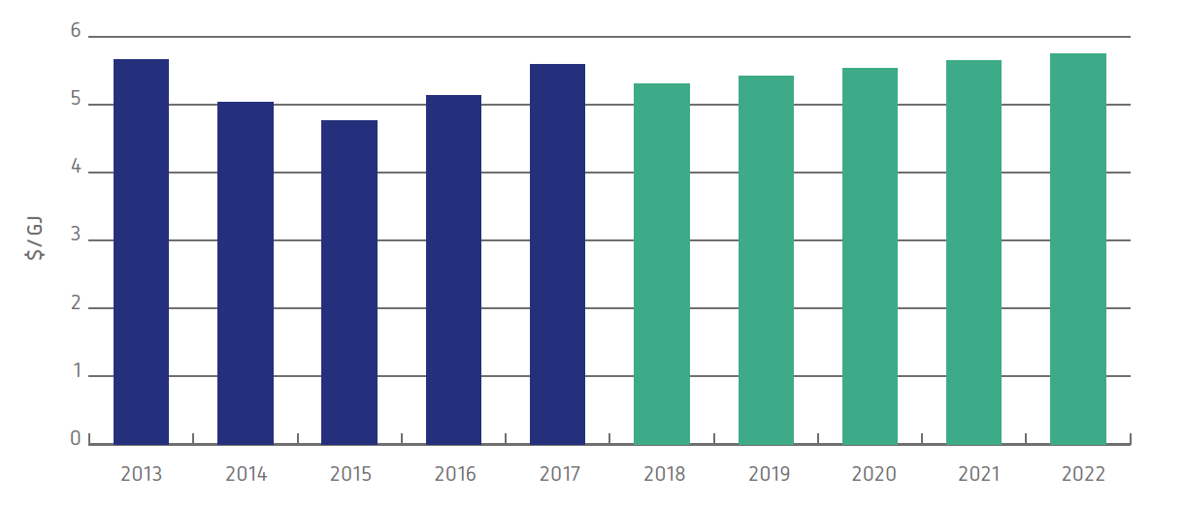
Impact of proposed prices
Typical residential customer ($/GJ, 2017)
Our proposal delivers an upfront 5% reduction on 1 January 2018. We are committed to keeping our prices low for customers.

Slide 13
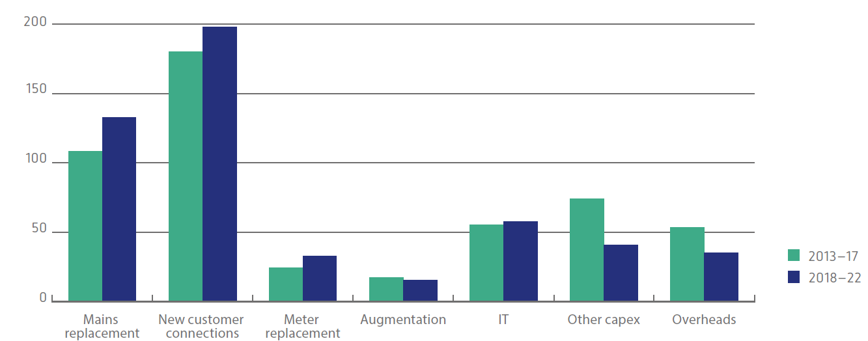
Proposed Capital Expenditure
Capital Expenditure ($m, 2017)
Similar levels of capital expenditure, predominantly on mains replacement and customer connections.

Slide 14
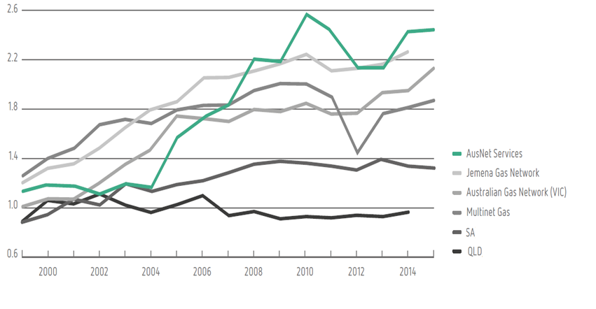
Responding to incentives
Opex productivity – partial factor productivity index
External benchmarking analysis indicates that we are one of the most efficient gas distributors in Australia.

Slide 15
We are proposing a more holistic incentives framework for gas networks
Efficiency Benefits Sharing Scheme
incentives to make operating expenditure efficiency improvements (30% sharing rate)
encourages us to find opportunities to deliver continued operating expenditure savings, and share these with customers.
Capital Efficiency Sharing Scheme
incentives to make capital expenditure efficiency improvements (30% sharing rate)
counterbalancing parameter which deflates efficiency rewards if agreed KPIs are not met
Network Innovation Scheme
provides an allowance for innovative projects which involve the research, development and demonstration of new applications or operational practices
Guaranteed Service Levels
compensate customers who have experienced service performance below the expected standard
EXISTING
NEW
15

Slide 16
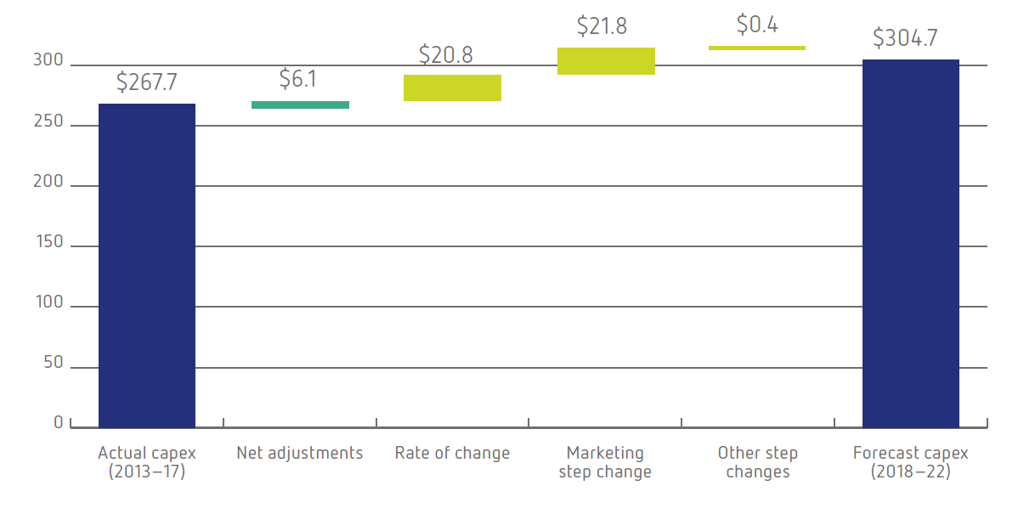
Proposed Operating and Maintenance (O&M) Expenditure
O&M Expenditure ($m, 2017)
Actual Opex
(2013-17)
Forecast Opex
(2018-22)
AusNet Services’ O&M expenditure will continue to be one of the lowest amongst our peers in Australia.

Slide 17
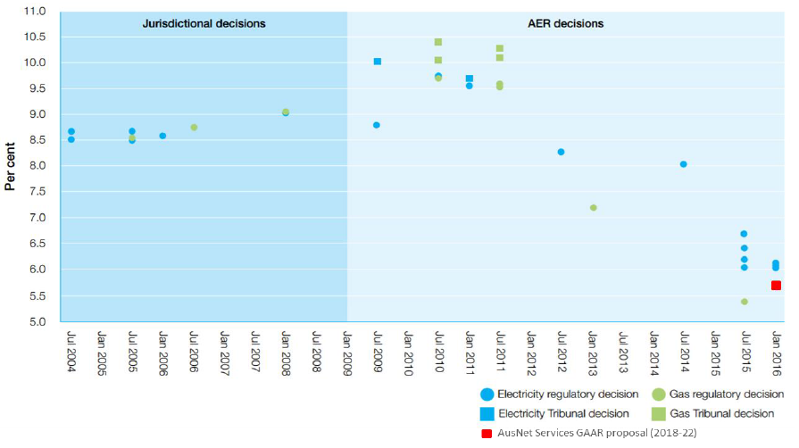
Rate of return
Weighted average cost of capital
Our proposed rate of return of 5.63% is one of the lowest rates ever applied to a regulated electricity or gas distribution network.

Slide 18

Key Takeaways
Our plan will…
Result in lower gas network charges on 1 January 2018
Continue investment in reducing safety risk and delivering service levels customers expect
Strengthen network innovation and capital expenditure efficiency incentives to ensure the network develops in a changing energy environment

Slide 19
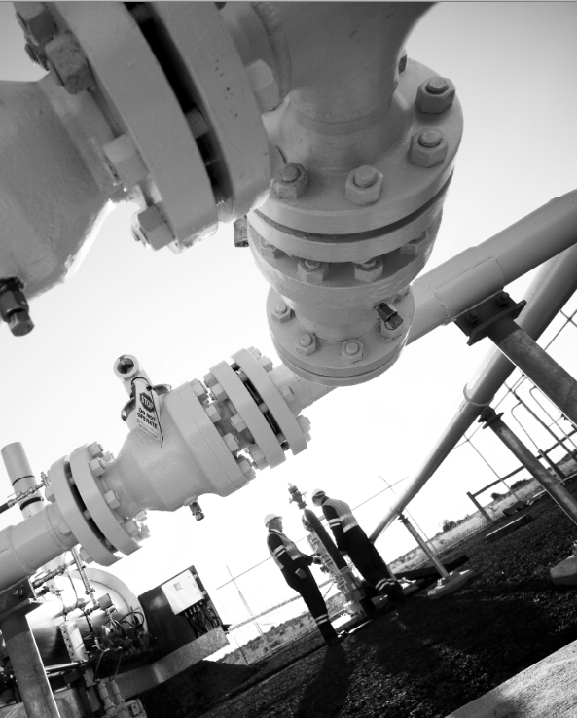
Questions
“
We are keen to hear your thoughts and feedback
”

