Slide 1
AER Public Forum – Productivity Review
Can Gas Distribution Productivity Trends be applied to Forecast Productivity for Electricity Distribution?

Slide 2
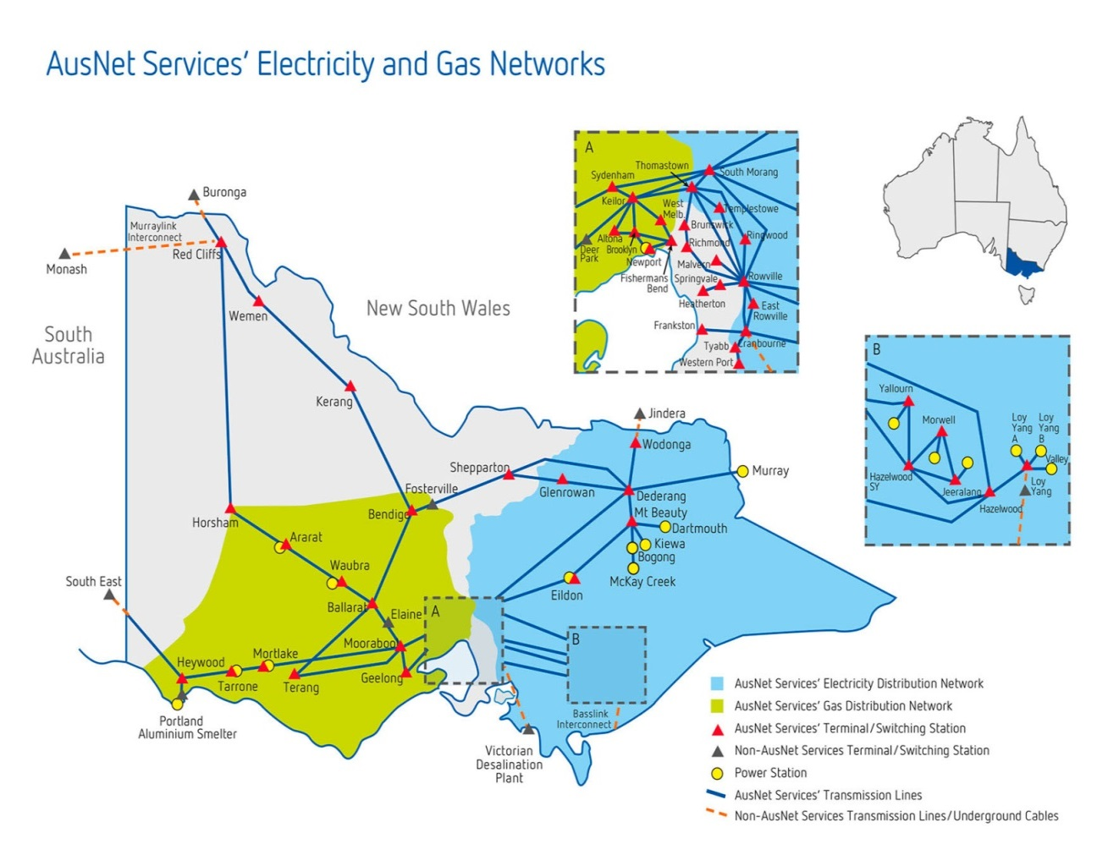
Operating networks across the energy sector
In OPFP terms we rank:
1st for electricity transmission (AER, draft 2017 results)
1st for gas distribution (Economic Insights)
9th for electricity distribution (AER draft 2017 results)
The same senior management team have delivered very different productivity results. This indicates that these industries are not good proxies for each other.
Our job is to drive productivity across our 3 different networks

Slide 3
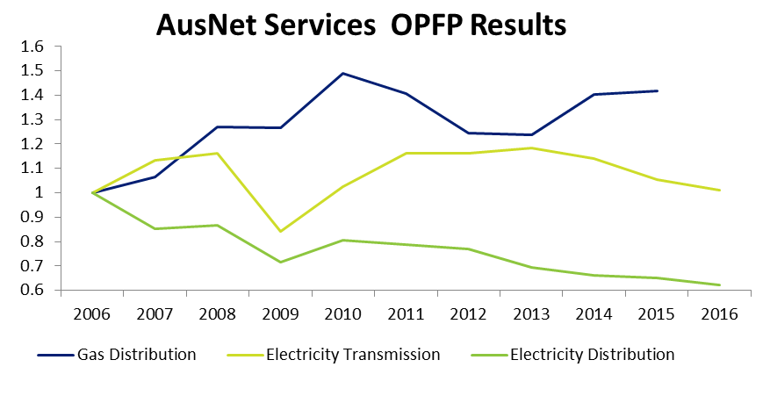
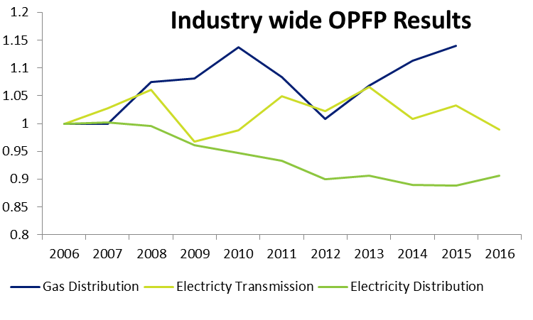
Operational productivity trends across the three sectors
Source: Data from Economic Insights - OPFP results set to 1 in 2006 to aid comparability.
Source: Data from Economic Insights - OPFP results set to 1 in 2006 to aid comparability.
The productivity of our networks has differed despite identical management, which illustrates there are industry specific factors driving OPFP performance.
* 2015 used as last common year of data

Slide 4
Differences between electricity and gas distribution
AER suggests historical gas productivity trend reflective of ‘technical trend’ going forward for electricity distribution because:
the gas distribution sector shares many similarities with the electricity distribution sector
In our experience, this is not the case.
Significant legislative change has driven vast safety and veg management expenditure in electricity distribution. This continues to impact productivity.
The expected significant additional penetration of DER will add additional costs, whilst putting downward pressure on energy delivered (downward pressure on productivity). The transformation of the role of the network is not occurring in gas distribution networks.
As a fuel of choice, there is greater scope to drive output growth in gas networks compared to electricity distribution and transmission businesses.
Historical gas distribution productivity trends have no relevance to electricity distribution
* 2015 used as last common year of data

Slide 5
Is electricity transmission more comparable?
Reason Given for Using Gas Distribution | Also Applicable to Transmission?
the gas distribution sector shares many similarities with the electricity distribution sector | ✓✓✓ Electricity distribution shares far more similarities with electricity transmission than with gas distribution
past productivity performance has been more stable in gas distribution than for electricity distribution and has not been subject to the same regulatory changes | ✓ OPFP for electricity transmission has been far more stable over time than for gas distribution.
we have technical change estimates for gas distributors estimated using econometric models similar to those we use for electricity distribution. | ~ Partial. OPFP modelling is available. However, the AER does not produce econometric models for electricity transmission networks.
Electricity transmission businesses are a better (but not perfect) comparator to the electricity distribution businesses
* 2015 used as last common year of data

Slide 6
Is electricity transmission more comparable?
There is some substitutability between the workforce for distribution and transmission businesses, so drivers of labour productivity factors are very closely related.
Output measures (particularly customers/end users, demand and energy throughput) are quite consistent between electricity distribution and electricity transmission when aggregated to the industry level.
Speed of technological change is comparable, as advancements often have applications in both electricity distribution and transmission – i.e SCADA solutions are more sophisticated in these networks compared to gas distribution.
Faster pace of legislative change than gas distribution, so more likely to be more reflective of ‘steady-state’ electricity distribution legislative change. The step change and pass-through regimes do not necessarily cover all the costs of legislative changes.
Electricity transmission businesses are a better (but not perfect) comparator to the electricity distribution businesses
* 2015 used as last common year of data

Slide 7
Use of time trends from econometric models
The AER did not use a time trend from econometric models produced using data from the electricity distribution industry. This was justified on the basis that:
The estimated time trend will be influenced by the drivers of productivity decline in the 2006–12 period that we don't consider will continue to prevail in the future
However, the AER’s draft 2017 benchmarking report shows that the time trend remains positive (declining productivity) only using data from 2012-17. This appears to invalidate the AER’s primary reason for rejecting a time period calculated based on electricity data.
Instead, the AER used a time trend derived from econometric models produced for the gas industry. The AER has presented no significant analysis to determine:
Whether the two industries are comparable, or have been impacted by different or similar factors.
Whether the time trend in the gas models capture drivers that are not expected to continue to prevail in the future. Importantly, growth in productivity in the gas sector appears to have slowed so using gas models will likely over forecast future productivity achieved even in that industry.
Factors driving lower productivity compared to gas distribution businesses are likely to continue to persist in electricity distribution businesses

