Slide 1
Preliminary Decision Conference
For SA Power Networks
13 May 2015
Adelaide
Bev Hughson
Consumer Challenge Panel Member

Slide 2
Some common acronyms
Acronym | Name
AER | Australian Energy Regulator
CCP | Consumer Challenge Panel
CESS | Capital Efficiency Saving Scheme
DNSP | Distribution Network Service Provider
EBSS | Efficiency Benefit Saving Scheme
ESCOSA | Essential Service Commission of Australia
MPFP | Multilateral partial factor productivity
NEM | National Energy Market
PD | Preliminary Decision (SAPN determination)
RAB | Regulatory Asset Base
SAPN | SA Power Networks
STPIS | Service Target Performance Incentive Scheme
WACC | Weighted Average Cost of Capital

Slide 3
Presentation Outline
Opening remarks
A quick history
The challenge of SAPN’s proposal to the AER
Response to SAPN’s proposal
Customers/stakeholders
AER’s Preliminary Decision – a CCP overview
Revenue
Opex
Capex
Regulatory principles
Consumer engagement
Concluding observations from the CCP

Slide 4
A quick history
SAPN: A proud past:
One of the more efficient networks in terms of both operating expenditure (opex) and capital expenditure (capex) in the NEM
Its expenditures have been close to its allowances, and long period of stable prices
Delivered safe and reliable network services to its SA customers
Demonstrated a high level of compliance with its regulatory obligations
Customers expressed relatively high level of satisfaction with SAPN
However in 2010-15:
Higher expenditures compared to 2006-10
Capex: ≈ 96%; opex: ≈ 41%*
SAPN’s revenue grew by ≈ 35%*, but demand down on forecast- prices rise significantly
Flat demand growth has also lead to growing spare capacity
The RAB has started to grow, as has RAB per customer
* Source: AER, State of the Energy Market 2014, Figures 2.4, 2.6 & 2.8. These figures are not necessarily the same as the data provided in the RIN data sets.

Slide 5
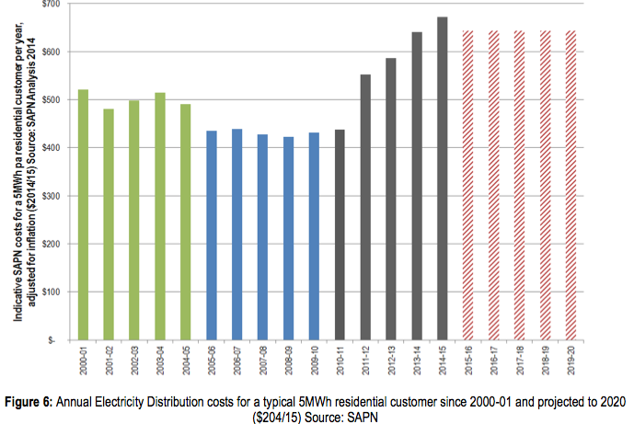
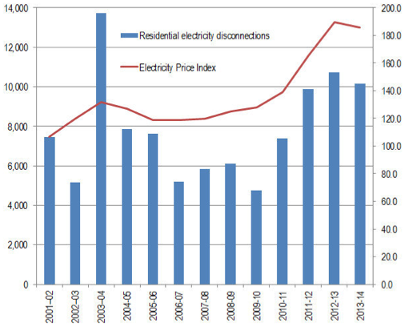
Network prices increased by over 55% through 2010-15; Disconnections more than double
Source; Extracts from submission by SACOSS et al to the SAPN 2015-20 Regulatory Proposal

Slide 6
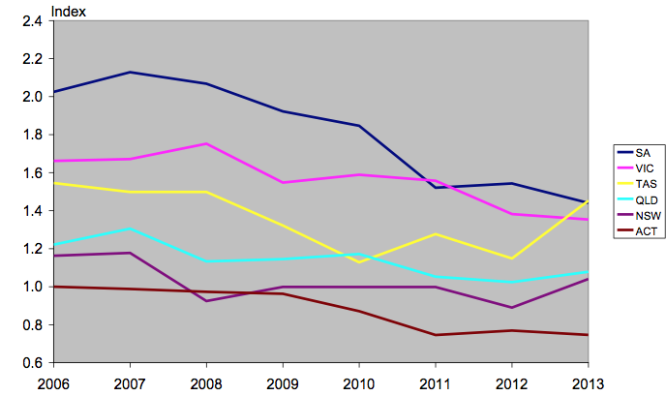
Multilateral partial factor productivity (MPFP) index (2006-2013) by state
Annual average MPFP growth rate for SAPN was -4.84% (average DNSP was -2.21%)
Source: Economic Insights, Economic benchmarking assessment of operating expenditure for NSW and ACT DNSP’s, 17.11.14, Figure 4.2, p 21. MPFP av annual growth rate from Table 4.1, p 20.

Slide 7
The AER’s challenge for 2015-20
SAPN has proposed very significant increases in both capex and opex for 2015-20 (NB: on top of big increases in 2010-2015)
SAPN is also forecasting continued decline in demand
Which means:
further decline in capacity utilisation
And therefore, in productivity
Prices rising at around CPI – but only because of the significant decline in the WACC
SAPN’s proposal misses the opportunity to propose significant price reductions that are sought by their customers
SAPN justifies much of the additional capex and opex based on:
Customer engagement research;
Regulatory/legal obligations;
Aging assets/risk management of assets

Slide 8
Questions posed at the December Public Forum
At the December Public Forum, the CCP posed the following questions:
Is SAPN’s overall revenue proposal reasonable, particularly given large increases (in real dollars) in the last regulatory determination (2010-2015)?
Is SAPN’s approach to the WACC reasonable?
Is the demand forecast reasonable?
Is SAPN’s proposed increase in capex reasonable?
Is SAPN’s proposed increase in opex reasonable?
Does SAPN’s consumer research provide sufficient justification for additional capex and opex?
Many of the SA community have spoken!
An unprecedented response
Over 30 submissions challenging aspects of SAPN’s proposal

Slide 9
An unprecedented response from the SA Community
Submissions come from a broad cross-section of SA community
Community organisations/green groups
Businesses/business organisations
Farmers/irrigators
Energy Retailers/Industry associations
State Governments/Councils
All expressing concerns about aspects of SAPN’s proposal – both the content & length!
General view from your submissions:
SAPN has done a good job in the past, but recent price increases have added to the other energy pricing pressures for customers
And there is little (no) justification for the 2015-20 increases in expenditure, particularly with demand flat/falling & increase spare capacity
Priority for most consumers is price relief

Slide 10
How has the AER responded?
AER generally agrees with SAPN’s forecast of demand growth ((≈ 0%) & consumer number growth (≈ 1% to 1.5%)
But (like consumers) the AER has rejected many of SAPN’s proposed additional expenditures
AER’s general approach is to look at historical expenditures & trends as a starting point
Although this is supplemented by other valuation techniques such as benchmarking, engineering assessments…
The AER seeks higher standard of “proof” for claims for additional expenditures;
it is not reviewing current prudency/efficiency (other than overall benchmarking)
Therefore not driving continuous productivity growth
The AER is relying on the “incentive mechanisms” (EBSS, CESS, STPIS) to encourage ongoing improvement

Slide 11
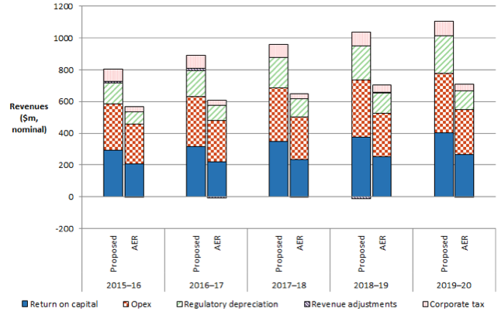
The AER reduces SAPN’s proposed revenues by ≈32%
Savings benefits to consumers roll forward
Source: AER, Preliminary decision SA Power Networks distribution determination, Attachment 1, Figure 1.2, p 1-11

Slide 12
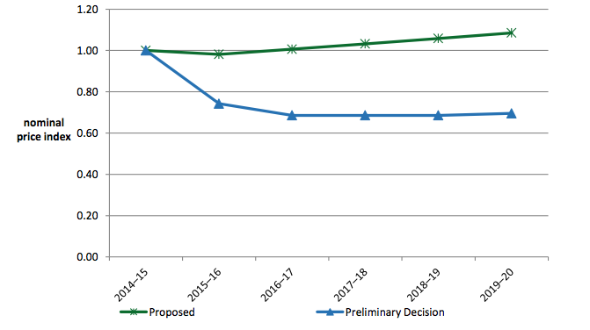
Average price path ($ nominal)
-1.9%
+2.6%
-25.8%
-7.6%
Overall, average of≈ 8.5% pa reduction in average nominal prices compared to SAPN’s proposal
AER, Preliminary decision SA Power Networks distribution determination, Attachment 1, Figure 1.3, p 1-12, using weighted average price changes submitted by SAPN adjusted to allowed revenue. Relative saving figure of 8.5% derived from AER, p 1-14 which states AER PD average decrease of 7.0% pa, SAPN average increase of 1.7% pa

Slide 13
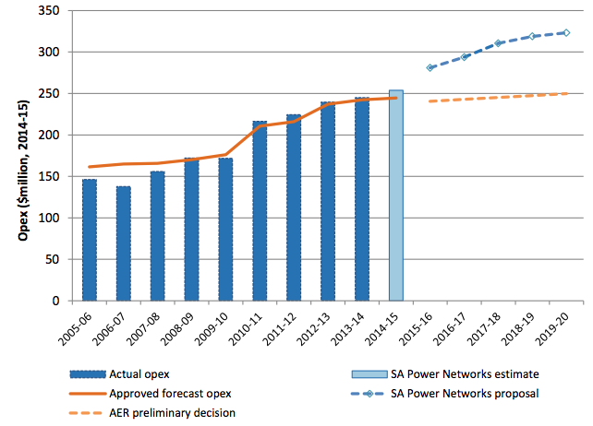
SAPN’s Operating Costs ($2014-15)
Some things to note:
In past, SAPN’s actual opex has closely matched the regulatory allowance.
Suggests the EBSS has had limited effectiveness?
Opex in 2010-15, ≈50% more than 2005-10
SAPN’s proposed opex , ≈100% more than 2005-10 (in real $)
The increased opex has resulted in a decline in opex efficiency since 2006 (e.g. MPFP)
However, the AER has accepted the 2013-14 opex as the “base year” for forecasting opex
If the AER accepted SAPN proposal, then base year” for 2020-25 would be ≈$320M ($14-15)!
The AER’s PD is still (just) above average of 2010-15 in $14.15
19.7% cumulative
Source: AER – Preliminary Decision SA Power Networks distribution determination, Attachment 7 – Operating Expenditure, April 2015, Figure 7.1, p 7-8

Slide 14
The AER’s assessment of SAPN’s 2015-20 proposal (All figures expressed in $2013-14)
AER Assessment Approach | SAPN Proposal | AER Response | CCP View
Base Year | Actual net opex of ≈$1,202M | Largely accepts SAPN’s base year; net opex of $1,196 | Sets a high base cost for 2015-20 given “slope” of opex in 2010-15
Rate of Change | Add $108M | Largely rejects, AER allows $27M | Agree with AER except for 0% productivity over 2015-20 period
Step Change | Add $217M | Largely rejects; AER allows $4M | Agree with AER
Total Change over Base Year | Add $325M (Total = $1,527M) | Add $31M (Total = $1,226M) | AER base year high & should include some productivity gain over period
Source: AER Preliminary Decision, Attachment 7 – Operating expenditure, Figures 7.2 (p 7-9) & 7.4 (p 7-20). Numbers may not add due to rounding

Slide 15
The AER finds SAPN’s additional opex does not meet expenditure criteria
Forecast Annual Rate of Change in opex (%)
Forecast step changes ($ 2014-15)
Source: Table 7.4 (p 7-22) & Table 7.5 (p 7-23). The Rate of Change includes price (e.g labour/material costs) and output changes (e.g. customer numbers, peak demand, line length). AER’s step change of $9.1M includes a negative step change for licence fee of -$5M. Net step change allowed is therefore $4M.

Slide 16
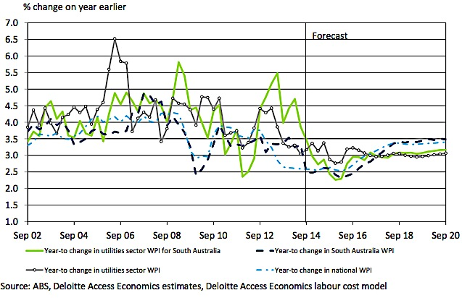
AER’ s Rate of Change Assessment Example: Labour costs
Rate of change:
SAPN proposing increases in labour rates of 1.5 – 2.0% pa above CPI
SAPN bases this on existing EBA and trend estimate after that
Many submissions state that this is too high given current circumstances
AER rejects SAPN proposal and the CCP agrees
Existing EBA is not sufficient basis to set forecast allowance (taken on its own)
Incentives for effective and accountable management lost
AER must make its decision on the basis of prudent & efficient benchmark costs
Up to SAPN management to decide optimal approach to overall wage bill given the AER’s overall opex decision

Slide 17
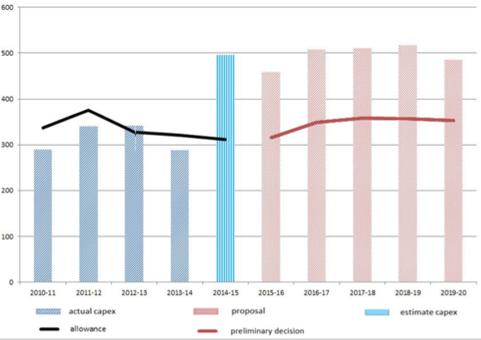
SAPN’s Capital Expenditure ($2014-15M, net),
Some things to note:
Historical capex closely matched allowance
Suggests SAPN has adopted a reasonable approach in the past
SAPN’s 2010-15 capex is an increase over 2006-10
SAPN’s proposed capex is over 55% greater than 2010-15 (in real $)
The increases in capex flow through to more rapid growth in the RAB
And lead to decline in productivity (given no growth in demand)
The AER’s Preliminary Decision represents a small increase (in real dollar terms) compared to 2010-15 actual capex
But, the AER’s decision is approx 33% reduction compared to SAPN’s proposal for 2015-20
BBB
B
Source: AER, Preliminary Decision SA Power Networks distribution determination, Attachment 6, Figure 6-1, p 6-12. The 2014-15 figures are adjusted for an error in the AER data. Used to prepare the chart and Y axis label removed as it incorrectly stated that the chart was in $2013-14)

Slide 18
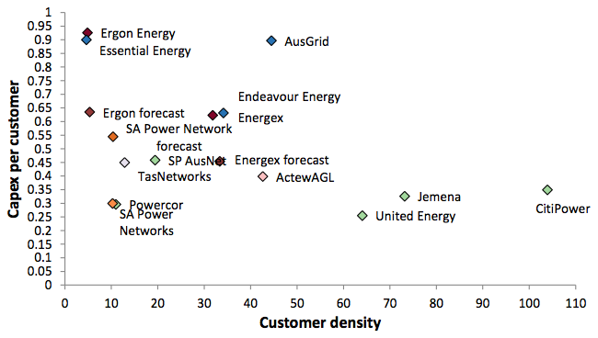
SAPN’s proposal would lead to significant decline in relative capex efficiency ($000s, 2013-14)
Source: AER, Preliminary Decision, Attachment 6, Capital Expenditure, Figure 6-4 (p 6-27)

Slide 19
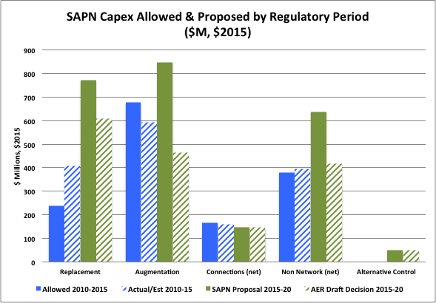
AER’s decision reflects stakeholder submissions
Replacement Capex:
Down ≈ 20% c/p to SAPN proposal
But more than 60% above 2010-15
AER does not support rate of replacement (given age) or significant increase in risk
Augmentation Capex:
Down ≈ 45% c/p to SAPN proposal
Reflects low growth overall
But provides for local growth
AER does not support additional bushfire & safety related capex & reliability expenditure
Other “discretionary” projects rejected
Kangaroo Island goes ahead
Non-Network Capex:
Down ≈ 35% c/p to SAPN proposal
IT deliverability/prudency?
Property/vehicles prudency?

Slide 20
What does ESCOSA say about reliability and service requirements?
ESCOSA sets the reliability & services standards for SAPN:
Reviewed in 2014 to apply for 2015-20 regulatory period
Designed to align closely with the AER’s STPIS scheme
Regularly monitors and assesses SAPN’s reliability and service standard performance; Along with the OTR
Previously conducted Willingness to Pay studies (WTP) when setting standards
ESCOSA did not appear to expect the 2014standards to increase costs:
“Based on SA customers’ continuing high levels of satisfaction with average reliability and customer service performance, there appears to be no need to increase the levels of service set, and hence the cost associated with meeting these levels…” (ESCOSA, Final Decision, SAPN Jurisdictional Services Standards for the 2015-20 Regulatory Period, May 2014, p 8)
“the reliability targets for the 2015-20 regulatory period will be set based on the most recent five years of reliability performance data to reflect the impacts of recent investment decisions by SAPN”. (ESCOSA, Fact Sheet – SAPN Jurisdictional Service Standards …Final Targets, Oct 2014, p 2)
“SAPN’s distribution network must be built to perform consistently within normal weather conditions…Network reliability measurements and improvements should focus on performance during the normal course of events and efficient restoration practices when the network is under unusual stress”. (ibid, p 3).

Slide 21
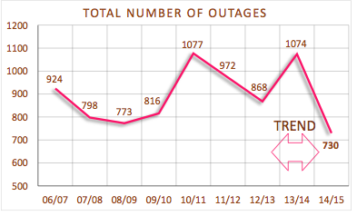
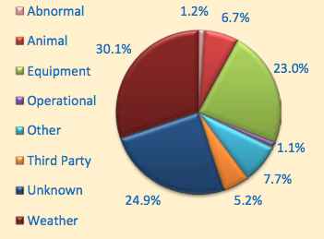
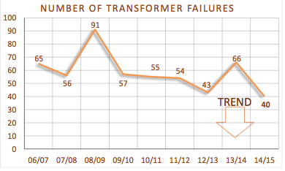
ESCOSA: SAPN’s reliability at a glance (summer 2014-15)
Of the 730 outages in summer of 2014-15, only 23% were due to equipment failure.
Over the whole year, average percentage of total faults caused by SAPN’s equipment failure was 19% (across 2011-12 to 2013-14)
Source: ESCOSA, Infographic, “Summer 2014/15 SA Power Networks’ reliability at a glance” & ESCOSA, Annual Performance Report 2013-14 – Electricity Distribution

Slide 22
AER establishes some important assessment principles
The emphasis in incentive regulation is on management accountability for its priorities & decisions
The AER approves (or replaces) the total capex and opex expenditure allowances
The AER does not “approve” specific projects
up to the businesses to set priorities for specific capex or opex projects
The AER does not prevent businesses from spending more than their regulatory allowances, but:
Overspend opex, then additional costs are borne by owners out of profits/retained earnings (the EBSS)
Overspend capex, then - assuming expenditure is found (ex post) to be efficient and prudent - additional capex may become part of the future RAB
And options are available for SAPN to seek pass through allowance for unexpected events/costs
SAPN has already done this for increased vegetation costs

Slide 23
AER’s assessment principles (2)
The AER assumes that a business has been operating efficiently (subject to benchmarking tests!)
Therefore, if no material change in circumstances, AER’s starting assumption is there is no need for additional expenditures
Up to the network to establish material change & that additional expenditures are prudent and efficient
Expenditure initiatives designed to improve network efficiency are not (per se) recognised as pass-through costs to consumers
The network will be rewarded through incentive schemes (EBSS, CESS)
Should be undertaken on a business case basis
Expenditure to improve reliability of network (above regulatory standards) are not (per se) recognised as pass through costs
The network will be rewarded through STPIS/public image …
Discretionary expenditure will not (per se) be compensated for
Programs with broad community benefit/stakeholders should not be funded by electricity consumers (unless through change of regulation), e.g.
A coherent and multidisciplinary response to bushfire &/or undergrounding

Slide 24
CCP’s Response to these Principles
Strongly support the AER’s overarching principles of management accountability
These are particularly important in the context of SAPN’s proposal for very significant increases in expenditure allowances
Which will lead to lower productivity, future price rises & inflated RAB
The AER has provided SAPN with expenditure allowances that are in line with, or greater than, previous expenditures (in real $)
It is up to SAPN management to respond to this by setting priorities & driving efficiency
SAPN will be rewarded through the incentive schemes for doing this
In a time of declining/flat demand, this focus is essential
What’s missing?
A clear strategy around demand management
More critical examination of historical expenditure efficiency
“Unbiased” use of regulatory discretion (e.g. WACC parameters)
Ambitious, more direct targeting of future productivity improvements
Assess proposals against the “competitive market test”

Slide 25
A Final Word About Customer Engagement
CCP notes and appreciates that SAPN has conducted an extensive customer engagement program over a number of years
Customers have indicated that they appreciated this commitment
And, it will assist SAPN management to set priorities in its expenditures
However, SAPN has used the customer engagement outcomes to justify very substantial increases in its expenditures: For example:
Significant additional expenditures on bushfire risk management, more undergrounding of assets, enhanced vegetation management - which are not required by regulation
Discretionary expenditures - things consumers say they would like, but are not required by regulation or industry practice
Note: SAPN can still spend on these, just not recover cost through the regulatory process
SAPN must, therefore, be willing to face greater and more detailed scrutiny of its engagement
And take appropriate account of the many submissions on customer engagement and its use by SAPN to justify additional expenditures

Slide 26
A Final Word About Consumer Engagement (2)
While SAPN considers its research is appropriate:
Direct feedback to the CCP tells a somewhat different story
Consumer submissions have raised considerable concerns about using the research to justify increased expenditures
Find it problematic that low income households would be willing to pay for additional services (as stated by SAPN) given their feedback from consumers
Concern that consumers did not really have sufficient knowledge and/or did understand the options
SACOSS research (2014) – 93% of respondents want reduction in price of electricity, onlly 7% comfortable with existing prices & 25% with difficulties/stress about electricity bills
Business submissions claim SAPN’s research does not reflect their members views:
Price reductions are the No 1 priority for 87% of its members/89% not willing to pay for any increase in reliability
The state government has expressed concerns about some programs
ESCOSA’s previous research indicated consumers were comfortable with current service standards
AER’s consultant cautioned about using study to justify large increases

Slide 27
CCP has its own concerns & supports AER’s caution
Did consumers have sufficient knowledge of:
the industry & its regulation to really understand the trade-offs between price & service
The actual outcome of the investment options (ie. not just cost, but lives saved etc)
the long term consequences of additional investment
the existing processes/penalties & rewards in place (e.g STPIS/GSL)
The current level of service being delivered by SAPN?
Did consumers understand that other parties had equal or more responsibility for managing the states bushfire risks & road safety (for instance)?
Did consumers have a clear option put to them that the alternative was a significant reduction in energy prices, within current levels of service?
Did framing the questions around a “CPI cap” influence the trade-off?
Statement only true because of reduction in WACC/hides the impact of the total costs
Did consumers understand the “risks”; eg:
If interest rates increase, or demand declines then increased expenditures will lead to higher than CPI prices
Particularly because adds circa $300M to the RAB – to be paid off over 30 years!

Slide 28
Concluding comments from the CCP
Much progress has been made, but CCP considers more to go:
We remain concerned about
The assessment of the WACC & the history of very high profits for SAPN (& others)
The AER’s approach to setting the efficient frontier and applying the benchmarks
The long term issue of the RAB value & declining demand
The potential for “status quo” thinking when SAPN’s customers are facing international competition and price/cost pressures
Are the rewards & penalties in the incentive schemes sufficient to overcome inertia
The approach to regulation that has led to volumes of “evidentiary” material
Consumer input has been invaluable to the CCP – and to the AER
We hope that SAPN will also take note of the many submissions
AND please, please keep it up
Still some stormy waters ahead…
This is a preliminary determination,
The AER is committed to revisiting some areas of expenditure/WACC to be updated
Potential for SAPN to appeal the AER’s decision
But consumers can appeal too (or intervene or provide additional information)

Slide 29
THANK YOU

