Slide 1
Regulatory Proposal 2022-27 AusNet Services - Transmission Presentation to Public Forum 16/12/2020 CCP23 Bev Hughson David Prins Mark Henley

Slide 2
Recognition of Country
We acknowledge the Traditional Owners of Country throughout Australia, in this situation the owners of the land hosting the AusNet Services Transmission network and the lands on which participants are located.
We recognise their continuing connection to land , waters and culture.
We pay our respects to their Elders past, present and emerging.

Slide 3
Assessment of consumer engagement
The AER elements for assessment table.
Application to AusNet Services – Transmission.
Note that this is ‘work in progress.’

Slide 4
AusNet Services Engagement

Slide 5
Nature of Engagement
Non – direct connect customers
AusNet says “Over the past two years, we have set out to systematically listen to and gather insights on what our customers and stakeholders think about the services we provide.
We established a dedicated Transmission Customer Advisory Panel (CAP) to assist and advise us in the development of our 2023-27 transmission plans.
We have reflected the views of customers and stakeholders in several key aspects of our Revenue Proposal, including the operating expenditure step changes … listing to our customers and stakeholders, we have been able to reduce our proposed revenue requirement by $8.00.”
Ongoing engagement: CCC (Consumer Consultative Committee), Customer Service and Experience Program, Infrastructure project community engagement, reputation research, Customer Satisfaction Research (transmission).
CCP was able to observe engagement activities from November 2020.
Direct Connect Customers
AusNet says “Managers now hold regular meetings with their (directly connected) customers for this (strategic relationships) purpose.”
CCP was unable to observe engagement with direct connect customers, other than those who were part of workshops / forums.

Slide 6
Breadth and Depth
Reasonable breadth in ongoing engagement as described by AusNet Services: CCC, Customer Service and Experience Program, Infrastructure project community engagement, reputation research, Customer Satisfaction Research (transmission).
The question of extent of ‘depth’ of engagement will need further consideration.
A wider range of future facing topics would ideally have been considered, eg DER / future grid thinking

Slide 7
Clearly Evidenced Impact
Customer Satisfaction Interviews – from AusNet
• Total energy prices have risen considerably in the last 5 years with significant impacts across all customer and stakeholder groups. Improved price transparency will build trust with customers and stakeholders. 8% reduction is solid response
• Overall satisfaction with reliability is high, uncertainty around system security and the quality of supply is increasing particularly among direct connect customers.
• Our strong reputation in the sector is underpinned by the perception of improved engagement. There is an appetite to see more engagement.
• From a service delivery perspective we have become a little easier to deal with. However, customers would like to see a focus on more open contract negotiation, more accurate cost estimates and improved communication going forward.
• There is a need to invest in understanding customers’ current and future network … ensuring there is sufficient capacity to host renewable generation.
• Better promote the important role that the transmission network will play in the transformation of the energy sector

Slide 8
Proof Point / Next Steps
“Proof point” aspects are largely with the AER.
“Reasonable opex and capex … in line with or lower than historical expenditure.” – Achieved.
CCP23 encouraged by “next Steps” engagement plans. February 2021 “briefing sessions” could be more engaging and seek IAP2 “Collaborate” level engagement.

Slide 9
Observations
CCP 23 Remains supportive of AER decision not to grant extension.
AusNet Services not going with Draft Plan / Proposal but having a well-planned post lodgment engagement program is likely a better option, particularly given the craziness of 2020!
Engagement activities mainly in the IAP2 spectrum “Inform – Consult” range, some activities tending to “Collaborate.”
Engagement program was slow to gain momentum.
June – September 2020 gained impetus and focus.
Breadth of engagement not obvious to CCP.
AusNet Services has listened actively and responsively to consumers / customers on the topics that they have engaged on. Could the breadth of topics have been more proactive (eg DER, Connections etc).
Engagement is “work in progress,” next steps are very important to consolidate recent gains.

Slide 10
Opex Opex over time, $real
Dotted red line (on right) is without easement land tax, solid line is all opex.
Controllable opex still increasing.
Engagement re Productivity was very constructive.
Base year of 2020-21 generally accepted in engagement.
Productivity focus welcome.

Slide 11
Opex MPFP, Transmission, 2020 report (MPFP = Multilateral Partial Factor Productivity)
AusNet Services performs well by comparison with peers. Noting it is a relatively concentrated network, compared to some other Australian Transmission Networks.
The decline in opex productivity for 2019 is of concern, AusNet expects improvement for 2020.

Slide 12
Step Changes
Possible extra step change foreshadowed re Transmission ring fencing guideline. CCP23 would need to see strong evidence to justify this.
Absorbed “Step Changes”
Transformer Oil replacement ($2.5m)
RiT-T obligation ($1.8m)
Superannuation Guarantee ($1.8m)
Council rate increases are of concern while Cyber Security was the subject of a number of questions from customers during engagement.

Slide 13
CAPEX

Slide 14
Capex Overview
AusNet Services differs from other transmission networks. AEMO is primarily responsible – with input from AusNet - for identifying major project needs, competitive contracting for the relevant services and recovering costs from consumers (via AusNet’s bundled transmission charges)
Significant changes in Victoria’s transmission infrastructure required to meet:
The state governments 2030 renewable energy target
The specific Renewable Energy Zone (REZ) developments identified by AEMO in its Integrated System Plan (ISP)
The operational changes that need to be made to support rapid expansion of small & large scale renewables, and coal generation plant closures
Ausnet has a relatively mature capex planning process. However, CCP23 is concerned with the increase in overall capex & declines in capex productivity measures.
CCP23 supports the AER conducting more detailed investigation of the BAU replacement capex, safety and compliance capex and the ICT program.

Slide 15
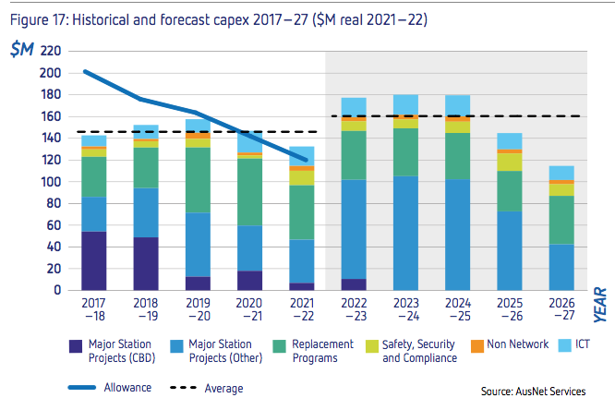
AusNet’s forecast capex of $796.2m ($real 2021-22) – a 9% increase to current period expected capex
Major drivers of increase:
Major station projects
Increased safety, security & compliance
ICT
Offset by:
Reduction in CBD projects & other replacement programs
AusNet Services: TRR 2023-27 – Overview Document, October 2020 (unsmoothed)

Slide 16
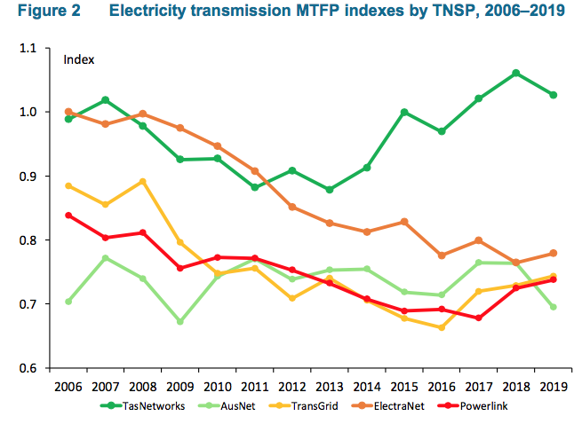
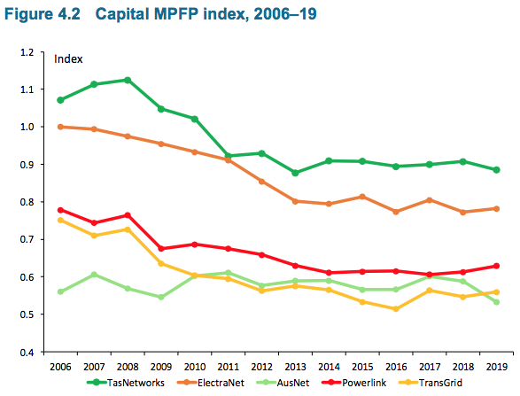
Declining capital productivity constrains improvements in overall productivity
Source: AER, Annual Benchmarking Report – Electricity Transmission networks, Nov 2020.

Slide 17
CCP23 supports the change in Ausnet’s capex focus to network ‘backbone’ projects but more review required by the AER of other capex
Increase in major station projects (up 18%):
New focus on switching stations that form the ‘backbone’ of the existing Vic transmission network or support interconnectors ✔
Replacement of terminal stations where distribution networks connect to the transmission networks ?
Shift in station capex from replacement of 220 kV assets to 500kV assets✔
Other replacement programs (down 13%): ?
Safety, Security and compliance (up 47%) ?
ICT (up 14%) ? (note shared cost issue)
Deferral of projects from current period to next period – prudent deferral?
Real cost increases in labour/contractor costs?

Slide 18
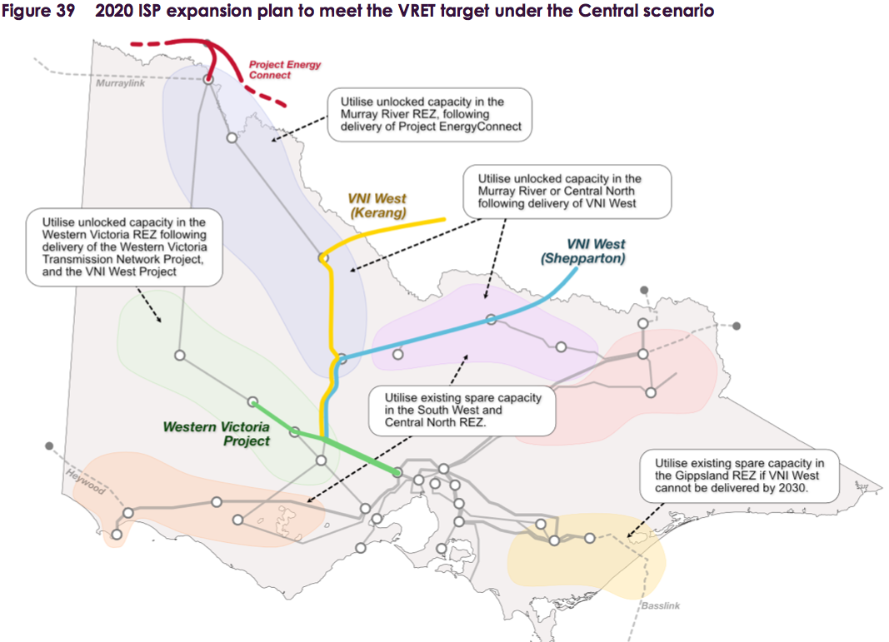
VRET target (50% by 2030) drives significant new investment in transmission with impacts on AusNet’s replacement plans
The ISP project “VNI minor upgrade” allows deferral of $33m transformer replacement at South Morang terminal station.
AEMO 2020 Vic Annual Planning Report

Slide 19
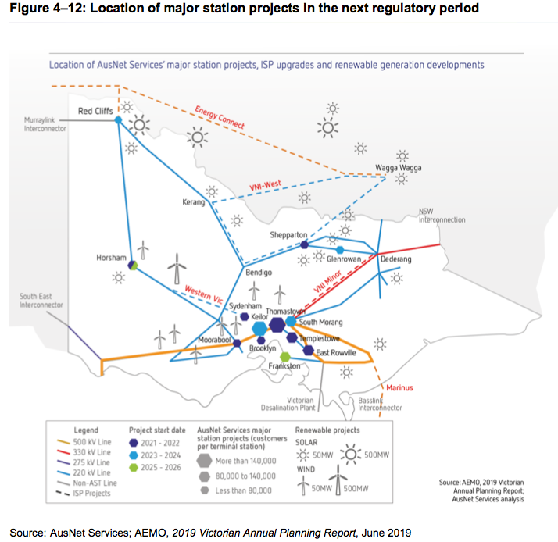
For review:
Updates for 2020 ISP & 2020 Vic Annual Planning Report?
Timing of projects?
Government policies and funding e.g. for VNI West.
RIT-T outcomes – potential for changes in costs & net benefits?

Slide 20
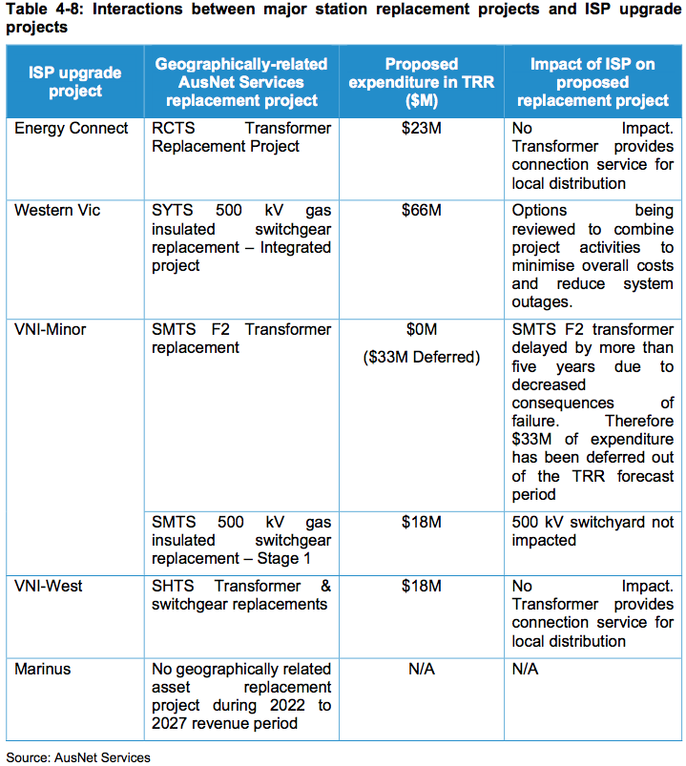
AusNet has worked with AEMO to identify interactions between ISP and its own capex assessments.
Source: AusNet Services: TRR 2023-27 Revenue Proposal, p 258

Slide 21
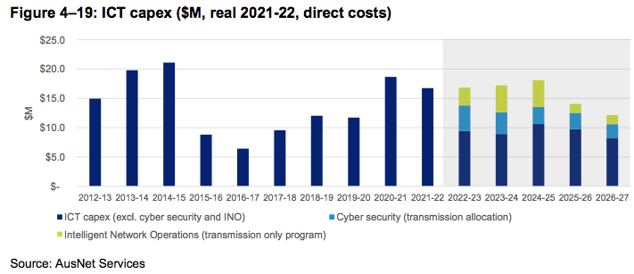
Forecast ICT capex increases by 14% compared to 2017-22
For Review:
Adequacy of business case.
Benefits to consumers (0.31% opex productivity saving?).
Allocation of costs for joint IT expenditure.
Approach to “Intelligent Network Operations” – link to AEMO’s ISP program?
Source: AusNet Services, TRR 2023-27 Revenue Proposal, October 2020, p 119.

Slide 22
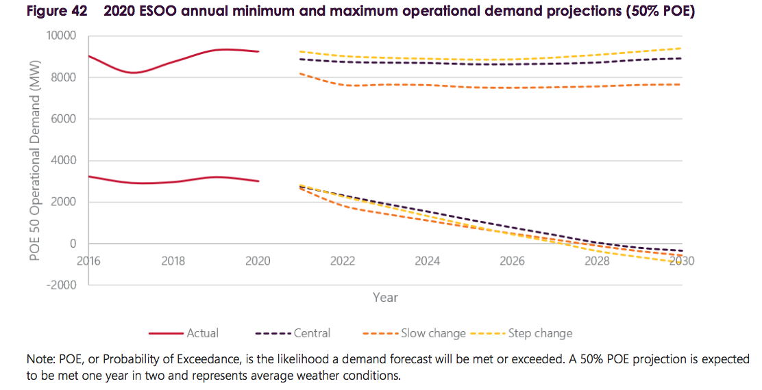
Managing declining minimum demand will be a major challenge for AusNet to manage efficiently.
Source: AEMO, Victorian Annual Planning Report

Slide 23
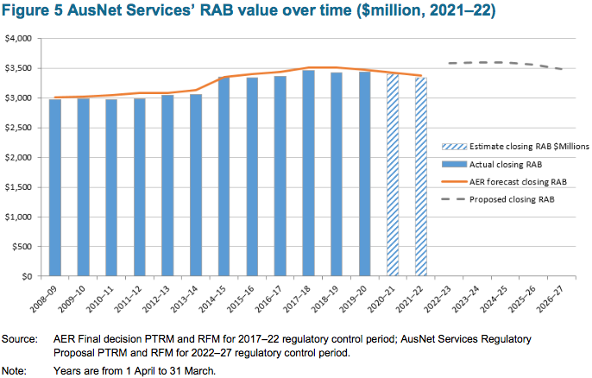
RAB growth low compared to other transmission business, reflecting more effective capex planning approach
For review:
Proposed roll in of $294m of ‘growth assets’ into RAB – inclusion of assets built at request of AEMO or DNSPs?
Visibility of these projects from consumer perspective.
Consistency with AusNet claim that “RAB per customer is expected to decline over the forthcoming period” (p 95).
Source: AusNet Services, TRR 2023-27 Revenue Proposal, October 2020

Slide 24
Further changes to depreciation approach- impact on current consumers & affordability?
AusNet proposing to depreciate decommissioned assets that are still in the RAB:
Claim that focus should be on economic life, not potential asset life (as currently in place)
If an asset has been decommissioned, or likely to be so in the 2023-27, then it should be fully depreciated in this period
Currently, AusNet includes only insulators and transformers – and suggests that in most cases the decommissioned assets would be replaced by ‘like-for-like’ assets in the 2023-27 regulatory period.
This brings forward $29m in depreciation costs in 2023-27, including $21.5m in 2022-23.
AusNet is also proposing to separate insulators and instrument transformers from broader asset class and reduce asset lives:
Insulators: from 60 to 40 years
Instrument transformers: 45 to 30 years
This approach will add some $35.6m ($2021-22) for each of the next three regulatory periods.
To our knowledge, AusNet has not tested these changes with their consumer bodies.
CCP23’s initial response is that there are significant and broader implications associated with changing the depreciation schedules to reflect decommissioning, and changing asset lives.
We expect AusNet and the AER to undertake further consultation on these changes.

Slide 25
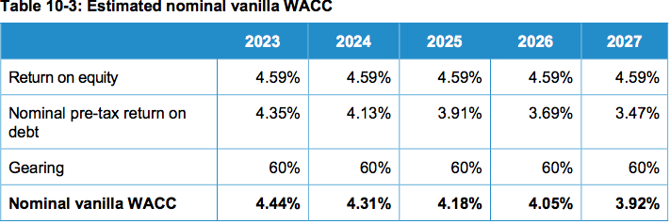
Rate of Return, Gamma & Forecast inflation
AusNet Services has adopted the AER’s 2018 Rate of Return Instrument to estimate the cost of capital & gamma.
Note:
Includes forecast inflation placeholder of 2.25%, but subject to AER’s final decision on approach to regulatory inflation (due December 2020).
Cost of debt updated annually – decline in cost of debt reflects trend in debt costs applied to the 10-year trailing average.
Gamma of 0.585 as determined in the 2018 Rate of Return Instrument.

Slide 26
Incentive Schemes

Slide 27
Incentive schemes
Opex and capex incentive schemes are intended to provide a mechanism for the regulated business to keep its opex and capex spending as low as possible.
The business benefits financially from cost savings, while sharing some of those benefits with customers.
Well designed incentive schemes incentivise the business to find additional sources of efficiency that could not have been envisaged at the time of the regulatory proposal and determination.
Badly designed efficiency schemes reward businesses for cost savings that should have been in the base proposal, either because the proposal and determination over-estimated costs in the first place or because it should have been reasonable at that stage to see that the expenditure was not required or could be deferred.

Slide 28
Incentive schemes
Incentive schemes that might apply to a transmission business:
Opex Efficiency Benefit Sharing Scheme (EBSS)
Capital Expenditure Sharing Scheme (CESS)
Service Target Performance Incentive Scheme (STPIS)
The EBSS CESS and STPIS all apply to AusNet Services in the 2017–22 regulatory control period.
AusNet Services has proposed the application of EBSS, CESS and STPIS in the 2022-27 regulatory period.

Slide 29
Opex Efficiency Benefit Sharing Scheme (EBSS)
The AER’s F&A stated:
We intend to apply the EBSS to AusNet Services in the 2022–27 regulatory control period if we are satisfied the scheme will fairly share efficiency gains and losses between the business and consumers.
This will occur only if the opex forecast for the following period is based on the businesses revealed costs.
Our transmission determination for AusNet Services for the 2022–27 regulatory control period will specify if and how we will apply the EBSS.
We support application of the EBSS on this basis.

Slide 30
Capital Expenditure Sharing Scheme (CESS)
The AER’s F&A stated the AER’s position to continue to apply the CESS as set out in its capex incentives guideline to AusNet Services in the 2022–27 regulatory control period.
We support application of the CESS on this basis.

Slide 31
Service Target Performance Incentive Scheme (STPIS)
The purpose of the STPIS is to provide incentives to TNSPs to provide greater transmission network reliability when network users place greatest value on reliability.
AusNet Services’ revenue proposal accepted the AER’s F&A proposal to apply version 5 of the STPIS for the next regulatory control period.
AusNet Services’ proposal raised an issue with one parameter that it maintained would result in an asymmetric scheme.
Our initial view is to support the AER’s response in its Issues Paper that a TNSP can only earn a reward for service improvement results once, and therefore it may not be appropriate to propose an alternative methodology.

Slide 32
Demand Management Incentive Mechanism
The Demand Management Innovation Allowance Mechanism (DMIAM) provides transmission network service providers with an allowance to undertake innovative projects related to demand management projects
In its F&A, the AER stated that it expected to develop and apply a DMIAM to AusNet Services for the 2022–27 regulatory control period
AusNet Services has indicated that it considers the DMIAM should be applied to it during the forthcoming regulatory control period.

Slide 33
Maximum Allowed Revenue

Slide 34
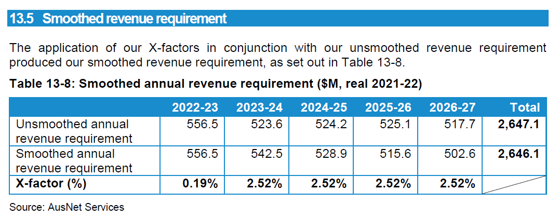
Unsmoothed and smoothed annual revenue requirement

Slide 35
Forecasts
The business sought (but did not get) a three-month extension to lodge its Revenue Proposal – to allow for forecasts to take better account of COVID-19.
While the AER decided to proceed along the existing review timelines, it acknowledged that adjustments to AusNet’s plans to address COVID-19 impacts may be needed following lodgement of the revenue proposal.
AusNet has said that it will:
Continue to engage with its customers throughout the regulatory process to seek their views on the pandemic’s effects, as these become clearer.
Reflect any new information, including AEMO’s latest demand forecasts, in its Revised Proposal.

Slide 36
Concluding Comments

Slide 37
DER, Large Scale Renewables
Mainly picked up in ISP associated work.
A consolidated narrative about emerging and future DER, large scale renewable generation and ‘future’ issues would be helpful for stakeholders.

Slide 38
Cost Pass Through and Contingent projects
This is a general Comment.
Responding to the uncertainty from industry change and more recently COVID-19 has led some network businesses to manage greater uncertainty by using Cost Pass through, contingent projects, RIT-T assessment and other approaches.
In general, these approaches are to be avoided when possible as they are not part of the 'ex-ante' revenue approval process, so the costs of these projects come later and are likely subject to less stakeholder scrutiny under the current practices.

Slide 39
Summary
Support for Capex re ISP. A stronger “future Transmission network” story would be useful
Mature overall capex planning process – but some areas need AER review
ICT Capex lacks a tangible description of consumer benefits, limited investment in “Intelligent network”, too much “Commercial in Confidence”& limited visibility on ICT capex sharing.
AusNet & AEMO working together a plus. Other TNSP’s should also keep working together for efficient development of the future NEM, in consumer best interest in effective .
Forecasts will need (regular) revision up to the final decision to best understand likely post-COVID demand implications.
Further Engagement
Consumer led topics
Opex cyber security & opex/capex tradeoffs re decisions on Cloud
Future network – ISP and government policy impacts
Post COVID
Depreciation on decommissioned assets

