Slide 1



Public Forum on Opex Productivity
30 November 2018
Consumer
Challenge
Panel

Slide 2
Overview (1)
Objective is to mirror the discipline facing firms in workable competitive markets
1.5% p.a. productivity improvement is the minimum
  Gives greatest weight to MPFP recognising further work is required
  IT review (including productivity benefits) required in near term
Review of determination of Frontier is overdue
Base to which productivity adjustment is applied needs to be considered
  Opex should be defined on functional basis
    i.e. applied to capitalised opex and overheads as well

Slide 3
Overview (2)
Regulation necessitates decision-making based on imperfect and incomplete information
This applies to Opex productivity
But AER must make a decision based on the best information before it
  It can continuously seek to improve the information base
  But cannot defer a decision until better information is available
Current assumption of zero productivity:
  Is not the best estimate given available, more recent information
  Does not reflect disciplines of competition
  Does not match consumer expectations

Slide 4
Question | Initial Response
1. Are there other sources of information to be considered? | Limited economy-wide data; disaggregated and survey data should be explored
2. Should all information be given equal weight? | No. Greater weight should be given to MPFP post-2012, subject to (1)
3. Applicability of time trend for gas distributors? | ‘Floor’ for electricity NSPs; not best estimate
4. Should we account for changes in undergrounding? | Partial ‘Floor’ for electricity DNSPs, not best estimate
5. Should economies of scale be considered? | No strong empirical evidence. Overlap with output factors?
6. Best way to use quality-adjusted labour productivity growth. | Current approach of using forecasts by Deloitte informed by ABS trends supported but total productivity needs to also include non-labour inputs.
7. Other forecasting approaches? | Yes. See (1)
8. Best option? | Option 4 – with further analysis and testing
9. Best estimate of productivity growth and basis? | 1.5% plus, based on MPFP and labour productivity extended to all inputs
10. Should this be applied through the current reset cycle? | Zero productivity estimate cannot be sustained. Revised estimate essential for near-term decisions, but ongoing development/updating required

Slide 5
Objective for productivity estimates
Objective:
Best available unbiased estimate of opex for efficient and prudent operator.
Efficient
Customers should not pay for inefficient costs
Unbiased
Essential for NPV=0 principle
Implies expected NPV of EBSS=0, if not put in cash flows
Best available
Recognises limitations of methods/data
Requires continuous observation and review

Slide 6
But trend productivity is only part of the story…
Estimate of efficient opex depends on:
  Assessment of efficiency frontier
  Rate of improvement in productivity
Estimate of efficiency frontier should also be reviewed
  Especially the 75th percentile assumption
Revelation of efficient costs in future is also important
  Sharing of efficiency gains and EBSS should also be reviewed

Slide 7
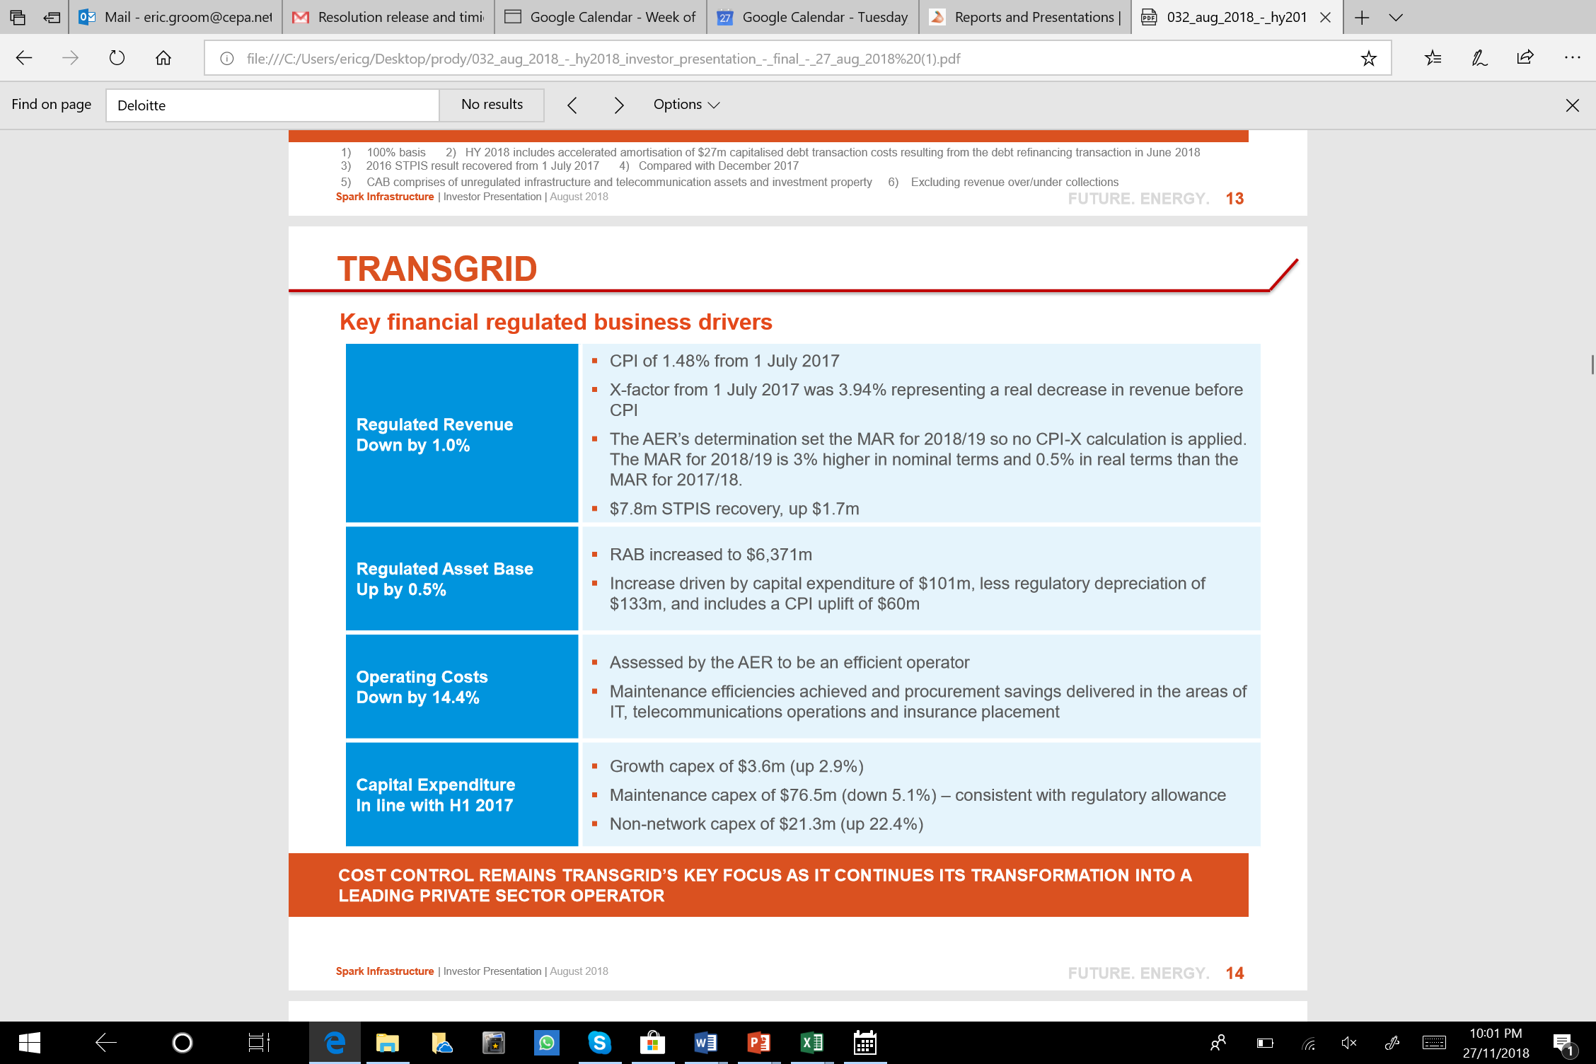
Clash of assumption, reality, and expectations
Assumption: Zero productivity change
Example of Reality: Transgrid
Expectations:
  Continuous efforts improve efficiency
  … reflecting competitive pressures
  Productivity payoffs from IT/Capex

Slide 8
Arguments against change
Adverse financial impact on NSPs
  Existence of an advantage does not justify continuation
Impact on incentives
  Changing the benchmark does not affect incentives (see below)
Imperfections in data and methods
  Recognised, but does not justify not improving estimate while continuing to work on further improvements
Productivity change is already in the forecasts you just cannot see it
  No evidence for this (see below)

Slide 9
Impact on Incentives?
Incentive to improve opex efficiency depends on:
  The period of de-linking allowed revenues and actual costs
  The sharing of benefits through the EBSS
Incentives do not depend on:
  The benchmark level of opex allowed, or
  Whether or not productivity improvements are built into the opex forecasts
  Assuming utilities prefer higher profits rather than lower profits

Slide 10
Is it already there?
Argument 1: Ongoing increases in service standards and regulatory requirements will offset productivity improvements
  This is already incorporated in the MPFP measures
  Argument only applies if the trend in multiple small increases in standards and reg requirements accelerates
Argument 2: Labour productivity improvement is already included in labour unit rate trends.
  ABS very clearly states that it is not
  Deloitte states that unit rates exclude labour productivity

Slide 11
Options
Option | Assessment
1. Status quo - zero | Reject: Not supported by data; inconsistent with expectations
2. Productivity growth from undergrounding | Partial floor only. Other sources of productivity must be considered.
3. Undergrounding plus gas distribution | Floor only. Opportunities for productivity improvement in gas more limited than electricity
4. Average Opex MPFP since 2012 | Best currently available. Pre-2012 trends distorted. Post 2012 analysis requires further testing (see below)
5. Labour productivity forecast | Partial floor only. Other sources of productivity must be considered.
6. Holistic approach | Agreed subject to caveats noted above. Alternative measures should be considered subject to caveats above and gaps. MPFP should be given greatest weight. Assessment in DP results in biased estimate.

Slide 12
MPFP estimates
Agreed: Opex tends are distorted pre-2012
  See Economic Insights Report and Ausgrid Revenue Proposal
Agreed: the focus is on the improvement in the relevant frontier
  In this case the top quartile, not the ‘absolute frontier’
But why estimate by excluding those deemed inefficient rather than focusing on the top quartile?
  Citipower, Powercor, SAPN and UE were most efficient in 2013.
  Their opex productivity improvement was 2.9% p.a.
  Variations provide estimates of 1.5% - 2.7% p.a.

Slide 13
Conclusions
MPFP estimates for top performers
  Range is 1.5% - 2.9%, median 2.6% p.a.
Labour productivity forecast extrapolated to other inputs
  1.5%
Undergrounding plus gas trend
  1.0% but biased down.
Conclusion: 1.5% is the minimum supportable estimate given available data.

