Slide 1
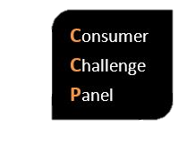
F&A Victorian Distribution 2021-25
CCP17 Initial response
Robyn Robinson, Mike Swanston, Mark Henley David Prins
Melbourne 25th October 2018

Slide 2

Role of the CCP
Set up under the Better Regulation Reforms
CCP17 is part of the ‘second iteration’ of the CCP – for EDPR 2021-25
We assist the AER to make better regulatory determinations by providing input on issues of importance to consumers
Represent a consumer ’real world’ perspective – the ‘person in the street’
Focus: consumer outcomes
Price, performance, service, corporate responsibility
Fair outcomes for all
A well-performing utility is of best value to the community

Slide 3
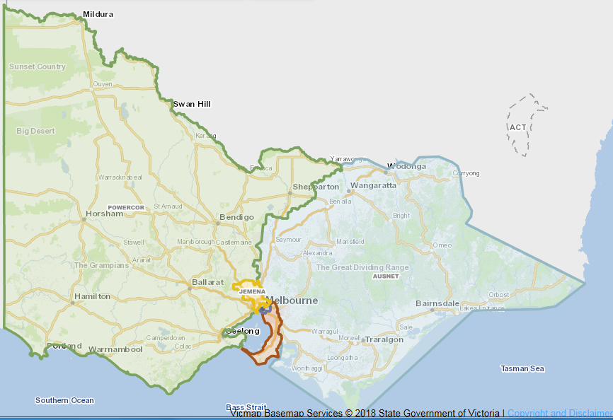
Who does what?

Slide 4
Context EDPR 2021-25
A number of elements of final decision in development:
  Rate of Return (set separately and binding)
  Tax
  Opex Productivity
  Tariffs
  new Classification Guideline
  Maybe profitability
  + Victorian and federal elections to both occur over next 6 months

Slide 5
Key Points
First F&A to embrace the Distribution Service Classification Guideline & Exempt Asset Guideline (issued 30 Sept 18 – required by NER rule change in Dec 2017)
Recent change to Victorian legislation (National Electricity (Victoria) Act 2005) means Ch 5A now applies means a change to connection services language and classifications
Consumer Engagement included as an element of F&A (first time?)
Retain incentive schemes – STPIS, EBSS, CESS, (from Dec 2017) DMIS, Victorian F-factor
Keep Expenditure Forecast Assessment Guideline reporting framework
Depreciation remains based on forecast Capex to establish RAB at 1 Jan 2026. With CESS, encourages Capex efficiencies.
Some particular issues raised by Vic DBs that are a little different to other states

Slide 6
Changes from last time
In this F&A, the main changes are bringing Vic into line with other states in classifications.
The term ‘network services’ becomes ‘common distribution service’
Language changes around connection services, now that CH5A applies in Vic, bringing it into line. The terms from CH5A - ‘basic, standard and negotiated’ now feature in Vic – are simpler than present.
Public lighting has moved into ACS, consistent with other states,
Emergency recoverable works & mutual support in emergencies, unclassified to SCS, again because of ring fencing. Common with all other states now. - Need for vigilance in this change to maintain a commitment for cost recovery from the causer party.
Ring fencing is also behind other changes in classification for small items such as issuing property services, sale of materials, clearance notices, security lighting and the like – all moving from unclassified to ACS. This has occurred in all jurisdictions.
Incentive schemes: add in DMIS

Slide 7
Issues from DB’s
AusNet Services has raised the allocation of ‘Stand-alone Power Systems’ as an SCS. A rule change initiated in Western Australia is currently being considered. AER will hold this over until further advice.
New ACS category of Network Safety Services & site visits – accepted as ACS
Clarity needed in the issue of ‘fault response – not network fault’.
Watchman lights - a new service – will be ACS
AusNet Services– new service ‘transmission network support’ – AER is thinking ‘unclassified’ and are seeking comments

Slide 8
CCP is looking at:
Connection services is a fairly big change, DBs vs AER’s interpretation of how things work may be controversial. (See p 37.)
The way AMI meters are carved out under Victorian legislation is ‘a little tricky.’ Other states metering price capped or contestable. How do the pieces fit together?
Public lighting is defined under the Victorian Public Lighting Code which is administered by the AER. The term ‘emerging public lighting’ is becoming common.
AusNet Services – new service ‘transmission network support’ – AER is thinking ‘unclassified’ and are asking for comments
AusNet Services – asking for a ‘Small Scale Incentive Scheme (SSIS)’ to cover services outside STPIS.
F-factor scheme, AER regulates, under State legislation
Consumer engagement, what is AER expecting? NB NewReg and 3 quite different approaches – all very interesting

