Slide 1
Pre-Determination Conference Murraylink 11 October 2017
Consumer
Challenge
Panel

Slide 2
Overview
Revenue Summary
Consumer Engagement
Opex
Capex
Rate of Return
Return on Equity
Market Risk Premium
Equity Beta
Inflation
Gamma and Tax

Slide 3
Revenue Summary
Draft Decision reduces proposed revenue by c12% - from $96.3m to $84.6m (nominal) over the 2018-23 regulatory period
Draft Decision reduces Capex by c%21 – from $33.8 to $22.6m ($2017-18)
CCP remains concerned by shortcomings in economic justification of expenditure and in consumer engagement

Slide 4
Effectiveness of MurrayLink’s Customer Engagement (CE)
What we said regarding ML’s approach to CE leading up to their proposal
Their approach to CE is “profoundly disappointing”; the only CE is limited and passive, i.e.
high level presentations to existing stakeholder forums (e.g. AEMO’s consumer forum), and
a “you contact us…” approach to listening to customers.
It does not comply with the requirements of the NER and AER’s Guideline
Contacts with third parties are simply on a BAU/operational basis
And ML appears to have made no attempt to evaluate or improve these limited relationships or engage on strategic issues or the regulatory proposal
On the other hand, ML is seeking significant increases in its opex and capital allowances from the AER;
And is proposing a range of variations from the standard regulatory approach, e.g to WACC components
Other parties re also concerned with ML’s
SA Govt submission (May 2017): “In summary, it is the Divisions experience to date, that ML has not conducted effective CE. The divisions view is that ML have an obligation to engage not only with their direct customers, but also with consumers and their representatives” (p.2)

Slide 5
Effectiveness of Engagement
What the AER concluded in the Draft Determination (DD)
Agreed with CCP9 and the SA Government. The AER states in its Overview (p. 39):
“We consider that ML has not taken any steps to engage with its customers as required by the rules and consistent with the CE Guideline”.
“This demonstrates ML’s lack of commitment to ongoing and genuine CE on issues relevant to consumers”
“We have seen a similar lack of commitment to CE by the APA Group, which manages ML, in our determinations for the Roma to Brisbane Gas Pipeline and the Victorian gas Transmission System”
“Our own consultation on ML’s proposal has shown there is stakeholder interest in the proposal”
ML has provided no evidence since then of any assessment of its CE or plans to improve its current approach
CCP9 strongly supports the AER’s conclusions. Our concern is with the regulatory consequences of ML’s actions:
Despite not engaging with direct & indirect users, the AER accepts ML opex and a large part of ML’s capex.

Slide 6
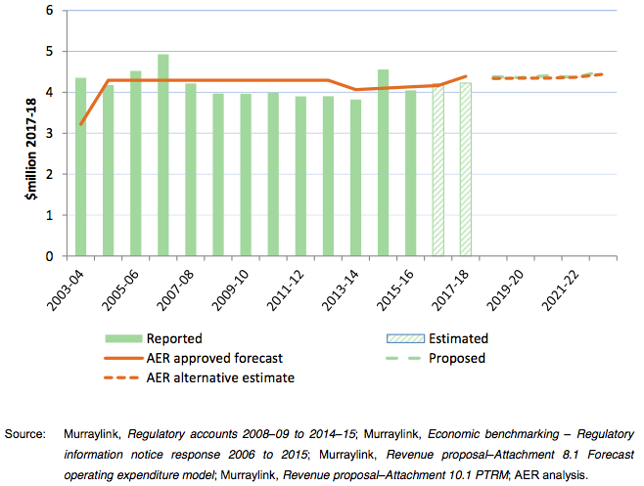
Draft Decision on Opex
AER accepts ML’s proposed opex of $22.1m ($2017-18)
This is a 5.6% real increase compared to 2013-18 period
AER’s own estimate $21.8m ($2017-18) is “not materially different”
While AER accepts total forecast opex it does not accept some components:
Increases ‘price growth’ due to higher labour cost allowance
Rejects proposed ‘step changes’
Rejects ‘category specific increases
Source: AER Draft Determination, Att 7, Figure 7.1, p. 7-6

Slide 7
Opex – what did CCP9 advise?
CCP9 advised the following:
ML’s proposed step change should be rejected. The step change refers to proposed priority service agreement with the manufacturer of ML’s key systems.
ML should also be required to market test the Operating Agreement that it holds with the APA Group
CCP9’s conclusions on the AER’s DD
Accept the AER’s DD to increase labour cost growth above CPI as this is consistent with the AER’s approach across other determinations
Support AER’s decision to reject step change & category specific charges, i.e that these costs can be managed within existing opex allowance
Remain concerned that the AER’s global opex view does not address the issue of efficiency of the Operating
Agreement with APA. Is the EBSS sufficient incentive?
Similarly a productivity factor of 0%, leaves incentive gap

Slide 8
Capex

Slide 9
Capex (2)
AER Draft reduces Capex by 21%
Removes expenditure ‘not supported’ by sufficient justification
Reduces allowance for major capex project – the Control System upgrade. Murraylink revised cost estimate post-submission by $2.27m
Requires a RIT-T for the project (as proposed by CCP)
Draft also rejects $2.5m “APA Management Costs” – a margin of c10% on the project costs – as ‘double dipping’.

Slide 10
Capex (3)
Murraylink has a potentially important role in ElectraNet’s ‘SA Energy Transformation’ RIT-T
Contingent project need remains to be determined
CCP remains concerned by limited economic justification for capex
RIT-T for Control System replacement is an opportunity for Murraylink to improve engagement with consumers and to provide robust business cases for expenditure

Slide 11
Weighted Average Cost of Capital
ML proposal: 6.54% (vanilla)
Rejected the RoR guidelines on CAPM approach, MRP, Beta, inflation, and gamma (value of imputation credits)
CCP 9 advice:
Evidence suggest current approach errs of the high side
AER should reject variations from the RoR guidelines
AER draft decision: 5.7% (vanilla)
Consistent with current guidelines and CCP 9 advice. Key changes:
MRP – 6.5% (cf Murraylink proposal of 7.18%)
Beta – 0.7 (cf 0.8)
Return on Debt – 4.78 (cf 5.16)
Inflation – 2.5% (cf 2.0)
Gamma – 0.4 (cf 0.25)

Slide 12
Draft Decision on WACC
CCP 9 supports the AER decision on WACC
AER has applied the current guideline having regard to:
Current market conditions
Recent decisions of the ACT and Federal Court
We accept the decision should not pre-empt the WACC review just commenced.
But evidence suggests the current approach errs on the high side, as indicated by
Strong investment proposed
The premium paid above RAB for regulated businesses
Decision supports (a) but doesn’t engage on (b)

Slide 13
Approach to Estimating Return on Equity
ML proposed different approach to implementing CAPM:
Based on estimates of past and current expected nominal market return instead of separate estimates of RFR and MRP
MRP implied by deduction
CCP response
Rejected criticism of AER approach – it is a valid, widely used application of CAPM
The case for focussing on past nominal returns is weak (the ‘Wright’ approach assumes constant real returns)
Increase in implied MRP is not be supported by other market data

Slide 14
Market Risk Premium
ML (by implication) gives greater weight to current estimates
WACC guideline requires a structured consideration of a wide range of information
Evidence suggests current approach to RoE errs on high side.
E.g acquisition values, broker reports, and capex plans.
Other regulators give weight to RAB multiples
MRP is reward for risk – no evidence of increased risk
MRP should reflect relative uncertainty and risks – measures (e.g. VIX, debt premiums) don’t suggest higher risk/uncertainty.
DGM estimates may be anomalous or biased
Reported results appear inconsistent with international estimates and fundamentals
Some reviews suggest DGM estimates may be biased upwards in the current climate
DGM is a long term model but influenced by market noise
Caution needed in interpreting estimates

Slide 15
Draft decision on MRP
The AER draft decision reached similar conclusions
CCP 9 supports the AER assessment
Recent data/events strengthen these conclusions
Endeavour Energy sold for 1.6 times its RAB
Indicators show further reductions in perceived risk
Bond spreads have declined and are the lowest since the GFC
The VIX (share volatility index) declined further through 2017
Following an increase in 2016, dividend yields are back to 2013 levels
IPART’s index of uncertainty (based on the Bank of England Index)
declined further and is below its long term average.

Slide 16
Falling Risk/Uncertainty

Slide 17
Beta
ML: Propose 0.8 based on shorter term estimates
CCP- 9 recommended continued use of beta of 0.7
Frontier supported longer (10 year) estimation period). Stephen Gray (Frontier) rejected use of shorter period in IPART hearings
Need to:
Examine fundamentals and consider overall evidence on RoE
Cross-check with practice in regard to adjustment of beta
No strong basis to change Beta
Draft decision retains beta of 0.7. CCP 9 accepts this but considers weight of evidence suggests it is high

Slide 18
Inflation
AER model is based on real WACC (i.e. nominal WACC less inflation). Inflation assumption has major impact.
Murraylink: 2% based on implied yield approach
CCP 9 recommended retention of current approach
WACC review underway. Change could pre-empt this.
Questionable whether implied yield reflects inflation expectations.
Draft decision: maintain current approach (2.5%)
CCP9 supports draft decision.
Inflation review has increased doubts about implied yields (e.g see RBA comments)
Demonstrated that differences between actual and expected inflation do not after real returns under current approach
Note: if ML uses nominal historic returns historic inflation is more relevant

Slide 19
Imputation Credits and Tax
ML proposal: Tax allowance of $5.0m, 0.25 gamma
CCP 9 advice:
Use gamma of 0.4, per guideline, subject to Federal Court decision
Review the approach to estimation of taxable income in the context of the WACC review as current approach appears to systematically overstate tax paid
AER draft decision: Tax allowance of $2.5m, 0.4 gamma, no change to approach to estimating taxable income
CCP 9 supports gamma of 0.4 and acknowledges the approach to estimating taxable income cannot be changed in this review. But two questions remain:
Does the current approach overstate taxable income in practice?
Why give stronger incentives to reduce tax paid than increase efficiency?

