Slide 1
Pre-Determination Conference - TransGrid 10 October 2017
Consumer
Challenge
Panel

Slide 2
Outline
Role of the Consumer Challenge Panel (CCP)
Customer engagement
Opex
Capex
WACC/Tax
Other issues

Slide 3
Objective of the CCP
Advise the AER on the effectiveness of TransGrid’s customer engagement activities and how this is reflected in the proposal; and
Advise the AER on whether the proposal is in the long term interests (LTI) of consumers with respect to price, quality and reliability of service, consistent with the NEO
The NEO is an economic efficiency objective with three principal dimensions:
Productive efficiency
Allocative efficiency
Dynamic efficiency

Slide 4
Effectiveness of TransGrid’s Consumer Engagement (CE)
What we said:
Recognised the significant improvement in TransGrid’s CE approach
CCP9 highlighted: early start, structured program, clear communication, feedback to participants, improved levels of trust & knowledge, support from senior management, commitment to ongoing consultation
Recommended further development for best practice:
Move from “inform” to “involve” & “collaborate” (IAP2 spectrum)
Proactively invite challenge from stakeholders on assumptions e.g assumptions underpinning the capex modelling
Develop framework for measurement & ongoing improvement
Provide more detailed information on risks as well as benefits of plans (e.g. forecast demand is less than expected)
Respond more to concerns around efficiency/productivity – particularly given past investments funded by consumers
Extend best practice CE to the RIT-T/contingent project processes
Specific issues around CE approach to PSF given the number of assumptions/estimates in the plan.

Slide 5
Effectiveness of CE
What the AER concluded in its Draft Determination:
Agreed with CCP that TransGrid had made significant improvements in its approach to CE, resulting in improved relations with business/community reps
Highlighted areas for improvement to achieve best practice (similar to CCP)
Noted other NSP’s work, e.g AGN’s CE with stated aim of delivering for the customer, underpinned by effective CE & capable of being accepted by the AER. Also referred to ElectraNet and TasNetworks
Move from informing and sharing to involving consumers in its decision making & collaborating on approaches to priority issues
Opening up to challenge by stakeholders/engage on more strategic issues
More structured review & measurements of CE program
Consider the balance & targeting of information for different customer categories
While TransGrid has gone further than most re its RIT-T for the PSF project, it could make assumptions more transparent & invite critical assessment

Slide 6
Effectiveness of CE
CCP assessment of the AER’s DD:
Generally agree with the AER’s position
New developments:
TransGrid has held three Advisory Committee (TAC) since its proposal
Not yet seen TransGrid’s response to the submissions/feedback on its initial proposal and the AER’s DD (“you said/we did”)
TransGrid’s stakeholder engagement program on its website does not appear to be updated since 2016?
However, TransGrid has indicated ongoing consultation with its consumer representatives (including re its revised proposal?)
We are expecting that these discussions will encourage an open exchange of views on both the AER’s DD & Transgrid’s revised proposal.

Slide 7
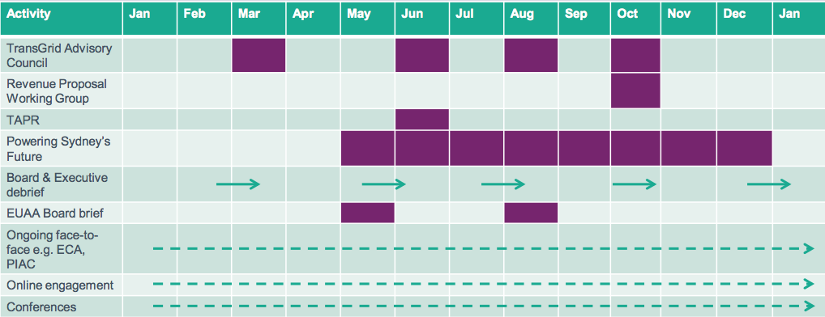
TransGrid: Engagement activities overview - 2017
Revised Revenue Proposal due 1 December
Source: Presentation to CCP 9, 4 May 2017

Slide 8
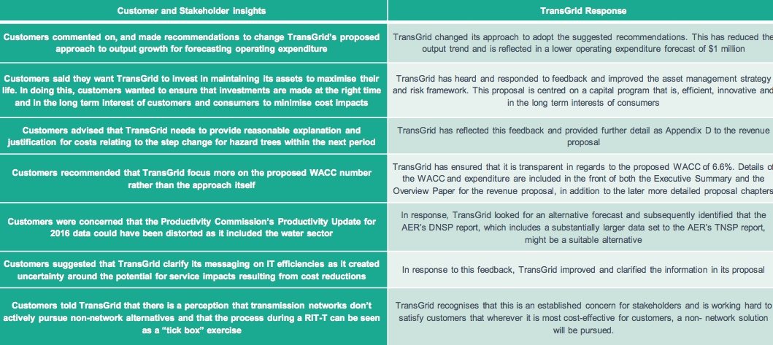
CE & the initial revenue proposal-where to now?
Source: Presentation to CCP 9, 4 May 2017
Some aspects of TransGrid’s proposal has been queried or rejected by the AER

Slide 9
Overall revenues
Compared to proposal Draft Decision reduces revenues and prices by 8.4%

Slide 10
Impacts on prices and consumers
CCP 9 welcomes the reduction in revenue and RAB cf proposal, but…
Transmission prices will still rise from $10.8/MWh to $12.95/MWh ($ nominal)
And there is the risk of
Further increases before 2022-23 due to contingent projects
Future increases with rising interest rates pushing up the WACC
Source: AER

Slide 11
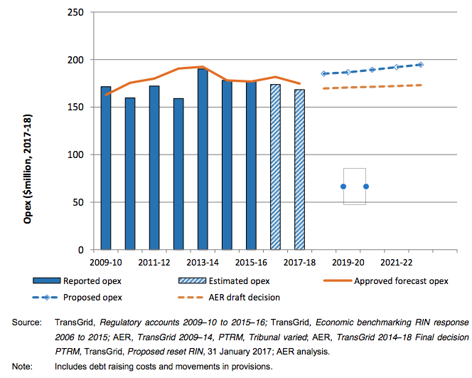
Draft Decision on Opex
Difference TG & AER = $74.7m ($17-18)
Key factors:
Estimate of 17/18 opex
Consistency with EBSS
Rate of change:
Input price growth
Productivity growth
Step changes:
Vegetation management
License conditions
Specific costs:
Debt recovery
Source: AER Draft Decision, Sept 17, Attachment 7, Figure 7.1

Slide 12
Opex – what did the CCP9 advise?
CCP9 noted the reduction in real opex since 13/14, but also TransGrid’s proposed real $ increase of some 11%
CCP9’s response to TransGrid’s proposal focused on the following concerns:
The forecast opex trend is inconsistent with past achievements in efficiency
TransGrid’s forecast of 0% productivity growth against recent trends
Customers’ concern with assumption of 0% productivity growth
TransGrid’s approach to estimating the 2017/18 opex
2017/18 opex forms the base against which forecast % growth is built
Inconsistency with EBSS calculations?
Justification for step changes
Nature of the regulatory obligation for increased vegetation management expenditure?
Is the proposed step change expenditure efficient?
Are savings to current costs adequately accounted for
AER’s DD addresses each of these issues & raises new considerations

Slide 13
Rate of Change
Rate of change based on:
Input price growth; output growth rate & productivity growth rate
Input price growth rate (expressed in % real $ increase)
AER’s DD 0.63%/pa c/f TransGrid 1.2%/pa
Agree on non-labour costs (0% real $ change)
Disagree on labour costs growth
Productivity growth rate (an industry wide measure)
AER = 0.2%, TransGrid = 0% (implied rate = 0.1%?)
AER refers to observed trends in transmission businesses in partial factor productivity (not multi-factor productivity which includes capital)
CCP’s preliminary position
Agree with AER on labour cost growth given trends
Agree with positive industry wide productivity trends although query whether AER is too conservative on this.

Slide 14
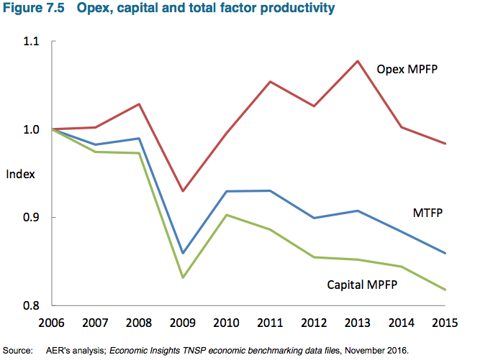
Industry Productivity Trends
Productivity Commission 2016 Report
EGWW Industry 2014-15
MFP growth 2.5%
Labour productivity – 7.8%
Overall summary:
While most industries exhibited positive MFP & LP growth in 2014-15, “particularly significant was the change in productivity of the Mining and Utilities industries”
https://www.pc.gov.au/research/ongoing/productivity-update/2016/2014-15-australian-productivity
Report to be updated later 2017
Comment:
While this covers the whole utility industry, CCP9 considers the revealed trend should not be ignored &
consumers support better approach
Source: AER Draft Determination, Fig 7.5, p. 7-36

Slide 15
Step Changes
CCP9 stated: “due to likely asymmetric operation of step changes, the AER must maintain a stringent test for accepting step changes and the standards for quantifying the net impact of changes” (p. 66)
TransGrid sought two step changes based on the claim of changed/new regulatory requirements:
$37.3m ($2017-18) for enhanced vegetation management
$29.5m ($2017-18) for compliance with operator’s licence (introduced in 2015)
AER DD allowed a total of $7.8m ($2017-18)
Rejected vegetation management claim in full
No material change in regulatory obligations
No substantial change in business operating environment
Proposed cost increases appear overstated
Potential for lower costs in other categories & reliability
Reduced allowance for licence compliance to $7.8m($2017-18)
acknowledge a change in licence conditions
However, claimed costs appear excessive
AER will review when updated audit information becomes available
CCP initial response
Overall pleased with AER’s detailed assessment of the proposed step changes against the regulatory principles
Agree with AER’s view on vegetation management
Qualified acceptance of AER’s view on licence compliance

Slide 16
Step Changes – some important questions
A step change is an asymmetric, and generally lasting increase in the regulatory opex allowance
Vegetation management
What counts as a change in regulatory obligations?
A change in the regulator is not necessarily a change in regulatory obligations
A critical audit report is not necessarily a change in regulations
E.g if the audit report identifies inadequacies in the recording or reporting of an activity, should this warrant a ‘step change’
TransGrid has always had an obligation to ensure it operates its network in a safe way
How to assess the efficient response & net costs?
Licence conditions (Dec 2015)– “critical infrastructure” conditions
TransGrid states to IPART auditor that since the end of 2015-16 it has complied with, or taken steps to comply with, the conditions
Query 1: We would expect the main compliance costs to have been incurred in 2016-17 (i.e. set up costs) – would they be in base year?
Query 2: At what point in time did TransGrid cease to control & operate from within Australia or allow personal information to be held outside Australia? Prior to sale, where was this held and would the cost have been included in opex in earlier years?
Query 3: Was this obligation known (or ought to be known) at the time of the sale of TransGrid (Nov 2015) – if known, should buyer bear this risk?

Slide 17
Capex
Dominant components are:
REPEX Program
Powering Sydney's Future (PSF)
Contingent Projects
REPEX program: Proposed $962m not accepted. Alternative estimate from AER of $758 (-21%).
CCP agrees that TransGrid’s risk based method is immature and likely to overstate need.
PSF proposed $331m not accepted. CCP agree that uncertainties in timing suggest a contingent project likely to be more appropriate than inclusion in ex-ante revenue allowance

Slide 18
PSF
Important and high-profile project. Media and political interest.
Important test of the ‘long term interest of consumers’
The need to eventually replace the ageing oil-filled Ausgrid cables is accepted. ‘Do nothing’ is not a sustainable option.
However, expenditure in 2018-23 relies on ‘bullish’ demand forecasts AND ‘bearish’ cable unavailability projections AND high Value of Customer Reliability (VCR)

Slide 19
PSF (2)
Annualised cost of the proposed expenditure is in the range of $20-$30m (AER estimate, D. Biggar paper)
No single ‘correct answer’ … consumers expect robust analysis and efficient expenditure to ‘manage’, not necessarily ‘eliminate’, the risks.
Multiple stakeholders: AER, TransGrid, Ausgrid, AEMO, EPA, NSW Govt … and consumers.
CCP has witnessed some constructive dialogue between stakeholders … more will be needed to arrive at an efficient revised proposal by 1 December 2017

Slide 20
Contingent Projects
TransGrid has provided further information since the original proposal. Including Broken Hill, latest information indicates 8 projects valued at between 2 and 6 billion.
Compares to TransGrid’s current Regulatory Asset Base of around $6,300m and Draft Capex allowance of $758m
 |  | Low ($m) | High ($m)
1 | New South Wales to South Australia Interconnector (NSI) | $ 279 | $ 1,084
2 | Reinforcement of Southern Network | $ 60 | $ 397
3 | Reinforcement of Northern Network (QNI Upgrade) | $ 63 | $ 1,600
4 | Support South Western NSW for Renewables | $ 89 | $ 473
5 | Reinforcement of Southern Network in Response to Snowy 2.0 | $ 831 | $ 1,228
6 | Support Central Western NSW for Renewables | $ 120 | $ 455
7 | Support North Western NSW for Renewables | $ 500 | $ 750
8 | Broken Hill | $ 52 | $ 178
 |  | $ 1,994 | $ 6,165

Slide 21
Contingent Projects (2)
Not all will proceed but is a key risk to revenues and prices for consumers going forward.
Many are driven by new investment in generation. Important interaction with AEMC ‘Coordination of Generation and Transmission Investments’ review and Finkel Review Recommendations.
Risk = effect of uncertainty on objectives
Key Risk is investment in long-lived infrastructure but the need does not appear (at all, in part or in terms of timing)
Current arrangements see consumers bearing this risk
Consumers reasonably expect a robust process

Slide 22
Weighted Average Cost of Capital
TransGrid proposal: 6.6% (vanilla)
CCP 9 advice:
Evidence suggest current approach errs on the high side
Current assumption for MRP (6.5%) should be retained
AER draft decision: 6.5% (vanilla)
Consistent with current guidelines and CCP 9 advice
Reduction in MRP from proposed 7.5% to 6.5% reduced real RoE from 7.5% to 7.2%
Cost of debt based on transition to Trailing Average (as accepted and proposed by TransGrid)

Slide 23
Draft Decision on WACC
CCP 9 supports the AER’s decision on WACC
AER has applied the current RoR guideline having regard to:
Current market conditions
Recent decisions of the ACT and Federal Court
We accept the decision should not pre-empt the WACC review just commenced
But evidence suggests the current approach errs on the high side, as indicated by
Strong investment proposed
The premium paid above RAB for regulated businesses
Decision supports (a) but doesn’t engage on (b)

Slide 24
MRP - What did CCP 9 Advise?
TransGrid: Simple average LT returns and DGM estimate
WACC guideline is less mechanical – requires a structured consideration of a wide range of information
Evidence suggests current approach errs on high side.
E.g acquisition values, broker reports, and capex plans. Other regulators give weight to RAB multiples
MRP is reward for risk – no evidence of increased risk
MRP should reflect market uncertainty and risks – measures (e.g. VIX, debt premiums) don’t suggest higher risk/uncertainty.
DGM estimates may be anomalous or biased
Reported results appear inconsistent with international estimates and fundamentals
Some reviews suggest DGM estimates may be biased upwards in the current climate
DGM is a long term model but influenced by market noise
Caution needed in interpreting estimates – see next slide

Slide 25
Consideration of DGM estimates
DGM estimates contain information on expectations for future returns, but…
DGM estimates:
Assume efficient markets that rationally incorporate new ‘news’
Require assumptions on long-term growth assumptions of investors
May be subject analyst bias in dividend forecasts
We know:
Financial markets are not always efficient, especially at the macro level and in the short to medium term.
Incorporation of news is complex – may be incorporated with significant lags and large step changes.
In the current environment (subdued growth and investment opportunities) dividend payout policies and long-term growth assumptions may have changed.
Need to consider DGM estimates carefully, cautiously, and not mechanically. They cannot be given a fixed weight.

Slide 26
Draft decision
The AER draft decision reached similar conclusions
CCP 9 supports the AER assessment
Recent data/events strengthen these conclusions
Endeavour Energy sold for 1.6 times its RAB
Indicators show further reductions in perceived risk
Bond spreads have declined and are the lowest since the GFC
The VIX (share volatility index) declined further through 2017
Following an increase in 2016, dividend yields are back to 2013 levels
IPART’s index of uncertainty (based on the Bank of England Index)
declined further and is below its long term average.

Slide 27
Reducing risk and uncertainty

Slide 28
Imputation credits and tax
TransGrid proposal: Tax allowance of $247.9m, 0.25 gamma
CCP 9 advice:
Use gamma of 0.4, per guideline, subject to Federal Court decision
Review the approach to estimation of taxable income in the context of the WACC review as current approach appears to systematically overstate tax paid
AER draft decision: Tax allowance of $168.5m, 0.4 gamma, no change to approach to estimating taxable income
CCP 9 supports gamma of 0.4 and acknowledges the approach to estimating taxable income cannot be changed in this review. But two questions remain:
Does the current approach overstate taxable income in practice?
Why give stronger incentives to reduce tax paid than increase efficiency?

Slide 29
Imputation Credits and Gamma
Since the CCP 9 submission in May 2017:
The Federal Court has determined on favour of the AER on gamma (0.40 instead of 0.25)
TransGrid has submitted a further paper from Frontier arguing for a gamma of 0.25
CCP 9 will respond to the Frontier paper in its submission on the draft decision. In brief:
The Federal Court found that the AER was not in error. Importantly, it clarified the meaning of the term ‘value of imputation credits’ consistent with the approach of the AER
The paper restates previous arguments rejected by the Federal Court that depend on a different (‘market value’) meaning of the value of imputation credits.
If NSPs consider that the Federal Court was in error, the issue needs to be brought back to the Federal Court
It is not for the AER to make a decision based on an interpretation of the meaning of the value of imputation credits not accepted by the Federal Court

Slide 30
Other Issues
The Draft Decision reduces the revenue adjustments by $46.8m – just over half the proposed adjustments.
The incentives under the EBSS account for a substantial proportion of these adjustments..
These are largely new issues and are the result of detailed analysis by the AER.
CCP 9 will need to carefully review these issues before it can comment.

