Slide 1
TransGrid Public Forum 11 April 2017
Consumer
Challenge
Panel

Slide 2
Outline
Role of the Consumer Challenge Panel (CCP)
Customer engagement
Revenue Requirement
Incentives and pricing

Slide 3
Objective of the CCP
Advise the AER on the effectiveness of Transgrid’s customer engagement activities and how this is reflected in the proposal; and
Advise the AER on whether the proposal is in the long term interests (LTI) of consumers with respect to price, quality and reliability of service, consistent with the NEO
The NEO is an economic efficiency objective with three principal dimensions:
Productive efficiency
Allocative efficiency
Dynamic efficiency

Slide 4
The National Electricity Objective (NEO)
Does the proposal promote Productive efficiency ?
Efficient costs, incentive schemes, risk reflective rate of return are all relevant.
Does the proposal promote Allocative efficiency ?
Pricing and value of reliability matters are relevant.
Does the proposal promote Dynamic efficiency?
Is the proposal consistent with the ENA/CSIRO Network Transformation Roadmap?
How does the proposal fit with contingent projects being advanced through RIT-T process?

Slide 5
Customer Engagement(CE) & the long terms interests of consumers
CE is now a key theme in the evaluation of the revenue proposals
CCP specifically tasked with providing feedback to the AER on the network’s CE approach
Consider each proposal in context of AER’s CE Guideline & general industry CE standards
Businesses must demonstrate:
Who, how, when and what issues it has engaged with its customers?
How this engagement has influenced its revenue proposals?
Do consumers agree the proposal is in their long term interests?
Is there a process for ongoing review of CE/continuous improvement?

Slide 6
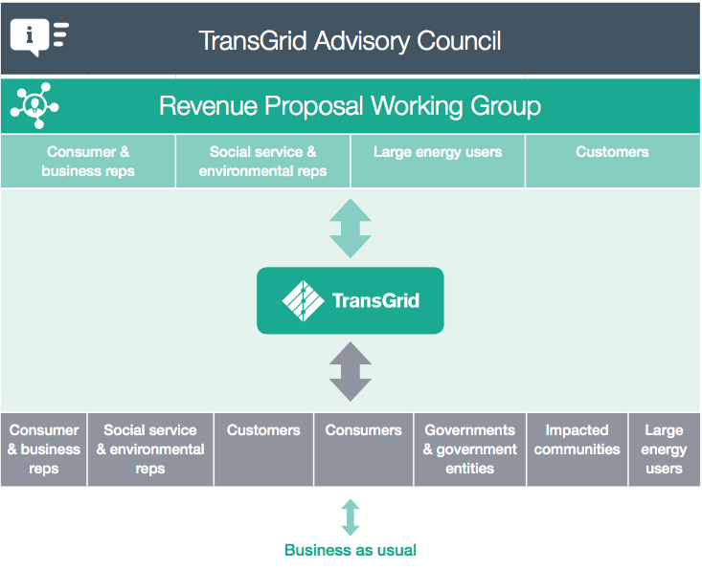
Transgrid’s CE framework
Other CE Activities:
NSW Energy Forum
Power Sydney Future Forum
Transmission Pricing Methodology
Reliability Standards
Independent stakeholder surveys
Ongoing engagement plans
Regional meetings
Joint meetings
Source: TransGrid Revenue Proposal 2018/19-2022/23, Appendix C, p. 3

Slide 7
Transgrid’s CE: Some highlights
Structured approach:
Identifies & engages a range of ‘direct customers’ & ‘indirect consumers’
Tailored engagement to reflect different levels of interest & knowledge in the market
Uses a variety of communication channels & site visits
Covers a range of relevant topics
Early commencement of engagement process
Allows time to build up knowledge and relationships
Active support from senior management
CEO participation & cultural change
Provide feedback on how CE influenced proposal
Plan for ongoing engagement beyond proposal

Slide 8
Transgrid’s CE: Some other observations
CCP’s discussion with TAC/RPWG participants - Outcomes:
General consensus that there has been a very significant improvement in Transgrid’s CE
Associated cultural change in interaction with customers
Different levels of industry knowledge still pose a problem for effective CE
Views range from information “clear” & “sufficient” to “too much information” & “couldn’t follow all of it”
General concern whether key customer issues are addressed:
Principal concern with price – has this been adequately addressed?
Productivity and continual improvement in efficiency
Not clear how increased replacement capex/IT has reduced future costs
Cost increases should be offset by savings elsewhere
Is Transgrid’s proposal reflecting an efficient commercial business?
How effectively & objectively is Transgrid evaluating its CE program?

Slide 9
Transgrid’s CE: Some other observations (cont)
RIT-T process? Contingent Projects? Non-network options?
Has Transgrid explained the RIT-T process
Has Transgrid explained risks associated with contingent projects
What processes are required to ensure timely & effective communication of and non-network opportunities
Transmission Tariffs
Consultation process on tariffs in current proposal?
Proposed consultation in future? (LRMC as a basis)
Potential long term impacts on future prices?

Slide 10
DISCUSS
Transgrid states:
“Transgrid’s engagement principles reflect a genuine desire to inform, consult and collaborate effectively, openly and in a transparent manner with interested parties.
It employs a “two-way engagement model” to:
Better understand needs and views of customers
Stakeholders have greater confidence that Transgrid is making the right decisions at the right time and in the long term interests of customers.
Has Transgrid met its own & the AER’s CE objectives?
Are there areas for improvement?

Slide 11
Revenue Requirement
Overview of proposed revenue and prices
Productive Efficiency
WACC
Opex
Capex
Dynamic Efficiency
Challenge of long term investments in a changing environment
Major capex proposals
Changing nature of demand & supply

Slide 12
Overall revenues and prices
TransGrid will ‘beat’ forecast capex and opex to 2018
Total opex and opex/kWh will decline in real terms
This + lower WACC more ‘modest’ revenue/price proposals. But
Is it a price reduction or increase? Further explanation may be required.
Proposal states prices will fall by 2.5% in real terms on average
PTRM shows 7.4% real increase in 2019 and 1% p.a. real increases in the following years
Forecast opex & capex increase in real terms
Therefore regulatory asset base (RAB) continues to grow
Questions and concerns
What happens in the future if interest rates rise?
Price increases may be higher than projected due to contingent projects
Options to defer and/or reduce expenditure on some major projects?
Some components of WACC exceed efficient financing benchmarks
Is there scope for further productivity gains?

Slide 13
Weighted Average Cost of Capital
Proposed WACC is 6.6% cf 6.84% set by AER in 2015 and 6.56% for 2018.
Important component of RR
Lower WACC offsets other cost increases, but may not last
TransGrid proposed WACC is largely in line with AER Rate of Return guideline but proposes:
Higher MRP (7.5% cf 6.5%) and gamma of 0.25
Higher MRP is based on updated estimates of expected MRP
Gamma expected to be resolved through appeal – but default should be 0.4 per guideline
Concern: is the higher MRP warranted?

Slide 14
Market Risk Premium (MRP)
TransGrid proposes that:
MRP should be based on long term average actual returns and DGM estimate of expected long term MRP
The DGM estimate has increased significantly MRP should increase correspondingly (from 6.5% to 7.5%)
Concerns
The WACC guideline is less mechanical – requires a structured consideration of a wide range of information
Issues with DGM model & potential upward bias
Increase in MRP may not be supported by other market data
The volatility of the DGM estimates of the MRP
It is intended to model long term expectations
But are long term expectations this volatile?

Slide 15
MRP – The evidence for greater risk?
Is there evidence that decisions on the RoE using the current approach have not met the NEO and RoR objective?
Acquisition values, broker reports, and capex plans suggest the WACC and RoE have more than met requirements of NEO and RoR objective. Other regulators have considered market value provides useful information – with limitations
Is there evidence supporting a significant reduction in the required expected RoE since 2014?
market data (eg rise on price/earnings ratio) is consistent with significant reduction in RoE
Do investment fundamentals and market evidence to support a widening risk premium between investments
MRP should reflect market uncertainty and risks – measures such as the VIX, debt premiums do not suggest an unusual level of risk and uncertainty. Comparable with 2013
TransGrid suggest inverse relationship between MRP and RFR – but a significant part of the decline in the RFR has been due to the decline in inflation expectations
Do the DGM estimates appear anomalous or biased?
the reported results appear inconsistent with international estimates and fundamentals
Some reviews suggest DGM estimates may be biased upwards
DGM is a long term model but results depend on assumptions and influenced
by shorter term market trends. Estimates need to be treated with caution.

Slide 16
Forecast Operating expenditure (Opex)
TransGrid will reduce its opex in real terms in the period to 2018 but it project to increase annual opex by 4.1% 2019-2023 (cf 2014-18).
2018 Opex (base year) estimates do not use AER’s methodology
Projected real opex is higher and increases more quickly cf 2005-2018
Concerns:
The changed approach to estimating 2018 Opex results in a higher estimate of costs. Is this reasonable, does it affect projected costs to 2023?
Projected efficient costs are significantly higher than trends in actual costs
Questions re base year estimate:
Does the TransGrid approach make better use of available information?
Will it affect the calculation of adjustments under the EBSS?
Will it affect the assessment of starting-point efficient costs?
Questions re projected Opex:
Should the increased vegetation costs be included? Is it a new regulatory requirement? If not, it should be based on a cost vs risk assessment. Are there offsetting risk reductions?
Has TransGrid made the case to replace the assumed productivity factor of 0.2 with zero?
Other businesses expect to improve productivity.
Can past trends be used as a cross-check on the base-step-trend approach?

Slide 17
Productive Efficiency - Forecast Operating expenditure (Opex)
TransGrid Past and Proposed Opex (2018 $m, real)
Source: AER Issues Paper, p24

Slide 18
OPEX forecasts
NER 6A6.6 specifies factors to be considered in reviewing opex.
Benchmarking:
Transparency and disclosure of data and methods, and replicability should be considered in assessing the weight to be given to benchmarking studies. This is relevant to the consideration of the benchmarking studies referred to by TransGrid
Capex/opex tradeoffs: To what extent have these been included in projections – e.g. the replacement of aging assets with high maintenance costs. Have these savings been factored into Opex?

Slide 19
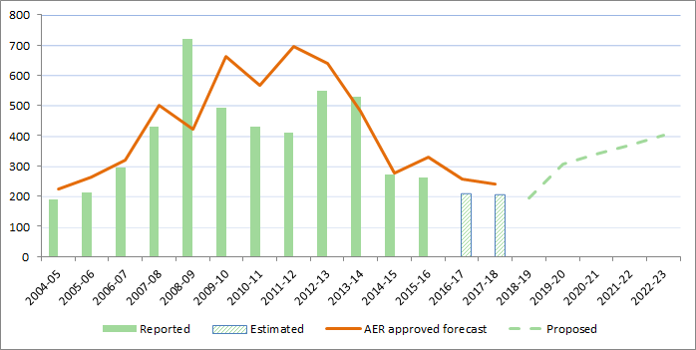
Capital Expenditure (Capex) forecast
Large decline in real $ capex in 2014-18
Below allowed capex
Significant increase in capex forecast:
Is increase in ‘base’ capex efficient & prudent?
Increase in replacement rate
new risk assessment process?
Increase Augmentation capex?
PSF project ($332m)
Market benefits ($64m)
Reliability ($41m, inc IPART requirements)
Increase in non-network capex?
≈ $100m on IT
Source: AER Issues Paper, p17

Slide 20
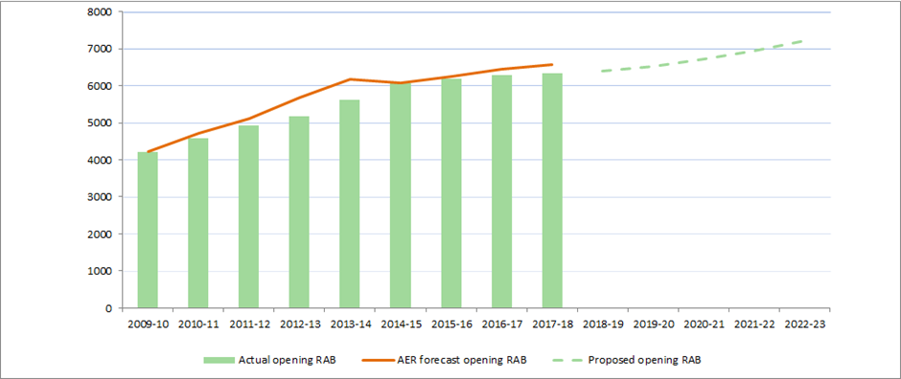
Growth in Base RAB (excluding contingent projects)
TransGrid RAB ($m, nominal)
Drivers of the RAB ($m, nominal)
Key point: Proposed program will see a continued increase in the RAB when there are increasing questions about the long role and nature of the transmission system and the infrastructure required.

Slide 21
RAB and Contingent Projects
Capex program = RAB growth above inflation
Putting upward pressure on prices (in real terms) especially if the cost of capital increases.
And RAB & price increase is likely to be higher
Proposal also includes 5 contingent projects estimated at between $543m and $2,274m on top of base capex including PSF by 2023-24.
Concerns:
Will the AER’s review of the contingent projects be the same as the tests under price reviews?
Stakeholders should be better informed of the potential range of price and revenue impacts.

Slide 22
Dynamic Efficiency: Capex & RAB
Concerns over Dynamic Efficiency given capex growth:
Demand uncertainty, technology change, decarbonisation risk of investing in long lived assets that will be underutilised in future
Will non-network option be able to compete with network options to ensure the most efficient options are chosen?
Is the option value of strategies that defer/reduce the investment in network assets properly evaluated?
Concerns over the RAB growth given ‘base capex’ & increase risk of significant price rises in future if
Interest rates increase (WACC)
Demand below forecast
Assets are under-utilised or redundant (no ‘write-down’)
But still need to meet reliability standards

Slide 23
Powering Sydney Future (PSF) – risk assessment
Demand:
Proposal takes a base trend forecast and adds specific new projects forecasts higher-than-AEMO forecasts. Concern:
Previous ‘new projects’ are in the base line data
Does the methodology to upward bias in forecasts?
Technological change
Distributed resources are becoming more economic and will rapidly change the sector – e.g see AEMO forecast of battery take-up
Need to consider risk of fundamental changes in next 5-15 years
Decarbonisation policies
NSW government has set a decarbonisation objective. Do the scenarios include this and prospect of stronger national policy
Above increased value in flexible, agile options.

Slide 24
PSF: Non-Network Options
TransGrid/AusGrid PSF stakeholder Forum in November was very valuable. Highlighted:
The significance of the project for energy users and the community.
Considerable interest from retailers/aggregators/load managers to provide non-network solutions that may reduce/defer network capex
Potential providers ranged from large retailers to smaller aggregators
Potential providers expressed confidence in competitiveness
But were concerned at information and timetable
How is TransGrid responding to ensure non-network options can compete and efficient options are not overlooked?

Slide 25
Incentives and prices.
CCP will review the incentive schemes – STPIS, EBSS & CESS – for past performance and future incentives. Are they working in the consumer interest?
Transgrid Pricing Methodology – no changes proposed from method applied to current RP. Transgrid has not replicated customer engagement so CCP will be looking for evidence that customers remain supportive.

