Slide 1
ElectraNet Public Forum 07 June 2017
Consumer
Challenge
Panel

Slide 2
Outline
Objective of the CCP
Customer engagement
Revenue Requirement and Path
WACC
Opex
Capex and Dynamic Efficiency

Slide 3
Objective of the CCP
Advise the AER on the effectiveness of ElectraNet’s consumer engagement activities and how this is reflected in the proposal; and
Advise the AER on whether the proposal is in the long term interests of consumers, consistent with the NEO.
The NEO is an economic efficiency objective with three principal dimensions:
Productive efficiency
Allocative efficiency
Dynamic efficiency

Slide 4
The NEO
Does the proposal promote Productive efficiency ?
Efficient costs, incentive schemes, risk reflective rate of return are all relevant.
Does the proposal promote Allocative efficiency ?
Pricing and value of reliability matters are relevant.
Does the proposal promote Dynamic efficiency?
Is the proposal consistent with the ENA/CSIRO Network Transformation Roadmap?
How does the proposal fit with contingent projects being advanced through RIT-T processes?

Slide 5
Consumer engagement (CE)
CCP role in assessing CE
Overview of CCP’s response to ElectraNet’s CE
Program Insights
CCP’s questions for consumers

Slide 6
Consumer Engagement & the long term interests of consumers
CE is now a key theme in the evaluation of the revenue proposals
CCP specifically tasked with providing feedback to the AER on the network’s CE approach
Consider each proposal in context of AER’s CE Guideline & general industry CE standards
Businesses must demonstrate:
Who, how, when and what issues it has engaged with its customers?
How this engagement has influenced its revenue proposals?
Do consumers agree the proposal is in their long term interests?
Is there a process for ongoing review of CE/continuous improvement?

Slide 7
Overview of CCP’s response to ElectraNet’s CE
ElectraNet’s CE program has been open, comprehensive and inclusive. It has benefited from:
Structured and carefully planned approach
Customer advisory panel (CAP) & Working Groups
Program phases:
design,
listen,
interpret & respond, &
ongoing CE
Early engagement including Customer Insights Report, Network Vision & Preliminary Regulatory Proposal
Multiple contact points & learning opportunities (two way)
AER participation – assist with technical issues & provide focus

Slide 8
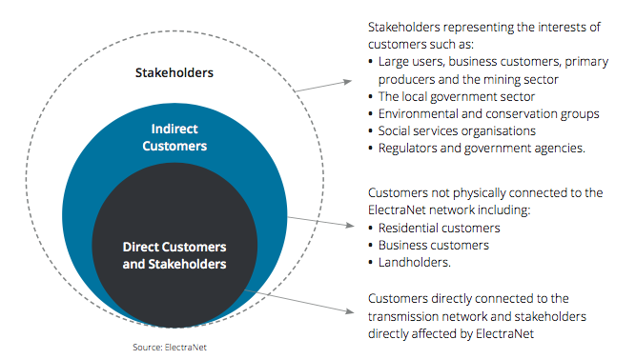
Understanding the “who” of CE
Source: Deloitte Customer Insights Report, September 2016, p 6. :

Slide 9
Overview of CCP’s response to ElectraNet’s CE (cont)
Commitment by senior management to the CE
Commitment leads to culture change throughout organisation
Commitment leads to learning and understanding
Commitment improves response from stakeholders
Clear, accurate and transparent presentation of information
Working group & “deep dives’ to examine more technical issues
Recording of meeting outcomes
Adequate time frames for consumers to consider issues
Receptive to feedback from consumers on both issues and meetings
Feedback from each engagement activity
Interim feedback from Preliminary proposal important

Slide 10
Independent CE Facilitator?
There are both benefits and risks of appointing an independent third party to ‘manage’ the CE program
Risks include:
delegation of responsibility for program’s success or failure
lack of commitment by the organisation to the process & its outcomes – just ‘ticking the regulatory boxes’
Poor communication and feedback with management & stakeholders
Benefits:
Increased professionalism/bring in new ideas
Dedicated resource
Ability to bring an ‘outsider’s critical appraisal
CCP impressed with ElectraNet’s approach that has found a reasonable balance to maximise benefits
Emphasis on both internal & external communication
Responsibility & ownership still sits with the business
Frank and regular feedback on progress
Is this a model that is suitable for all NSPs?

Slide 11
“Program Insights”: Overall satisfaction with ElectraNet’s service – but…
Customer Insights
Comment/Response
Lower, more stable & transparent costs – price path deliver reductions
Adaption to changes e.g. distributed generation & storage solutions
Exploring DM initiatives and incentives to assist customers change usage
Tariff design not understood/peak demand charges confusing
Satisfied with reliability (Sept 16) but consider prudent expenditure requires risk based approach and/or cost benefit
Does proposed price path deliver this? Consider WACC, inflation, depreciation.
Does the forecast and capex program reflect these changes?
Has proposal adequately included DM opportunities & tariff design?
Has ElectraNet adequately communicated tariff structures & rationale to its key stakeholders?
Has this view changed since Sept ‘16 & what is most appropriate response to the issues of cost/reliability?
Based on Deloitte, Customer Insights Report, September 2016. Not all ‘insights’ included.

Slide 12
CCP’s Questions on CE
There are a number of significant risks around ElectraNet’s proposal
CCP is concerned to ensure these risks are adequately explained to and discussed with consumers
For example – we will highlight today issues such as:
Sensitivity of average prices to accuracy of forecasts
The cumulative growth in nominal and real revenues given CPI + 3% increases from Year 2 to 5.
Impact of inflation forecast (vs AER approach) on regulatory outcomes
Potential changes arising from the recent decisions of the Federal Court on rate of return inputs (gamma and cost of debt) & security reviews (Including Finkel review)
Substantial investments in contingent projects and long term price implications
RIT-T process and DM opportunities
Important that ElectraNet’s CE program continues to engage customers on these risks and seek to confirm priorities in a changing world.

Slide 13
Conclusions on AER’s CE questions?
How far has ElectraNet’s early engagement gone towards achieving its intended benefits?
Has the early engagement process enhanced the regulatory process?
If you have been involved with other TNSP reviews, are there aspects of ElectraNet’s process so far that are better or less well developed than other TNSP engagement processes?
Is ElectraNet’s process likely to have improved its understanding of customer concerns and taken these into account in determining its revenue proposal for the long term interests of consumers?

Slide 14
Revenue Requirement
Overview
WACC
Debt
Gamma
Inflation
Forecasts
Opex
Capex
Overview
System security expenditure
Contingent projects

Slide 15
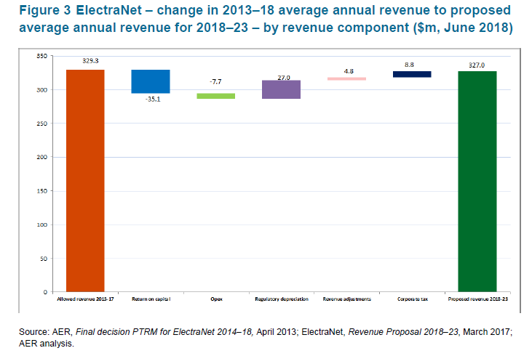
Overall revenues and prices
Proposal: 0.3% p.a. (real) decrease (excluding contingent projects) over the period.
Reflects:
Lower WACC and opex, offset by …
Lower inflation and gamma assumptions, and
Higher depreciation rate
Return on capital
Depreciation
Adjustments
Corporate Tax
Opex

Slide 16
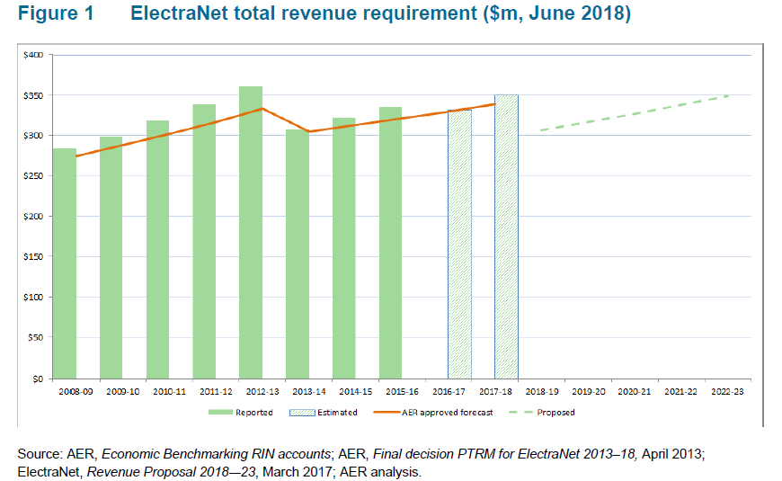
Maximum annual revenue (MAR) Smoothed ($m nominal)
 | 2017-18 | 2018-19 | 2019-20 | 2020-21 | 2021-22 | 2022-23 | Total
Annual MAR | 349.6 | 312.3 | 329.1 | 346.7 | 365.3 | 384.9 | 1738.2
 |  | CPI-12.4% | CPI+3.3% | CPI+3.3% | CPI+3.3% | CPI+3.3%

Slide 17
Revenue and Prices
Key concerns:
RAB Growth hidden by lower WACC
Are the capex projects efficient?
What are the contingent project risks?
Does opex reflect the costs of an efficient service provider?
Very interested in consumer views on the ‘saw-tooth’ revenues and prices. Rules impose some constraints (6A.6.8) but consumers may prefer smoother path.

Slide 18
Weighted Average Cost of Capital
Proposed WACC is 6.02%
Important component of Regulated Revenue
Lower WACC offsets other cost increases, but may not last
ElectraNet's proposal largely in line with AER Rate of Return guideline:
Risk free rate 2.83%
Market risk premium 6.5%
Beta 0.7
Return on debt 5.1%
Gearing 60%
But ElectraNet's proposal differs from AER’s on:
Gamma – it uses 0.25 rather than 0.4
Inflation – it uses an estimate of 1.97% based on bond
yields

Slide 19
Debt
ElectraNet has based its cost of debt on the AER’s transition to a trailing average. But it also states:
“However, the mechanism and timing in which the trailing average approach is implemented remains the subject of significant debate in the industry. For the purposes of our Revenue Proposal, we have applied the AER’s prevailing approach to the return on equity and return on debt”.
Various appeals on the approach to forecasting debt costs have created uncertainty
In its recent decision the Federal Court determined that:
the benchmark entity is an entity facing similar risk (whether regulated or unregulated)
The benchmark cost of debt should be based on the efficient financing strategy of the benchmark entity
the same benchmark need not be used for all networks

Slide 20
Implications for this review
CCP 9 notes that
Efficient financing strategy depends on the entity’s appetite for risk.
Large businesses in Australia use interest rate swaps and other instruments to manage financial risk even though these may involve additional cost
Implication: Trailing average without any hedging may not reflect financing practice outside the regulated sectors. Large corporations use various strategies.
Competitive market principles could support an ‘on-the-day’ rate in theory
There is considerable uncertainty on the implications of the Court’s Decision
In this context the CCP 9 considers that
ElectraNet should commit to maintaining the position on debt costs in its revised revenue proposal.
Any change to the cost of debt should be based on changes in interest rates rather than changes in the approach
If such a change were made stakeholders should have the opportunity
make further submissions prior to AER considering the proposal.

Slide 21
Gamma
ElectraNet proposes a gamma (the value of imputation credits) of 0.25.
The Rate of Return Guideline specified a value of 0.4 based on a review of available evidence
AER has consistently used 0.4 and the Federal Court upheld the AER’s position
AER should maintain its use of 0.4

Slide 22
Inflation
AER currently estimates expected or forecast inflation using a combination (geometric average) of:
The RBA’s short term (2 years) forecast
The mid-point of the RBA’s inflation target for subsequent years (year 3 – 10)
ElectraNet's forecast of 1.97% is based on the difference in yields on indexed and nominal bond yields (‘implied inflation’)
1.97% is low compared to the RBA’s target range (2-3%) and inflation under RBA’s inflation targeting which has averaged close to 2.5%.
Using 1.97% increases revenues by $77.43m or 4.74% (real)
The AER is reviewing its approach to its inflation allowance and it would be premature to change approach until this review is completed
This is a complex issue and CCP 9 will need to consider the issues further in the context of the review underway.

Slide 23
Inflation – preliminary comments
There are merits in consistency of approach through time – as TransGrid noted any variations will average out over multiple regulatory periods
AER previously used the implied inflation approach and switched to the current approach with NSPs’ support.
It was due to biases in the implied inflation approach. Market conditions and biases change over time. Even if smaller now, they can re-emerge.
The implied yield approach is not the only market-based estimate of inflation expectations – Interest rate swaps are a more direct measure.
ElectraNet states that differences between actual and expected inflation affects revenues.
However, CCP 9’s preliminary analysis (using the PTRM) suggests it affects nominal revenues but not real revenues or returns
So is there a basis for making substantial changes and introducing new risks based on what may be short term events?

Slide 24
Inflation – preliminary comments
The assumption of inflation has a significant impact on prices: +$77.43m or 4.74% in real terms
The AER’s model is designed to ensure that the utility can achieve its real WACC
The real WACC is the nominal WACC less inflation
A lower assumed inflation leads to a higher real WACC
From CCP 9’s preliminary analysis of the AER’s model the primary effect of the change in inflation is to increase the regulatory depreciation allowance.

Slide 25
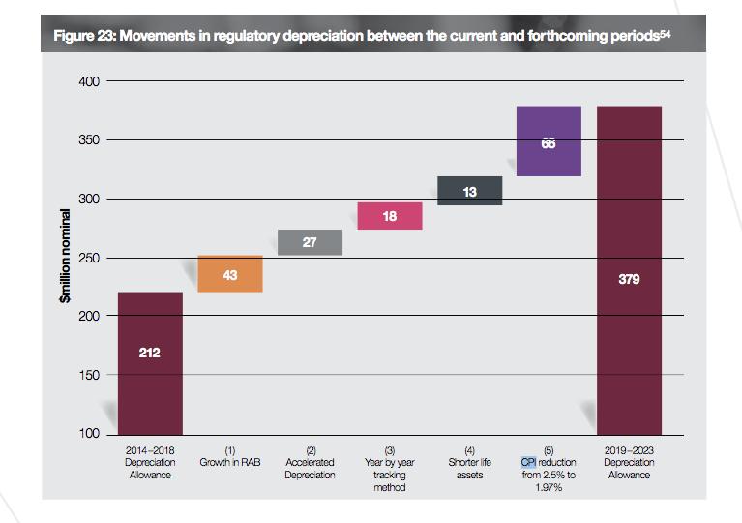
Inflation expectations – impact on depreciation costs
Source: ElectraNet Revenue Proposal Overview 2019-23, p. 64

Slide 26
Prices and Demand Forecasts

Slide 27
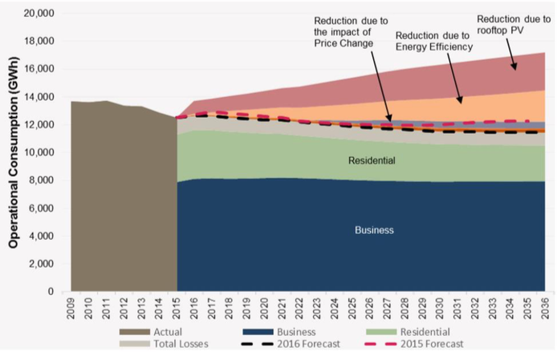
The forecast challenge – continued decline in ‘operational’ consumption
Source, AEMO, 2016 National Electricity Forecasting Report Chart Pack , 2016, slide 23. :

Slide 28
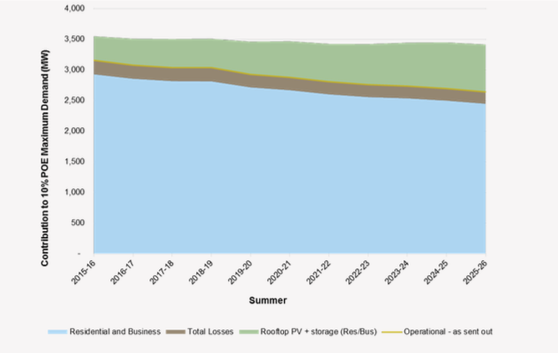
And in ‘operational’ peak demand (10% POE maximum demand)
Source: AEMO, South Australian Demand Forecasts, June 2016, Figure 4, p., 9.

Slide 29
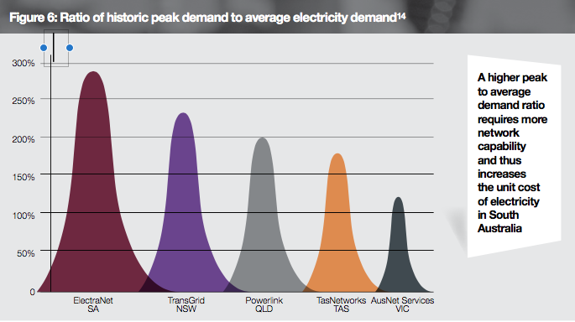
Future risks – SA has worst load factor which adds to unit costs over time
However, analysis of capacity data suggests there is a utilisation ratio of less than 50% even at 10% POE forecast
Source: ElectraNet Revenue Proposal Overview, March 2017, p. 19.

Slide 30
Network Utilisation
Preliminary examination of ElectraNet’s 2016 performance data suggests that:
capacity built for previous growth projections
even at current 10% POE, there is considerable ‘excess’ capacity in most areas of the transmission network
Projection for declining peak demand indicates that the level of excess capacity will increase
This has implications for ElectraNet’s future planning decisions:
Limits augmentation capex requirements;
Raises questions on ‘like-for-like replacement capex
How is low/declining utilisation of existing assets incorporated into the risk matrix
All other things being equal, lower utilisation should lead to reduced maintenance requirements and longer life.
Consider further in context of:
the AEMC’s proposed rule changes on replacement expenditure
SA Planning standards & response to System Black event.

Slide 31
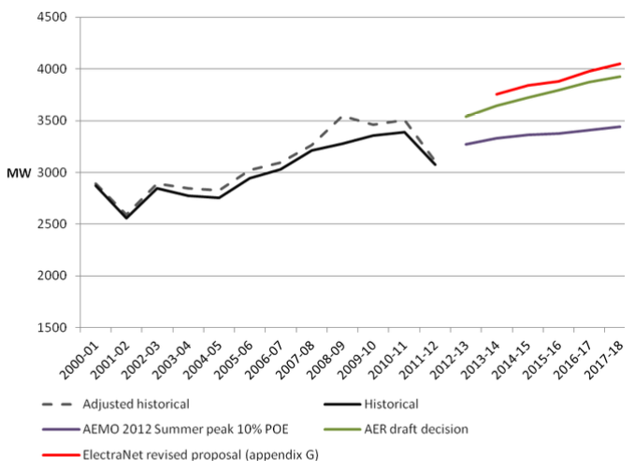
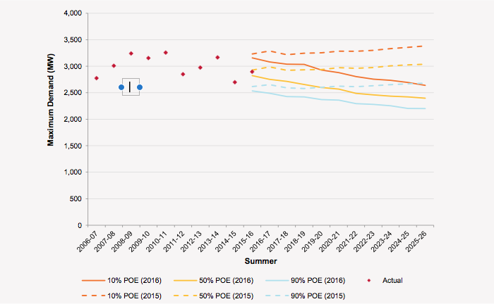
Impact of forecast error on average prices to customers in revenue cap
ElectraNet Revised Proposal
10% POE Demand Forecast in 2013-14
AEMO 2016 10% POE Forecast at 2015 and 2016
Sources: AER, Final Decision, ElectraNet 2013-14 to 2017-18, Figure 5.1, p. 21 ; AEMO, 2016 South Australia Demand Forecast.

Slide 32
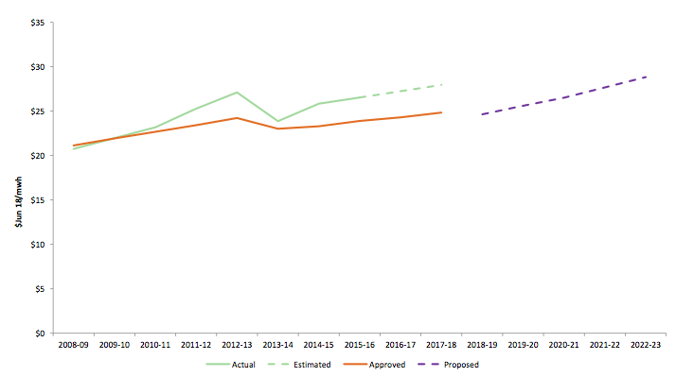
Average price has increased to recover revenue cap from declining volumes

Slide 33
Opex
Proposed total Opex = $436m ($Jun 2018) for 2018-23
1% less than actual/estimated in current period (AER p10)
11% less than ‘trend allowance’ (ElectraNet p57)
AER Issues Paper does not identify any issues
No change from forecast presented in Preliminary Revenue Proposal
CCP will consider further in context of benchmarking

Slide 34
Capex & Dynamic Efficiency
The ElectraNet context is unique
Significant changes to the generation mix – type and location – have and will occur … ~50% renewables
Central to the System Black in September 2016
System Security responses still being developed
Making long-term investments in response to an uncertain future means risk (effect of uncertainty on objectives)
Efficient risk allocation contributes to dynamic efficiency
Contingent projects a key mechanism that can reduce risks to the business and consumers – but…

Slide 35
Capex & Dynamic Efficiency
AEMC, Reporting on drivers of change that impact transmission frameworks, Draft Stage 1 Report, 11 April 2017
“While there are processes to review TNSPs' application of the RIT-T, to the extent that costs and benefits are forecast inaccurately, then these risks are born in full by consumers...” [p10]
“This allocation of risk becomes more important in an uncertain or changing environment, as the risks associated with transmission investment increase.” [p12]
CCP9 sees this as a key issue for ElectraNet and this reset

Slide 36
Capex
Proposed forecast capex of $458m ($2017-18)
39% reduction on 2014-18 … but
ElectraNet has proposed 5 contingent projects with combined indicative costs of between $630 - $850m
80% of proposed capex is for refurbishment and replacement of assets (REPEX)
CCP is interested in peer-to-peer comparisons of these ‘risk based’ REPEX programs
Network Security Capex is a mix of ex-ante revenue and contingent projects

Slide 37
Network Security
ElectraNet proposes $16m in current period, $32m in 2019-23. Added post-System Black.
AEMC, System Security Market Frameworks Review, Directions Paper, 23 March 2017
Proposes requirements on TNSPs to maintain inertia and procure fast frequency response (FFR) services
SA Energy Transformation RIT-T responds to an identified need (1 of 3) of:
“providing appropriate security of electricity supply, including management of inertia, frequency response and system strength, in South Australia”

Slide 38
Network Security (2)
The AEMC Review of System Black 28 September 2016 is yet to conclude
AEMC Market Review: Reporting on drivers of change that impact transmission frameworks – may lead to revisiting Optional Firm Access?
AEMO Future Power System Security Program + Finkel Review will also be relevant
SA Energy Security Target … and more?
Can consumers be confident of no overlaps? And no gaps?
How can consumers remain involved?

Slide 39
Contingent Projects
ElectraNet has proposed 5 contingent projects with combined indicative costs of between $630 - $850m
Two RIT-T processes are underway:
SA Energy Transformation
PSCR issued 7 November 2016
“A Project Assessment Draft Report (PADR), including a full quantitative assessment of the costs and benefits of each of the options being considered, is expected to be published mid-2017”
Eyre Peninsula reinforcement
PSCR issued 28 April 2017
ESCOSA Review of Eyre Peninsula Reliability underway
Essential that CE actively pursued given the size and importance of projects

Slide 40
Contingent Project(s)
Attempts to quantify the impact on bills of these projects (ElectraNet p43) is welcomed
SA Energy Transformation Project RIT-T also impacts on MurrayLink and a proposed contingent project with an estimated cost of $994m if all elements proceed.
One RIT-T option includes MurrayLink control system upgrade to provide fast frequency response.
Overlap with NCIPAP expenditure ($17m - largely on increasing the capability of the Heywood Interconnector) is unclear.

Slide 41
CSIRO/ENA
Network Transformation Roadmap … specifically for SA:
“Big and small batteries will support South Australia’s energy transformation”
“South Australia already leads the nation in the installation of new large-scale renewable generation and is set to become a leading installer of large scale battery capacity, small-scale renewables and batteries will also play an important part.”
Capex of $6m proposed for ESCRI Battery Storage Project is interesting precedent. Market is moving fast, is regulated funding appropriate?

Slide 42
Summary
Consumer Engagement
WACC parameters – Gamma and Inflation forecasts
Capex and Dynamic Efficiency
Comments / suggestions for the CCP can be sent via ElectraNet2018@aer.gov.au

