Slide 1
Setting the DMO2
AER – Default Market Offer Forum
Jacqueline Crawshaw
Associate Director

Slide 2
Our vision for the market
Affordable
ECA promotes these three advocacy principles as the basis for better consumer outcomes.
Better consumer
outcomes
Optimised
Individualised

Slide 3
Moving beyond the ‘trilemma’ – to consumer focused outcomes
INDUSTRY DIMENSION | CONSUMER ATTRIBUTE
Affordable The industry can only regain trust by addressing prices | Satisfied Paying no more than they need to for the service they want
Individualised Information and services to meet consumers where they are | Engaged Consumers can engage on their terms
Optimised System decisions include consumers and their assets, rewards, prices and decisions | Confident That the markets / systems are working in their interests

Slide 4
Consumer dissatisfaction is well founded
Source: ACCC Retail Electricity Pricing Inquiry Preliminary Report
Setting the DMO2, November 2019

Slide 5
Household’s value for money
Value for money for energy services continues to rank behind all other utilities
Source: ECA Energy Consumer Sentiment Survey, June 2019

Slide 6
Affordability is an ongoing concern
Source: ECA Energy Consumer Sentiment Survey

Slide 7
Confidence in the market
Consumer confidence that the market is working in their interest is low across all jurisdictions

Slide 8
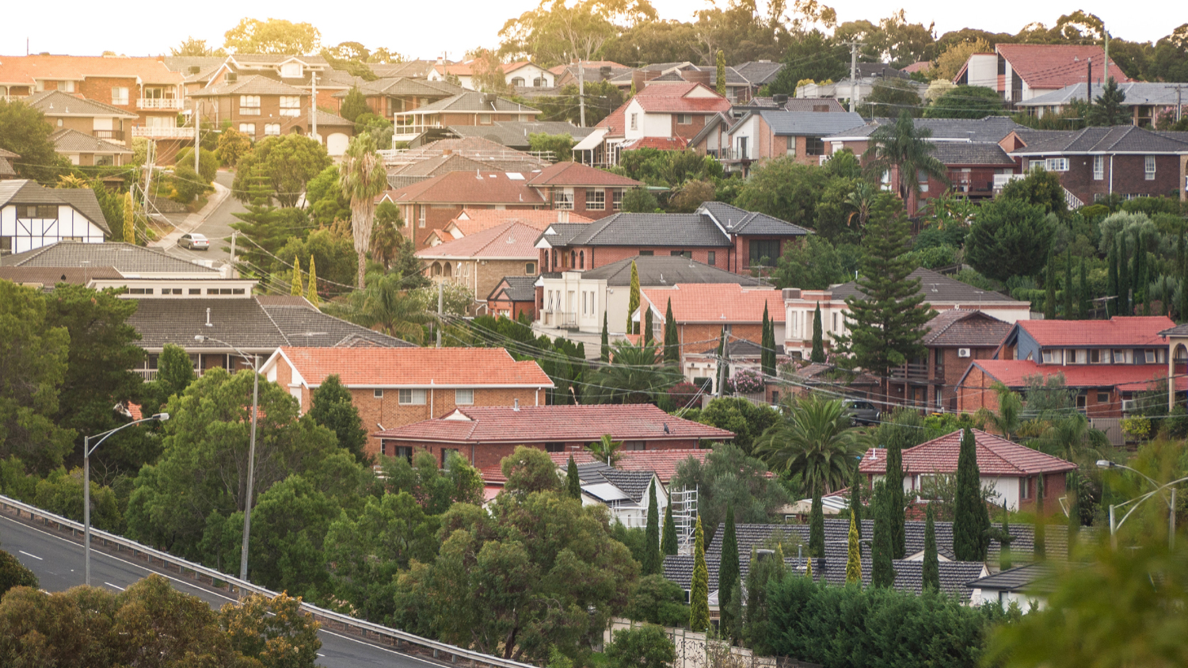
Nearly a million households and business customers on standing offers, or default contracts, … have already seen automatic savings to their electricity bills.
ACCC, Media Release 16 Sept 2019

Slide 9
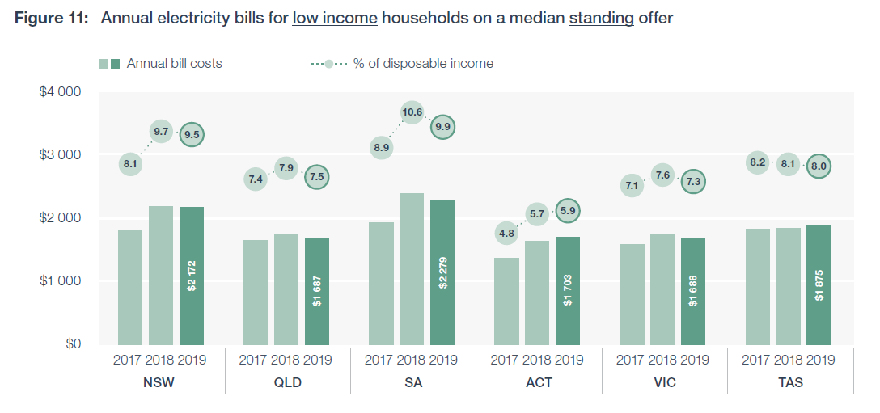
Affordability for low income households
Source: AER, Affordability in retail energy markets, September 2019

Slide 10
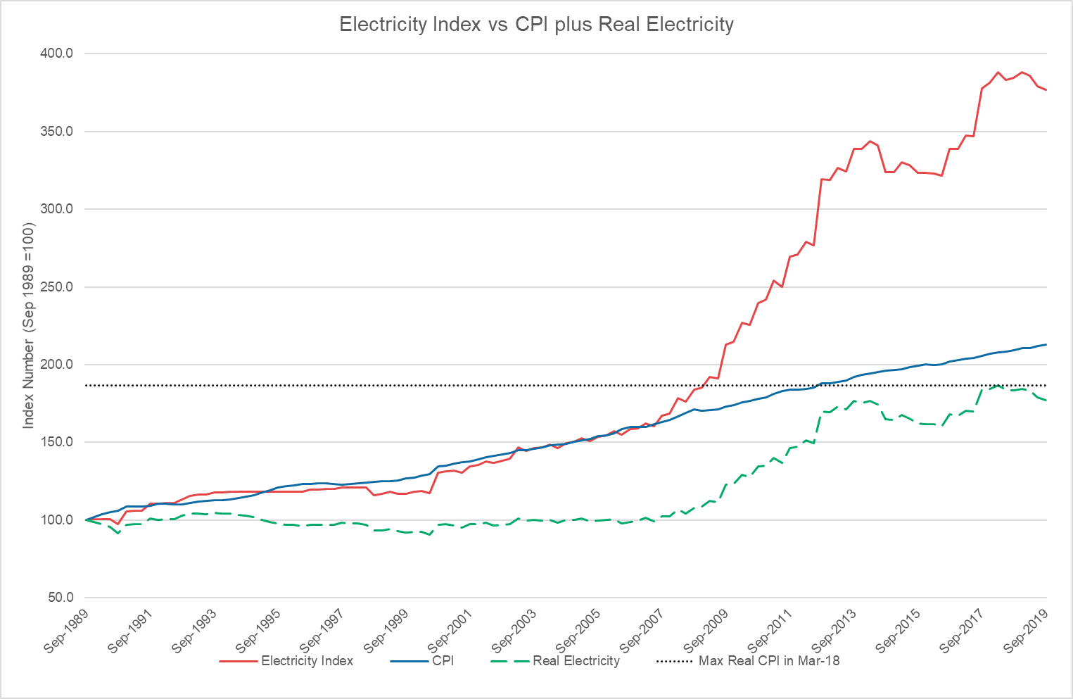
Some good news on prices

Slide 11

Where to from here?

Slide 12
Affordability as a constraint throughout the supply chain
Review and ratchet

Slide 13
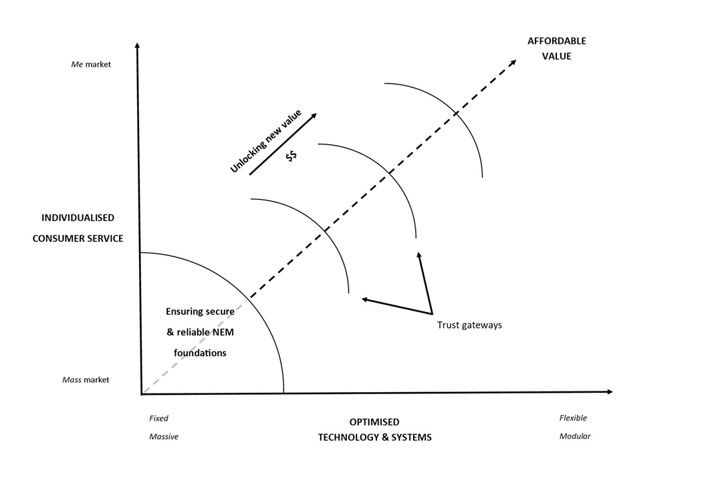
A framework for thinking about the future

