Slide 1
ELECTRANET REVENUE PROPOSAL
STAKEHOLDER Forum
Classification: Public
7 June 2017

Slide 2
Agenda
Overview
Current Environment
Price Impacts
Capital Expenditure
Operating Expenditure
Other Components
Early Engagement Approach

Slide 3
Revenue proposal overview

Slide 4
On 28 March 2017 we lodged our Revenue Proposal for the five year period commencing 1 July 2018
Our expenditure plans and priorities are built on the extensive early engagement we have undertaken with our stakeholders
Our Revenue Proposal responsibly balances security, reliability and affordability
We are playing our part to ensure future security of electricity supply for South Australia

Slide 5
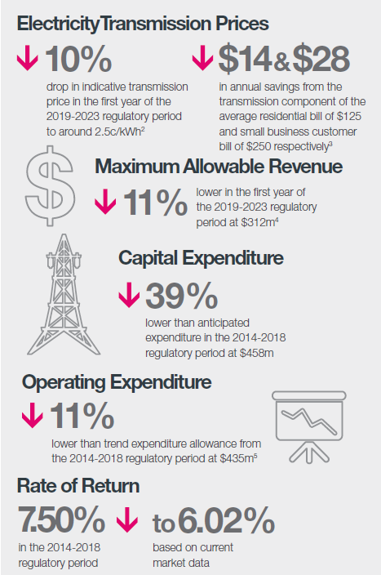
The headline figures

Slide 6
We are at the forefront of change in the energy sector
South Australia has reached world-leading levels of renewable energy penetration
Challenges are increasing from lower levels of synchronous generation
A range of external reviews, inquiries and policy measures are unfolding
South Australian renewable generation capacity relative to demand
ElectraNet is responding to these challenges
*Annualised year to date data

Slide 7
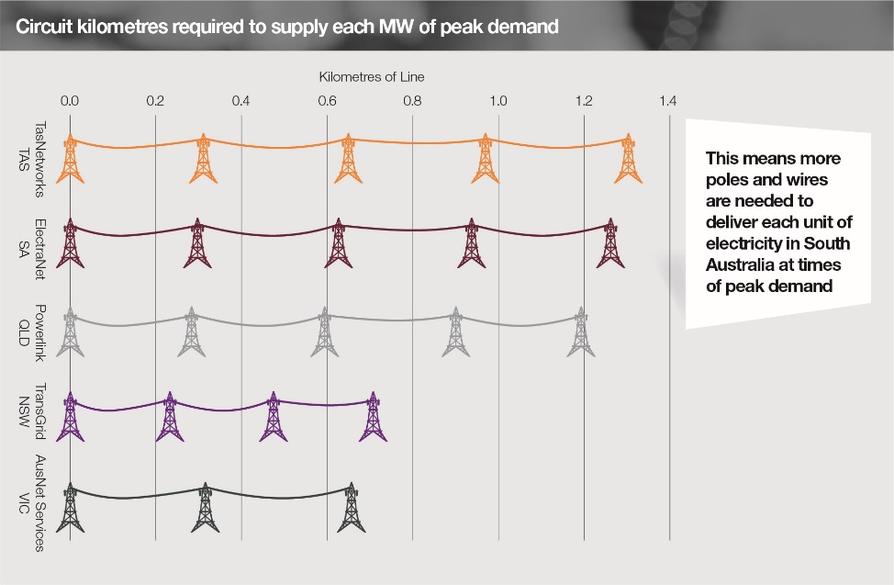
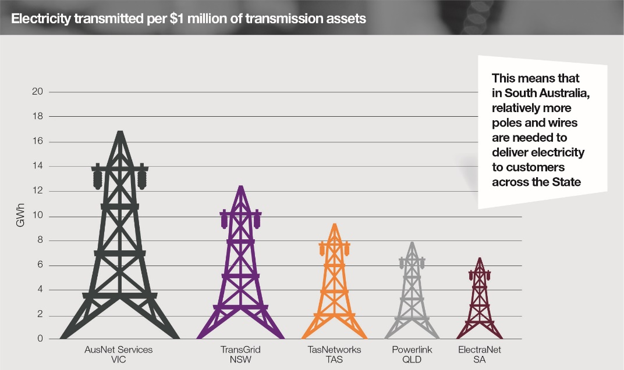
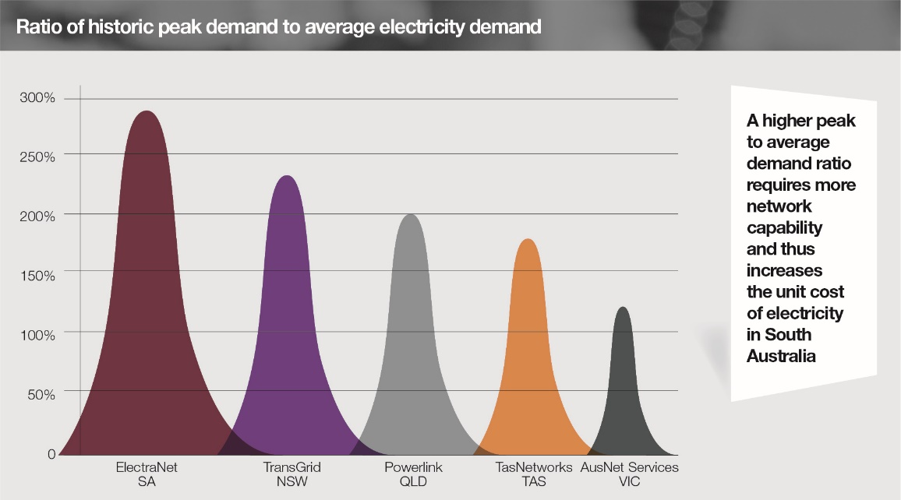
WE perform well despite the unique challenges of our network
Affordability
Reliability
Choice

Slide 8
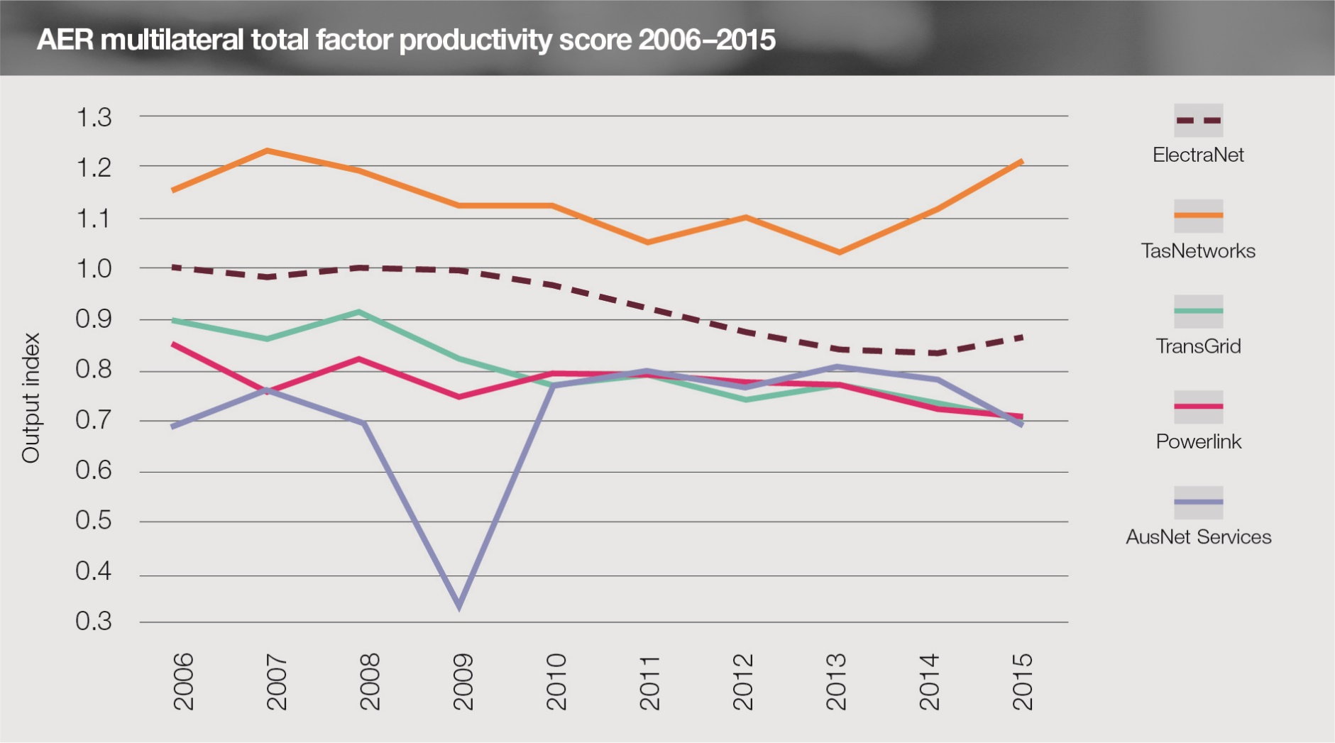
Electranet is one of the most efficient transmission networks
Affordability
Reliability
Choice
Overall efficiency performance compares favourably with other networks despite the external factors that drive up efficient costs in South Australia

Slide 9
Transmission prices

Slide 10
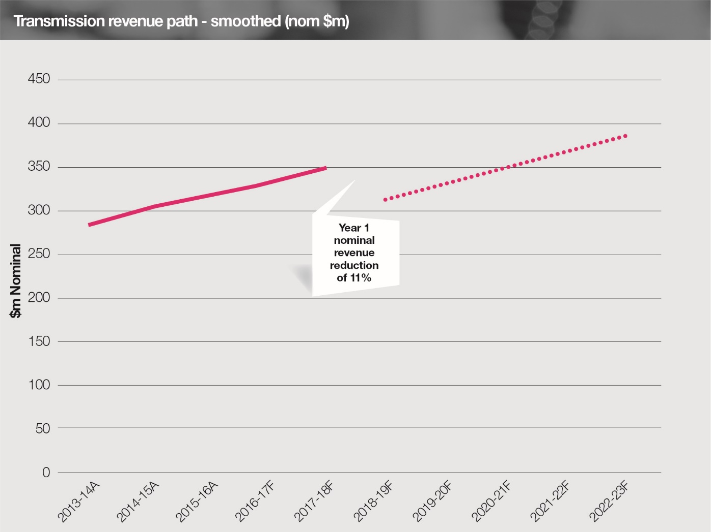
Revenue PROJECTION
Our Revenue Proposal involves an 11% decrease in revenue at the start of the coming period

Slide 11
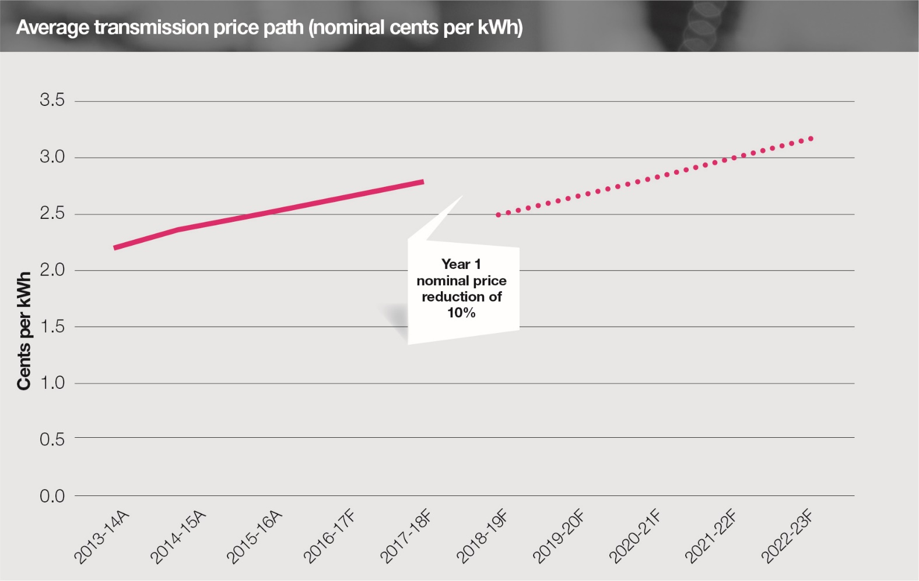
price path
Average transmission prices are estimated to fall by 10% in the first year
Transmission costs are set to fall (from 9%) to around 8% of a household bill by the end of the coming period

Slide 12
Capital expenditure

Slide 13
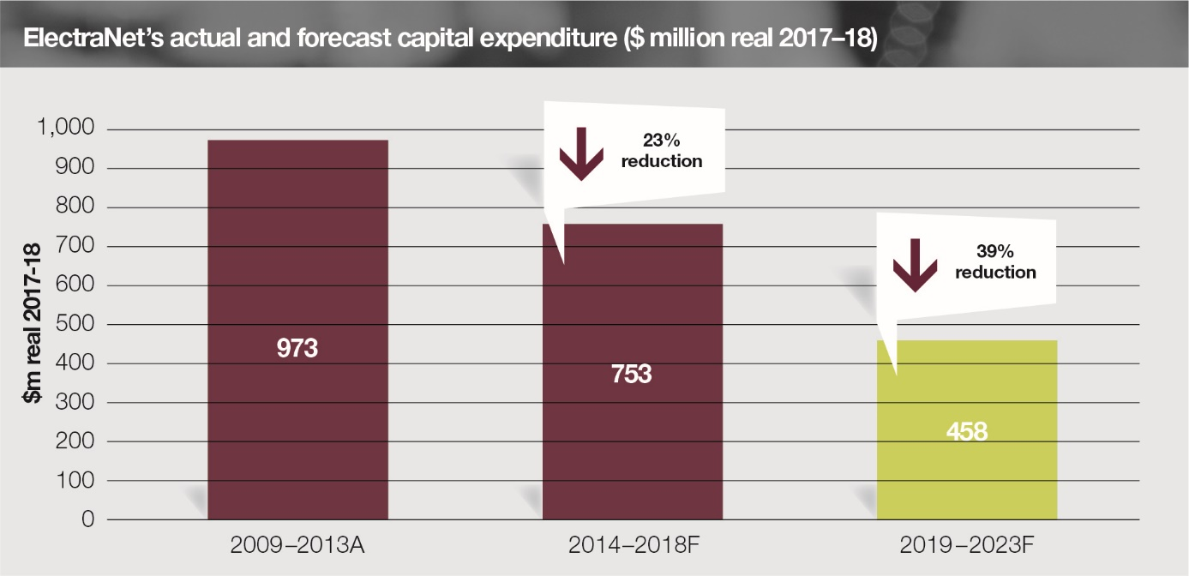
capital expenditure outlook
We have proposed a 39% reduction in our capital program, while investing in network security and reliability

Slide 14
demand OUTLOOK

Slide 15
capital expenditure PROGRAM

Slide 16
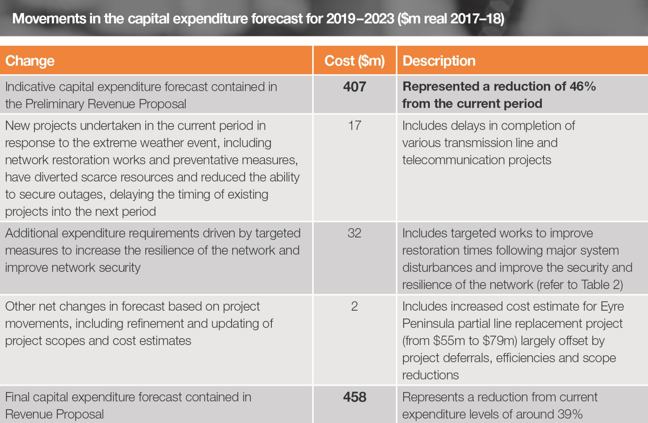
NETWORK SECURITY INVESTMENTS

Slide 17
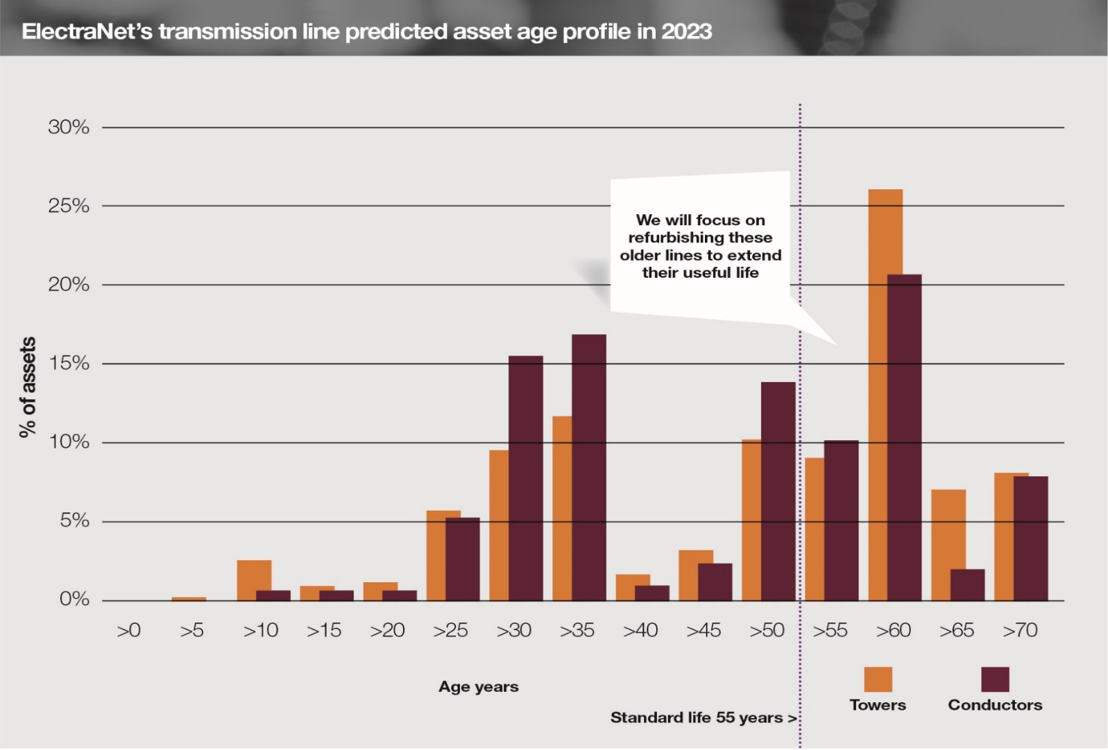
SA HAS AMONG THE OLDEST TRANSMISSION LINE ASSETS
Our focus is on addressing transmission line condition and risk to ensure reliability of the network

Slide 18
Capex Forecasting Approach
OUR Forecasting APPROACH
Inputs
Function
Controls
Network Vision
Demand Forecasts
Planning Process
Network Models
AEMO review
Reliability Standards
Statutory Obligations
Condition Assessments
Analysis of Limitations
Economic Assessment Model
Investment Risk Tool
Project Prioritisation
AEMO Review
Check estimates
Estimating System
Options Analysis
Economic Analysis
Risk Assessment
Market Data
Historic Costs
Scope & Estimate
Wage growth
Inflation
Cost Escalation
Capex Model
Equity Raising cost
Capital Expenditure
We apply a risk-based approach to identify the most economic solutions

Slide 19
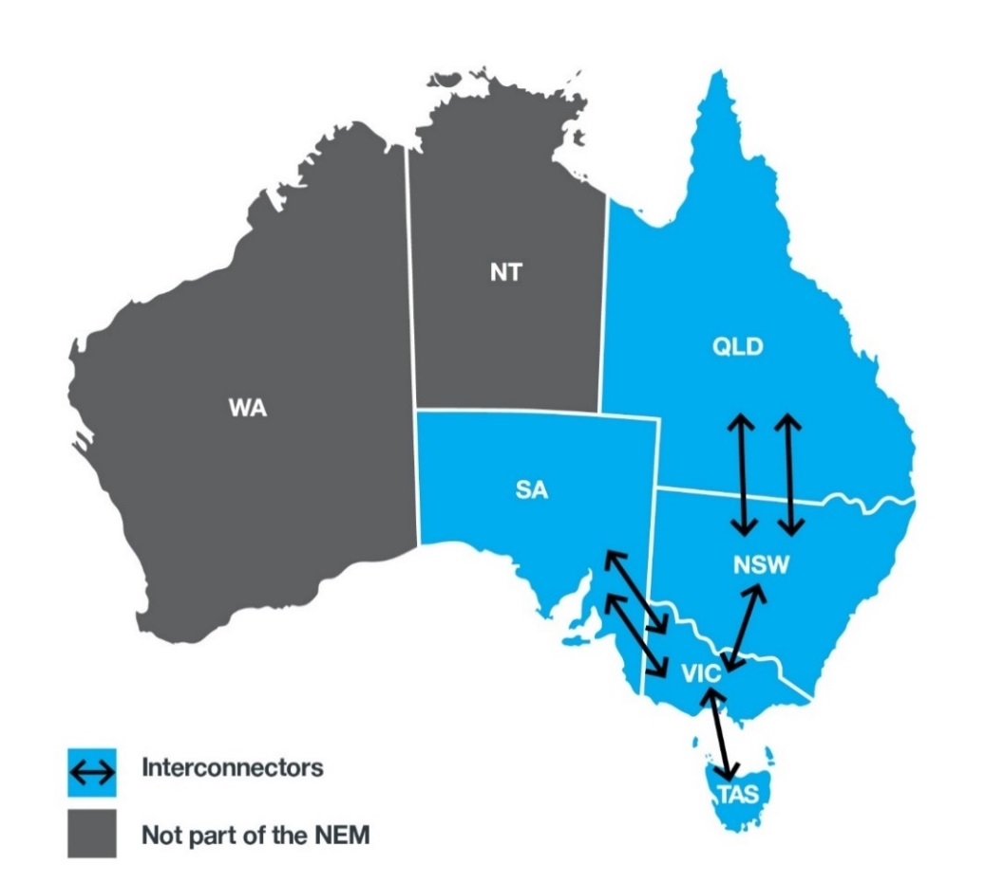
Increased interconnection is vital to achieving affordable and reliable supply
The transmission network can help the nation harness large-scale renewable energy developments and meet renewable energy targets
Increased interconnection across the National Electricity Market will:
facilitate market competition between generation sources
deliver system security
open the market to more renewable generation
Investigation of options continues through the South Australian Energy Transformation project

Slide 20
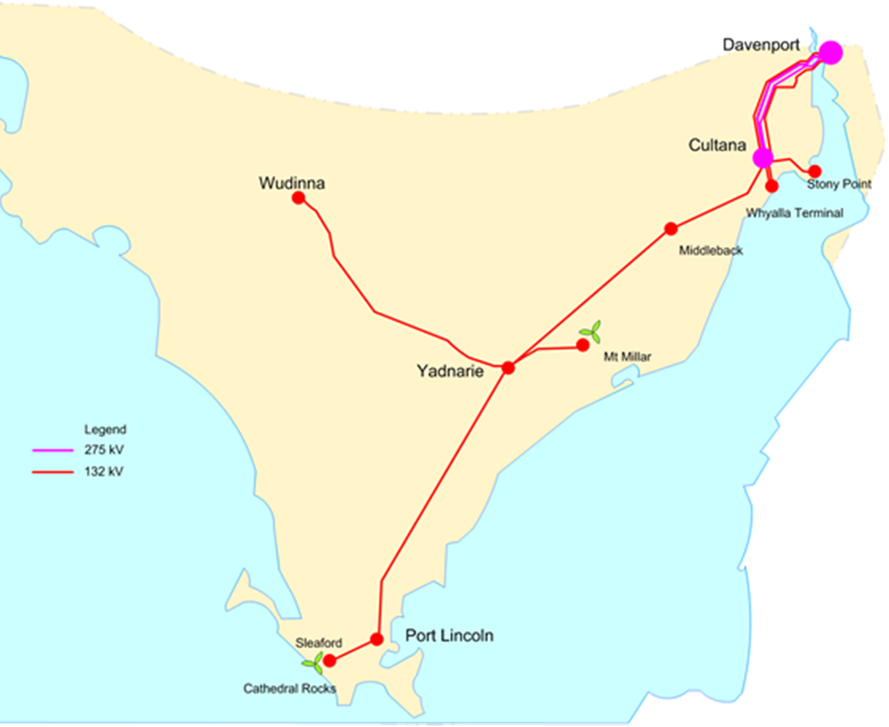
Eyre Peninsula Electricity Supply Options
ElectraNet is investigating options for future reliable and affordable electricity supply to the Eyre Peninsula
Partial line replacement is currently included in the ex ante forecast at approx. $80m to replace asset components at end of life
Full line replacement is an option that would only proceed if the benefits to customers exceed costs
Peak electricity demand is about 100 MW south of Cultana with about 35 MW at Port Lincoln

Slide 21
Contingent projects

Slide 22
OPErating expenditure

Slide 23
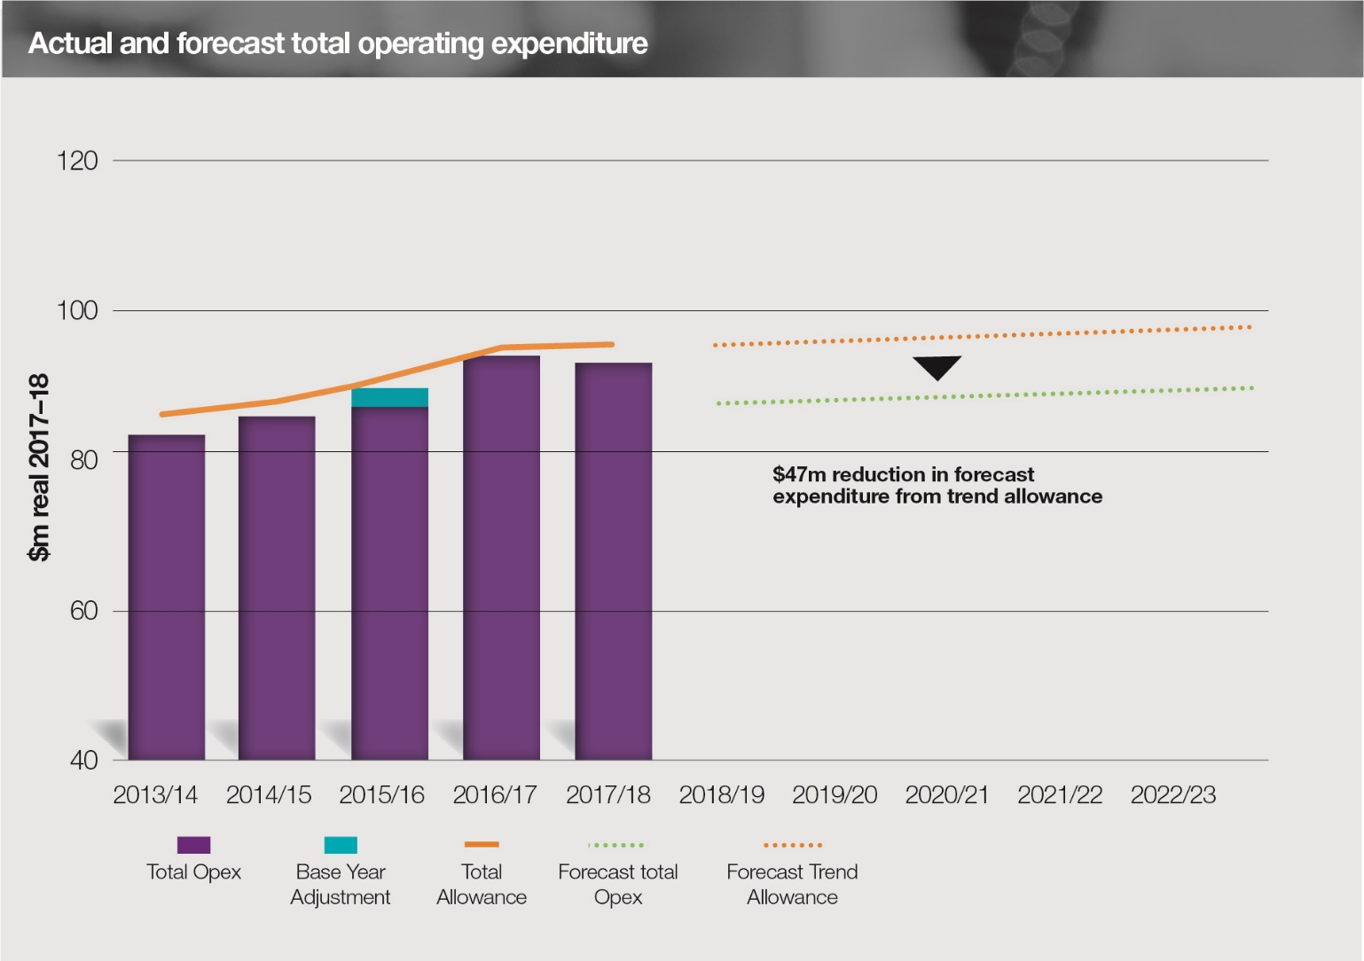
operating expenditure forecast
We are continuing our drive for efficiency through an 11% reduction in our operating costs

Slide 24
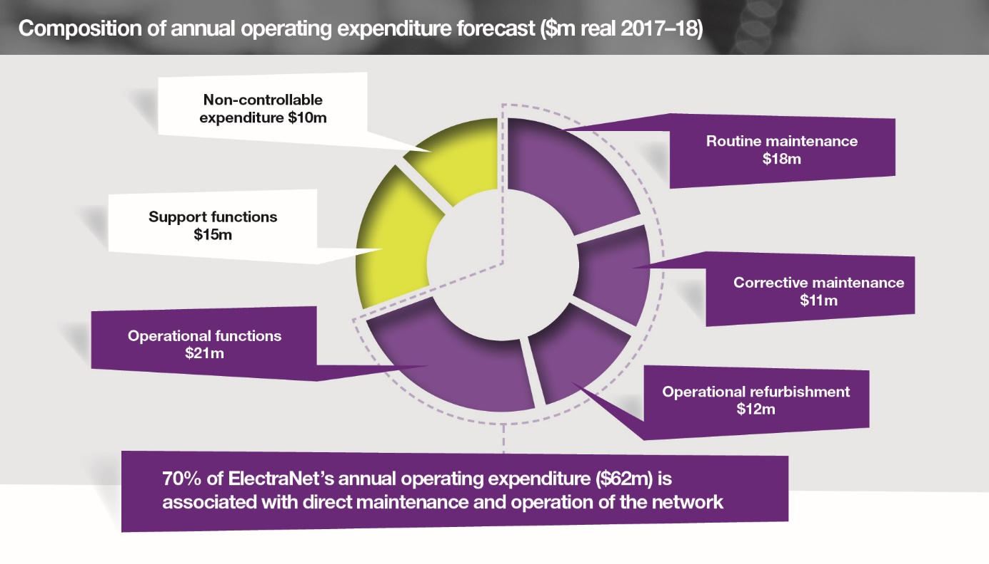
operating expenditure Breakdown

Slide 25
The financial ‘building blocks’

Slide 26
The financial ‘building blocks’
We have applied standard AER approaches to the financial ‘building blocks’ of our Revenue Proposal
Return on Capital - 46%
Opex -27%
Depreciation -22%
Tax - 4%

Slide 27
Return on capital
ElectraNet has calculated a rate of return using the AER’s Rate of Return Guideline

Slide 28
Customer ENGAGEMENT OUTCOMES

Slide 29
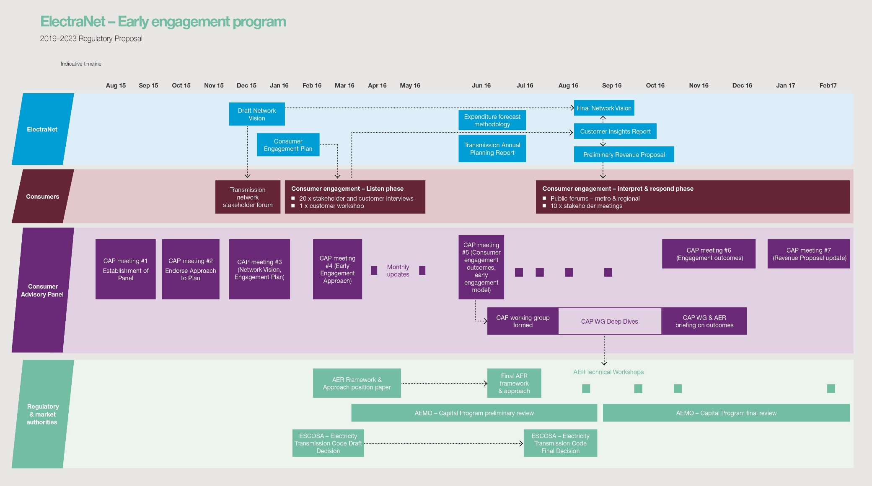
OUR EARLY ENGAGEMENT PROGRAM

Slide 30
CONSUMER ADVISORY PANEL

Slide 31
OUR approach
Customer Insights Report
Network Vision
Preliminary Revenue Proposal
Customer Engagement Outcomes Report
Revenue Proposal

Slide 32
customer feedback HELPED SHAPE OUR PROPOSAL
Affordability
Reliability
Choice

Slide 33
QUESTIONS AND ANSWERS

