Slide 1
NSW Public Forum
Essential Energy’s Regulatory Proposal
10 July 2014
Gary Humphreys, Chief Operating Officer

Slide 2


What we will talk about
Introducing Essential Energy
How we engage our customers
Minimising costs and network price increases
Our five-year plans
Generation
Transmission
Distribution

Slide 3
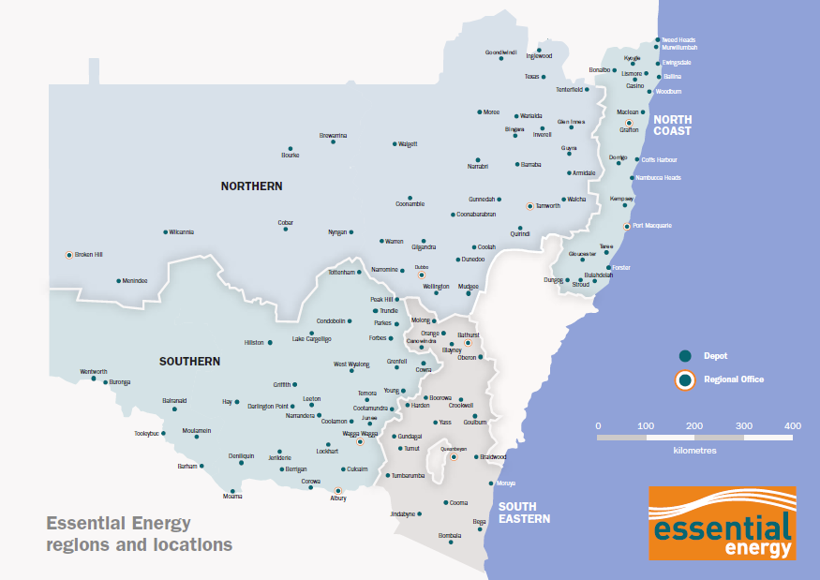
Our business today
Australia’s largest electricity network
Owned by the NSW Government
Servicing 815,000 home and business customers in NSW
Network covers 737,000 square kms
  1.4 million power poles
  200,000 km of power lines
  135,000 substations
Average 4 customers per km of line
Building our network today would cost an estimated $24 billion

Slide 4

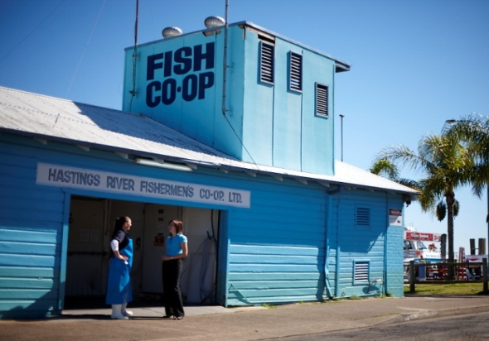
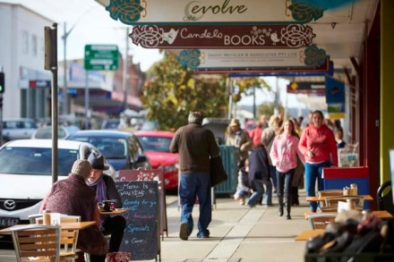
Listening to our customers
Inform
Consult
Involve
Collaborate
Empower
Research
1013 customer surveys
8 focus groups

Slide 5
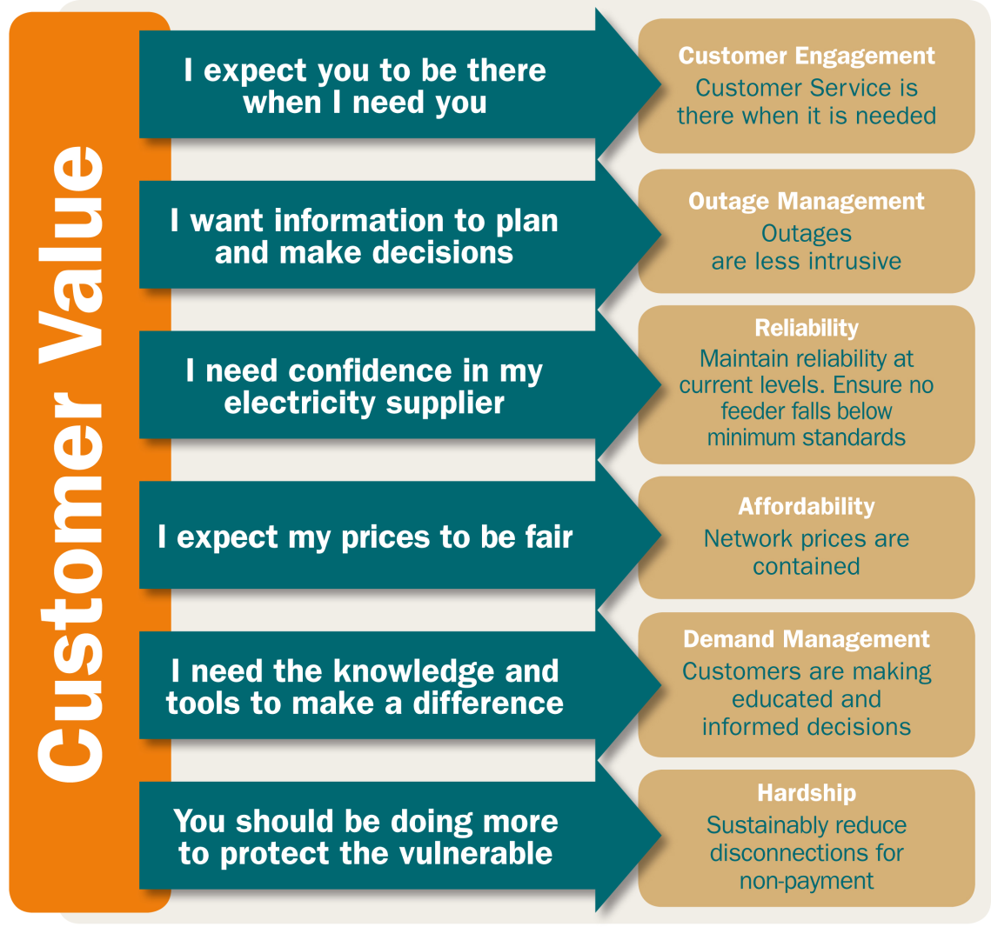
Delivering customer value
What our customers told us they want:
Availability
Information
Confidence
Fair prices
Tools
Protection
✓
✓
✓
✓
✓
✓

Slide 6
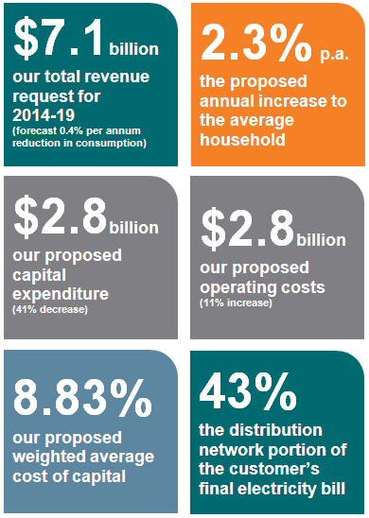
Our plans for the next five years
Drivers for expenditure
  Rising electricity charges
  Age and condition of network infrastructure
  Pockets of demand growth
  Meeting our regulatory & legislative obligations
  The need to manage vegetation
Notes:
Opex and capex presented as real 13/14$

Slide 7

Network price increases below CPI
During 2009-2013, distribution network costs represented approximately half of your total electricity bill
For 2014-2019, we propose to keep distribution network costs to approximately 43 per cent of your final electricity bill, with average price increases held at 2.3 per cent (below CPI)
CPI forecast at 2.5%

Slide 8
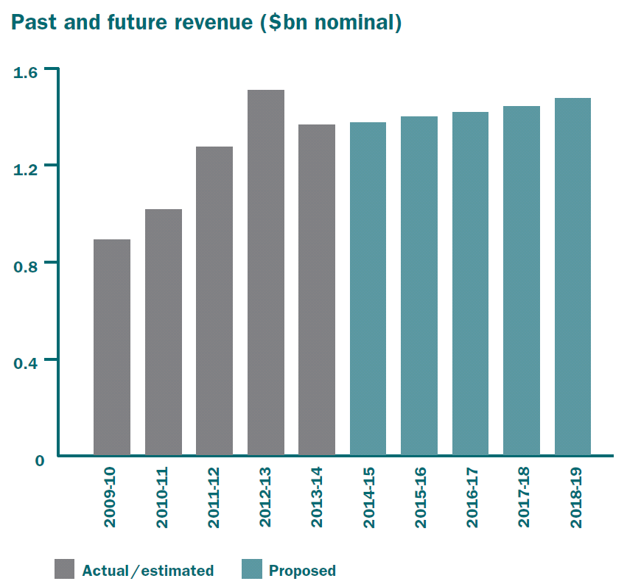
Proposed revenue 2014-2019
The amount of revenue the AER allows Essential Energy to collect from its customers to fund the safe and efficient operation of its network has a direct impact on customers’ electricity bills
For the next five years, our total revenue request is $7.1 billon

Slide 9
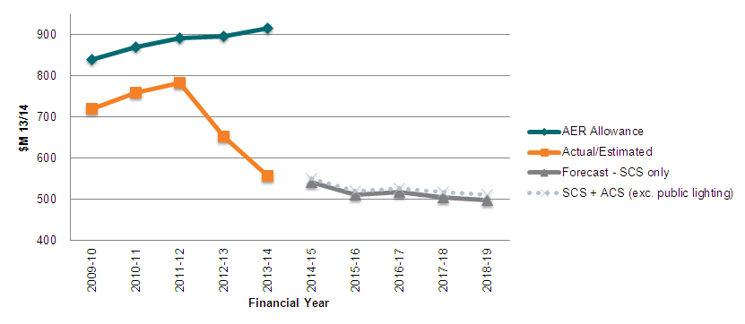
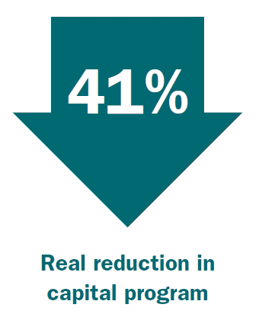
Capital expenditure
Approved by AER 2009-14: $4.2 billion
Proposed to AER 2014-19: $2.8 billion
Notes:
Our capital program will reduce from $4.2 billion approved by the AER for 2009-14, to a proposed $2.8 billion for the next five years – a reduction of 33 per cent (nominal), which is 41 per cent below the CPI (real)

Slide 10
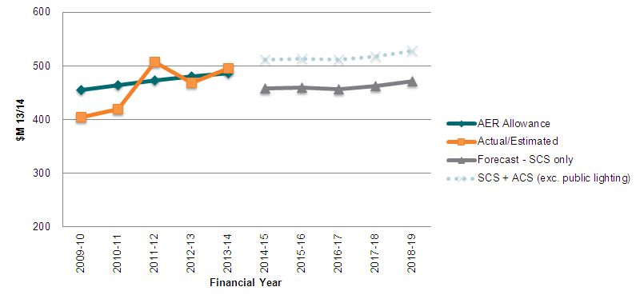
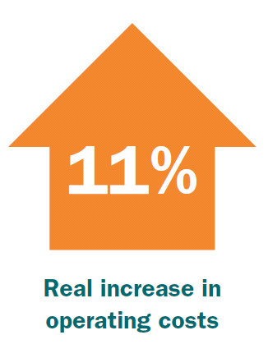
Operating expenditure
Approved by AER 2009-14: $2.3 billion
Proposed to AER 2014-19: $2.8 billion
Notes:
Our operating program will increase from $2.3 billion approved by the AER for 2009-14, to a proposed $2.8 billion for the next five years – a increase of 25 per cent (nominal), which is 11 per cent above the CPI (real)

Slide 11
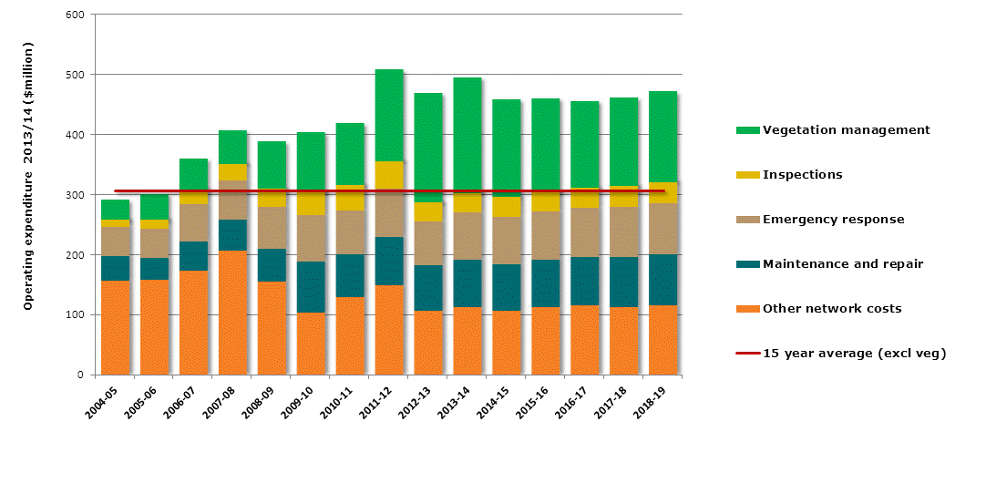
Operating expenditure in context
The total increase in operating expenditure between the previous regulatory period (2009-2014) and the upcoming regulatory period (2014-2019) is $30 million
Excluding vegetation management, this holds operating expenditure for 2014-2019 in line with the 15 year average

Slide 12


How we’ll reduce costs
Capital expenditure: prioritise projects, defer capital expenditure and implement efficiencies
Peak demand: future forecasts allow reduced infrastructure investments
Policies and procedures: review to eliminate discretionary expenditure
Benchmarking: creating measurable reference points for continuous improvement
Labour costs: reduce with a streamlined operating model
Reduce the need for overtime
Notes:
Eliminating stranded overheads resulting from lower forecast capital expenditure

Slide 13
Alternative control services
The Past
The Future
Public lighting costs have been under-recovered for many years.
Need to make public lighting sustainable for the 150,000+ streetlights currently managed on behalf of local councils.
CPI price increases from 1 July 2014 to enable budget planning
Substantial increases from 1 July 2015
Proposed prices only bring Essential Energy in line with the rest of NSW.
Public Lighting
Currently classified as Standard Control Services (SCS) with limited transparency.
Reclassified to Alternative Control Services (ACS) with increased transparency - may appear separately on some retailer bills.
Metering
Ancillary
Network Services
Currently, non-routine SCS services provided to customers on request.
Charged on a ‘user-pays’ basis to avoid all Standard Control customers ‘subsidising’ specific requests of the ‘few’.

Slide 14


Feedback on our proposal
Essential Energy’s customers and stakeholders can provide feedback on our Regulatory Proposal at:
Email: ourplans@essentialenergy.com.au
Post: Chief Operating Officer
Essential Energy
PO Box 5730
Port Macquarie
NSW 2444
Phone: 13 23 91
Online: essentialenergy.com.au/contactus

