Slide 1


The Australian Energy Regulator
Public forum
Draft decision: Jemena Gas Networks (NSW) Ltd
2015–20 Access arrangement

Slide 2

Today’s agenda
Presentations from:
  AER – Sebastian Roberts, General Manager Networks
  Consumer challenge panel – Robyn Robinson & David Prins
  Jemena Gas Networks (JGN) – Rob McMillian
Time for questions at the end of presentations
Close at 4.30pm

Slide 3
The Australian Energy Regulator
Public forum
Draft decision: Jemena Gas Networks (NSW) Ltd
2015–20 Access arrangement
Sebastian Roberts
General Manager, Networks

Slide 4
:
About our draft decision
Our draft decision reflects changes to the National Gas Law and Rules in 2012
It draws on guidelines from our Better Regulation program
CCP advice throughout JGN review
Stakeholder consultation process

Slide 5
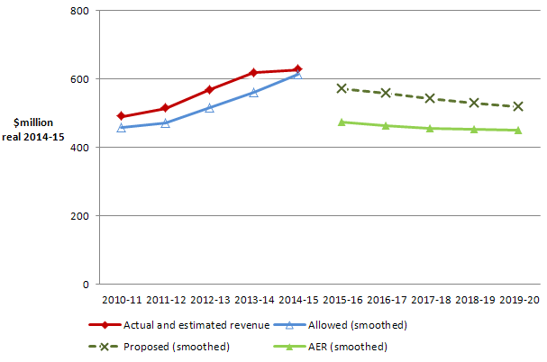
Total revenue
JGN's past total revenue, proposed total revenue and AER draft decision revenue allowance ($million, 2014–15)

Slide 6
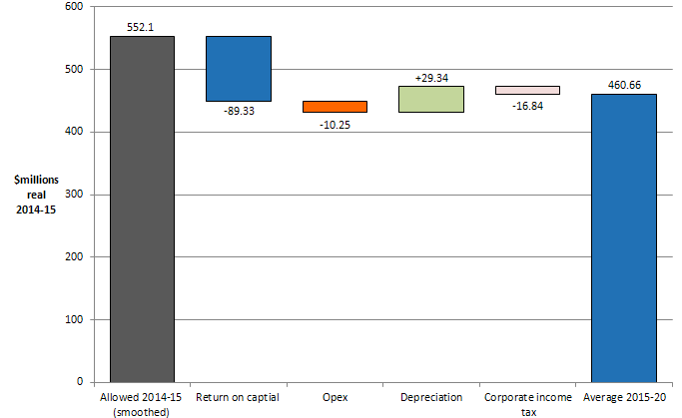
Total revenue: Differences between proposal and draft decision
AER’s draft decision annual average revenue (smoothed) compared with the 2014–15 building block revenue (smoothed) ($million, 2014–15)

Slide 7
Indicative impact on bills
Gas distribution charges represent approximately 50 per cent of a customer's annual gas bill.
There is considerable uncertainty about wholesale gas prices in the near future.
All else constant we estimate our draft decision would reduce the annual gas bill:
  for residential customers by $112 ($nominal) in 2015–16, which is an 11 per cent reduction.
  for small business customers by $539 ($nominal) in 2015–16, which is an 11 per cent reduction.

Slide 8
Rate of return
 | 2010–15 AER decision | 2015–18 JGN’s proposal | 2015–18 AER draft decision
Nominal risk free rate (cost of equity) | 5.85% | 4.12% | 3.55%
Equity risk premium | 5.2% | 6.59% | 4.55%
MRP | 6.5% | N/A | 6.5%
Equity beta | 0.8 | N/A^{(d)} | 0.7
Gearing ratio | 60.0% | 60.0% | 60.0%
Inflation forecast | 2.60% | 2.55% | 2.55%
Nominal post–tax return on equity | 11.05% | 10.71% | 8.1%
Nominal pre–tax return on debt | 10.02% | 7.30% | 5.93%
Nominal vanilla WACC | 10.43% | 8.67% | 6.80%

Slide 9
Capital expenditure
AER draft decision compared to JGN’s past and proposed capex ($million, $2014-15)

Slide 10
Capital expenditure
JGN proposed capital expenditure of $1,130.4 million ($2014-15).
Our draft decision: $918.6 million ($2014-15), 18% lower than proposal
The principal drivers for capex :
  unit costs of new connections (40% of capex cuts)
  facilities renewal projects (12% of cuts)
  meter replacement rate (17% of cuts)
  direct capex overheads (17% of cuts)

Slide 11
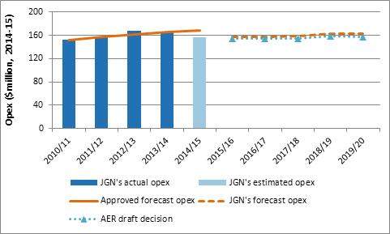
Operating expenditure
AER draft decision compared to JGN’s past and proposed opex ($million, $2014-15)

Slide 12
Operating expenditure (cont)
JGN proposed an operating expenditure of $789.3 million ($2014-15).
Our draft decision provides a substitute operating expenditure of $779.7 million ($2014-15).
The principal drivers for our substitute opex are:
  Lower growth in input prices
  No increase in opex for regulatory reporting

Slide 13
Demand forecasts
We have adopted higher forecast than JGN
This results in an increase in annual per customer consumption of:
  8 per cent for residential
  6 per cent for small business customers, and
  around 17 per cent for commercial customers
Leads to a decrease in JGN’s tariffs by around 8 per cent

Slide 14
Non-price terms and conditions of access
The Reference Service Agreement sets out JGN’s terms and conditions for access to its network
It is a starting point for users of the network to engage with JGN and create their own contracts
We have proposed a number of revisions to JGN’s reference Service Agreement, relating to:
  Requiring JGN to more appropriately allocate risk
  Clarifying how certain terms will operate
  ensuring that the RSA does not seek to pre-determine matters in which JGN has discretion under energy laws

Slide 15
Next steps
Revised proposals from JGN on 27 February 2015
Stakeholder submissions 27 March 2015
Final decision May 2015

