Slide 1


Australian Energy Regulator
Predetermination conference:
AER draft decisions on NSW electricity distribution regulatory proposals 2015-19
8 December 2014

Slide 2

AER draft decisions on NSW regulatory proposals
Warwick Anderson

Slide 3
Contents
High level generalised presentation
The businesses
The AER and our role
Overview of the proposals and draft decisions
Key drivers
Main elements
  RAB
  Capex
  Opex
  Rate of return
Next steps

Slide 4
The NSW distribution businesses

Slide 5
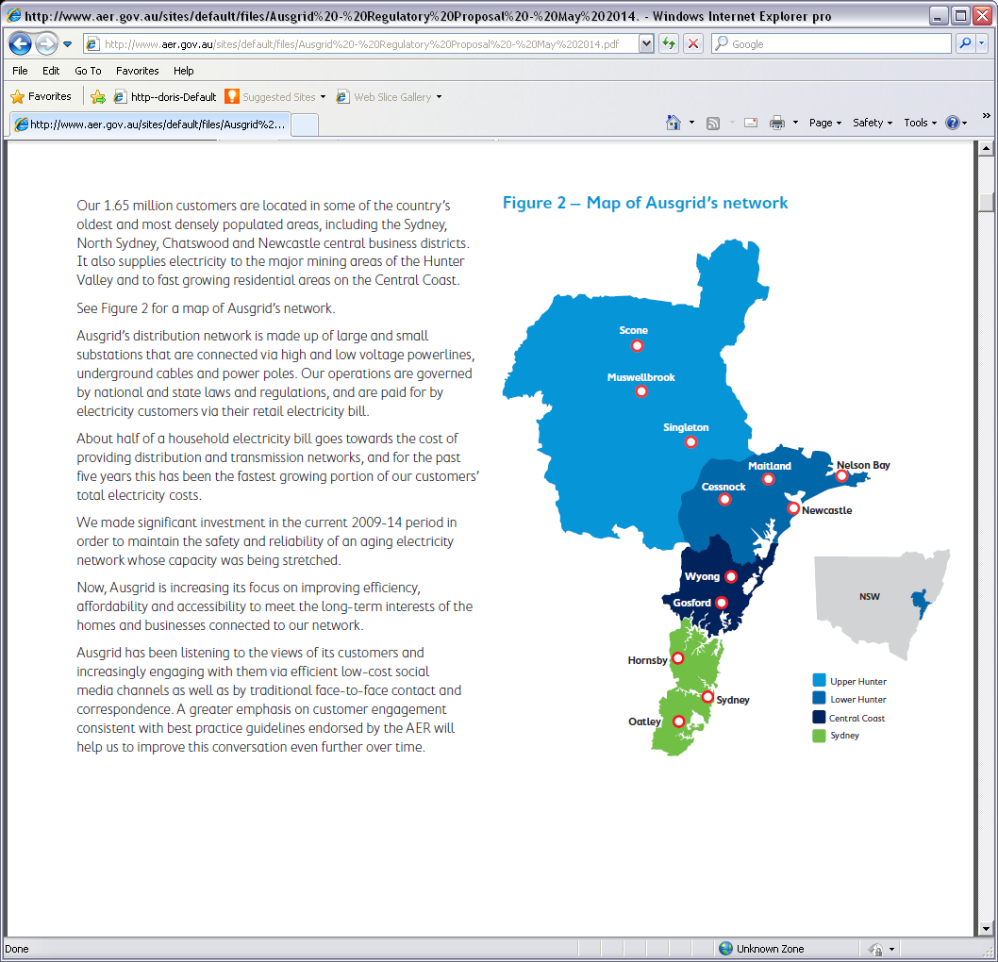
Ausgrid’s service area

Slide 6
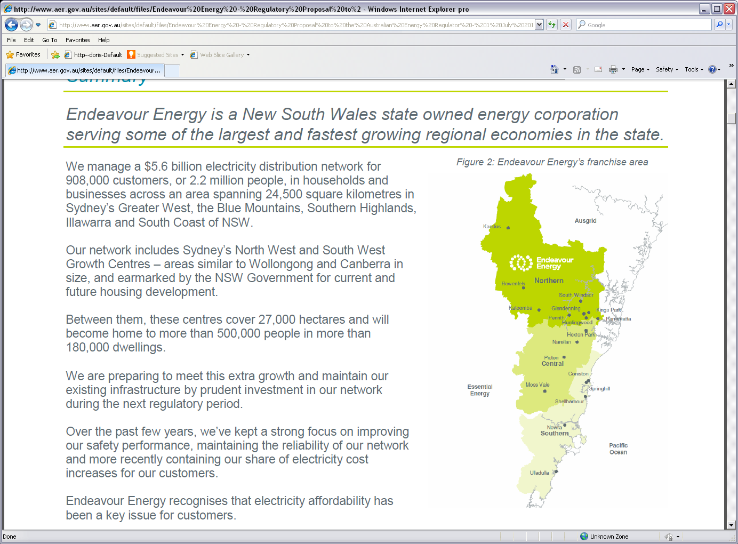
Endeavour Energy’s service area

Slide 7
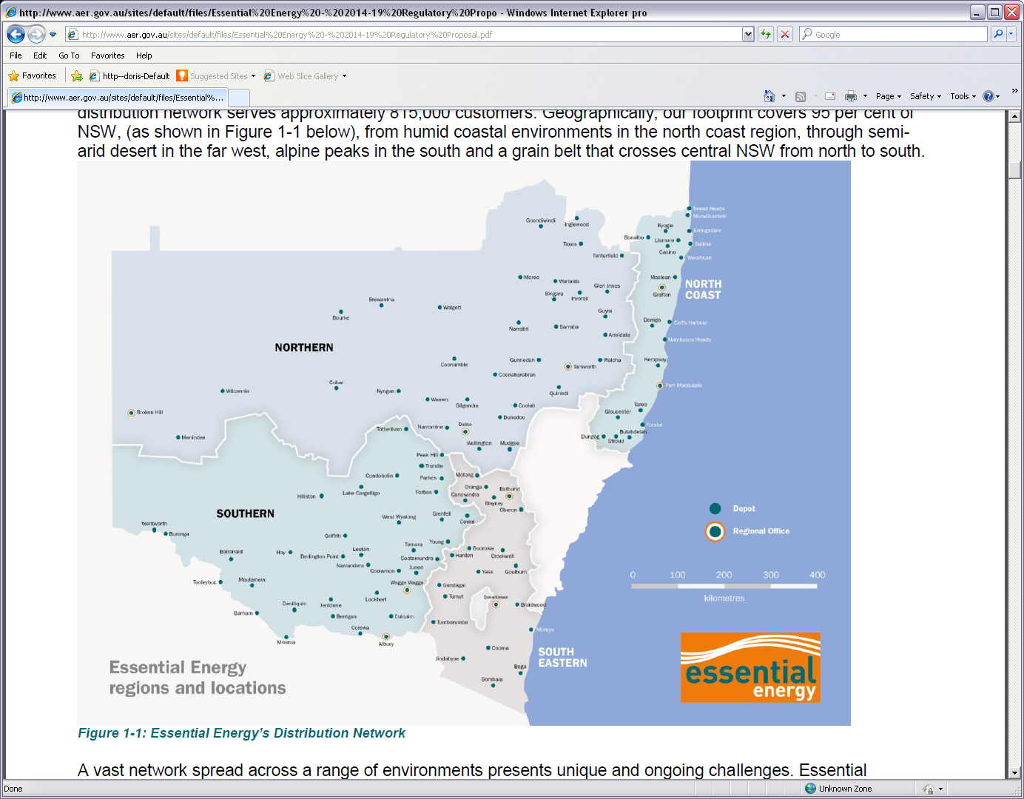
Essential Energy’s service area

Slide 8
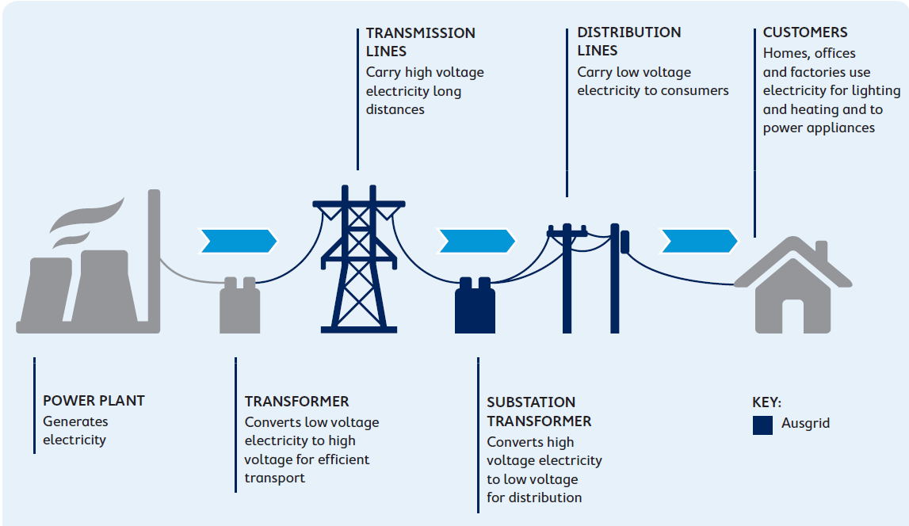
Electricity industry structure

Slide 9
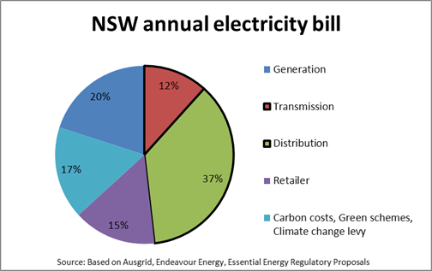
Contribution to total bill

Slide 10
The AER and our role

Slide 11
The current process
Draft decisions released on 27 Nov 2014 for:
  4 distribution businesses (1 in ACT, 3 in NSW)
  3 transmission businesses (2 in NSW, 1 in Tasmania)
  1 gas distribution business (Jemena Gas Networks NSW)
Final decisions due 30 April 2015 (Jemena a bit later)
We are also assessing three regulatory proposals for Qld/SA distribution businesses
Preliminary decisions on the Qld/SA proposals are to be released by 30 Apr 2015 and final decisions by 31 Oct 2015

Slide 12
The NEO
Our task – to set a maximum allowance that the networks are permitted to recover from customers consistent with the NEO:
To promote efficient investment in, and efficient operation and use of, electricity services for the long term interests of consumers of electricity with respect to –
  Price, quality, safety, reliability and security of supply of electricity; and
  The reliability, safety and security of the national electricity system

Slide 13
Better regulation
Expenditure forecast assessment guideline
Expenditure incentives guideline
Rate of return guideline
Consumer engagement guideline
Shared assets guideline
Confidentiality guideline

Slide 14
The proposals and AER draft decision

Slide 15
AER draft decisions
Not to accept proposals
We are not satisfied the proposals advance the NEO to the greatest degree
Instead we have made draft decisions that we are satisfied reflects the underlying drivers
We see the influence of these drivers in the main components of our draft decision

Slide 16
Total revenue

Slide 17
Total revenue - Ausgrid

Slide 18
Total revenue – Endeavour Energy

Slide 19
Total revenue – Essential Energy

Slide 20
  Key drivers

Slide 21
Key drivers
Our draft decisions reflect the key drivers:
Opportunities for services to be provided more efficiently
Assessment and management of risk
Demand
Financial market conditions

Slide 22
  Key driver – efficiency

Slide 23
Key driver - efficiency
Better Regulation benchmarking consultation started in 2012
Produced robust, consistent data set
Models prepared by benchmarking consultant – Economic Insights
Overall benchmarks (MTFP) indicate:
  Productivity across the sector been in decline
  VIC / SA DNSPs most productive
  NSW/ACT less productive

Slide 24
Key driver – efficiency

Slide 25
  Key driver – risk assessment and management

Slide 26
Issues in risk assessment and management
Evidence that the businesses have overstated asset risk
NSW government has adjusted reliability standards
In addition, trend improvement in high level indicators of risk on the networks
  Asset age
  Utilisation
  Service performance

Slide 27
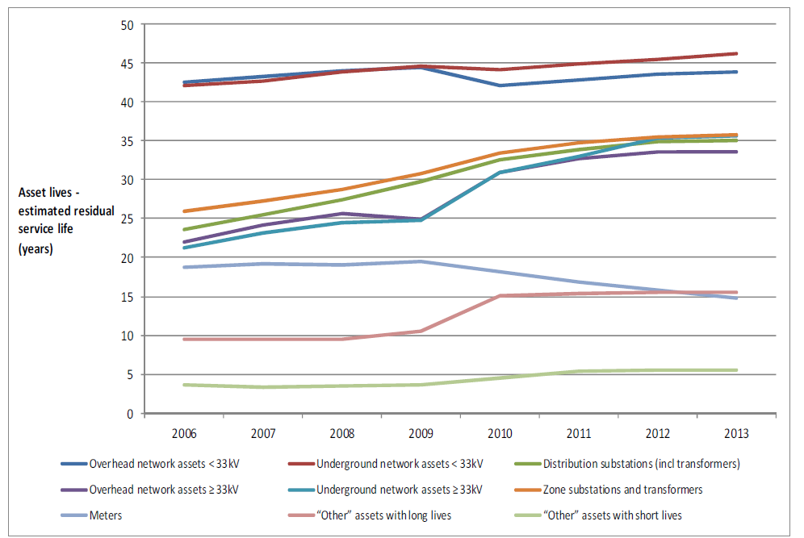
Residual asset lives – Ausgrid

Slide 28
Network utilisation - Ausgrid

Slide 29
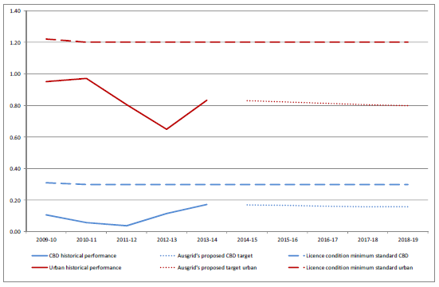
Ausgrid SAIFI performance – CBD and urban

Slide 30
  Key driver - demand

Slide 31
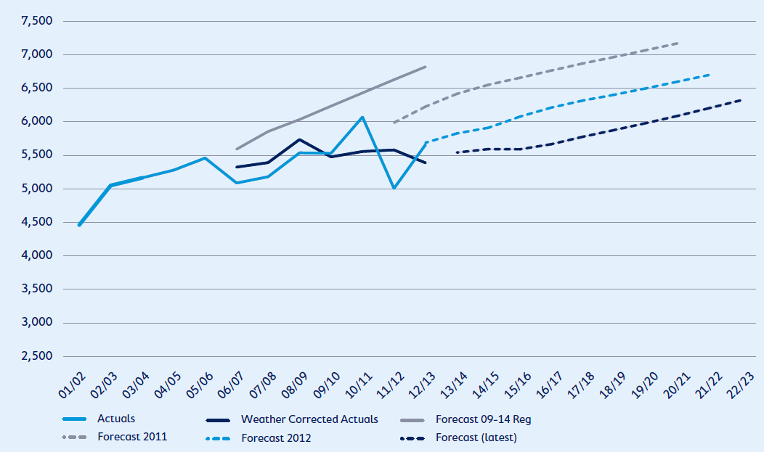
Summer peak demand – Ausgrid

Slide 32
  Key driver – financial market conditions

Slide 33
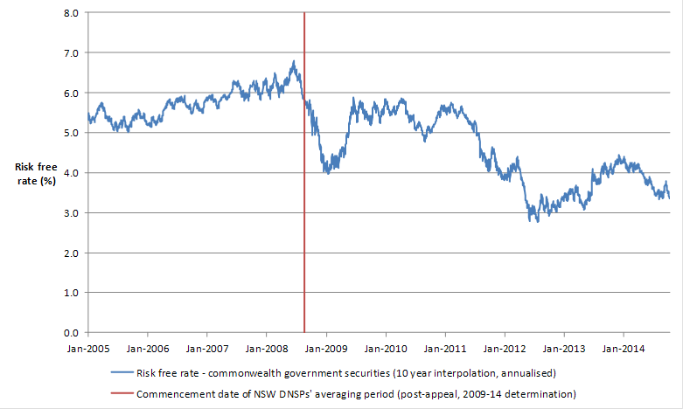
Financial market conditions

Slide 34
  Main elements of the decision

Slide 35
Elements
  Regulatory Asset Base (RAB)
  Capital expenditure (capex)
  Operating expenditure (opex)
  Rate of Return (RoR)
  Meters
  Public lighting

Slide 36
  Regulatory asset base (RAB)

Slide 37
RAB
  Our draft decisions provide for increases in the businesses’ RAB
  But at a lower rate than proposed

Slide 38
RAB - Ausgrid

Slide 39
RAB – Endeavour Energy

Slide 40
RAB – Essential Energy

Slide 41
  Capital expenditure (Capex)

Slide 42
Capex
Augmentation expenditure (augex)
  Key drivers of augmentation expenditure are
    maximum demand and
    reliability standards
Replacement expenditure (repex)
  Replacing an asset with its modern equivalent where the asset has reached the end of its economic life.

Slide 43
Ausgrid – Augex

Slide 44
Endeavour Energy – Augex

Slide 45
Essential Energy – Augex

Slide 46
Ausgrid – Repex

Slide 47
Endeavour Energy – Repex

Slide 48
Essential Energy – Repex

Slide 49
  Operating expenditure (Opex)

Slide 50
Opex criteria
The opex criteria provide that the total forecast must reasonably reflect:
  the efficient costs of achieving the operating expenditure objectives
  the costs that a prudent operator would require to achieve the operating expenditure objectives
  a realistic expectation of the demand forecast and cost inputs required to achieve the operating expenditure objectives.

Slide 51
Opex
Base-step-trend approach
  Select an efficient base level
    Typically the revealed cost in a particular year
    In this case we have looked carefully at the efficiency of the base year
  Step changes to take account of external drivers such as changes to regulatory obligations
  Trend underlying costs such as labour cost escalations

Slide 52
Base opex
In light of previous productivity estimates we have carefully reviewed the efficiency of the base opex of each business
Developed cost modelling and other detailed assessments
  Accounts for customer density, demand density and underground assets
  Also considered voltages, asset age and climate
Peers in other states are able to provide safe reliable services at lower overall levels of opex

Slide 53
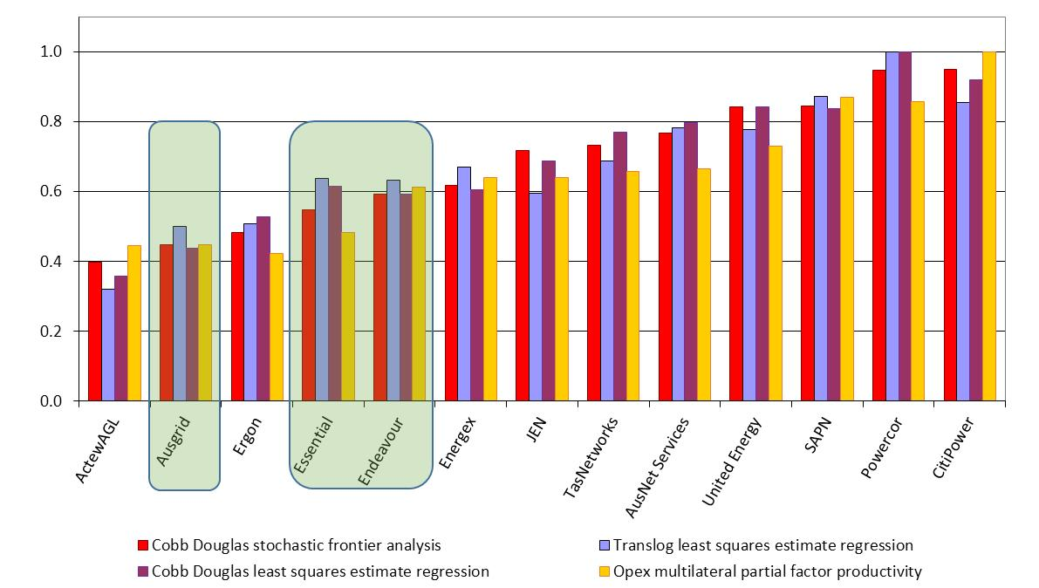
Benchmarking

Slide 54
Contributing factors
Labour and workforce management
  relatively inflexible workforces
  Labour costs above peer costs
  Management of costs e.g. overtime
  Less outsourcing than more efficient peers
Full benefits of Networks NSW efficiency programs not reflected in base year

Slide 55
Adjustment to base opex
The combination of evidence indicated that base opex for the NSW DNSPs could not be used as our starting point
Cost modelling and benchmarking used to determine scope of adjustment

Slide 56
Step changes
Significant list of step changes from the 3 businesses
Largely not accepted because they are internally generated rather than external

Slide 57
Rate of return

Slide 58
Rate of Return
 | 2009–14 Decision | 2015–19 Ausgrid's proposal | 2015–19 AER draft decision
Nominal risk free rate (cost of equity) | 5.82% | 4.78% | 3.55%
Nominal post–tax return on equity | 11.82% | 10.11% | 8.1%
Nominal pre–tax return on debt | 8.82% | 7.98% | 6.51%
Nominal vanilla WACC | 10.02% | 8.83% | 7.15%

Slide 59
Return on Equity (RoE)
No single objective measure of expected RoE
Employ a 6 step process to make use of all available information according to its merits
Use Capital Asset Pricing Model (CAPM) as our foundation model
Then review outcome of foundation model against other information that can inform our decision
Outcome of foundation model consistent with other indicators

Slide 60
Return on Equity

Slide 61
Return on Debt (RoD)
How to estimate RoD?
  RBA series or Bloomberg series
Type of methodology
  On-the-day, trailing average or some combination
Advantages and disadvantages of each approach, but we selected the trailing average approach
  Wide support from customers and networks
  Reduces volatility in prices between regulatory periods
  Reduces interest rate risk for networks

Slide 62
How to commence the trailing average?
We applied the approach set out in our RoR guideline
  New debt incorporated as it is progressively refinanced each year
  Our starting point for existing debt is continuation of on-the-day approach
  Consistent with the application of the benchmark efficient approach
  Avoids windfall gains and losses
  Preserves the outcomes and risk profile of the debt strategies chosen by the businesses under incentive regulation

Slide 63
Gamma
No single objective indicator
Draw on a wide range of material to inform our decision
In guideline we said 0.5
After reviewing material and latest estimates we have updated to 0.4

Slide 64
Metering

Slide 65
Metering
No exit fees
Residual capital costs will be classified as a standard control service and recovered from the general network customer base
An annual charge for existing customers will recover the costs associated with the existing meter regulatory asset base

Slide 66
Public lighting

Slide 67
Public lighting
We amended proposed maintenance costs associated with:
bulk light replacement
spot replacements per day
lamp spot failure
labour and overheads
Outcomes
Essential Energy’s revenue up 5 per cent from current levels (proposed 60 per cent increase)
Ausgrid and Endeavour’s revenue down 20 per cent from existing levels

Slide 68
Consumer engagement

Slide 69
Consumer engagement
Seen as increasingly important
  AEMC in its 2012 rule determination require
  .. the NSP to indicate in its regulatory proposal the extent to which it has engaged with consumer representatives. The NSP must also include an overview paper in its proposal for consumers…
Still a work in progress from all parties, but we are making advances
  Unprecedented level of consumer engagement in the AER’s decision making process
  Better regulation process
  Submissions
  Engagement activities of businesses

Slide 70
Consumer Challenge Panel (CCP)
On 1 July 2013, the AER established the CCP as part of our Better Regulation program
The CCP assists the AER to make better regulatory determinations by providing input on issues of importance to consumers.
In December 2013 the AER published its consumer engagement guideline

Slide 71
Summary of submissions
Around 80 submissions
Most submissions considered regulatory proposals are not in the long term interests of consumers
We have taken all submissions from stakeholders into account in reaching our draft decision
Based on the submissions and our consultation with consumers, we are not satisfied that the proposals adequately reflects the views of consumers

Slide 72
Next steps
Task | Date
Pre-determination conference/ public forum on AER draft decisions | 8 December 2014
Distributors submit revised revenue proposals | 20 January 2015
Stakeholder submissions on AER draft decisions and revised revenue proposals close | 13 February 2015
AER issues final decision | By 30 April 2015

