Slide 1


The Australian Energy Regulator
Pre-determination conference
Draft decisions: TransGrid & Directlink transmission determinations

Slide 2

Today’s agenda
Presentations from:
  AER – Chris Pattas, General Manager – Networks
  Consumer challenge panel – Ruth Lavery and Hugh Grant
  TransGrid – Peter McIntyre, Managing Director
Time for questions at the end of presentations
Close at 2.30pm
Short recess until presentations on Jemena Gas Networks start at 3.00pm

Slide 3
The Australian Energy Regulator
Pre-determination conference
Draft decisions: TransGrid & Directlink transmission determinations
Chris Pattas, General Manager

Slide 4
About our draft decision: context and framework
Changes to the National Electricity Law and Rules in 2012
  National Electricity Objective
  Revenue and pricing principles
  A greater role for consumers
    Consumer engagement
    Consumer challenge panel
Our 2013 Better Regulation Program
  New guidelines setting out our approach

Slide 5
Total revenue: TransGrid
TransGrid's past total revenue, proposed total revenue and AER draft decision revenue allowance ($ million, 2013–14)

Slide 6
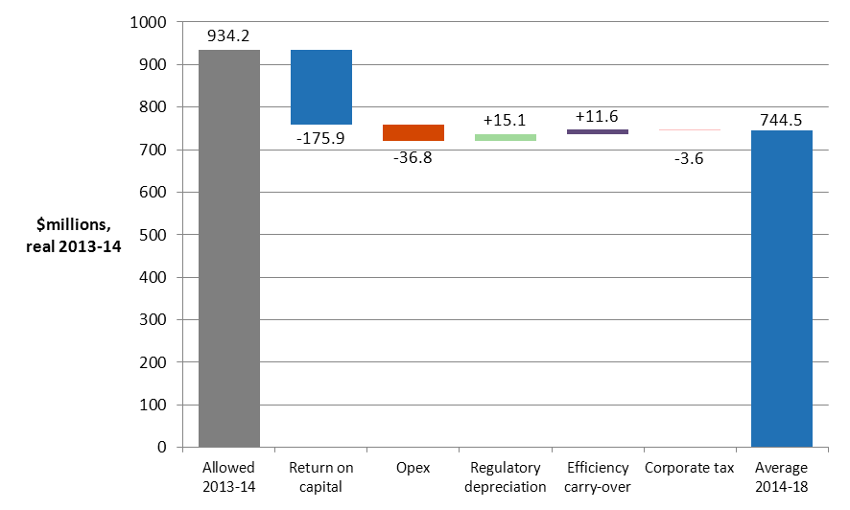
Total revenue: Key differences between proposal and draft decision
AER's draft decision on building block costs
($ million, 2013–14)
TransGrid:
Rate of return
  7.24 (AER)
  vs.
  8.83 (TransGrid)
34% reduction to
  proposed capex
16% reduction to
  proposed opex

Slide 7
Treatment of TransGrid’s transitional year (the ‘true up’)
For TransGrid this regulatory period originally due to commence on 1 July 2014
The rules provided for a transitional regulatory decision to allow for an expedited transition to the new rules
Fast-tracked placeholder determination March 2014
Rules provide for “true-up” as part of current determination
$94.3m (nominal) to be returned to customers over 2015-18
TransGrid | 2014–15
AER draft decision – notional MAR | 751.1
AER transitional decision – placeholder revenue | 845.4
Difference | –94.3

Slide 8
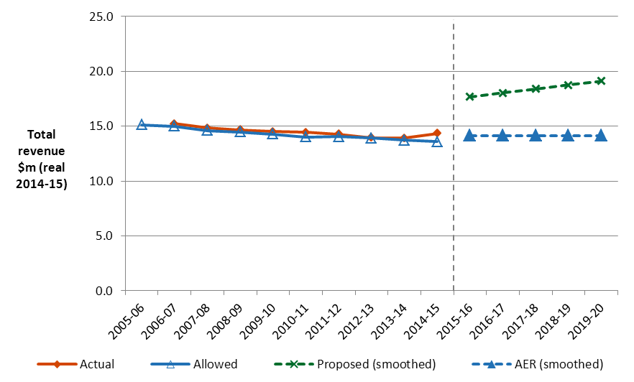
Total revenue: Directlink
Directlink's past total revenue, proposed total revenue and AER draft decision revenue allowance ($ million, 2014–15)

Slide 9
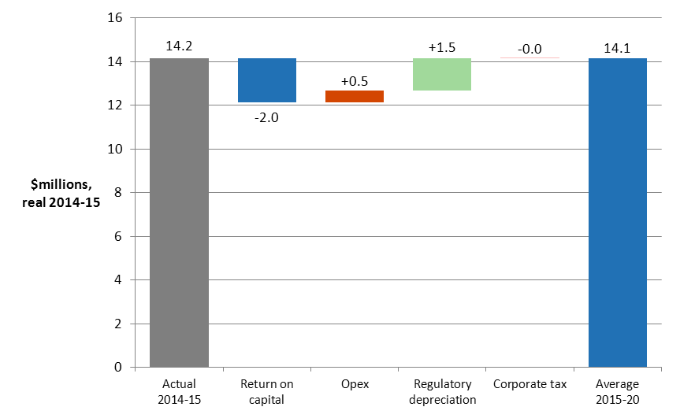
Total revenue: Key differences between proposal and draft decision
AER's draft decision on building block costs
($ million, 2014–15)
Directlink:
Rate of return
  6.80 (AER)
  vs.
  8.06 (Directlink)
27% reduction to
  proposed capex
37% reduction to
  proposed opex

Slide 10
Total revenue and impact on price
Average transmission charges forecast to decrease from around $17.7 per MWh in 2013–14 to $15.6 per MWh in 2017–18.
Estimated impact on the average annual electricity bills for customers in NSW and ACT over 2014–18 ($ nominal)
 | 2013–14 | 2014–15 | 2015–16 | 2016–17 | 2017–18
NSW residential annual bill | 2227 | 2225 | 2201 | 2205 | 2208
Annual change |  | –2 (–0.1%) | –24 (–1.1%) | 4 (0.2%) | 4 (0.2%)
ACT residential annual bill | 1959 | 1957 | 1936 | 1939 | 1942
Annual change |  | –2 (–0.1%) | –21 (–1.1%) | 3 (0.2%) | 3 (0.2%)
NSW small business annual bill | 3584 | 3580 | 3542 | 3548 | 3553
Annual change |  | –4 (–0.1%) | –38 (–1.1%) | 6 (0.2%) | 6 (0.2%)
ACT small business annual bill | 2939 | 2936 | 2905 | 2909 | 2914
Annual change |  | –3 (–0.1%) | –31 (–1.1%) | 5 (0.2%) | 5 (0.2%)

Slide 11
Key drivers for these decisions
Improving financial market conditions. Previous decisions reflected uncertainty, global financial crisis. Interest rates and risk premiums are now materially lower.
Demand. System peak demand in NSW decreased on average by around 3.9 per cent per annum over the past five years. Growth in peak demand is expected to be modest in these regulatory control periods. These expectations indicate a reduced need for growth related expenditure in the forthcoming period.
Reliability. Network performance metrics show that performance has remained relatively stable—or has improved. This suggests that a more modest asset replacement program will be required in the forthcoming period.
Risk assessment. Risk management processes informing TNSP forecasts are overly risk averse and result in higher capex forecasts than are reasonably necessary.

Slide 12
Rate of return
 | 2009–14 AER decision | 2015–18 TransGrid’s proposal | 2015–18 AER draft decision
Nominal risk free rate (cost of equity) | 5.86% | N/A | 3.55%
Equity risk premium | 6.0% | 6.35% | 4.55%
MRP | 6.0% | N/A | 6.5%
Equity beta | 1.0 | N/A | 0.7
Gearing ratio | 60.0% | 60.0% | 60.0%
Inflation forecast | 2.47% | 2.52% | 2.50%
Nominal post–tax return on equity | 11.86% | 10.5% | 8.1%
Nominal pre–tax return on debt | 8.85% | 7.72% | 6.67%
Nominal vanilla WACC | 10.05% | 8.83% | 7.24%
Value of imputation credits (gamma) | 0.5 | 0.25 | 0.4
TransGrid
Directlink
% | 2006–15 AER decision | 2015–20 Directlink’s proposal | 2015–20 AER draft decision
Nominal risk free rate (cost of equity) | 5.32% | 4.30% | 3.55%
Equity risk premium | 6.0% | 4.55% | 4.55%
MRP | 6.0% | 6.5% | 6.5%
Equity beta | 1.0 | 0.7 | 0.7
Gearing ratio | 60.0% | 60.0% | 60.0%
Inflation forecast | 2.97% | 2.50% | 2.55%
Nominal post–tax return on equity | 11.32% | 8.9% | 8.1%
Nominal pre–tax return on debt | 6.32% | 7.50% | 5.93%
Nominal vanilla WACC | 8.32% | 8.06% | 6.80%
Value of imputation credits (gamma) | 0.5 | 0.25 | 0.4

Slide 13
Capex: TransGrid
Proposal: $1,387.4m ($2013-14)
Draft decision: $922.3m ($2013-14)

Slide 14
Capex: TransGrid
Proposal reflects significant change in composition of forecast capex (repex/augex)
Lower growth related capex consistent with trends in demand
Higher repex:
  Technical review by EMCa identified systemic issues
  Upwards bias in forecasts
  Room to defer/reduce scope of works
  Lower cost options
Actual capex 2009-14; TransGrid’s forecast capex 2014-18

Slide 15
Key adjustments to capex: TransGrid
Accepted TransGrid’s forecasts of growth related capex (augmentation and connections)
  significant reduction in forecast augex compared with historical augex aligns with the low levels of demand growth forecast over the 2014–2018 period
Replacement capex—reduced from $952.2 m to $647.6 million ($2013–14): (30 per cent less than proposed by TransGrid).
  EMCa technical review identified a number of systemic issues
  overestimation of risk and in turn, overstatement of forecast repex.
Security and compliance capex—reduced from $129.6 m to $46 million ($2013–14)
  Similar systemic issues; bias towards options that eliminate the hazard, rather than more efficient management options
Strategic property acquisitions—Reduced from $114.7m to $10.9m($2013–14)
Contingent project: Powering Sydney’s future—updated demand forecasts support deferral to next regulatory period
  Related reductions to opex

Slide 16
Opex: TransGrid
Proposal: $784.5m ($2013-14)
Draft decision: $659.7m ($2013-14)

Slide 17
Key adjustments to opex: TransGrid
Base year opex—whole-of-business benchmarking for transmission in its infancy: we cannot confidently measure the relative efficiency of TransGrid's opex.
  used TransGrid's proposed 2012-13 base year opex for estimating our alternative estimate, but did not accept a number of TransGrid's proposed base year adjustments.
Forecasting method—did not accept selective adjustments to increase the base year expenditure used to forecast opex: accounts for $22.2 million ($2013–14) of the difference between TransGrid's proposal and our estimate.
Rate of change—proposal higher than our estimate: accounts for $11.6 million ($2013–14) of the difference between TransGrid's proposal and our estimate.
Step changes—significant step changes for consumer engagement ($8.8m) and a demand management innovation allowance ($10.2m) not included in our opex forecast.
Network support—TransGrid proposed $26.4m of pre-emptive procurement of network support associated with the 'Powering Sydney's Future' contingent project

Slide 18
TransGrid’s pricing methodology
TransGrid's proposed pricing methodology seeks to introduce a number of changes.
Aspects of the proposal can not be approved:
  do not give effect to the pricing principles in the National Electricity Rules (NER) or comply with the guidelines.
Draft decision | Proposal
Further consultation required | For locational TUoS services, switching to a 20 day peak period cost allocation
 | The introduction of MVA pricing
Accept | Modifying the way the excess demand charge is calculated
Not accept | The ability to amend aspects of TransGrid's approved pricing methodology during the regulatory control period
 | For non–locational TUoS and common transmission services, basing prices on maximum demand and applying a side constraint equal to CPI + 3 per cent
 | The availability to negotiate a fixed price with its transmission network customers

Slide 19
Capex: Directlink
Proposal: $35.20m ($2014-15)
Draft decision: $25.63m ($2014-15)

Slide 20
Key adjustments to capex: Directlink
Increase in 2019-20 for upgrade to control system ($13.07 million ($2014-15)): more than half of Directlink’s approved capex
Based on an engineering review, adjustments to:
  reflect lower cost estimates for some projects than those included in Directlink's proposal
  adjust the scope of Directlink's proposed program of works to reflect improvements in performance expected to result from its past and forecast expenditure
  remove from our substitute estimate of forecast capex those projects for which a need (in the 2015-20 regulatory control period) had not been demonstrated.

Slide 21
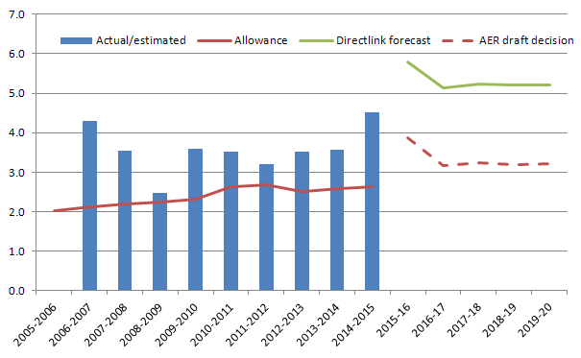
Opex: Directlink
Proposal: $26.5m ($2014-15)
Draft decision: $16.7m ($2014-15)

Slide 22
Key adjustments to opex: Directlink
A reduction of 37.2 per cent compared to Directlink's proposal.
Bottom-up assessment of Directlink's opex requirement for 2015-20 to estimate the efficient opex a prudent operator of the Directlink interconnector would require to achieve the opex objectives.
When compared to the resulting estimate, Directlink's proposal is materially higher.
Forecast costs of operating and maintenance, insurance and the commercial services fee are above those that would be incurred by an efficient service provider.
Forecast does reflect the capex and opex risk mitigation measures proposed by Directlink (and included in our draft decision) to reduce the risks associated with the Directlink asset

Slide 23
Next steps
Revised proposals from TransGrid and Directlink on 13 January 2015
Stakeholder submissions 6 February 2015
Final decision April 2015

