Slide 1
Draft decision – initial views
Rob McMillan
December 2014

Slide 2
Agenda
Presentation agenda
In a nutshell…
NSW gas market – our perspectives
Customer engagement – building on a positive start
Draft decision – areas we agree
Draft decision – areas we will question
Your views – our contact details
Many areas of agreement, some important areas we will question

Slide 3
Gas market changes

Slide 4
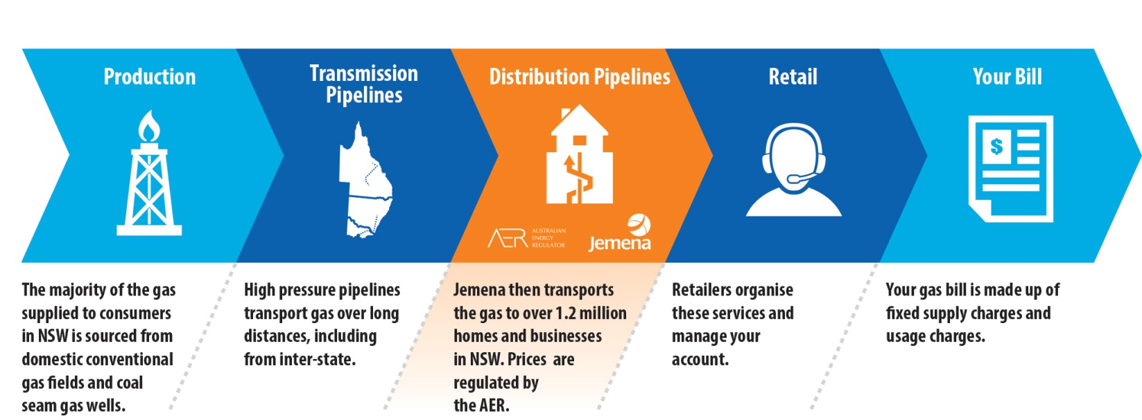
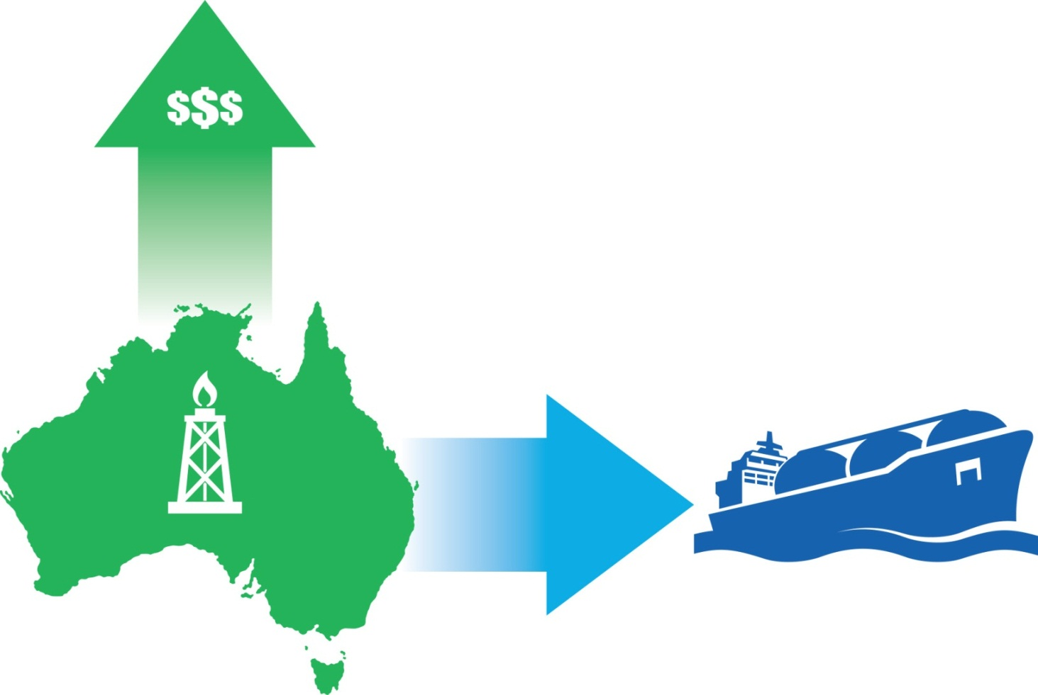
The gas market is changing
Notes:
The changes in the gas market are primarily being caused by external factors – the international LNG market (especially in Asia) with its strong demand and high prices are driving a significant structural shift as our domestic gas markets as producers and owners of gas look to new markets – this affects transmission and distribution owners, and of course customers.
Rises in wholesale gas costs (>$4/GJ, $2015 real) will add $100 (small gas consumers) -$200 (regional gas customers) p.a in nominal terms to typical household bills by 2020.
Potential to become a highly political and media focused sector – will we see the same sort of focus on the gas regulatory framework as we have in electricity?

Slide 5
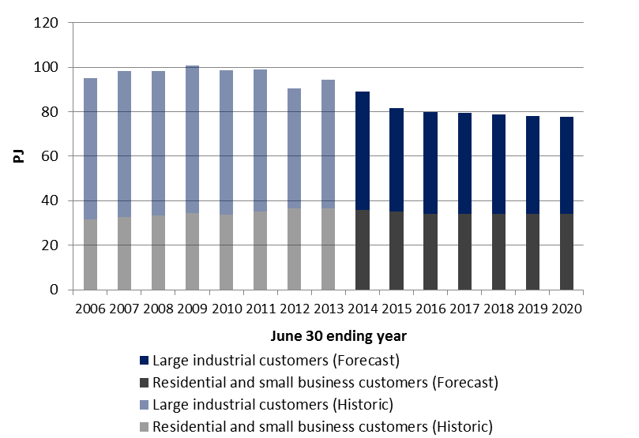
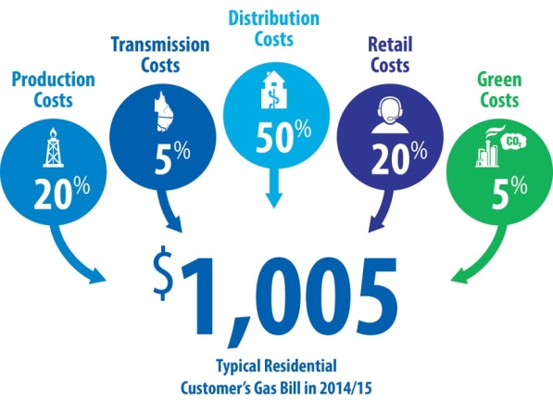
What is the potential impact on retail prices?
A potential future
Actual and forecast gas demand in the JGN (PJ per year)
Currently a typical residential gas bill is around $1000, but a typical gas bill could be $200 more expensive by 2019/20 (incl. inflation) due to higher wholesale gas prices
Our concern:
Rising retail gas prices make people look for value for money options…
…and most customers have access to a range of options for powering their homes and businesses (e.g. grid-electricity, solar PV)
…putting downward pressure on gas demand.
JGN’s response
Participating in government policy reform to seek regulatory barriers are lifted to bring new gas supply on line as soon as possible
Continue to be proactive in attracting new customers
Keep downward pressure on our costs and our network prices—especially for key markets
Respond to changes in the way gas is used
Provide a service that customers value.
Notes:
A typical residential retail customer bill is around $1000 per year. Non-network costs account for around 50% of a typical customer bill.
These costs are forecast to add almost $200 to a typical gas customer bill over the 5 years. This is primarily the result of the increasing demand for gas in australia’s domestic gas market.
Assuming our network prices are unchanged, a typical customer bill could increase from $1000 to around $1200
Gas is not an essential service natural gas has always completed against other types of fuels such as:
Electricity
LPG or bottled gas
wood for heating and coal and oil for industrial applications
As homes and appliances become more efficient it means that less gas is used reducing average loads. You may think this is a good thing from your point of view but the more customers we have means that we can spread the fixed costs of running and maintaining the gas network across a greater number of customers and puts downward pressure on prices
Like in any competitive market, we need to be proactive in marketing our product and offering a service customers value. If we were not proactive we could expect ongoing decreases in gas usage, which would put upward pressure on gas prices
Like in any competitive market, we need to be proactive in marketing our product and offering a service customers value. If we were not proactive we could expect ongoing decreases in gas usage, which would put upward pressure on gas prices
Some relevant considerations that are impacting our competitive environment include:
Gas is a fuel of choice in NSW – not an essential fuel like energy. Customers have a range of fuel choices
NSW has low residential gas penetration rates compared with colder climates
JGN always privately owned and rolled out based on incremental economic return
NSW not as cold as some other states eg. Victoria
Average NSW residential gas consumption is declining as customers increasingly take up R/C air conditioning and energy efficiency increases
Need to reverse decline in market share by increasing the take up of gas appliances. For example, convincing a household with gas hot water to switch their heating and cooking to gas as well.
There is a dislocation of gas and electricity prices that is expected to continue
Delivered price of gas is expected to increase at a higher rate than electricity over the next few years
All of these factors combine to put pressure on the competitive position of gas in NSW and increase the importance of growing the gas culture in NSW, increasing customer numbers and natural gas appliance sales.
Over the past 10 years :
Residential and small business market (Volume market) has grown on average by just under 2% pa from 31 to around 36 PJ pa
Demand market has hovered around mid- 60 PJ mark.
These dynamics are changing primarily because of changes in the wholesale gas market.
We see the Volume market declining over the next 2 years and then hovering around the 34 PJ mark – growth in customer numbers of over 2% pa is offset by declining use per customer (rising gas prices, declining electricity prices driving appliance substitution, and general improvements in appliance efficiency)
Demand market declining significantly reflecting the closer of several large customers, and then hovering around the mid-40 PJ mark.
In total a loss of over 20PJ by the end of the period

Slide 6
Customer engagement

Slide 7
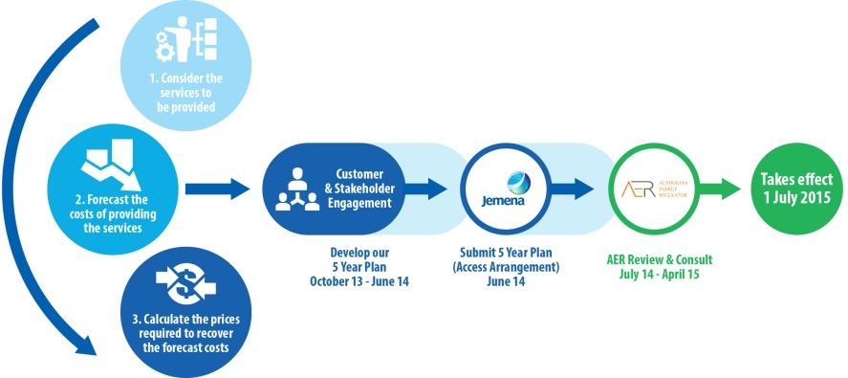
Our on-going engagement commitments
Help our customers, stakeholders and the community understand how gas services and prices are determined
Keep our customers, stakeholders and the community informed of emerging factors that are influencing the energy market (including JGN), and our customers and stakeholders
Involve our customers, stakeholders and the community in our decision making, and provide opportunities for them to provide feedback on the range of issues that are important to them
Acknowledge and respond to the feedback we receive, including how it has influenced our decision making
Be transparent about what we can and cannot do to manage gas prices and services, and what customers can do
Measure, report and improve the effectiveness of our engagement through time.

Slide 8
AER draft decision

Slide 9
Areas where we agree
We are efficient, but can continue to improve
Historical capital expenditure
98.8% of JGN’s forecast operating expenditure (exc. debt raising costs)
5 per cent opex productivity factor for the period.
Efficient and equitable pricing
Customer engagement highly regarded
Tariff structures, including low fixed charges to support gas connections
New tariffs for energy intermediaries
We have taken genuine steps to engage with our customers
Our proposal was strengthened by the overall quality of our engagement
Our engagement met the requirements of the AER’s guidelines

Slide 10
Areas we will question – cost of equity
Pick a winner or use a consensus
AER picked one model as its foundation—the Sharpe-Lintner CAPM—and used it to filter other relevant evidence
An alternative is to use a consensus approach to estimating the cost of equity
AER approach
Questions
By filtering evidence, AER constrains its effect on the cost of equity
AER also makes other evidence meaningless by either not using it or by suggesting it produces wide ranges that cannot force a rethink of its estimate
How should various pieces of evidence be combined?
Does the AER approach lead to more or less stable cost of equity estimates over time?
Does the AER approach support efficient investment?
Notes:
The AER’s general approach is to cast each piece of additional evidence as producing a wide range of outcomes that encompasses the AER’s allowed return on equity. The effect is that none of the additional evidence leads the AER to reconsider its original estimate of the allowed return on equity. This applies to models as well. It appears that when the AER does not want to give weight to a model or piece of evidence, it comes up with varied estimates and says that there is instability and no clear direction etc.
The AER’s presumes that the Sharpe-Lintner CAPM is superior to all other cost of equity models. This does not hold when tested in the real world, and therefore relying on it without adjusting for known problems risks setting the cost of equity so that it does not promote efficient investment.

Slide 11
Areas we will question – gamma
Value or redemption
AER estimates gamma by looking at how much imputation credits are used (or redeemed), or are assumed to be used
An alternative is to look at how much they are valued by the market, much like stocks and bonds
AER approach
Questions
AER looks primarily at tax redemption and equity ownership statistics to estimate gamma
AER places limited weight on studies of how much investors value imputation credits, which leads to a higher estimate of gamma (and lower allowed tax)
Does it matter whether investors value imputation credits or not?
If investors that can or do use credits are assumed to value them fully, then does this affect their incentives to invest efficiently if they do not?
Should gamma be estimated consistently with how the cost of equity is?
Notes:
The key question is whether gamma is a market value or a redemption rate. If gamma is a market value, then tax redemption and equity ownership statistics provide upper bound estimates of theta at best.
Dividend drop off studies are the primary evidence of market value, and have been endorsed by the Australian Competition Tribunal.
The AER approach is a little mixed here because it combines estimates of both market value and redemption, even though it considers the latter the correct definition.

Slide 12
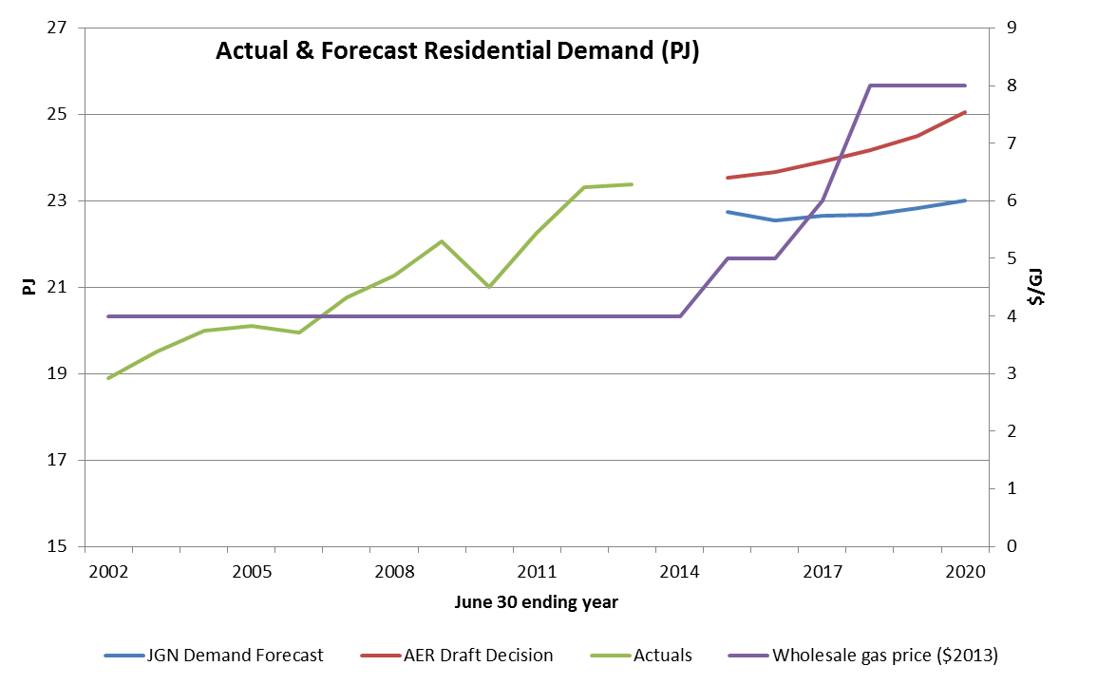
Areas we will question – demand forecasts
Demand forecasts – reality check
Notes:
AER argues that economic growth drives residential consumption.
Do people cook more, have more hot showers, or heat their homes more based on the state of the economy? However, households will respond to rising gas prices.

Slide 13
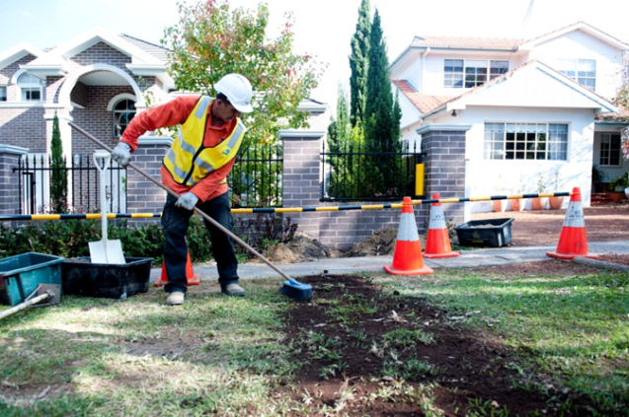
Areas we will question – capital expenditure
Connections – concerning inconsistencies
JGN established new contracts for routine construction in October 2012. As it was a competitive tender price, we are satisfied that the unit rates drawn from these contracts which form the basis of estimates used in JGN's proposed capex are efficient.
Versus
We therefore calculated the connection unit rates using actual data between 2008 and 2013.
Major projects
20 page consultant report to challenge almost $100M worth of projects that deliver important customer outcomes
Technical errors in engineering assessments
Explanatory documentation ‘missed’, leading to rejection of costs
Notes:
Cost of connecting new customers: its not reasonable or sustainable for us to re-negotiate efficient, market-based contracts (which are acknowledged by the AER as such) but then have the AER set our allowances with no regard to these contracts.
Major projects: Our initial review suggests that the AER’s assessment was rushed and has resulted in a number of key errors.
We are keen to work with the AER over coming months to ensure our revised proposal is targeted and focussed.

Slide 14
Your views

Slide 15
Our revised proposal
Preparing our revised proposal
Have your say
Review the AER’s draft decision
Customer Council meeting on 8 Dec 14, and potentially another in late Jan/Feb 15
Engage with customers and stakeholders Jan/Feb 15
Prepare our revised proposal and lodge by 27 Feb 15
www.aer.gov.au

