Slide 1
Ausgrid – Endeavour - Essential
Networks NSW
PRESENTATION TO AER PRE-DETERMINATION
CONFERENCE
CONTENTS
Legislative framework for revised and final determinations
NNSW / AER views on customer priorities
Points of agreement
NNSW issues of concern in AER Draft Determinations
NNSW revised regulatory proposals
Menzies Hotel
Sydney
14 Carrington Street
8 December
2014
VINCE GRAHAM
Chief Executive Officer

Slide 2
1
Legislative framework for revised and final determinations
WH&S
Law
National
Electricity
Law
NSW
Reliability
Standards
DIRECT OBLIGATION
ON NNSW and AER
Fair Work
Act
REGULATORY OBLIGATION
ON NNSW RECOGNISED
BY NER
2

Slide 3
2
Alternate views on customer priorities
NNSW
AER
1
Safe
1
Affordable
2
Reliable
2
Reliable
3
Affordable
3
Safe
3

Slide 4

3
NNSW / AER points of agreement
1
Need to continue to drive operating and capital efficiency improvements for benefit of NSW consumers
2
Benefits of robust and reliable benchmarking to inform but not
determine capital and operating efficiency improvements
3
Need to address uncompetitive enterprise agreements
across the industry including NSW
4
Need to align Final Determination with NEO, NEL and NER
4

Slide 5
4
NNSW – issues of concern
AER has not had sufficient regard to the “safety and reliability” criteria in the NEO, NEL or NER. Significant aggregate cuts to OPEX and REPEX have been made by the AER without consideration of the “safety and reliability” clauses of the OPEX and CAPEX criteria in the NER.
AER’s failure to publish the Benchmarking Report by 30 September 2014 has eliminated AEMC’s intent to have an assessment period before NSW draft determinations published at end of November 2014. Procedural fairness has been irrevocably compromised by AER.
AER’s strong reliance on an untested and unstable OPEX benchmarking model – outcomes not discussed with operators. Provisions of clause 8.7.4(c) of the NER have been ignored.
5

Slide 6
4
NNSW – issues of concern (continued)
Transitional “placeholder” determination for FY15 and a proposed “true up” for that year of $913m. (see slide 13)
Introduction of new regulatory principles. AER now proposes:
  networks should reduce REPEX and accept greater risk and higher rates of network failure;
  no longer recognising FWC certified enterprise agreements that the AER considers inefficient. This is in contrast to AER’s view for the recent SP AusNet 2014-17 determination -
  “SP AusNet’s Enterprise Agreement outcomes, nevertheless reflect the presumably free negotiations between SP AusNet, its employees and representative unions, and we are not privy to those negotiations.”
  preference for more local service interruptions (blackouts) at local level with customer compensation.
Forecasts of consumption and relationship of consumption to network costs.
6

Slide 7
4.1
Safety and reliability
AER has cut aggregate OPEX (up to 39%) and REPEX (up to 43%), and failed to undertake any evaluation of safety and network reliability impact. AER has declined to identify how aggregate cuts should be applied abrogating its responsibility under Commonwealth WH&S Act and ignoring findings of Ian Hanger’s QC Royal Commission into the Home Insulation Program (p.309).
Cuts would see $460m removed from NNSW vegetation and bushfire mitigation programs over the regulatory period. AER’s proposed funding cuts to vegetation programs have NOT been risk assessed for the 160,000km of line of NSW network in bushfire-prone areas.
Cuts would require immediate reduction of 4,600 employees including 750 apprentices without risk assessment of continuing network capability to maintain a safe and reliable network without a transition.
Increase in local service interruption (blackouts) proposed by AER will occur on hottest (or coldest) days not risk assessed by AER for 54,000 life support customers in NSW.
7

Slide 8
4.1
Retrospective OPEX reductions proposed by AER draft determination
Other 19%
AER Cut 35%
Vegetation 19%
Labour 62%
AER Approved 65%
NNSW FY14
AER Draft Determination
NNSW will not propose cuts to vegetation and bushfire risk management programs in revised proposals.
8

Slide 9
4.2
Opex and benchmarking model – issues of concern
AER’s failure to publish 1st Benchmarking Report by 30 September 2014 breached NER, and is procedurally unfair to NSW distributors who must submit revised proposals to AER by 20 January 2015. AEMC proposed a two month period between the first annual benchmarking report and the AER’s NSW draft determinations.
Substantial change in benchmarking model approach from August 2014 draft to 27 November 2014 published report. The final report was not subject to consultation required under NER clause 8.7.4(c).
AER’s RIN data “unstable and unreliable”. (Economic Insights comment)
Illogical and unexplained model outcomes. (Slide 11)
NNSW cannot replicate how AER has bridged from benchmarking model outcomes for base year FY13 to its Draft Determinations for FY15 to FY19.
9

Slide 10
4.2
The benchmarking process
Inputs
Model
Interim “efficient
frontier” and FY13 adjustments
AER Draft Determination for OPEX
Based on AER’s benchmarking RIN data
Post modelling corrections
AER’s “empirical considerations”
Obvious and significant differences in “basis of preparation” of RIN data.
30% correction to model outcomes required to make sense of ActewAGL model outcomes. Real problem with inconsistent RIN data.
NNSW cannot readily understand how AER has applied other empirical considerations to bridge benchmarking model outcomes for FY13 and draft OPEX determinations for FY15 to FY19.
10

Slide 11
4.2
Benchmarking anomalies
Economic Insights reports that using only AER’s RIN data “produced econometric estimates that were relatively unstable” (p.28) and “all models are by definition a simplification of reality and may not capture all relevant effects”. (p.47)
Vegetation control is the second largest OPEX expense after labour (33% of OPEX for Essential Energy) but is not represented at all in the benchmarking model.
Arbitrary 30% adjustment to ActewAGL OPEX benchmarking outcomes because model outcomes didn’t make sense.
Excluding vegetation expense Essential Energy receives less OPEX (and similar REPEX) compared to Endeavour Energy for a network 540% longer with 450% more distribution substations.
If Essential Energy was taken to the “efficient frontier” it would have approximately $50m p.a. (net of vegetation expense) of operating expenditure to maintain their network supporting approximately 10% of the current workforce.
THE LACK OF INDUSTRY CONSULTATON BY THE AER AND THE ILLOGICAL OUTCOMES OF THE AER’S BENCHMARKING MODEL NOW THREATEN TO DERAIL THE CREDIBILITY OF BENCHMARKING AS A REGULATORY TOOL
11

Slide 12
4.2
Benchmarking model
Networks NSW would encourage AER to have the Productivity Commission independently assess the methodology, reliability and robustness of their benchmarking model.
12

Slide 13
4.3
Retrospectivity and FY15 “true up” NNSW total
$913m
AER’s “efficient frontier”
$
$913m
13

Slide 14
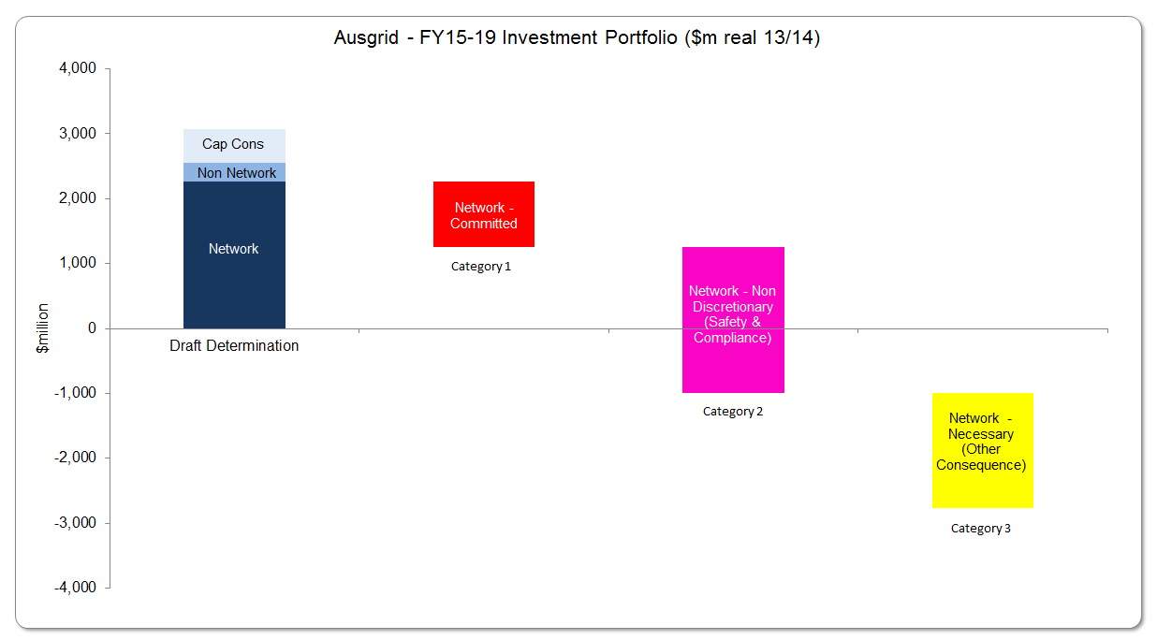
4.5
CAPEX Prioritisation - Ausgrid
14

Slide 15
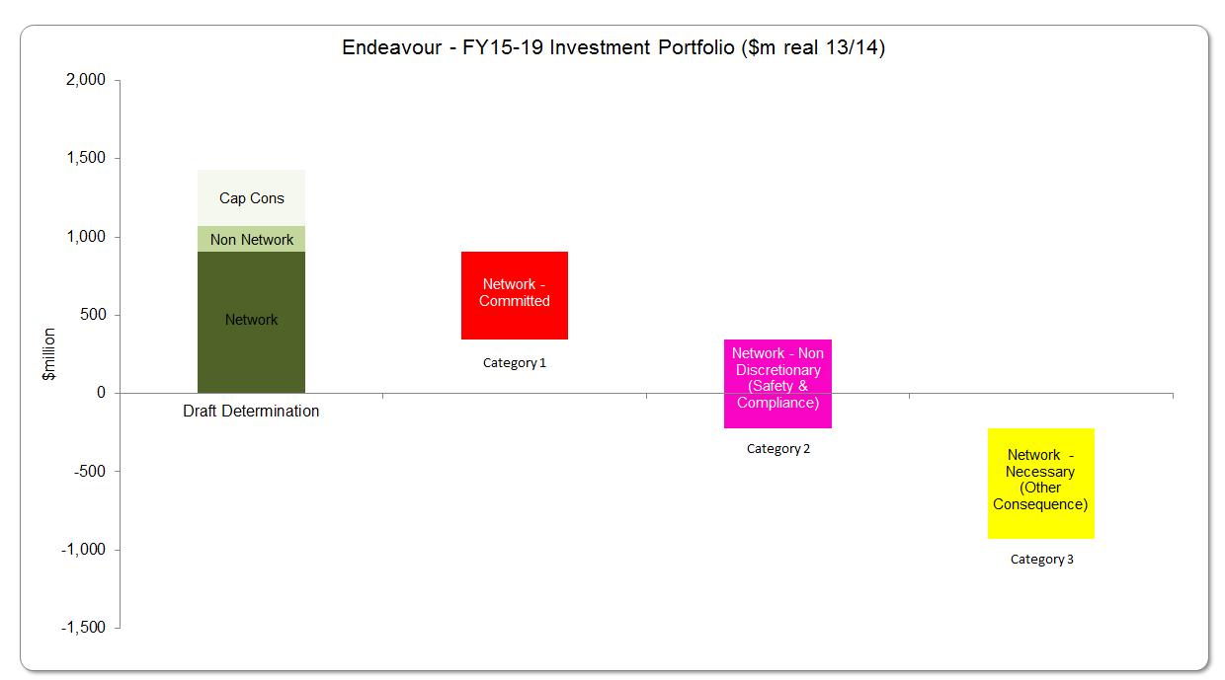
4.5
CAPEX Prioritisation – Endeavour Energy
15

Slide 16
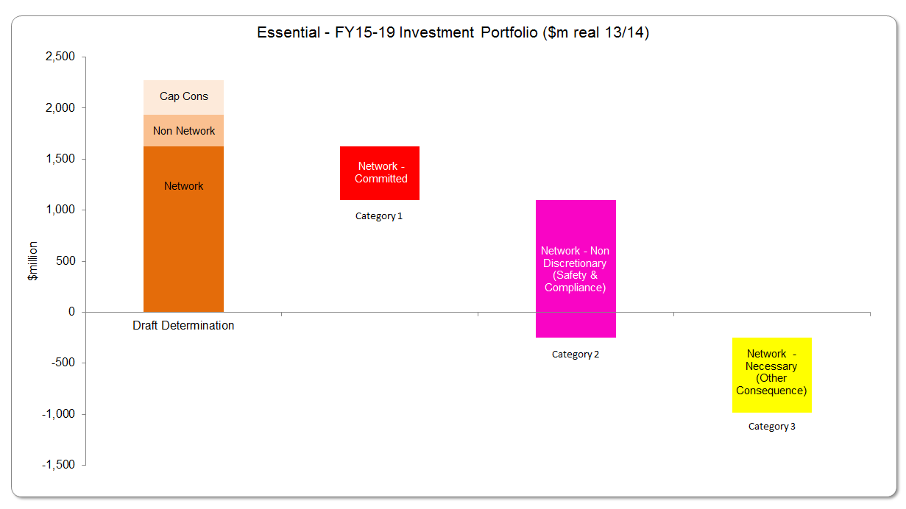
4.5
CAPEX Prioritisation – Essential Energy
16

Slide 17
4.6
Forecasts of consumption and relationship of consumption costs
Electricity consumption FY15 year to date October 2014 has increased by 2.3% compared to same period in FY14.
Variation in future electricity consumption will not impact network costs for:
  Opening RAB;
  WACC
  OPEX
  REPEX
  New network connections.
Variations in forecast energy consumption or peak demand have minimal impact on five year CAPEX program submitted by NNSW to the AER.
17

Slide 18
5
NNSW – revised regulatory proposals
Will give a considered response to AER’s draft determinations and reassess our OPEX and CAPEX proposals in the interests of a safe, reliable and affordable network for consumers.
Will provide to the AER a safety and reliability risk assessment of the AER’s draft determinations against NEO, NEL, NER and WH&S Act.
Will continue to honour enterprise agreements certified by the Fair Work Commission.
Will reject AER being able to have regard to the OPEX benchmarking model because of:
  AER’s failure to follow NER to publish the first annual benchmarking report by 30 September 2014 and to consult on that report denying procedural fairness;
  defective and unreliable outcomes.
18

Slide 19
5
NNSW – revised regulatory proposals (continued)
Will not increase as proposed by the AER our risk profile for:
  Employee and public safety;
  Vegetation and bushfire risk management;
  Life support customers on local distribution networks.
Will maintain an ordered priority for:
  Safety
  Reliability
  Affordability
19

Slide 20
5
Letter from Commissioners Fire & Rescue NSW and NSW Rural Fire Service
Letter from Commissioner Greg Mullins, Fire & Rescue NSW dated 4 December 2014 to Vince Graham and Paula Conboy – extract:
“I fear that the impact of the draft determination could be a greater reliance on Fire & Rescue
NSW in storm situations, due to smaller numbers of available utility staff and less vegetation
management activities. As illustrated above, I am deeply concerned that this could lead
directly to greater loss of life and property in the community due to fire crews being engaged
for even longer periods at "wires down" incidents.
I am hopeful that you will be able to provide some reassurance that this will not be the case.
You may also be able to advise whether or not the AER plans to consult more widely on its
draft determination, and whether detailed risk assessments of the broader impacts of its draft
determination have or will be conducted. I am available at short notice to meet and discuss
this significant issue.”
Letter from Commissioner Shane Fitzsimmons, NSW Rural Fire Service dated 5 December 2014 to Vince Graham and Paula Conboy – extract:
“It would appear that the broader ramifications of the draft determinations have not been subject to a detailed risk assessment by the AER and I strongly encourage the AER to undertake detailed risk assessments of the broader impacts of these determinations in their current form.”
20

