Slide 1



TransGrid’s response to AER draft determination
Presentation
Revenue Proposal
AER Public Forum
AER Public Forum
Peter McIntyre
Peter McIntrye, Tony Meehan, Nicola Tully
Managing Director
December 2014

Slide 2
A time of change
TransGrid’s response to changing market
Deferred $600 million of capital expenditure
Dramatic reduction in proposed augmentation
Removal of Powering Sydney’s Future project from proposal
Revenue growth below CPI
Demand GWh
1961 2014
TransGrid is adapting to changing demand and future proofing electricity supply in NSW.

Slide 3
National Electricity Objective
Post 2013
"promote efficient investment in, and efficient operation and use of, electricity services for the long term interests of consumers of electricity with respect to –
(a) price, quality, safety, reliability and security of supply of electricity; and
(b) the reliability, safety and security of the national electricity system"
TransGrid does not believe the AER has struck the right balance in meeting the National Electricity Objective.

Slide 4
TransGrid’s operational expenditure
Post 2013
The AER has found “no evidence that TransGrid’s base Opex is materially inefficient”
Primary areas of concern | Cost to TransGrid over regulatory period | Average cost per annum for a typical end user
Major maintenance projects | $27 million | ~$1.32
Vegetation management | $12 million | ~59c
Demand management innovation | $10 million | ~49c
While TransGrid understands the impact of it’s decisions on consumer bills, it believes safety and reliability are major priorities.

Slide 5
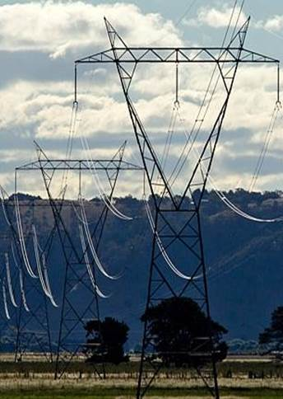
TransGrid’s replacement expenditure
AER has proposed a reduction of over 30% in proposed replacement safety and compliance capital expenditure on grounds of:
  historical trend; and
  an assertion our asset management governance is lacking
However:
  AER has not made any assessment of the safety or reliability impacts of their proposed cuts
  TransGrid is certified to ISO55001, the leading international standard in asset management
Example:
Low span lines
Recent aerial surveys highlighted a need for remediation on low span lines
We are proposing works to ensure they will meet current Australian Standards
While TransGrid understands the impact of it’s decisions on consumer bills, it believes safety and reliability are major priorities.

Slide 6
TransGrid’s replacement expenditure
Post 2013
TransGrid’s proposed replacement expenditure is sensible.

Slide 7
Consumer engagement
AER
‘Service
providers should engage with
their consumers
so they can provide services that better align with consumers' long term interests.’
Consumers told us
“The customer engagement process you provide is second to none in the country. Well done.”
(Consumer Advisory Representative, Mar 2014)
“The interest in genuine discussion of the issues of each of the participants.”
(Consumer Advisory Representative, Nov 2014)
AER
‘We do not consider it is efficient… to engage with distribution customers as TransGrid is proposing”
AER Draft Determination, Nov 2014
AER Consumer Engagement Guidelines,
Nov 2013
“
”
(Consumer Advisory Representative, Nov 2014)
TransGrid regards consumer engagement as an essential part of our future business.

Slide 8
WACC
We agree with the AER’s methodology to measure the cost of debt but...we disagree on taking 10 years to implement it.
The AER has said “Our transitional arrangements...avoids potential windfall gains or losses to service providers or consumers from changing the regulatory regime for the return on debt.”
The AER’s transition imposes approximately a $255 million windfall loss on TransGrid over the next 10 years.
Post 2013
TransGrid should not be punished for prior adoption of a staged debt management practice.

Slide 9
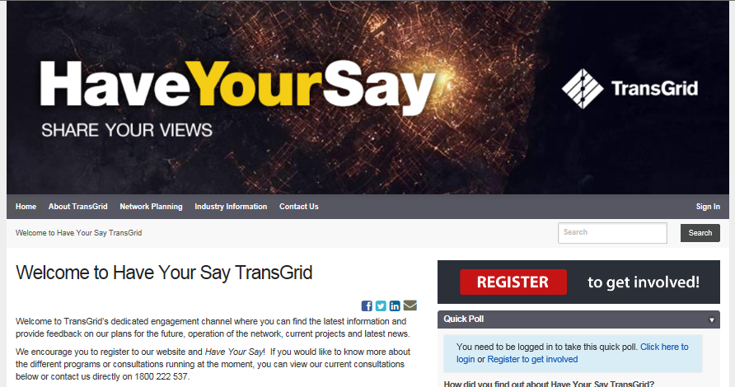
Have your say
Post 2013
TransGrid looks to continue the conversation with consumers and representatives.

