Slide 1
Ofgem’s use of financeability and RoRE tests in setting the allowed rate of return
Better Regulation workshop on Rate of Return Guidelines
25 February 2013
Notes:
This presentation sets out at a high level the way Britain’s energy regulator, Ofgem, utilises holistic measures of risk and return when assessing the allowed rate of return in its determinations. The presentation is intended to encourage a debate on the usefulness of such approaches in the AER context, but it does not take a position on whether the AER should adopt these approaches.

Slide 2
Structure
Ofgem’s framework
Financeability testing
  What is it?
  Illustrative example
Return on Regulatory Equity (RoRE) analysis
  What is it?
  Illustrative example
Summary

Slide 3
Ofgem’s framework
How does Ofgem think about the WACC?
  What matters to investors is the overall balance of risks and rewards in the price control package
  Cost of capital depends on the above, not an isolated theoretical concept
Process for deciding on allowed rate of return:
  Cost of debt indexed
  For cost of equity and (notional) gearing:
    Long-term CAPM estimates, sense-checked against precedents and other market evidence (transaction premiums, DGM) – range for consultation
    Companies propose specific values (could be outside Ofgem range)
    Ofgem carries out financeability testing, RoRE analysis, cash flow risk assessment – calibration of various options
    Board makes decision on appropriate values

Slide 4
Financeability (1)
Ofgem’s ‘financing duty’: should have regard to its decisions allowing an efficient network company to finance its activities
Interpretation: network companies attain investment grade credit rating
Application: financeability testing at each reset decision
Assumptions:
  stand-alone basis
  notional financial structure
  no out/under-performance of regulatory assumptions (i.e. capex, opex, incentive revenue)
Necessarily judgement-based:
  Ratios typically account for 30-40% of rating agencies’ decision
  Different agencies place emphasis on different ratios (or calculate them differently)
  Short-term deviations from targets typically not a concern
Ultimately, security provided by regulatory framework is the key reason network companies attain investment grade rating

Slide 5
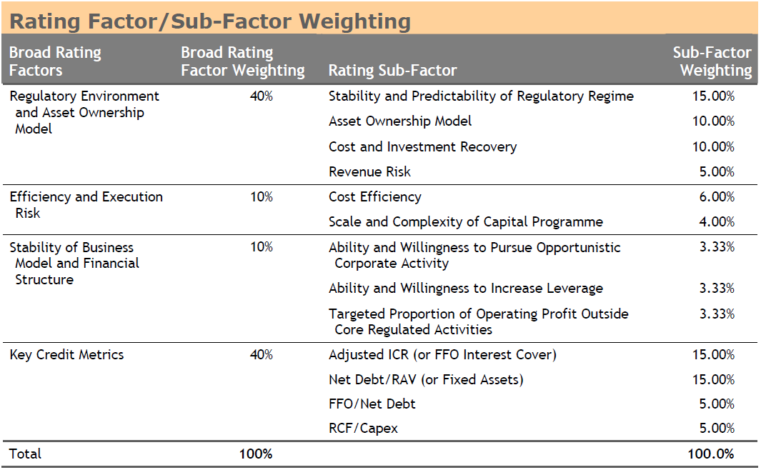
Financeability (2)
Financeability is defined by more than just credit ratios
Source: Moody’s, Rating Methodology for Regulated Electric and Gas Networks, August 2009

Slide 6
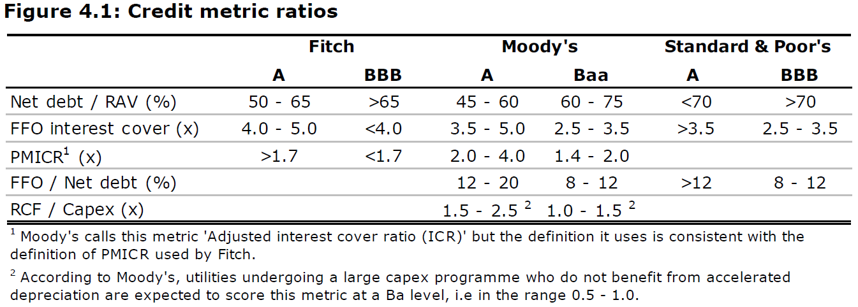
Financeability (3)
Ofgem does not follow approach of any one rating agency, or try to meet criteria of the three major agencies
Broad assessment criteria consulted on, but detailed assessment kept confidential to avoid focus on minutiae of detail
Source: Ofgem, Decision on strategy for the next transmission and gas distribution price controls – RIIO-T1 and GD1 – Financial issues, March 2011

Slide 7
Financeability (4)
Illustrative example of how a regulator might apply financeability tests
A company’s proposal might appear overly generous
A package based on purely theoretical evidence might be too tight
A balance can be struck by applying various levers (cost of equity, notional gearing, etc.)
Notes:
This slide provides a simplified illustration of how the credit metrics element of financeability testing might be incorporated using a ‘dashboard’. For simplicity of exposition, the example uses Moody’s target ratios for Baa rating, but a regulator may choose to consider target ratios from a number of rating agencies, and may consider the target ratios in other rating bands or across a number of bands. Financeability testing, however, is more than just testing credit ratios against their targets, and necessarily involves an element of judgment.

Slide 8
RoRE (1)
What is it? An attempt to quantify the potential upside and downside rewards for shareholders in the price control package
What does it do? Allows comparison across network companies; where consistent information is available, could also compare across sectors and over time
How does Ofgem use it? On a forward-looking basis at each reset to calibrate the package
Assumptions:
  Notional financial structure
  Probable baseline performance may not have zero revenue impact
  Where incentives are uncapped, probable minimum and maximum impact
  Abstract from relationship between elements
Necessarily judgement-based:
  What is the desired target RoRE range?
  Tension between wider RoRE range and financeability constraints

Slide 9
RoRE (2)
Illustrative example of how a regulator might use RoRE analysis
Notes:
The red lines represent examples of where a regulator might set its target upside and downside for RoRE. The figure shows how the price control package compares to these targets under four calibrations of the return on equity and notional gearing.

Slide 10
Summary
Ofgem’s approach can be characterised as:
  Use CAPM, precedents, other evidence to frame cost of equity and (notional) gearing decision
  Use financeability and RoRE assessments to calibrate package and achieve appropriate balance between risks and rewards
Necessarily judgement-based approach – mechanistic application would not achieve appropriate outcomes
Question for AER/stakeholders is whether approach is useful in Australian context
Use of financeability and Return on Regulatory Equity assessments necessarily requires the regulator to apply judgement

