Slide 1
Network Exemption Guideline review 2016
Tom Stevens-Downie
26 September 2016

Slide 2
Embedded Networks rule change
National Electricity Amendment (Embedded Networks) Rule 2015
17 Dec 2015 - AEMC published Final Determination
1 Dec 2016 - AER to publish revised Network Exemption Guideline
1 March 2017 - AEMO to publish ENM service level procedures and accreditation requirements
1 Dec 2017 – Embedded Networks rule commences
Notes:
Rule change implementation timeline

Slide 3
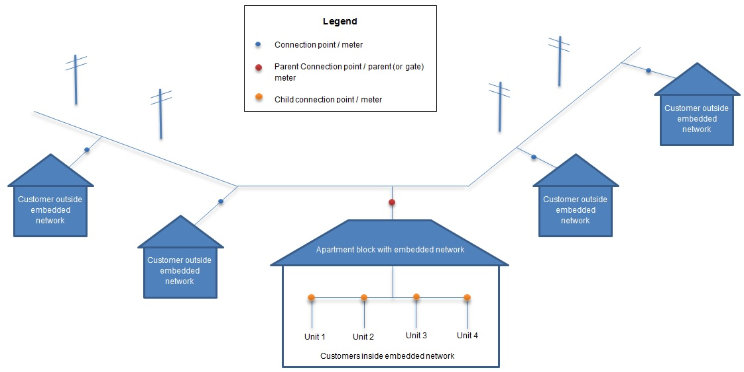
Embedded Networks rule change
Notes:
Embedded network vs direct connection
To aid discussion of:
market customer with direct connection – NMI, billing for consumption and network charges
EN customer purchasing from onseller – NMI not required, billing for consumption and network charges
On-market EN customer – NMI, billing for consumption (retailer) AND billing for network charges (ENO)

Slide 4
Embedded Networks rule change
Issue
Aims to facilitate access to retail competition for customers in embedded networks
Solution
Creates new accredited service provider: the Embedded Network Manager (ENM)
Notes:
Rule change – problem and solution

Slide 5
Embedded Networks rule change
Embedded network manager responsibilities
Recording details of customers’ metering installation in MSATS
Registering NMIs for child meters
Notes:
ENM responsibilities

Slide 6
Embedded Networks rule change
When an ENM is required
Default position (ENM required immediately):
  Network exemption holders who own, operate or control an embedded network must:
  become accredited as or an Embedded Network Manager; or
  appoint an accredited Embedded Network Manager.
ENM not required:
  Embedded networks situated in jurisdictions that do not afford the right to a retailer of choice for embedded network customers
Notes:
AER guideline to decide which exemptions may defer requirement for an ENM

Slide 7
Embedded Networks rule change
ENM requirement deferred:
If the AER considers that the likely costs of complying with ENM conditions outweigh the likely benefits to persons connected, or proposed to be connected, to the embedded network, the AER may […] determine to exempt that person or class of persons from the requirement to comply with the ENM conditions until such time as an ENM conditions trigger occurs. (NER r.2.5.1(d2))
ENM conditions trigger:
Small customer enters into a market retail contract and cooling off period has expired
Large customer enters into a contract for the sale of energy
Notes:
AER guideline to decide which exemptions may defer requirement for an ENM

Slide 8
Embedded Networks rule change
Questions?

Slide 9
Changes to support the rule change
Embedded networks that require an ENM immediately:
30+ customers at site; and
those customers relate to exemption classes ND1, ND2, ND10, NR1, NR2, NR3, NR4, NR5, NR6
Notes:
Network Exemption Guideline amendments: supporting the EN rule change
Large sites
Small business, large business and residential classes

Slide 10
Changes to support the rule change
Embedded networks that may delay requirement for ENM:
less than 30 customers at site
Exemption classes other than ND1, ND2, ND10, NR1, NR2, NR3, NR4, NR5, NR6
Notes:
Network Exemption Guideline amendments: supporting the EN rule change
small sites

Slide 11
Changes to support the rule change
‘Eligible communities’
Definition
Exemption classes ND2, NR2, NR3 and NR4
Operate cooperative bulk purchasing schemes to share the savings of reduced electricity prices
Exception to ENM requirement rules
May elect to defer ENM appointment for 30+ customers
Notes:
Network Exemption Guideline amendments: supporting the EN rule change
Eligible communities must be residential classes

Slide 12
Changes to support the rule change
‘Eligible communities’
Conducting a poll of eligible community members
A two-thirds majority allows deferment of ENM requirement for 30+ customers
A two-thirds majority allows ENM costs to be charged only to users of ENM services
  Price matched offer can be made to EN customers considering switching to on-market retailer
Notes:
Network Exemption Guideline amendments: supporting the EN rule change
Polling members of eligible communities
Normally, ENM costs must be absorbed and not recouped from specific customers

Slide 13
Changes to support the rule change
Questions?

Slide 14
Other proposed amendments
Metering standards and churn
New and replacement meters to conform to current standards for NEM metering
Non-compliant meters to be upgraded at the cost of embedded network operator
  Unless customer does not seek a market offer
Retailers may purchase current meter or replace it upon ‘winning’ an customer in an embedded network
Notes:
Other amendments: metering
Previous standard – pattern approved meter
Proposed standard – NEM standard as detailed in Chapter 7 NER

Slide 15
Other proposed amendments
Access to retail competition and network conversions
Condition 4.1.12 requires 100% consent for conversion if jurisdiction entitles consumers to retailer of choice
Applications without 100% consent previously assessed on individual basis with specific additional conditions attached
4.9 of the guideline formally includes these specific additional conditions
Notes:
Other amendments: retrofitting

Slide 16
Other proposed amendments
Access to retail competition and network conversions – additional conditions
Provision of retrofit information
Collecting and recording explicit informed consent
Offer matching
Duplication of network charges
Metering arrangements
Approval by AER
Notes:
Other amendments: retrofitting

Slide 17
Other proposed amendments
Prohibition of advance fees and rebates
An ENM must not pay an advance fee or a rebate to a property owner, developer or exempt embedded network service provider or any other person in connection with the provision of ENM services or to secure a right to provide services to an embedded network regulated by the AER.
An exempt embedded network service provider must not seek an advance fee or a rebate from any other person in connection with the provision of ENM services or to secure a right to provide services to an embedded network regulated by the AER.
Notes:
Other amendments: rights on embedded networks

Slide 18
Other proposed amendments
Smaller amendments
Changes to exemption class definitions
Contact information and notification obligations
Information provision and unbundling
Dispute resolution
  Including access to Ombudsman schemes
Increased requirements for HV networks
Notes:
Other amendments: bullet points of amendments listed under section 5:
Selling vs supply for class descriptions
ND10 class definition to explicitly include private education facilities (e.g. Universities)
NDO6 class definition: ‘Large Corporate Entity’ clarified to include trust or other corporate entity of equivalent size to a reporting entity under Corporations Law is eligible
ND9 class definition: NBN associated technologies explicitly covered under the telecommunications services class
Contact available for all matters concerning operation and access to embedded network
Notification of life support customers to reflect role of retailer at parent meter
Notification of customers for planned outages

Slide 19
Other proposed amendments
Questions?

