Slide 1
SA Power Networks Electricity Distribution reset 2020-25
Stakeholder meeting: AER preliminary framework and approach
17 April 2018

Slide 2
Who are we
The AER works to make Australian energy consumers better off by:
  regulating electricity networks and covered gas pipelines, in all jurisdictions except WA
  enforcing the laws for the NEM and spot gas markets in southern and eastern Australia
  protecting the interests of household and small business consumers by enforcing the NERL

Slide 3
What is the Framework and approach?
1st step in 2 year electricity reset process
F&A determines:
  Service classification
  Form of control
  Control mechanism
  Application of guidelines and incentive schemes
  Approach to depreciation
Notes:
Service Classification - sets out services the AER will and will not regulate and how those services are classified. The classification of services then flows to the prices charged for those services and how they are charged.

Slide 4
South Australia distribution determination process
Step | Date
AER publishes preliminary F&A for SA Power Networks | March 2018
Stakeholder forum | 17 April 2018
Submissions on the preliminary F&A for SA Power Networks close | 27 April 2018
AER to publish final F&A for SA Power Networks | July 2018
SA Power Networks submits its regulatory proposal to AER | January 2019
AER publishes issues paper and holds public forum | March/April 2019*
Submissions on regulatory proposal close | May 2019
AER to publish draft decision | September 2019
AER to hold a predetermination conference | October 2019
SA Power Networks to submit revised regulatory proposal to AER | December 2019
Submissions on revised regulatory proposal and draft decision close | January 2020*
AER to publish distribution determination for regulatory control period | April 2020

Slide 5
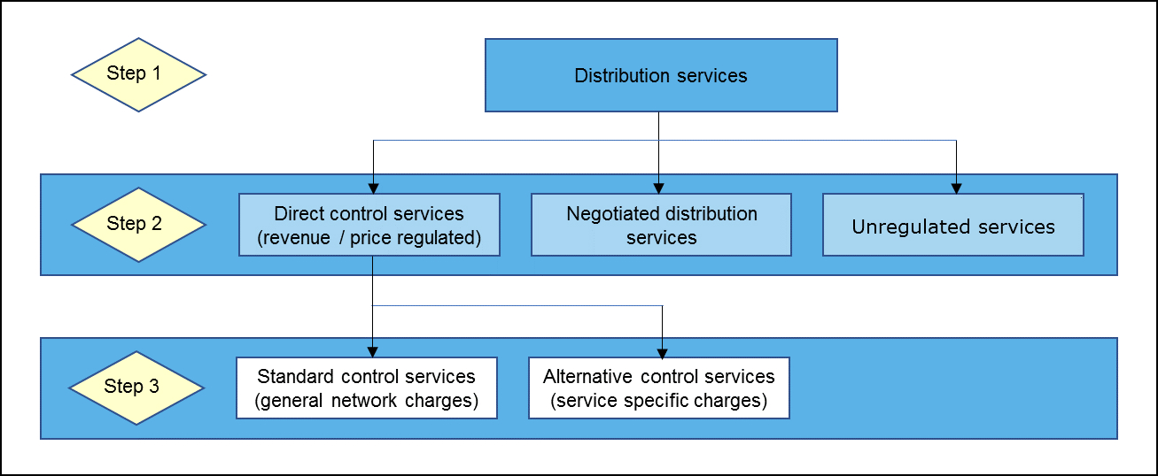
How we classify services

Slide 6
Major drivers of change for the 2020-25 regulatory period
Ring-fencing
Power of Choice
AEMC contestability rule change
New incentive scheme – DMIS
Increased focus on consumer engagement
Notes:
Ring-fencing

Slide 7
Ring-Fencing has caused a rethink of service classification
Major Changes include:
  Negotiated services reclassified as alternative control
  New services to be classified
New services include:
  Notices of arrangement and completion
  Rectification works to maintain network safety
  Provision of training to third parties for network related access
  Authorisation and approval of third party service providers design, work and materials
  Certain metering services
Notes:
Our Ring-fencing guideline introduced more stringent RF obligations and this has caused many distributors to rethink how existing services are classified.

Slide 8
Power of choice reforms change metering contestability
Type 1-4 meters are unregulated and so ring-fenced from DNSPs
Type 5 & 6 meters are also unregulated, but SA Power Networks may continue to provide some Type 5 & 6 services as alternative control services
SA Power Networks is required to provide other metering services to support the contestability framework
Other classification changes include:
Change “network services” to “Common distribution service”
Support for another distributor during an emergency event (new service – standard control)

Slide 9
AER proposed classification of SA Power Networks' distribution services
SA Power Networks' distribution services
Direct control (revenue/price regulated)
Standard control
(shared network charges)
Alternative control
(service specific charges)
Negotiated
Unregulated
Metering services (aside from legacy meters)
Common distribution services (formerly 'network services')
Type 7 metering services
Connection services
Ancillary services
Public lighting services
Legacy type 5 & 6 metering provision (installed prior to 1 December 2017)
Non-standard connection services

Slide 10
New incentive scheme
Demand management incentive scheme (DMIS)
Demand Management innovation allowance mechanism (DMIA)
  incentivises efficient expenditure in non-network options for demand management
  Improved DMIA provides for R&D development fund

Slide 11
Increased focus on consumer engagement
SA Power Network’s phased approach:
  Early 2017; preliminary research to understand customer sentiment and priorities
  Followed by deliberative-style workshops, focus groups, and online engagement exploring key themes of network price, reliability and resilience, and network of the future
  In 2018 focus of engagement narrows to explore complex topics with stakeholders in dedicated ‘deep dive’ workshops
This feedback will help refine the regulatory proposal to be submitted January 2019

Slide 12
How can stakeholders get involved?
We invite submissions on our preliminary F&A by 27 April 2017, in particular on:
  Non-standard connections
  Introduction of new services between reg periods
  Our proposed service classification table
  Our approach on depreciation, incentive schemes etc.
Have your day during SA Power Network’s consumer engagement – details available: https://www.talkingpower.com.au

