Slide 1
Annual Pricing Process Review
Stakeholder workshop 2
Tuesday 27 September 2022

Slide 2
Acknowledgement of Country

Slide 3
Agenda/Contents
1
Side constraint mechanism – overview
2
Q and D factors
3
New/trial tariff treatment
4
General feedback
5
Scenario analysis

Slide 4
Side constraint mechanism – overview
Purpose
Refine the side constraint mechanism and apply consistently across all networks
Issue
The side constraint mechanism is inconsistently applied by DNSPs
Our attempt to ensure a consistent approach uncovered adverse outcomes under some scenarios (namely, a declining consumption forecast)
These adverse outcomes included restricting DNSPs from recovering their total allowed revenue
We need to amend the side constraint mechanism to address these scenarios
Standardised pricing model applies two different interpretations of the current mechanism, based on the definitions set in the relevant regulatory determinations
The current applications do not provide consistent constraints across networks, varying due to quantity movements, quantity of annual revenue adjustments, and tariff structures

Slide 5
Side constraint mechanism – overview
Process
AER consult on its proposed position through annual pricing process review
AER communicate final position on side constraint mechanism in October-November
Relevant DNSPs include side constraint mechanism in regulatory proposals in January 2023 (2024 for Qld/SA and 2025 for Vic)
AER to revise pricing models to include the updated side constraint mechanism
Updated model will be provided alongside regulatory determination

Slide 6
Side constraint mechanism – overview
We sought feedback on:
Our definition of incremental revenues
Our proposed Q factor, and if it appropriately accounts for changes in quantities
Our proposed position on new and trial tariffs
An alternate application of the mechanism
Accessibility of formulae and definitions
Scenario analysis and any scenarios that should be tested
Any other issues not addressed
Feedback
General support for reviewing the side constraint mechanism
Some further engagement on technical aspects required

Slide 7
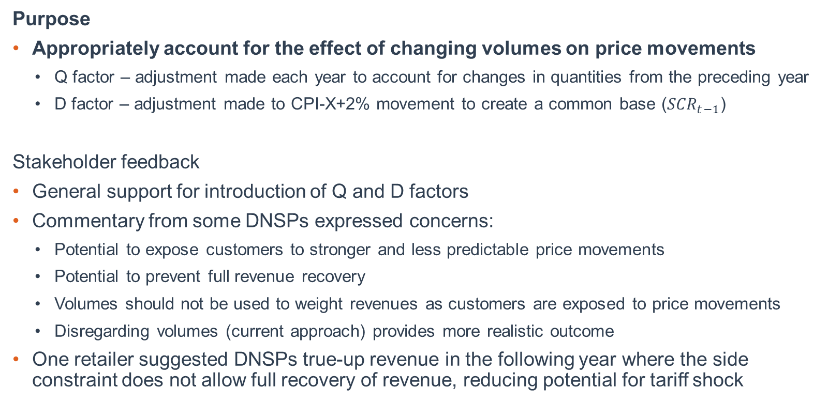
Q and D factors
Purpose
Appropriately account for the effect of changing volumes on price movements
  Q factor – adjustment made each year to account for changes in quantities from the preceding year
  D factor – adjustment made to CPI-X+2% movement to create a common base (${SCR}_{t−1}$)
Stakeholder feedback
General support for introduction of Q and D factors
Commentary from some DNSPs expressed concerns:
  Potential to expose customers to stronger and less predictable price movements
  Potential to prevent full revenue recovery
  Volumes should not be used to weight revenues as customers are exposed to price movements
  Disregarding volumes (current approach) provides more realistic outcome
One retailer suggested DNSPs true-up revenue in the following year where the side constraint does not allow full recovery of revenue, reducing potential for tariff shock

Slide 8
Q and D factors
AER response
Q and D factors ensure the allowed weighted average price movements are comparable to overall revenue movements +2%
Aligns weighted average price movements to revenue movements, where the current mechanism produces a disconnect between revenue and price movements
Ensures total allowed revenue is recoverable
Under revenue-capped services:
  Allowed revenues are adjusted each year
  Quantities are forecast and are exogenous
  Prices are proposed based on these quantities to produce a compliant revenue outcome
Where there is no revenue movement between years, prices will still vary as a result of changing quantities

Slide 9

Q and D factors
Scenario example
Total revenue is constant
Quantities decrease by 10% equally
Prices must increase to meet total revenue
If quantities are not accounted for, the permissible percentage under the side constraint mechanism is 2%
Equal price movements, using fixed quantities, provides equal weighted average revenue movements
Movement exceeds permissible percentage
If prices were restricted to 102% movement, only 91.8% of allowed revenue could be recovered
If quantities decrease by more than 2%, a DNSP can not recover the allowed revenue
${TAR}_{t}={TAR}_{t−1}$
$q_{t}^{ij}=0.9×q_{t−1}^{ij}$
$p_{t}^{ij}=1.1\dot{1}×p_{t−1}^{i}$
$∆{TAR}_{t}+2\%=100\%+2\%=102\%$
$\frac{{SCR}_{t}}{{SCR}_{t−1}}=111.1\dot{1}\%$
$111.1\dot{1}\%>102\%$
${Rev}_{t}=q_{t}^{ij}×p_{t}^{ij}=0.9×q_{t−1}^{ij}×1.02×p_{t−1}^{ij}$
${Rev}_{t}=0.918×{TAR}_{t−1}=0.918×{TAR}_{t}$

Slide 10

Q and D factors
Scenario example
Total revenue is constant
Quantities decrease by 10% equally
Prices must increase to meet total revenue
If quantities are accounted for, the permissible percentage under the side constraint mechanism is 13%
Equal price movements, using fixed quantities, provides equal weighted average revenue movements
Movement does not exceed permissible percentage
DNSP can recover allowed revenue
${TAR}_{t}={TAR}_{t−1}$
$q_{t}^{ij}=0.9×q_{t−1}^{ij}$
$p_{t}^{ij}=1.1\dot{1}×p_{t−1}^{i}$
$∆{TAR}_{t}+2\%+Q_{t}=100\%+2\%+11.1\dot{1}\%=113.1\dot{1}\%$
$\frac{{SCR}_{t}}{{SCR}_{t−1}}=111.1\dot{1}\%$
$111.1\dot{1}\%<113.1\dot{1}\%$

Slide 11
Q and D factors
Workshop discussion
Is it appropriate to account for quantities to ensure DNSPs can recover their allowed revenue?
Does the proposed approach appropriately reflect the approach set out in the NER?
Is the proposed approach a suitable alternative to calculating movements using variable quantities (rather than the approach to use fixed year t quantities), which would require previous year’s quantities to be included in the model also?
Would deferring recovery of revenue where quantities are not adjusted for be appropriate? Would this reflect the NER and compliance with other mechanisms?
Is there anything else that should be considered?

Slide 12
New/trial tariff treatment
Purpose
Appropriately account for new and trial tariffs in weighted average revenues
Stakeholder feedback
New and trial tariffs will be absorbed in the same way new customers on existing tariffs are absorbed into tariff class revenue
Provide clear guidance for how lack of prices in preceding year for new tariffs and tariff trials should be addressed

Slide 13
New/trial tariff treatment
AER response
Movements measured for side constraint mechanism are at the tariff class level
When new customers cause quantities to increase, prices in that tariff class generally adjust to accommodate to maintain constant weighted average revenue (where all else is equal)
Where a new tariff or trial tariff is introduced, and customers are new customers of that tariff class, this will have the same effect and will reduce prices for existing customers
Where a new tariff or trial tariff is introduced, and customers are existing customers of that tariff class moving to the new/trial tariff:
  Quantities for the existing tariff will decrease
  Side constraint revenue calculated using 0 prices for the new/trial tariff will be lower
  The Q factor, calculated as the difference between TAR and SCR for the preceding year, will adjust for the variances created by 0 prices (that is, the Q factor will adjust for those quantities that aren’t applied to anything in the SCR)

Slide 14

New/trial tariff treatment
Scenario example – new customers
In year t-1, 10 customers (assumed equal usage) pay $10
In year t, 1 new customer (equal usage) signs up to new tariff
New tariff price is $5, existing tariff price becomes $9.50
All revenue equal
Permissible percentage not exceeded
$p_{t−1}^{i=1}=\$10, q_{t−1}^{i=1}=10$
$p_{t}^{i=2}=\$5, q_{t}^{i=2}=1$
$p_{t}^{i=1}=\$9.50, q_{t}^{i=1}=10$
${SCR}_{t}=\left(\$9.50×10\right)+\left(\$5×1\right)=\$100$
${SCR}_{t−1}=\left(\$10×10\right)+\left(\$0×1\right)=\$100$
${TAR}_{t−1}=\$100;{TAR}_{t}=\$100$
${PP}_{t}=102\%+Q_{t}=102\%+0\%=102\%$
$\frac{{SCR}_{t}}{{SCR}_{t−1}}=\frac{\$100}{\$100}=100\%$
$100\%<102\%$

Slide 15

New/trial tariff treatment
Scenario example – existing customers
In year t-1, 10 customers (assumed equal usage) pay $10
In year t, 1 customer (equal usage) moves to new tariff
New tariff price is $10, existing tariff price remains $10
Preceding year side constraint revenue understated due to no prices in preceding year
Permissible percentage not exceeded due to Q factor adjustment
$p_{t−1}^{i=1}=\$10, q_{t−1}^{i=1}=10$
$p_{t}^{i=2}=\$10, q_{t}^{i=2}=1$
$p_{t}^{i=1}=\$10, q_{t}^{i=1}=9$
${SCR}_{t}=\left(\$10×9\right)+\left(\$10×1\right)=\$100$
${SCR}_{t−1}=\left(\$10×9\right)+\left(\$0×1\right)=\$90$
${TAR}_{t−1}=\$100;{TAR}_{t}=\$100$
${PP}_{t}=102\%+Q_{t}=102\%+11.1\dot{1}\%=113.1\dot{1}\%$
$\frac{{SCR}_{t}}{{SCR}_{t−1}}=\frac{\$100}{\$90}=111.1\dot{1}\%$
$111.1\dot{1}\%<113.1\dot{1}\%$

Slide 16
New/trial tariff treatment
Workshop discussion
Does the Q factor appropriately account for new/trial tariffs by adjusting for those quantities that are aligned with $0 prices in the preceding year?
Are there scenarios where customers may move between tariff classes in being allocated to a new or trial tariff? (Likely accounted for by Q factor, but not explored yet)
Is there anything else that should be considered?

Slide 17
General feedback
Stakeholder feedback
Revised side constraint mechanism be reflected in DMO (Red)
Retailers retain right to pass on additional charges to customers (Red)
Alternate approach is mathematically the same, but departs from current presentation and is therefore less pragmatic (though one comment in agreement with the alternate being more transparent and consistent with NER)
  The alternate approach was intended to align better with the NER, providing a CPI-X+2% permissible percentage, and discounting revenues to highlight base CPI-X revenues
  We note that maintaining presentation of current approach is more pragmatic and preferred as people are familiar with this approach
Some immaterial fluctuations around 2% threshold in tested scenarios
  We expect this is likely due to small margins between TAR and calculated p x q revenue

Slide 18
Scenario analysis
Purpose
Demonstrate application of proposed side constraint mechanism under expected scenarios
Stakeholder feedback
Test the mechanism under the following scenarios:
  Scenario 4a: single tariff class quantities increase (+10%) where another tariff class quantities decrease (-10%)
  Scenario 4b: single tariff class quantities decrease (-5%) where another tariff class quantities decrease by a different amount (-20%)

Slide 19
Scenario analysis
AER response
Both scenarios permit DNSP to recover allowed revenue
Both scenarios permit flexibility in price movements across tariff classes (scenario 4a around 17% price increase, scenario 4b around 32% price increase)
Equity is maintained – that is, a DNSP is not able to adjust prices for a particular tariff class significantly where that tariff class has experienced a significant change in consumption quantities
DNSP maintains the ability to move prices in different tariff classes within the 2% constraints
Scenario 4a maintained compliance under current approach, whereas scenario 4b breached compliant under the current approach, and would restrict DNSP to recovery of 95% of allowed revenues
Each scenario will yield different price movements depending on ratio of revenues and quantities across tariff classes

Slide 20
Scenario analysis
AER response
We tested a 3rd scenario (4c), decreasing small business consumption quantities by 5%, and increasing residential consumption quantities 13.7%
This scenario provides a side constraint revenue for the preceding year (t-1 prices x t quantities) that matches the t-1 calculated and allowed revenues
That is, the effective Q Factor is 0% despite quantity movements as the revenues are equal under variable and fixed quantities
This scenario worked under both the current and proposed mechanism
This scenario, like the previous scenarios, maintained equity, and allowed DNSP discretion in moving the prices within the 2% constraints

Slide 21
Scenario analysis
AER response
We also applied the proposed approach to the DNSPs 2022–23 pricing proposals
The proposed approach produced permissible percentages that were lower than the applicable permissible percentages for 10/14 DNSPs
Of these, 4 DNSPs had tariff class movements that would have exceeded the permissible percentage under the proposed approach by up to 4%
In each of these instances, these tariff class movements were 5-7% higher than the total movement across all customers
These were offset by movements in other tariff classes that were up to 10% lower than the total movement across all customers
Only 2 DNSPs would be effectively constrained by the 2% threshold, as the NER disregards downward price paths (represented by positive X-factors) in the permissible percentage

Slide 22
Thank you
We will publish our final position in December
Please contact us directly to discuss any issue – AERPricing@aer.gov.au

